Slide 1
Microservices
Resilient and Reliable Service Implementation Using Azure Service Fabric

Slide 2
Agenda for the day
Microservices
Monolithic vs SOA vs Microservices
Microservice Architecture
Common Microservice design patterns
Azure Service Fabric
Introduction
Clusters and Nodes
Development, Testing and Deployment
.NET Core
Kestrel
NGINX
Demo
1
2
3

Slide 3
What are Microservices?
Isn't SOA the same?

Slide 4
Monolithic vs SOA vs Microservices
Monolithic
Single Unit
SOA
Coarse-grained
Microservices
Fine-grained

Slide 5
Microservices Architecture
Microservice architecture is a method of developing software applications as a suite of independently deployable and small autonomous services.
Each service runs a unique process.
Communicates through a well-defined, lightweight mechanism (API’s and Message Queues)
Why go for Microservices?
  Technology Heterogeneity (.NET, Java, Node etc…)
  Resilience
  Scaling
  Ease of Deployment
  Organizational Alignment (Goes with domain driven design)
  Autonomous services
  A single service will do one single task well

Slide 6
Microservices Architecture
Monolithic
Microservices
User Interface
User Interface
Business Layer
.NET
Microservice
NodeJs
Microservice
Java
Microservice
Data Interface
SQL Server
SQL Server
MongoDB
Oracle

Slide 7
Common Microservices Design Patterns
Circuit Breaker Pattern
Handle faults that may take a variable amount of time to rectify when connecting to a remote service or resource. This pattern can improve the stability and resiliency of an application.
Success
Closed
Success
Failure or Timeout
Half Open
Failure
Open
Fail Fast
Wait time elapsed

Slide 8

Common Microservices Design Patterns
Api Gateway Pattern
The API Gateway pattern defines how clients access the services in a microservices architecture. The Api-Gateway defines a single entry point for all clients.
.NET
Microservice
Client
API-Gateway
NodeJs
Microservice
Java
Microservice
Client

Slide 9
Common Microservices Design Patterns
Database per Service pattern
Keep each microservices persistent data private to that service and accessible only via its API.
.NET
Microservice
NodeJs
Microservice
Java
Microservice
SQL Server
MongoDB
Oracle
Single Service per Host and Multiple Services per Host
Different deployment strategies.
Node 1
Node 2
Node 3
Vs
Node 1
.NET
Microservice
NodeJs
Microservice
Java
Microservice
.NET
Microservice
NodeJs
Microservice
Java
Microservice

Slide 10
Honorable mentions….
Client-side Discovery and Server-side Discovery patterns
Used to route requests for a client to an available service instance
The Messaging and Remote Procedure Invocation patterns
Different ways that services can communicate.
Microservice chassis pattern
Build micro services using a framework that handles cross-cutting concerns.

Slide 11



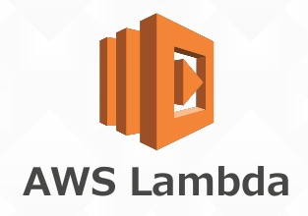
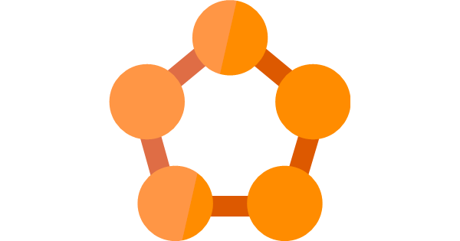


Microservices Chassis Frameworks
Microservices Framework for Java
Azure Service Fabric

Slide 12
Azure Service Fabric

Slide 13
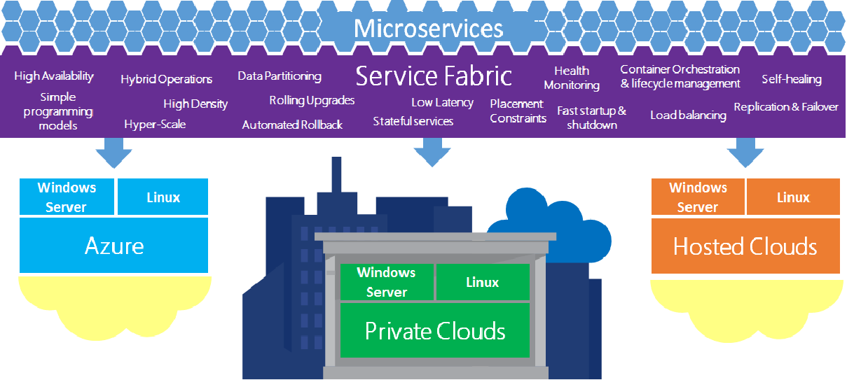

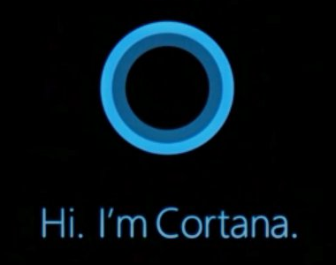
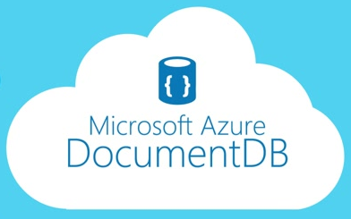
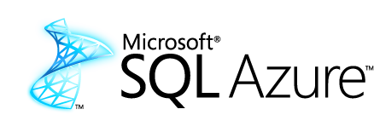
Azure Service Fabric
Application platform for distributed reliable, hyper scale, Microservice-based applications

Slide 14
Advantages of using Service Fabric
Develop massively scalable applications that are self-healing
Develop highly reliable stateless and stateful microservices
Deploy to Azure or to on-premises datacenters that run Windows or Linux with zero code changes. Write once, and then deploy anywhere to any Service Fabric cluster.
Deploy self hosted applications and service (Kestrel, OWIN host, NodeJs)
Develop applications that are composed of microservices by using the Service Fabric programming models (Reliable Actor, Reliable Services model).

Slide 15
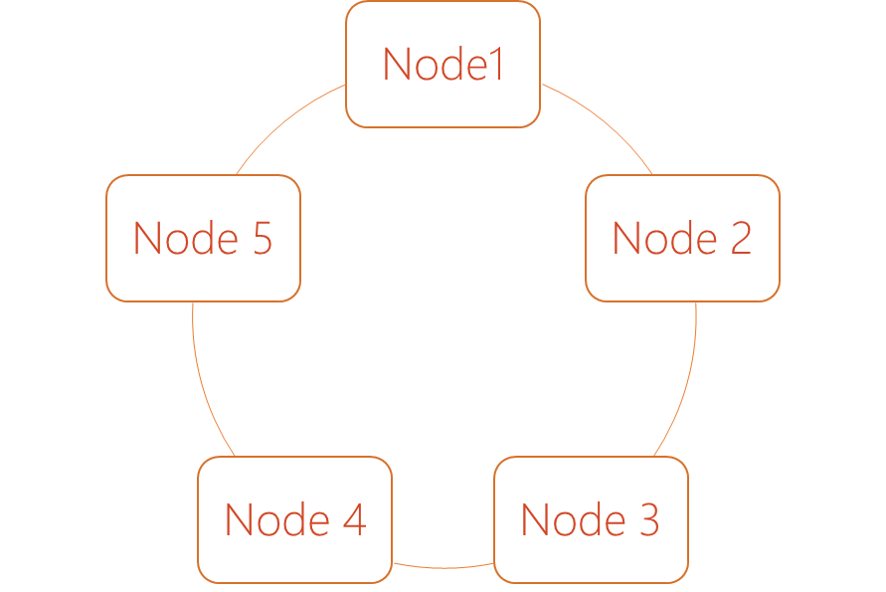
Clusters and Nodes
Service Fabric Clusters
A cluster is logical group of machines which are referred to as nodes.
Service Fabric Nodes
A node is a Virtual Machine.
A node can be a Linux or Windows.
Service fabric can be configured to host 0 or any number services or applications on a single node. (Assuming that your node vertical scales accordingly)
Cluster

Slide 16
Development, Testing and Deployment
A service developer develops different types of services using the Reliable Actors or Reliable Services programming model.
The development environment in the SDK is identical to the production environment, and no emulators are involved. In other words, what runs on your local development cluster deploys to the same cluster in other environments.
Chaos Test Scenarios, application built to cause faults in the cluster for testing purpose of the service fabric.
Deploying an application on the service fabric combines the following steps into one simple operation:
  Creating the application package
  Uploading the application package to the image store
  Registering the application type
  Removing any running application instances
  Creating a new application instance

Slide 17
.NET Core
What is .NET Core?
.NET Core is the latest moduler version of .NET.
It is a new open-source and cross-platform framework for building modern cloud based internet connected applications, such as web apps, IoT and mobile backends.
Allows you to separate out your host from the application.
Why use .NET Core?
.NET Core is cross platform, so you can run it on Windows, Linux, Docker and Mac
You don't need to install the .NET Framework to run it. Instead, you ship all the required dlls with your application.
You can use Visual Studio Code to develop your application, which is free and lightweight in comparison to Visual Studio. And you can use it on different platforms as well.
.`NET Core has a number of architectural changes that result in a much leaner and modular framework.

Slide 18
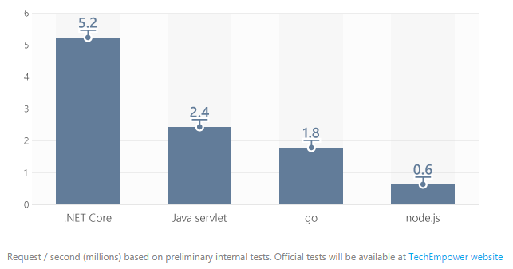
Kestrel
What is Kestrel?
.NET Core includes a managed cross-platform web server, called Kestrel.
Kestrel is the new cross platform .NET web server which runs on Linux, Mac and Windows 10 and will, eventually, run on Raspberry Pi.
Kestrel is way faster when compared to IIS. According to some measure it is about 20 times faster than IIS.

Slide 19
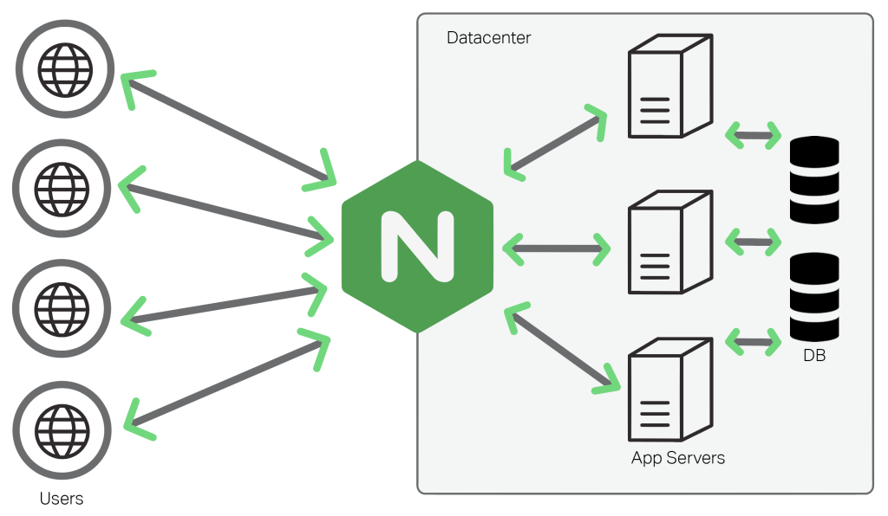
NGINX
What is NGINX?
NGINX (Pronounced as Engine-X) is an open source, lightweight, high-performance web server or proxy server.
Nginx can be used as a reverse proxy server for HTTP, HTTPS, SMTP, IMAP, POP3 protocols, on the other hand, it is also used for servers load balancing and HTTP Cache.
Why use NGINX?
Can be used as a proxy or a load balancer
Its super fast, light weight and more platform independent.

Slide 20
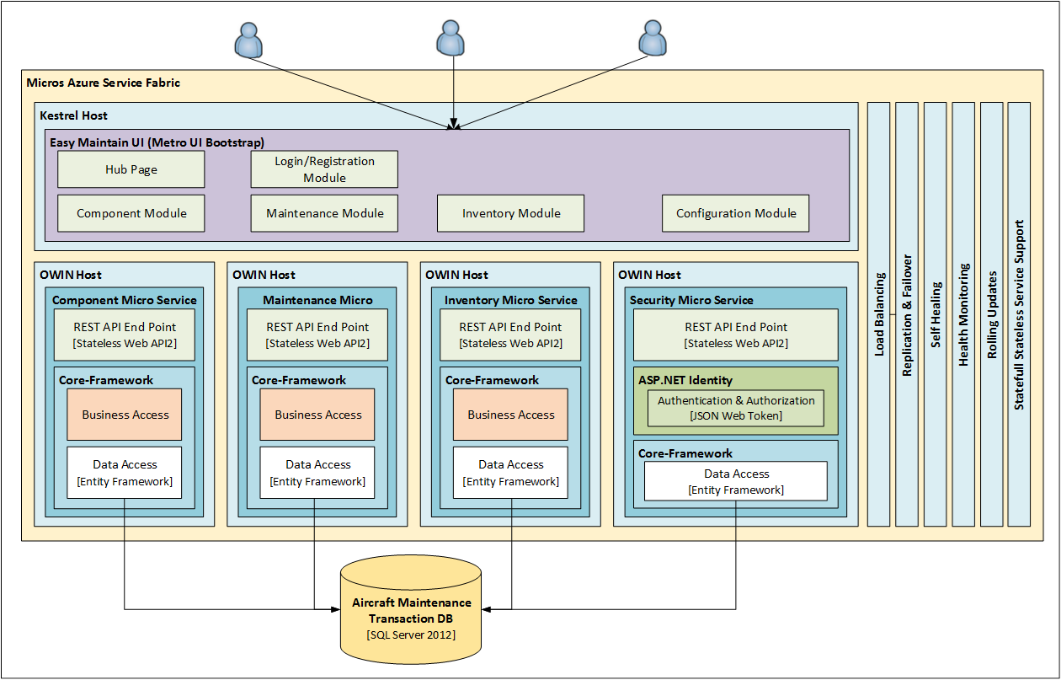
Proof of Concept

Slide 21
Questions?

Slide 22
Thank You

