Slide 1
Microservices
Resilient and Reliable Service Implementation Using Azure Service Fabric

Slide 2
Agenda for the day
Microservices
Monolithic vs SOA vs Microservices
Microservice Architecture
Common Microservice design patterns
Azure Service Fabric
Introduction
Building applications with Azure Service Fabric programming models
Clusters and Nodes
Demo
1
2
3

Slide 3
What are Microservices? Isn't SOA the same?

Slide 4
Monolithic vs SOA vs Microservices
Monolithic
Single Unit
SOA
Coarse-grained
Microservices
Fine-grained

Slide 5


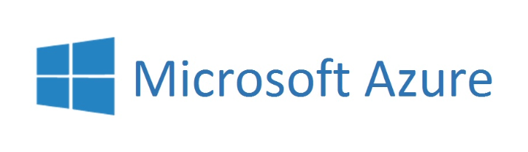
Microservices Architecture
Microservice architecture is a method of developing software applications as a suite of independently deployable and small autonomous services.
Each service runs a unique process.
Service isolation is achieved using containers.
Inter service communicates through a well-defined, lightweight mechanism (API’s and Message Queues)
Reliable/Concurrent
Collections

Slide 6
Microservices Architecture
Monolithic
Microservices
User Interface
User Interface
Business Layer
.NET
Microservice
Node.js
Microservice
Java
Microservice
.NET
Microservice
NodeJs
Microservice
Java
Microservice
Data Interface
.NET
Microservice
NodeJs
Microservice
Java
Microservice
SQL Server
SQL Server
MongoDB
Oracle

Slide 7
Why go for Microservices?
Technology heterogeneity (.NET, Java, Node.js etc…)
Resilience
High reliability and availability
Scaling
Ease of deployment
Organizational alignment (Goes with domain driven design)
Autonomous services (Self managed services)
Service upgrade with ensure zero down time (Rolling updates)
Faster developer rampup

Slide 8
Microservices Design Patterns

Slide 9
Common Microservices Design Patterns
Circuit Breaker Pattern
Handle faults that may take a variable amount of time to rectify when connecting to a remote service or resource. This pattern can improve the stability and resiliency of an application.
Success
Closed
Success
Failure or Timeout
Half Open
Failure
Open
Fail Fast
Wait time elapsed

Slide 10

Common Microservices Design Patterns
Api Gateway Pattern
The API Gateway pattern defines how clients access the services in a microservices architecture. The Api-Gateway defines a single entry point for all clients.
.NET
Microservice
Client
API-Gateway
NodeJs
Microservice
Java
Microservice

Slide 11
Common Microservices Design Patterns
Database per Service pattern
Keep each microservices persistent data private to that service and accessible only via its API.
.NET
Microservice
NodeJs
Microservice
Java
Microservice
.NET
Microservice
NodeJs
Microservice
Java
Microservice
.NET
Microservice
NodeJs
Microservice
Java
Microservice
SQL Server
MongoDB
Oracle

Slide 12
Common Microservices Design Patterns
Single Service per Host and Multiple Services per Host
Different deployment strategies.
Single Service Per Node
Multiple Service Per Node
Node 1
Node 2
Node 3
Node 1
.NET
Microservice
NodeJs
Microservice
Java
Microservice
.NET
Microservice
NodeJs
Microservice
Java
Microservice
Service separation achieved using Containers

Slide 13
Common Microservices Design Patterns
Client-side Discovery Patterns
When making a request to a service, the client obtains the location of a service instance by querying a Service Registry, which knows the locations of all service instances.
Virtualized or containerized environment
Service Instance A
Service Client /
API Gateway
Registry Aware HTTP Client
Service Instance B
Register Service Location
Service Instance C
Query Service Location
Service Registry

Slide 14
Common Microservices Design Patterns
Server-side Discovery Patterns
When making a request to a service, the client makes a request via a router (a.k.a load balancer) that runs at a well known location. The router queries a service registry, which might be built into the router, and forwards the request to an available service instance.
Virtualized or containerized environment
Service Instance A
Service Client /
API Gateway
Router / Load Balancer
Service Instance B
Register Service Location
Service Instance C
Service Registry
Query Service Location

Slide 15
More microservices patterns….
Service registry
Self registration
3rd party registration
Serverless deployment
Shared database
Service instance per VM
Service instance per Container
Chris Richardson
www.microservices.io/patterns

Slide 16



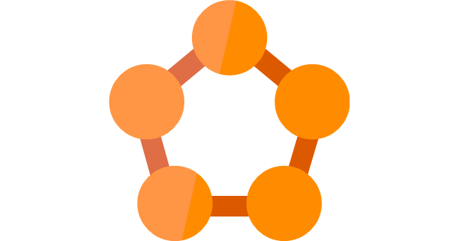


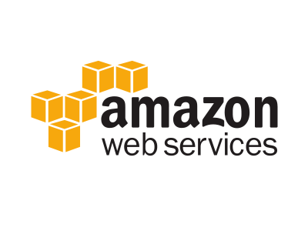
Microservices Frameworks
Microservices Framework for Java
Azure Service Fabric

Slide 17
Azure Service Fabric

Slide 18
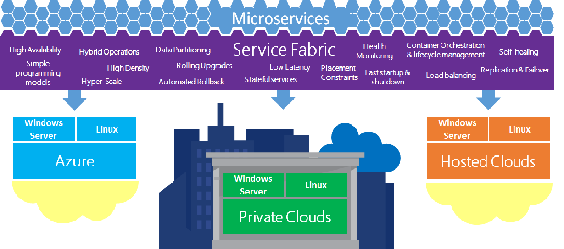

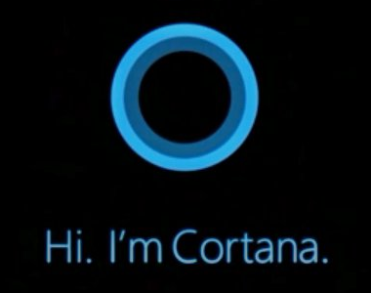
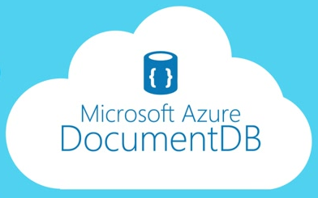
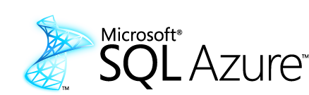
Azure Service Fabric
Application platform for distributed reliable, hyper scale, Microservice-based applications

Slide 19
What can you build/deploy with Service Fabric?
Stateless applications
A service that has state where the state is persisted to external storage, such as Azure databases or Azure storage
Communication through concurrent collections
Stateful applications
Reliability of state through replication and local persistence (Reliable Collections)
Reduce latency
Reduces the complexity and number of components in traditional three tier architecture
Existing apps written with other frameworks
These are called guest executables. (Node.js, Java etc...)

Slide 20
Development
Reliable Actor API
Build reliable stateless and stateful objects with a virtual Actor Programming Model
Suitable for applications with multiple independent units of state and compute
Automatic state management and turn based concurrency (Single threaded execution)
Reliable Services API
Build stateless services using existing technologies such as ASP.NET
Build stateful services using reliable collections
Manage the concurrency and granularity of state changes using transactions
Communicate with services using the technology of your choice (e.g. WebAPI, WCF)

Slide 21
Clusters and Nodes
Service Fabric Clusters
A cluster is logical group of virtual machines
It can scale up to 1000s of machines
Service Fabric Nodes
A node is a Virtual Machine
Runs on Linux or Windows
Able to host containers
Individually scalable
Service fabric can be configured to host 0 or any number services or applications on a single node. (Assuming that your node vertical scales accordingly)
Node1
Node 2
Node 3
Node 4
Node 5
Cluster

Slide 22
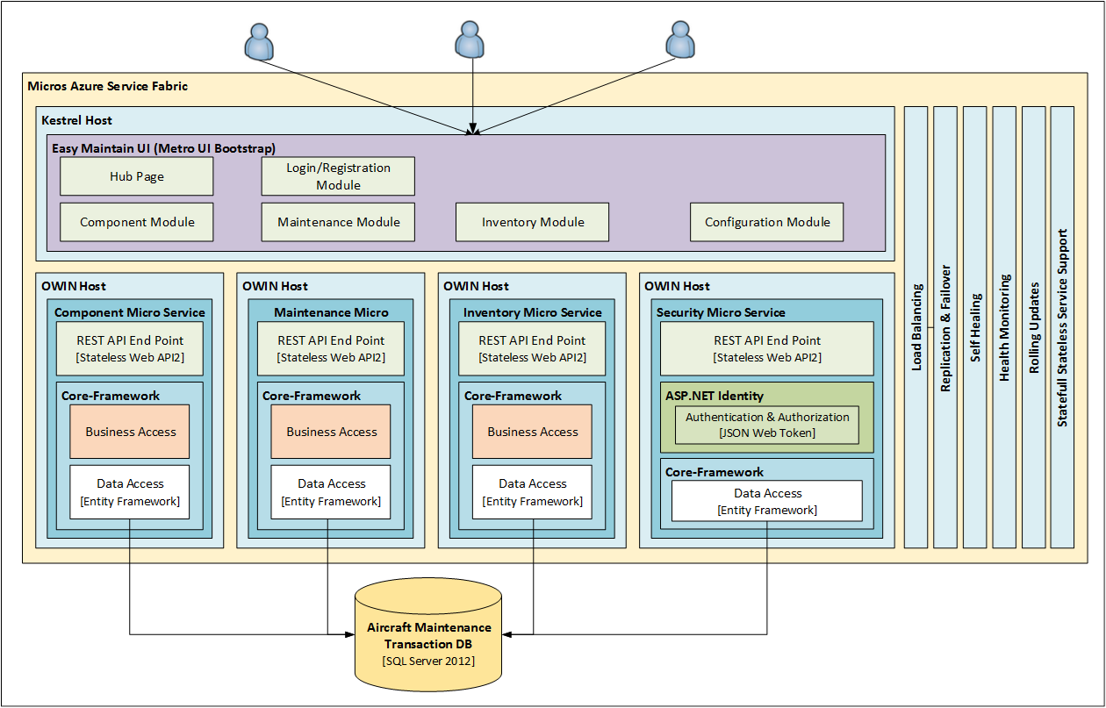
Proof of Concept
.NET Core
Kestrel
OWIN host
NGINX

Slide 23
Proof of Concept
NGINX (Proxy)
Azure Service Fabric
Easy Maintain UI (MVC .NET Core)
Easy Maintain UI (MVC .NET Core)
Easy Maintain UI (MVC .NET Core)
JWT Token
Inventory Microservice
[Stateless REST API]
Component Microservice
[Stateless REST API]
Maintenance Microservice
[Stateless REST API]
Security Microservice
[Stateless REST API]
.NET
Microservice
NodeJs
Microservice
Java
Microservice
Java
Microservice
.NET
Microservice
NodeJs
Microservice
Java
Microservice
Java
Microservice
SQL Server

Slide 24
Demo

Slide 25
Questions?

Slide 26

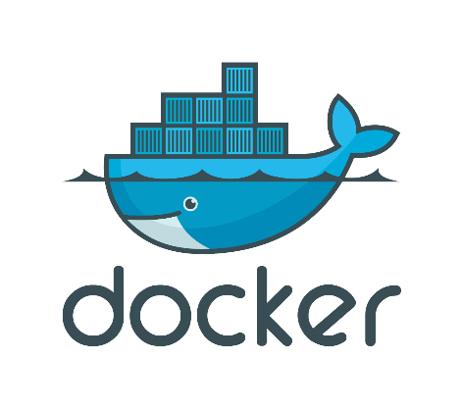
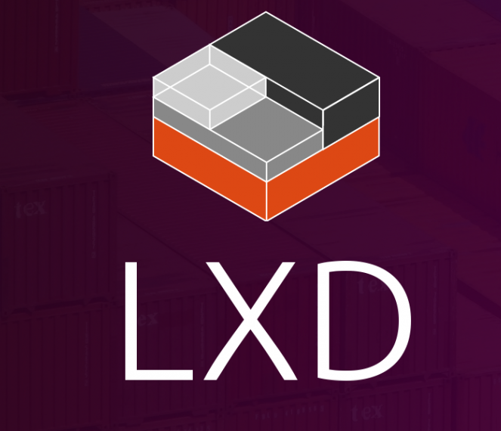
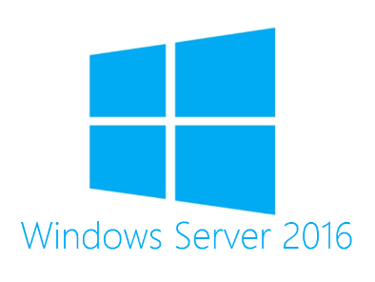


Appendix
Containers
Containers wrap a piece of software in a complete file system that contains everything needed to run: code, runtime, system tools, system libraries – anything that can be installed on a server.
Guarantees that the software will always run the same, regardless of its environment.

Slide 27
Appendix
What is .NET Core?
.NET Core is the latest modular version of .NET.
It is a new open-source and cross-platform framework for building modern cloud based internet connected applications, such as web apps, IoT and mobile backends.
Allows you to separate out your host from the application.
Why use .NET Core?
.NET Core is cross platform, so you can run it on Windows, Linux, Docker and Mac
You don't need to install the .NET Framework to run it. Instead, you ship all the required dlls with your application.
You can use Visual Studio Code to develop your application, which is free and lightweight in comparison to Visual Studio. And you can use it on different platforms as well.
.`NET Core has a number of architectural changes that result in a much leaner and modular framework.

Slide 28
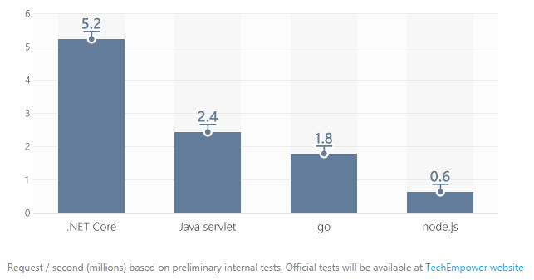
Appendix
What is Kestrel?
.NET Core includes a managed cross-platform web server, called Kestrel.
Kestrel is the new cross platform .NET web server which runs on Linux, Mac and Windows 10 and will, eventually, run on Raspberry Pi.
Kestrel is way faster when compared to IIS. According to some measure it is about 20 times faster than IIS.

Slide 29
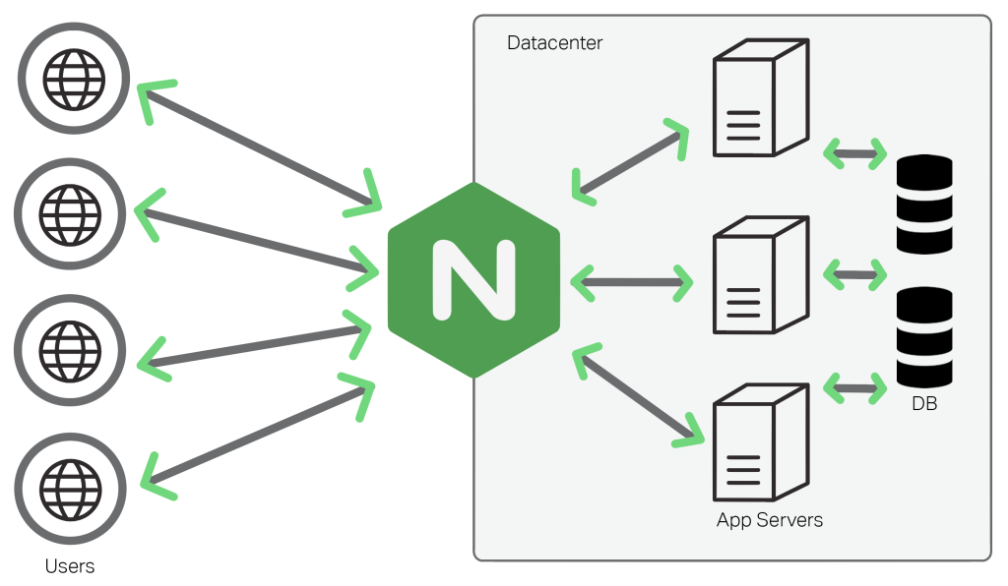
Appendix
What is NGINX?
NGINX (Pronounced as Engine-X) is an open source, lightweight, high-performance web server or proxy server.
Nginx can be used as a reverse proxy server for HTTP, HTTPS, SMTP, IMAP, POP3 protocols, on the other hand, it is also used for servers load balancing and HTTP Cache.
Why use NGINX?
Can be used as a proxy or a load balancer
Its super fast, light weight and more platform independent.

Slide 30
Appendix
Open Web Interface for .NET
OWIN is a specification defines how we can separate the Host from the Application.
Encourage the development of simple modules for .NET web development
Stimulate the open source ecosystem of .NET web development tools
Host (OWIN Host, IIS, Custom Console App)
Middleware
(Authentication, WebAPI, SignalR)
Server
(Http Listener)
Application
Framework
(WebAPI)

Slide 31
Appendix
Service Fabric Development, Testing and Deployment
A service developer develops different types of services using the Reliable Actors or Reliable Services programming model.
The development environment in the SDK is identical to the production environment, and no emulators are involved. In other words, what runs on your local development cluster deploys to the same cluster in other environments.
Chaos Test Scenarios, application built to cause faults in the cluster for testing purpose of the service fabric.
Deploying an application on the service fabric combines the following steps into one simple operation:
Creating the application package
Uploading the application package to the image store
Registering the application type
Creating a new application instance

Slide 32
Thank You

