Slide 1
Microservices
Resilient and Reliable Service Implementation Using Azure Service Fabric
By Brian Perera and the Micros Team
Notes:
(30 seconds)
Good afternoon everyone, thanks for coming
In the micros account we have developed a practice to research about a technical topic and present it to the account by weekly. This time around Nishantha Hettiarachchi said, why just the Micros account, let share it with the rest of Virtusa. We are not experts in microservices but a set of techies who love to learn new technologies.
This K-talk is about Microservice, we will be touching base with Azure Service Fabric.

Slide 2
Agenda for the day
Microservices
Introduction
Monoliths. SOA and Microservices
Common Microservice design patterns
Azure Service Fabric
Introduction
Building applications with Azure Service Fabric programming models
Deployment internals - Clusters and Nodes
Demo POC
1
2
3
Notes:
(15 seconds)
This is a agenda for this session
So lets get started…

Slide 3

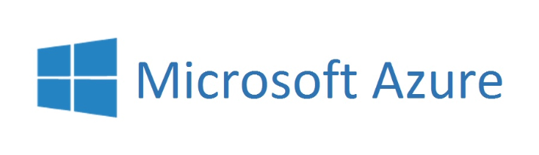

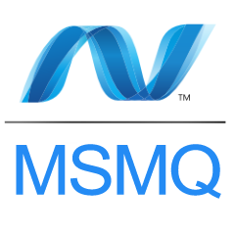
Microservices Architecture
Microservice architecture is a method of developing software applications as a suite of independently deployable and autonomous services.
Each service runs a unique process and has a bounded context.
Service isolation is achieved using containers.
Inter service communicates through a well-defined, lightweight mechanism (API’s and Message Queues)
Reliable/Concurrent
Collections
Notes:
independently deployable and manageable, Small or fine grained and autonomous (self managed).
Each service runs a unique process. – This mean that they run independently.
Service separation is achieved using containers. So what are containers?

Slide 4
Microservices Architecture
Monolithic
Microservices
User Interface
User Interface
Business Layer
Shipping Service
(.NET)
Inventory Reports
(Node.js)
Product Catalog
(Java)
.NET
Microservice
NodeJs
Microservice
Java
Microservice
Data Interface
.NET
Microservice
NodeJs
Microservice
Java
Microservice
SQL Server
SQL Server
MongoDB
Oracle
Notes:
This is a tradition tiered Monolithic application. Developed, tested and deployed as a one single strip.
Let look at the microservices architecture. Your UI client application talks to different services, which talk to their own data bases.

Slide 5
Isn't SOA the same?
SOA
Differentiators
Application Modeling happens around business capabilities
Scope and size defined using Bounded context
Autonomous Services
Lightweight communication
Automated deployments
Microservices
Notes:
There is a quite a debate between the SOA community and microservices community about this. SOA community claims that they have been following the microservice pattern for more than a decade, and that they don’t need a new name for it.
Martin Flower a famous microservices solution architect states that Microservices are a subset of SOA
Some say microservices are a specialization of SOA
Clear differentiates
Service modeling happens around business capabilities
Bounded context
Services are autonomous
Communicate with lightweight mechanisms
Automated deployment

Slide 6
Common Myth
SOA
Coarse-grained
Microservices
Fine-grained
Notes:
It’s a common myth that Microservices needs to be more granular than SOA services.
Breaking up a services into smaller parts means that the
overall complexity increases. It then becomes a overhead on maintaining the services.
Its impossible to implement patterns like single Db per service patterns
With Domain driven design concepts we need to find the right balance, when defining the size and scope of the service.

Slide 7
When to use Microservices?
Technology diversity (.NET, Java, Node etc…)
Resilience
Autonomous services
High reliability and availability
Individually scalable services
Expecting ease of deployment
Partial deployment
Service upgrade with ensure zero down time (Rolling updates, Blue/Green deployment)
If you need organizational alignment
Full stack development team for each department
Increase developer productivity
Faster trouble shooting using service monitoring
Reduce ramp up time, due to simplicity
Notes:
When we are working with diverse technology stacks
Resilience – ability to self heal and spring back to life
Go through the rest

Slide 8
When not to use Microservices
If the solution is simple
When you don’t have full stack developers
When your team does not have Domain Driven Design expertise
When performance is more important than reliability and availability
When you don’t have a matured Dev Ops team to manage services and deployments
If you don’t believe in concepts like “Big Design Up Front”
Testing services is a relatively cumbersome
Multiple services to be tested
Service integration testing is challenging
Notes:
Go through the items
Talk a
Big design

Slide 9
Microservices Design Patterns
Notes:
Let talk about the common patterns used with Microservices

Slide 10
Common Microservices Design Patterns
Circuit Breaker Pattern
Handle faults that may take a variable amount of time to rectify when connecting to a remote service or resource. This pattern can improve the stability and resiliency of an application.
Success
Closed
Success
Failure or Timeout
Half Open
Failure
Open
Fail Fast
Wait time elapsed
Notes:
What is the problem that this pattern handles?
This patterns ensures that, If a service fails, we should not be ideally keep hitting that service for a response. We should give it time to self heal.
It’s a simple state machine.
Close state -> Open -> Half Open

Slide 11

Common Microservices Design Patterns
Api Gateway Pattern
The API Gateway pattern defines how clients access the services in a microservices architecture. The Api-Gateway defines a single entry point for all clients.
.NET
Microservice
API-Gateway
NodeJs
Microservice
Client
Java
Microservice
Notes:
What is the problem that this pattern handles?
In a microservice environment we are talking about a lot of services. We can’t let clients try to connect to all the services individually. We then use the change of implementing security and loadbalancing.
So we define a single entry point to our services.

Slide 12
Common Microservices Design Patterns
Database per Service pattern
Keep each microservices persistent data private to that service and accessible only via its API.
.NET
Microservice
NodeJs
Microservice
Java
Microservice
.NET
Microservice
NodeJs
Microservice
Java
Microservice
.NET
Microservice
NodeJs
Microservice
Java
Microservice
SQL Server
MongoDB
Oracle
Notes:
What is the problem that this pattern handles?
If we really see it, having one database would mean that it becomes a single point of failure. If the central DB goes down all the services goes down with it.
By having a a single DB per service we are ensuring that the whole application will not fail at the same time.

Slide 13
Common Microservices Design Patterns
Single Service per Host and Multiple Services per Host
Different deployment strategies.
Single Service Per Node
Multiple Service Per Node
Node 1
Node 2
Node 3
Node 1
.NET
Microservice
NodeJs
Microservice
Java
Microservice
.NET
Microservice
NodeJs
Microservice
Java
Microservice
Service separation leveraged using Containers
Notes:
Single Service Per Node
Services instances are isolated from one another
There is no possibility of conflicting resource requirements or dependency versions
A service instance can only consume at most the resources of a single host
Its straightforward to monitor, manage, and redeploy each service instance
The drawbacks of this approach include:
Potentially less efficient resource utilization compared to Multiple Services per Host because there are more hosts
Multiple Service Per Node
The benefits of this pattern include:
More efficient resource utilization than the Service Instance per host pattern
The drawbacks of this approach include:
Risk of conflicting resource requirements
Risk of conflicting dependency versions
Difficult to limit the resources consumed by a service instance
If multiple services instances are deployed in the same process then its difficult to monitor the resource consumption of each service instance. Its also impossible to isolate each instance

Slide 14
Common Microservices Design Patterns
Client-side Discovery Patterns
When making a request to a service, the client obtains the location of a service instance by querying a Service Registry, which knows the locations of all service instances.
Virtualized or containerized environment
Service Instance A
Service Client /
API Gateway
Registry Aware HTTP Client
Service Instance B
Register Service Location
Service Instance C
Query Service Location
Service Registry
Notes:
What is the problem that this pattern handles?
In a microservice environment we are talking about a lot of services.
A service will not be located on a fixed location. If a service failure occur another instance will be spinning up on a new ip address.
The service registry keeps track of the service locations.
The client side proxy talks to the service registry find out where the service is deploys and then talk to it.
The client is now tightly coupled with the service register.

Slide 15
Common Microservices Design Patterns
Server-side Discovery Patterns
When making a request to a service, the client makes a request via a router (a.k.a load balancer) that runs at a well known location. The router queries a service registry, which might be built into the router, and forwards the request to an available service instance.
Virtualized or containerized environment
Service Instance A
Service Client /
API Gateway
Router / Load Balancer
Service Instance B
Register Service Location
Service Instance C
Service Registry
Query Service Location
Notes:
This pattern addresses the same problem but removes the dependency between the client and the service registry.
The service register communication is handed over to a router or load balancer. This router talks to the service register to locate the service.
AWS elastic loadbalancer or Azure load balancer can be used as a router.

Slide 16
More microservices patterns….
Service registry
Self registration
3rd party registration
Serverless deployment
Shared database
Service instance per VM
Service instance per Container
Chris Richardson
www.microservices.io/patterns
Notes:
These are some of the other patterns out there.
If you go to Chris Richardson site you will be able to find a lot more information related to microservices

Slide 17
Do we need to manually implement all the patterns?
Notes:
The answer is no

Slide 18
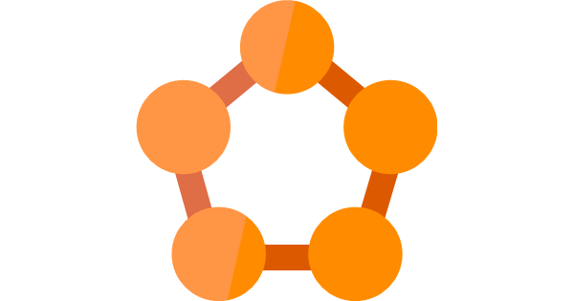
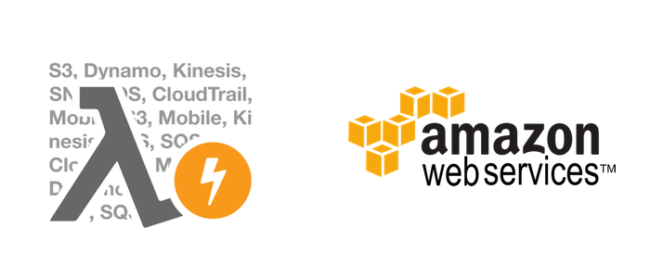

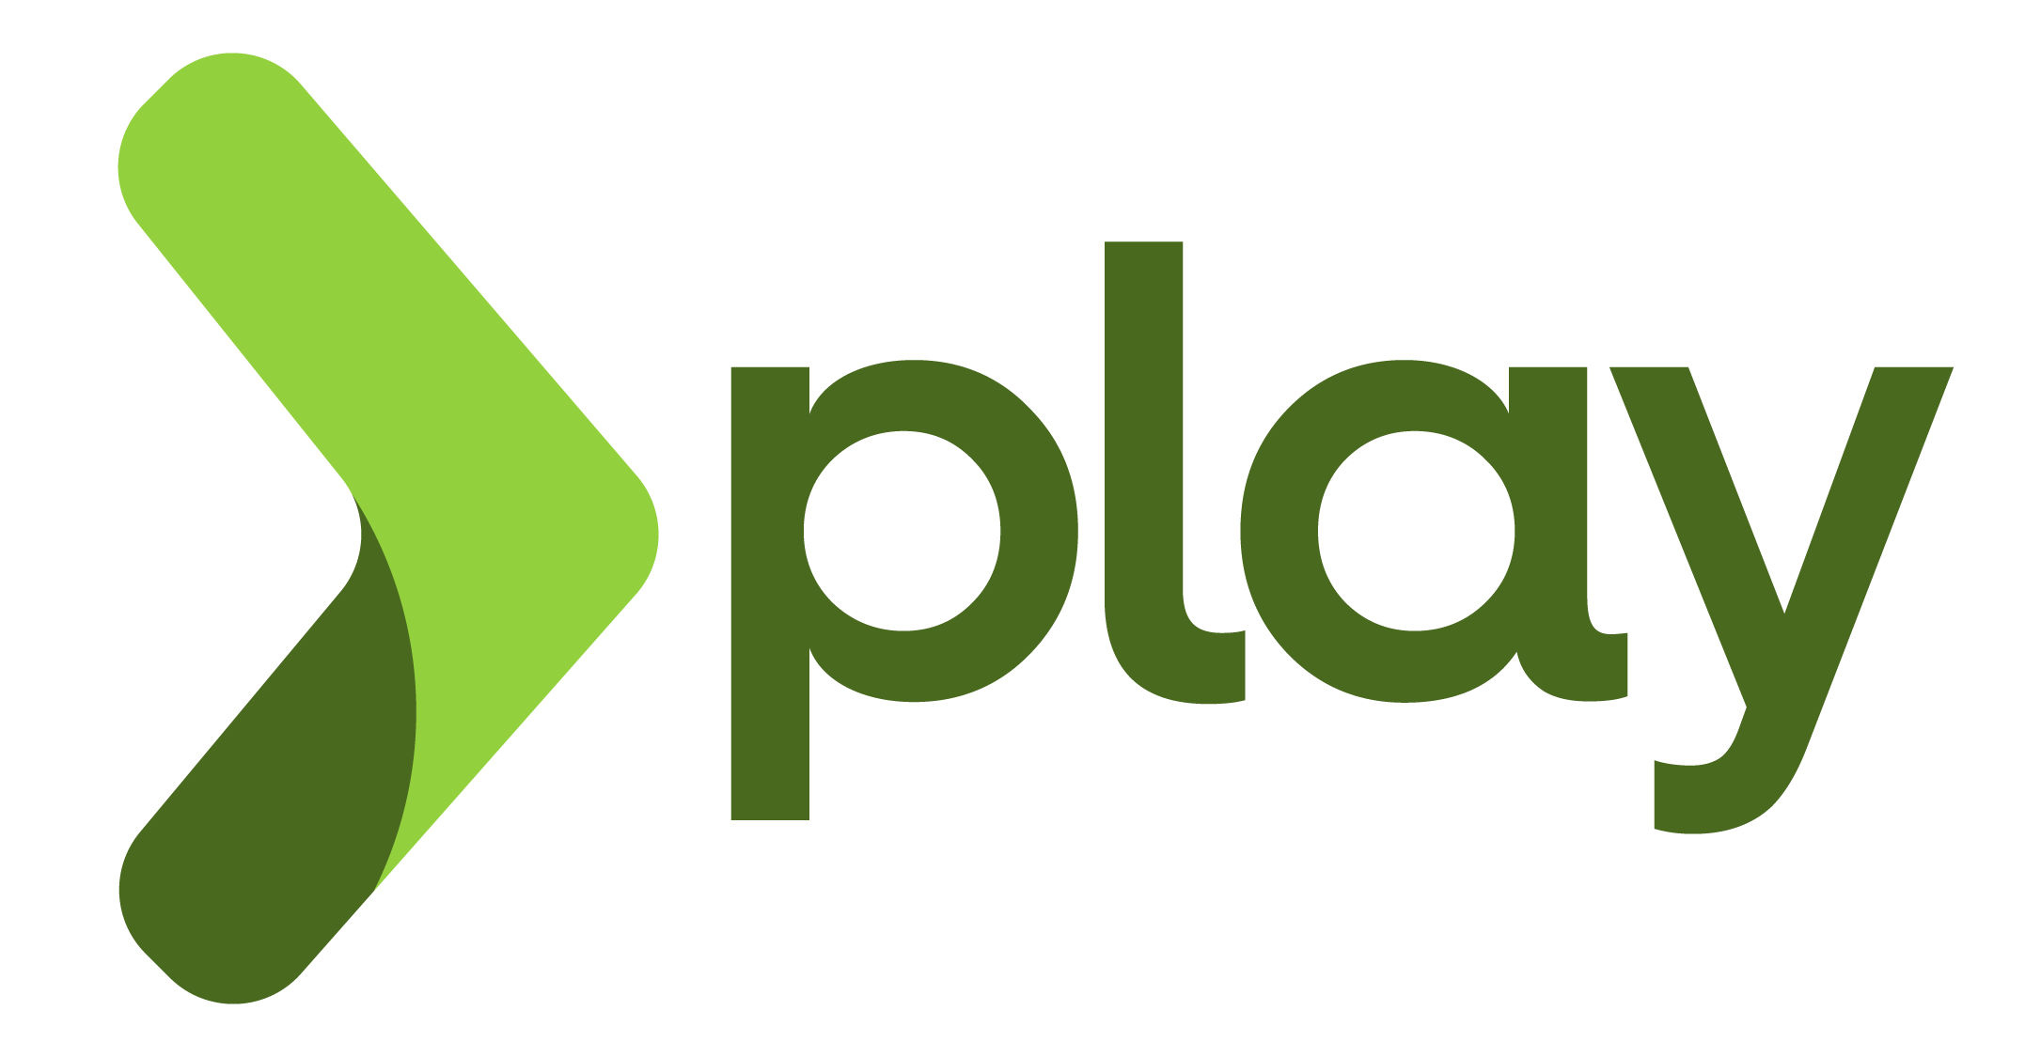


Microservices Frameworks
Azure Service Fabric
Microservices Framework for Java
Notes:
There are already frameworks to build to handle these. We just need to use them.
These are some of the frameworks out there.

Slide 19
Azure Service Fabric
Notes:
We will now be talking a bit more about the Azure Service Fabric

Slide 20
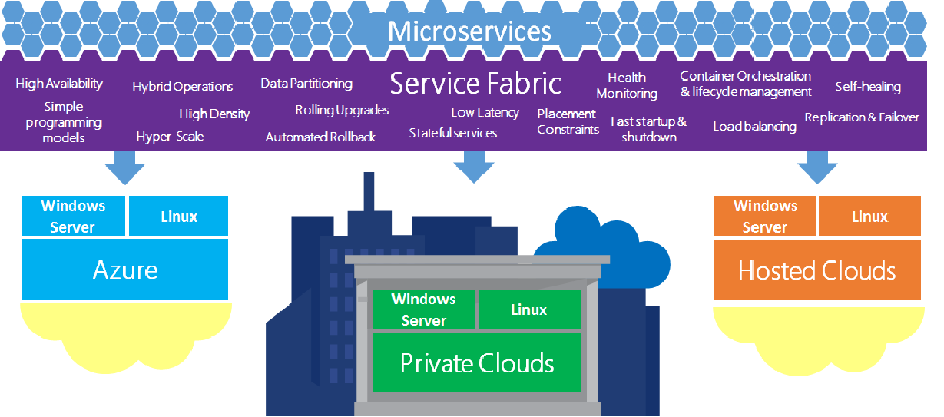

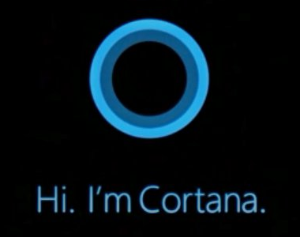
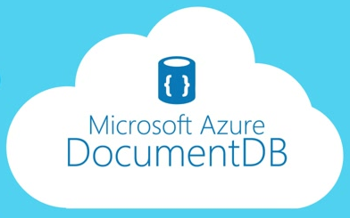
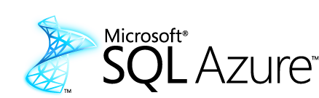
Azure Service Fabric
Application platform for distributed reliable, hyper scale, Microservice-based applications
Notes:
This platform allows you to build, test and deploy microservices.
You don’t need to worry about the cross cutting concerns. Service fabric will take care of them for you.
Features like, loadbalancing, health monitoring, Replication & failover, state management, messaging are handled by service fabric.
When it comes to deployment strategies, you can give to deploy your services on the Windows or Linux box on Azure, Private Clouds or even hosted clouds like AWS. You have that flexibility.
So is this new? The answer is no. Microsoft has been using this for their internal systems for the past 5 years.
Microsoft has now given us the capability build resilient applications using this framework.

Slide 21
What can you build/deploy with Service Fabric?
Stateless applications
A service that has state where the state is persisted to external storage, such as Azure databases or Azure storage
Communication through concurrent collections
Stateful applications
Reliability of state through replication and local persistence (Reliable Collections)
Reduce latency
Reduces the complexity and number of components in traditional three tier architecture
Existing apps written with other frameworks
These are called guest executables. (Node.js, Java etc...)

Slide 22
Service Fabric Development Models
Reliable Actor API
Build reliable stateless and stateful objects with a virtual Actor Programming Model
Suitable for applications with multiple independent units of state and compute
Automatic state management and turn based concurrency (Single threaded execution)
Reliable Services API
Build stateless services using existing technologies such as ASP.NET. (.NET Core)
Build stateful services using reliable collections
Manage the concurrency and granularity of state changes using transactions
Communicate with services using the technology of your choice (e.g. WebAPI, WCF)
Notes:
We can implement stateless and stateful services using the virtual actor programming model. Actor programming model might be a separate K-talk all together.
Useful if you have multiple independent units
Supports turn based concurrency or single threaded access
Build stateful ASP.NET MVC applications on top of .NET core, which are deployed on Kestrel
Build stateful services using reliable collections
Manage concurrency using transactions
Pick your technology for communications
Mind you there already templates available in visual studio 2015.

Slide 23
Deployment - Clusters and Nodes
Service Fabric Clusters
A cluster is logical group of virtual machines
It can scale up to 1000s of machines
Service Fabric Nodes
A node is a Virtual Machine
Runs on Linux or Windows
Able to host containers
Individually scalable
Service fabric can be configured to host 1 to any number of services or applications on a single node. (Assuming that your node vertical scales accordingly)
Node1
Node 2
Node 3
Node 4
Node 5
Cluster
Notes:
Now lets get to the internal of the service fabric deployments.
A cluster is a collection of nodes which are VM’s
A cluster can scale up to 1000s of machines
VM on linux or windows
Able to host containers. (Windows and docker containers)
Scalable
Multiple applications on a node

Slide 24
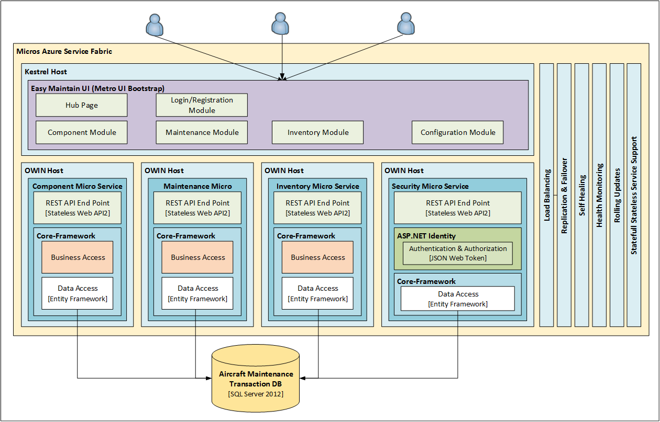
Proof of Concept
.NET Core
Kestrel
OWIN host
NGINX
Notes:
Couple of month back we got a oppertinity do a presale for a aircraft maintence provider. The POC that we are presenting is a small subset of what we tried to propose.
The goals was to provide a SAS solution using azure service fabric.
The POC application consists of 4 microservices and 1 web application.

Slide 25
Proof of Concept
NGINX (Proxy)
Azure Service Fabric
Easy Maintain UI (MVC .NET Core)
Easy Maintain UI (MVC .NET Core)
Easy Maintain UI (MVC .NET Core)
JWT Token
Inventory Microservice
[Stateless REST API]
Component Microservice
[Stateless REST API]
Maintenance Microservice
[Stateless REST API]
Security Microservice
[Stateless REST API]
.NET
Microservice
NodeJs
Microservice
Java
Microservice
Java
Microservice
.NET
Microservice
NodeJs
Microservice
Java
Microservice
Java
Microservice
SQL Server
Notes:
Explain why we used NGINX for proxy

Slide 26
Demo

Slide 27
Questions?

Slide 28

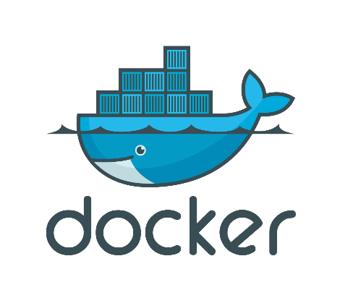
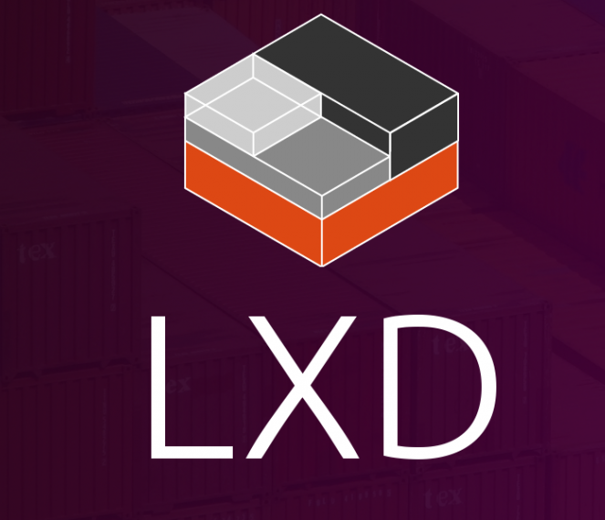
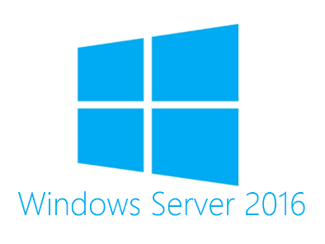


Appendix
Containers
Containers wrap a piece of software in a complete file system that contains everything needed to run: code, runtime, system tools, system libraries – anything that can be installed on a server.
Guarantees that the software will always run the same, regardless of its environment.
Notes:
Think of a freight container. Normally we try to separate out the goods that we ship using containers. For example, you’re a business man who ships pianos. And you are good at it, but someone asks you to ship whisky with the pianos. And you put everything into the same place and ship it. Now there complaints for the clients saying that the whisky is split all over the pianos. So if you had containerized based on concern you would be shipping pianos in 1 container and the whisky in another 1. If your whisky is split your pianos are not impacted.
This same concept applies to services. This is why containering or as some people say dockerizing is important.
In software terms what does it mean. We can wrap up code, runtime, system tools, system libraries into a container
Production, dev env compatibility issue no more

Slide 29
Appendix
What is .NET Core?
.NET Core is the latest modular version of .NET.
It is a new open-source and cross-platform framework for building modern cloud based internet connected applications, such as web apps, IoT and mobile backends.
Allows you to separate out your host from the application.
Why use .NET Core?
.NET Core is cross platform, so you can run it on Windows, Linux, Docker and Mac
You don't need to install the .NET Framework to run it. Instead, you ship all the required dlls with your application.
You can use Visual Studio Code to develop your application, which is free and lightweight in comparison to Visual Studio. And you can use it on different platforms as well.
.`NET Core has a number of architectural changes that result in a much leaner and modular framework.

Slide 30
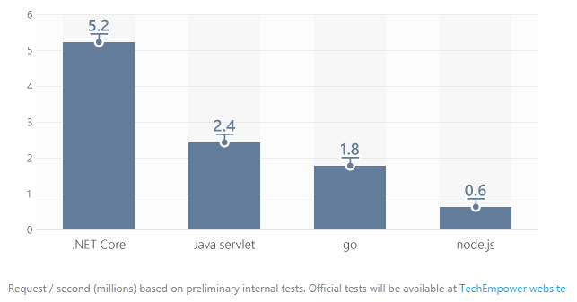
Appendix
What is Kestrel?
.NET Core includes a managed cross-platform web server, called Kestrel.
Kestrel is the new cross platform .NET web server which runs on Linux, Mac and Windows 10 and will, eventually, run on Raspberry Pi.
Kestrel is way faster when compared to IIS. According to some measure it is about 20 times faster than IIS.

Slide 31
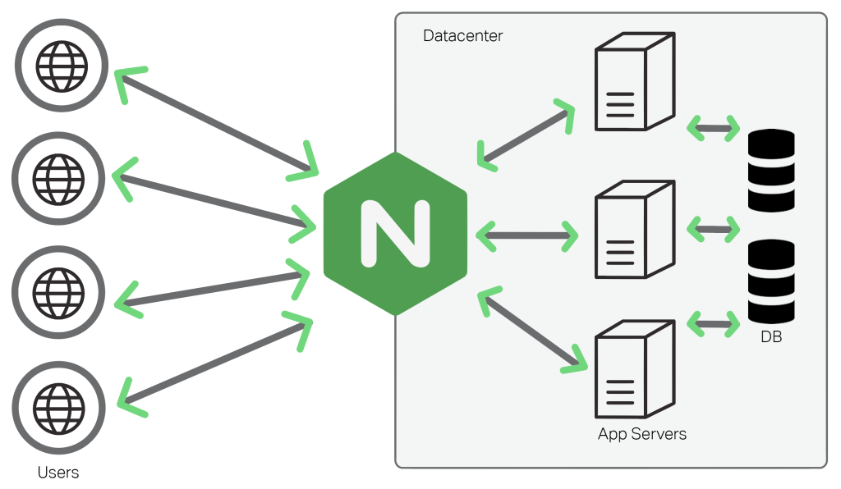
Appendix
What is NGINX?
NGINX (Pronounced as Engine-X) is an open source, lightweight, high-performance web server or proxy server.
Nginx can be used as a reverse proxy server for HTTP, HTTPS, SMTP, IMAP, POP3 protocols, on the other hand, it is also used for servers load balancing and HTTP Cache.
Why use NGINX?
Can be used as a proxy or a load balancer
Its super fast, light weight and more platform independent.

Slide 32
Appendix
Open Web Interface for .NET
OWIN is a specification defines how we can separate the Host from the Application.
Encourage the development of simple modules for .NET web development
Stimulate the open source ecosystem of .NET web development tools
Host (OWIN Host, IIS, Custom Console App)
Middleware
(Authentication, WebAPI, SignalR)
Server
(Http Listener)
Application
Framework
(WebAPI)

Slide 33
Appendix
Service Fabric Development, Testing and Deployment
A service developer develops different types of services using the Reliable Actors or Reliable Services programming model.
The development environment in the SDK is identical to the production environment, and no emulators are involved. In other words, what runs on your local development cluster deploys to the same cluster in other environments.
Chaos Test Scenarios, application built to cause faults in the cluster for testing purpose of the service fabric.
Deploying an application on the service fabric combines the following steps into one simple operation:
Creating the application package
Uploading the application package to the image store
Registering the application type
Creating a new application instance

Slide 34
Appendix
Domain Driven Design
Domain Driven Design is a methodology and process prescription for the development of complex systems whose focus is mapping activities, tasks, events, and data within a problem domain into the technology artifacts of a solution domain.
Domain
Bounded Context
Single Responsibility Principal
Ubiquitous Language

Slide 35
Thank You
Notes:
Once again thank you very much for your participation. Hope to see you all during the next tech talk.

Slide 36
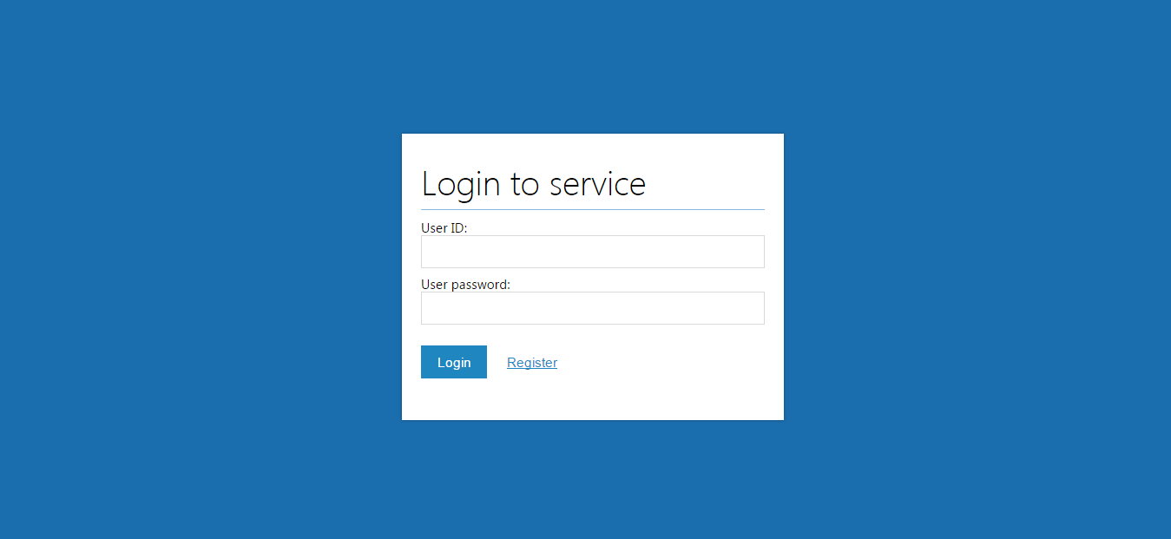

Slide 37


Slide 38
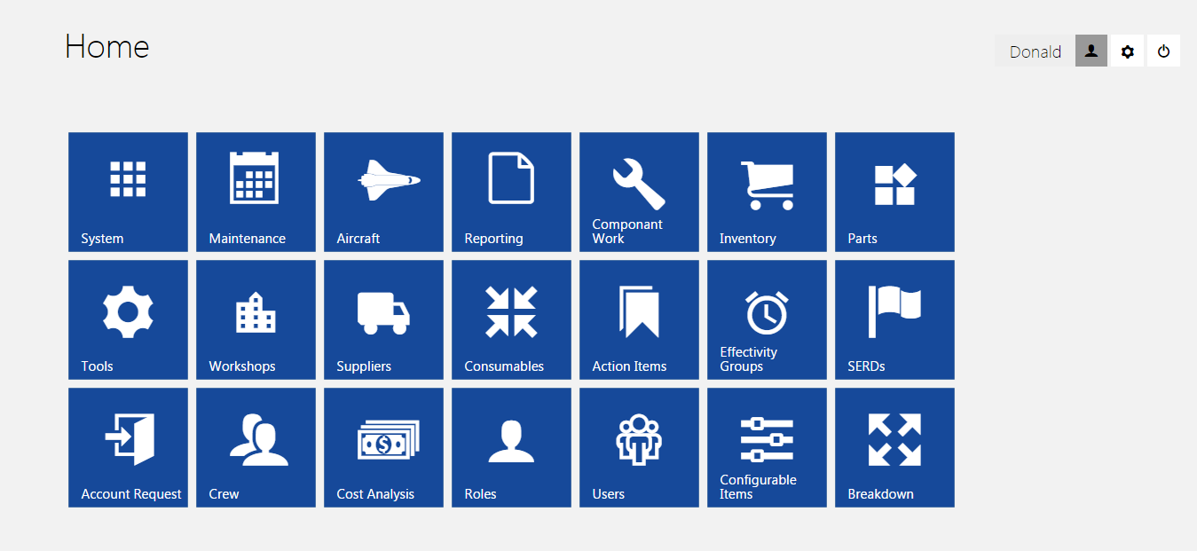

Slide 39
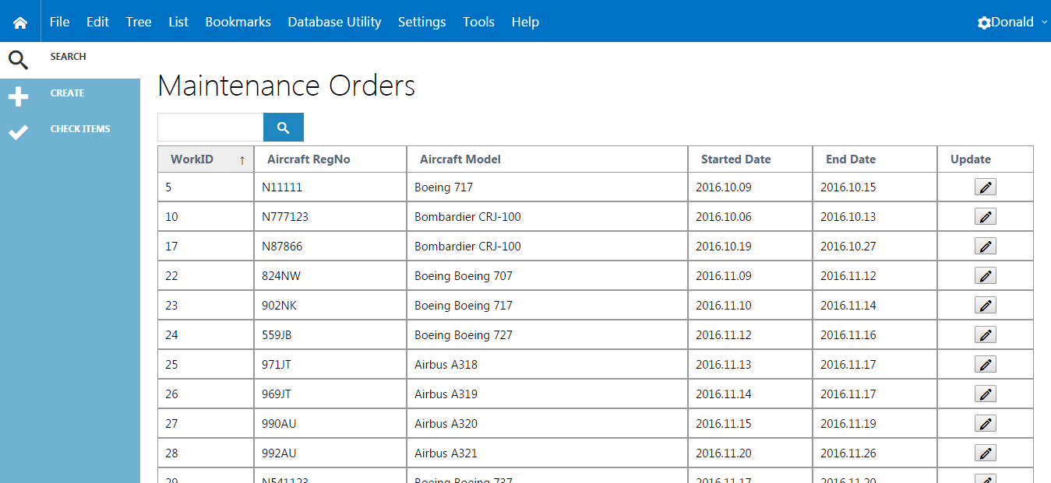

Slide 40
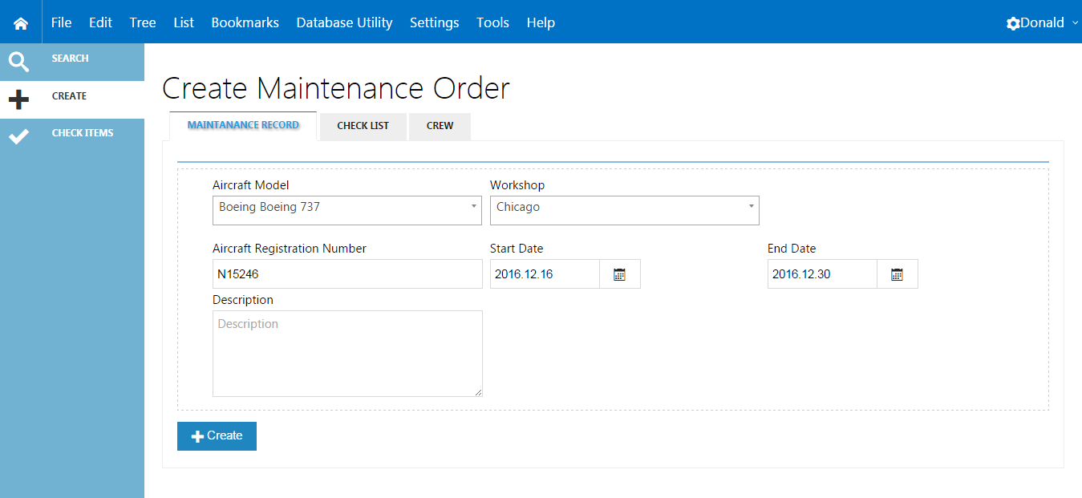

Slide 41
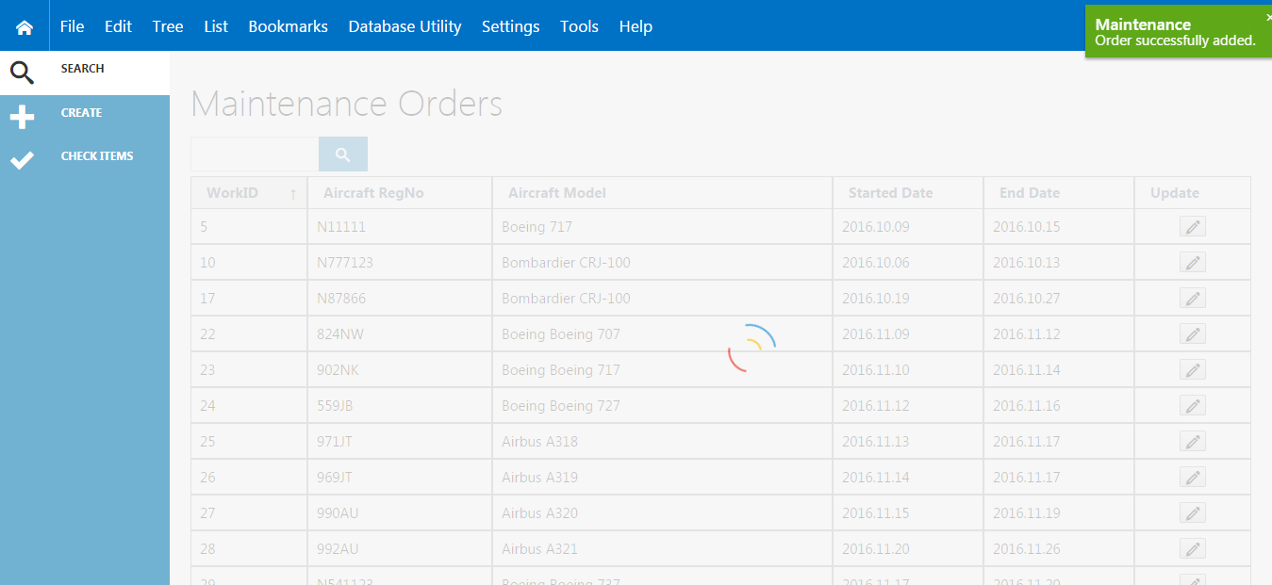

Slide 42
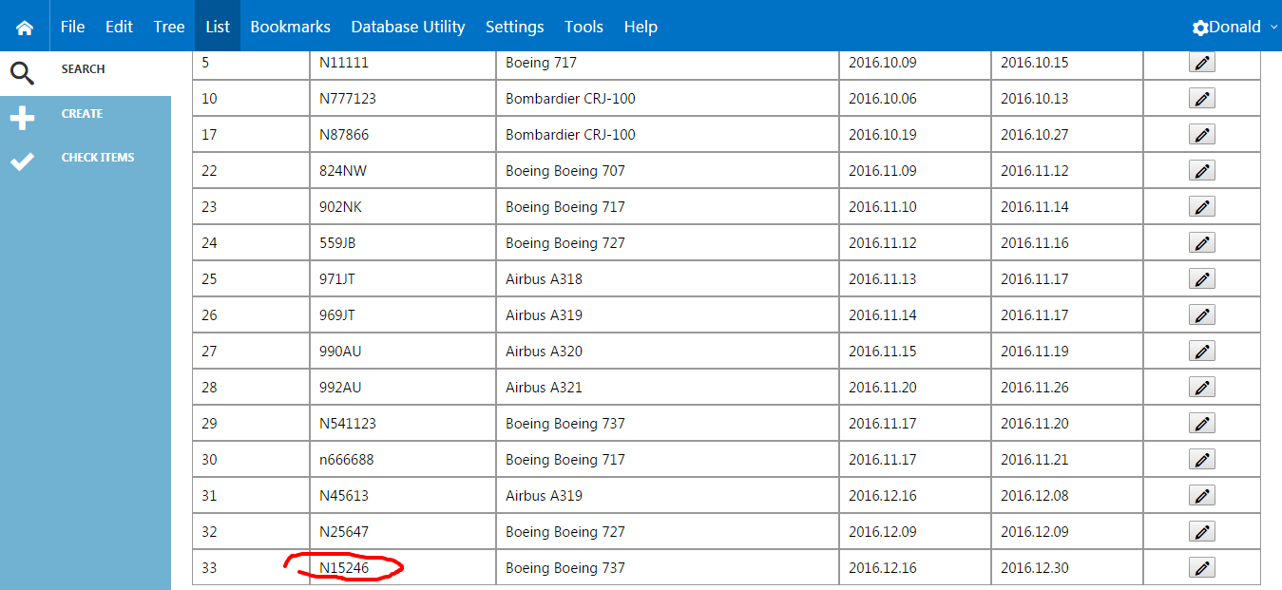

Slide 44
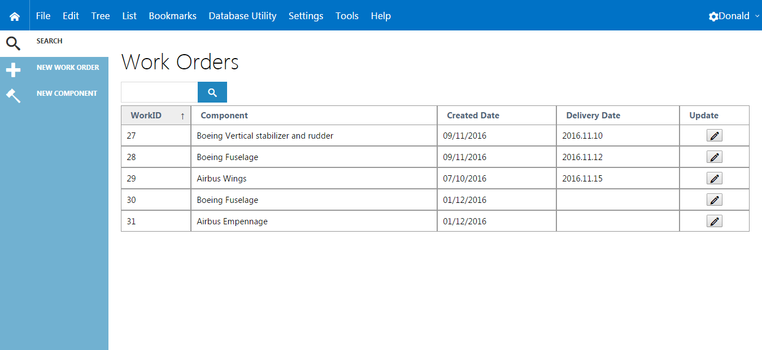

Slide 45
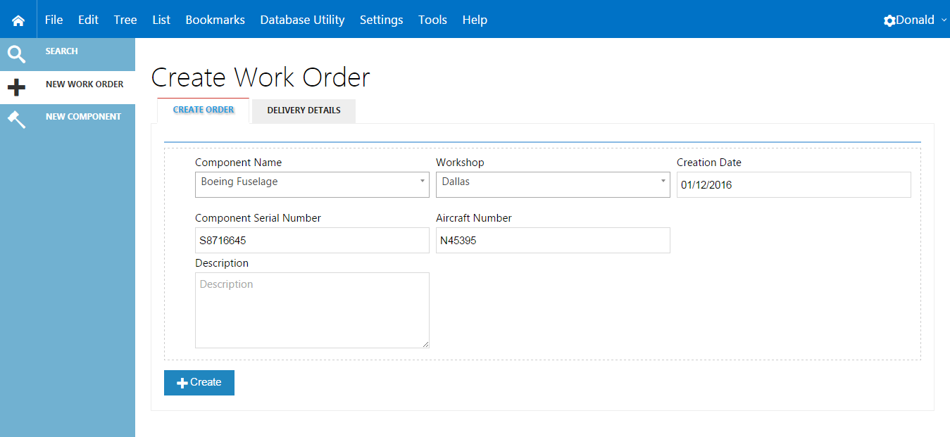

Slide 46
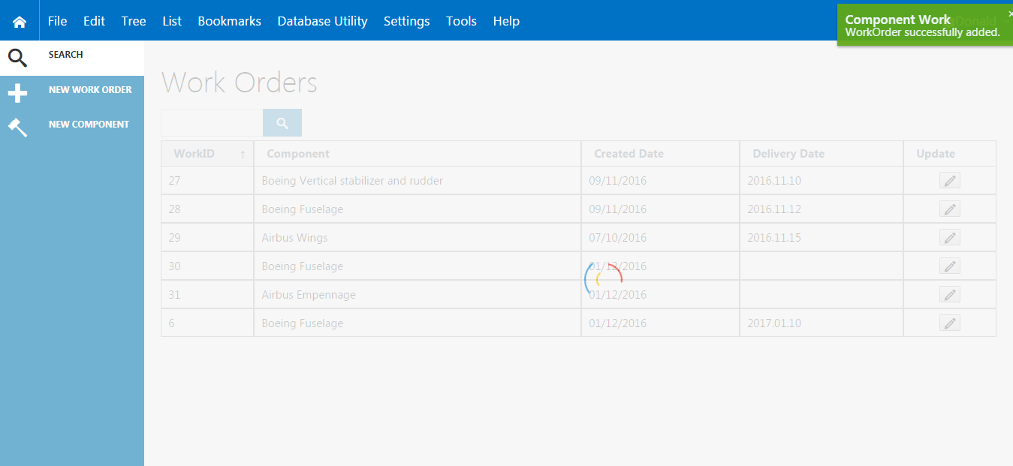

Slide 47
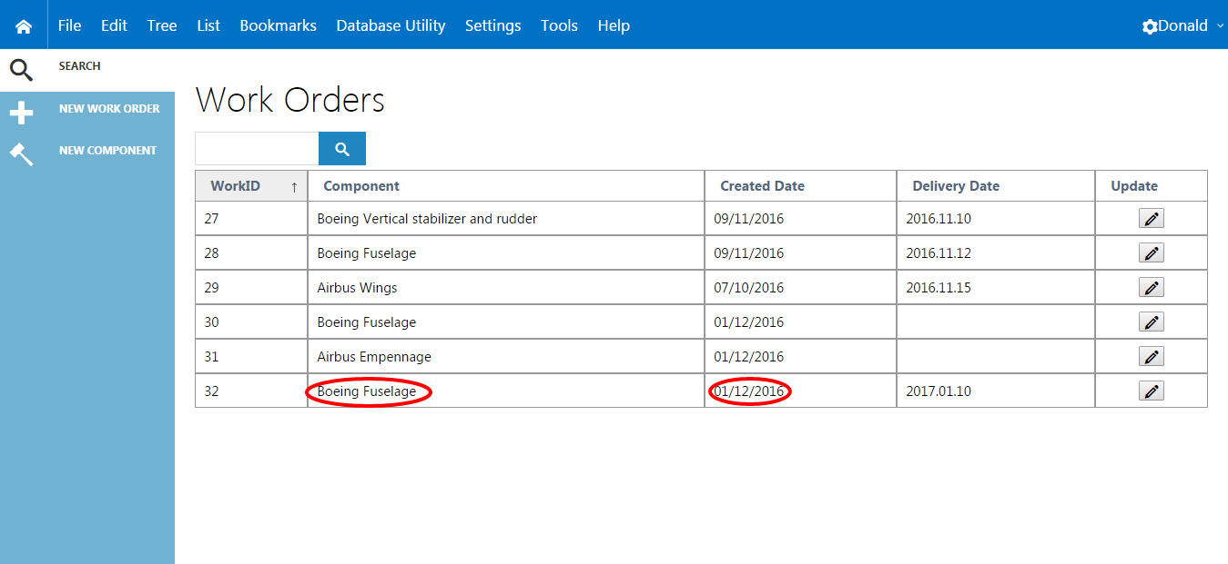

Slide 48
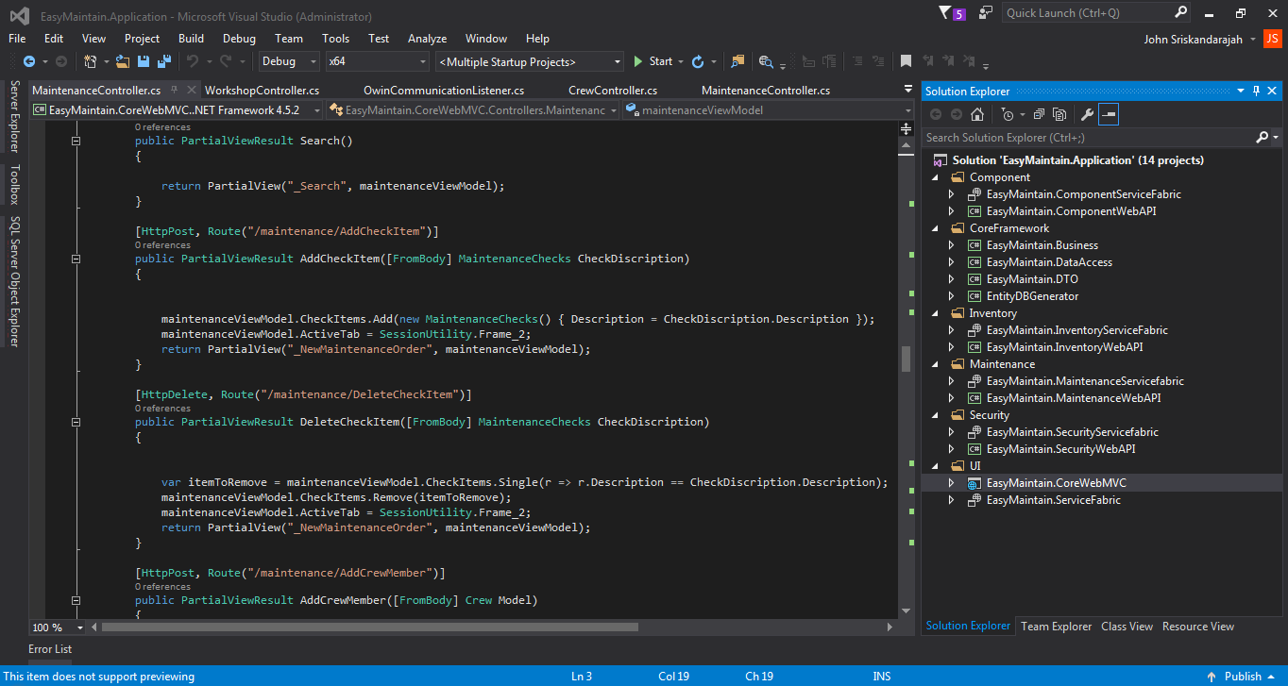

Slide 49
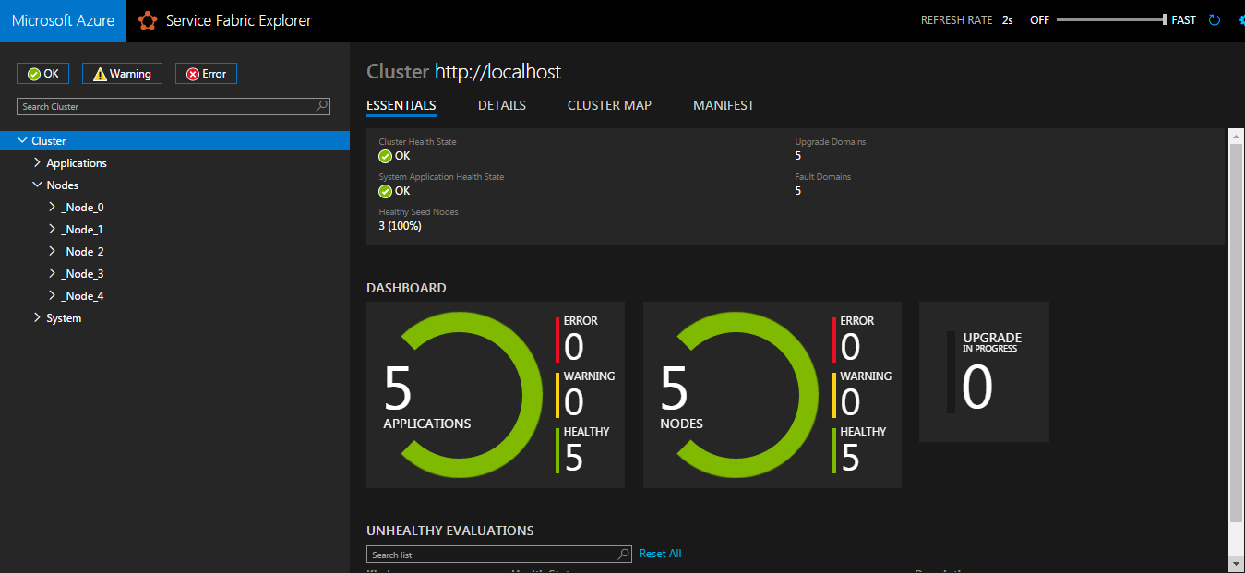

Slide 50
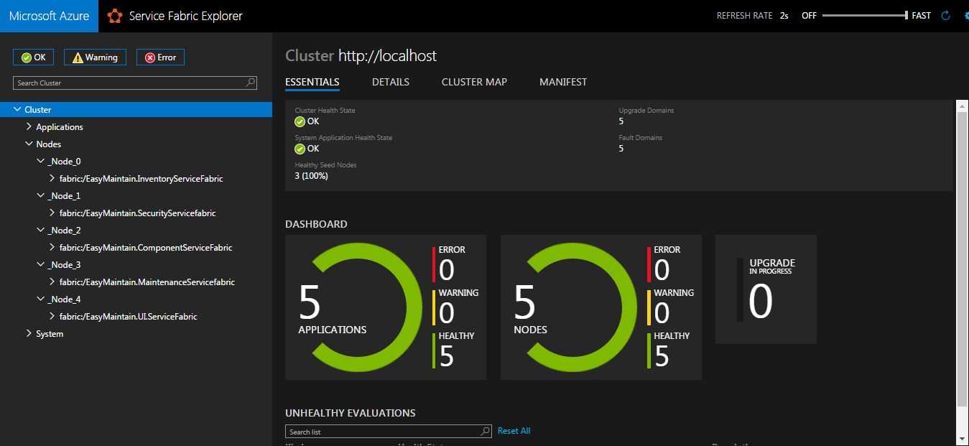

Slide 51
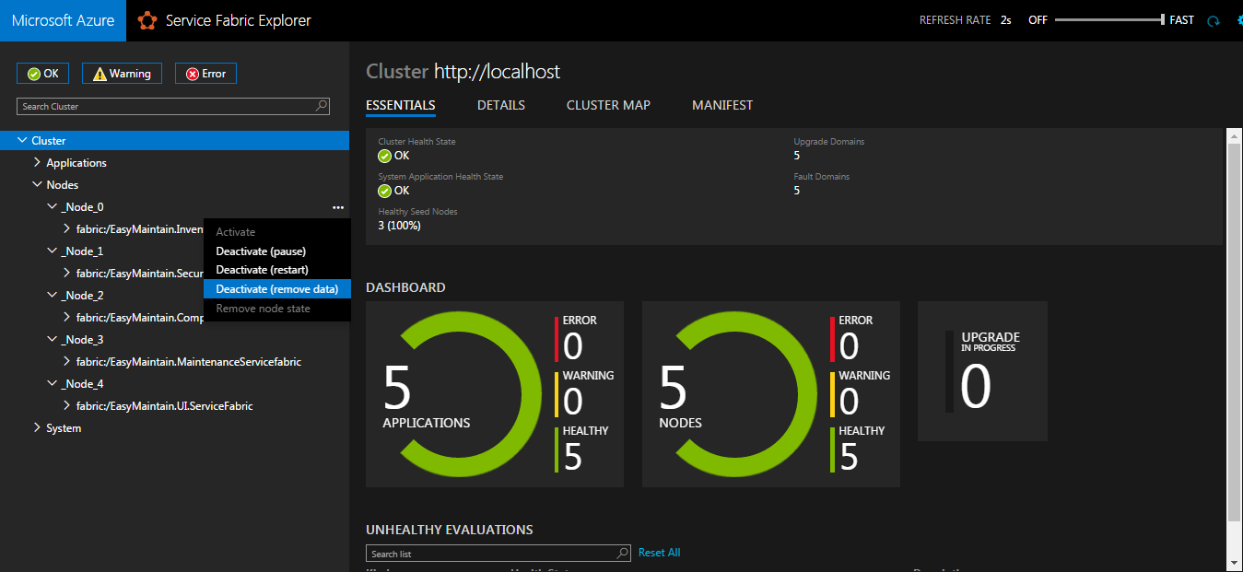

Slide 52
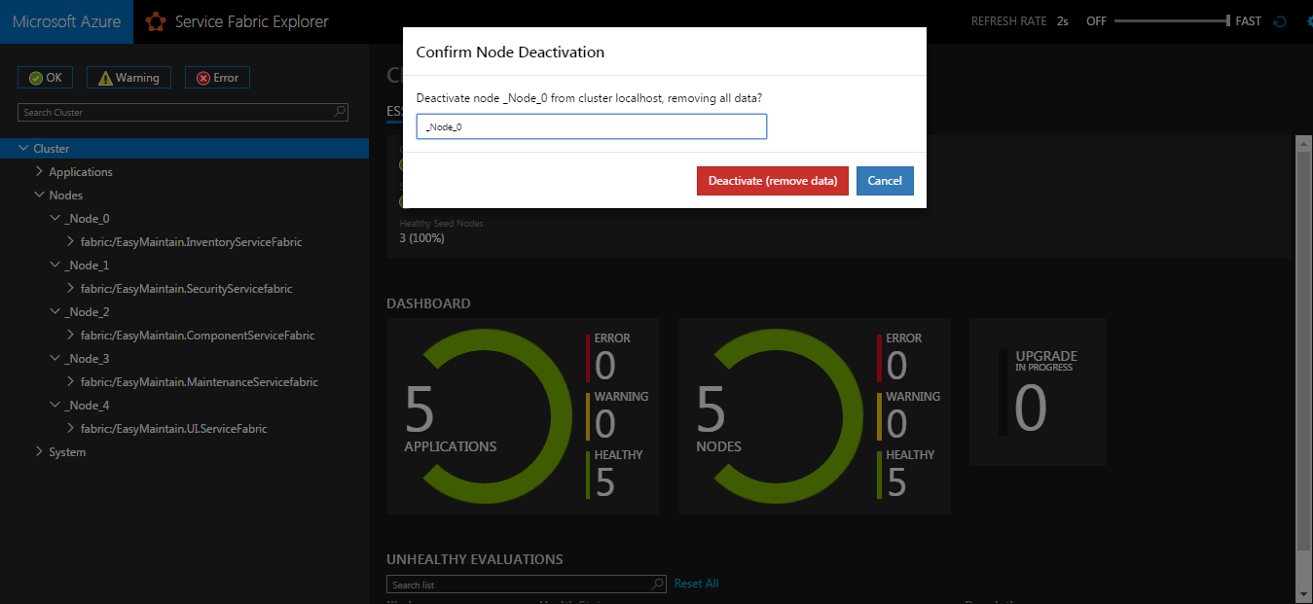

Slide 53
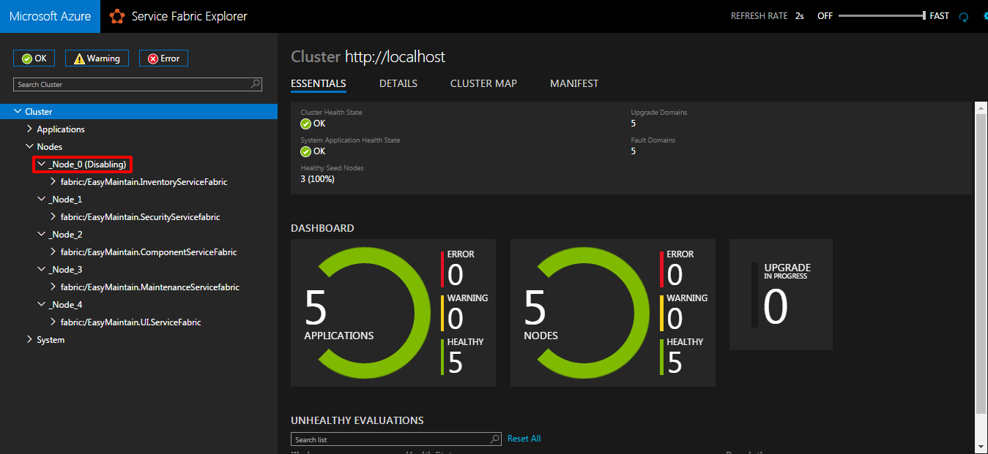

Slide 54
