Slide 1
Microservices
Resilient and Reliable Service Implementation Using Azure Service Fabric

Slide 2
Agenda for the day
Microservices
SOA and Microservices
Monolithic vs Microservice Architecture
Common Microservice design patterns
Azure Service Fabric
Introduction
Clusters and Nodes
Development, Testing and Deployment
.NET Core
Kestrel
NGINX
Demo
1
2
3

Slide 3
What are Microservices? Isn't SOA the same?

Slide 4
SOA and Micro Services
Service Oriented Architecture
TODO
Microservices Architecture
TODO
SOA
Microservices

Slide 5
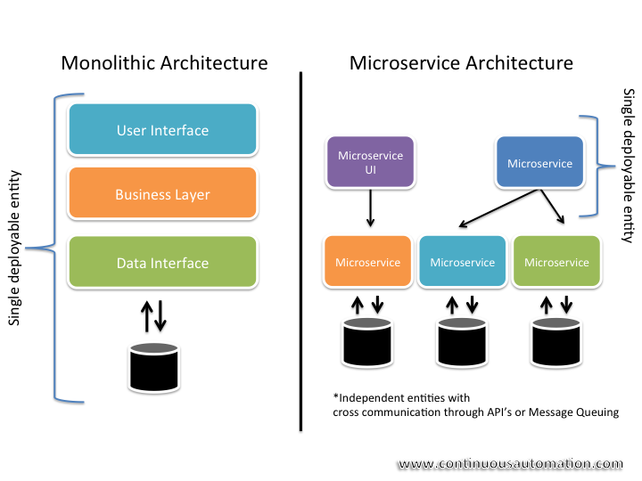
Monolithic vs Microservices
Monolithic
TODO
Microservices
TODO

Slide 6
Common Microservices Design Patterns
Circuit Breaker Pattern
TODO
Api Gateway Pattern
TODO

Slide 7
Honorable mentions….
TODO
TODO

Slide 8
Micro Services Frameworks
TODO
TODO

Slide 9
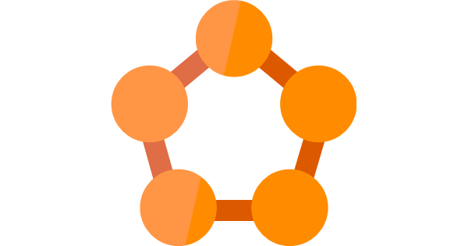
Azure Service Fabric

Slide 10
Azure Service Fabric
Introduction
TODO

Slide 11
Clusters and Nodes
Introduction
TODO

Slide 12
Development, Testing and Deployment
Introduction
TODO

Slide 13
.NET Core
Introduction
TODO

Slide 14
Kestrel
Introduction
TODO

Slide 15
NGINX
Introduction
TODO

Slide 16
Proof of Concept
Logical Diagram
TODO
Deployment Diagram
TODO

Slide 17
Questions?

Slide 18
Thank You

