Slide 1
What is the Relationship Between Hand Size and Weight?

Slide 2
Background
Weight is an important measurement for medical and other purposes
Weight is a sensitive topic
If we could predict weight from other measurements that everyone feels comfortable disclosing, that would be useful
Notes:
John

Slide 3
Our Survey
Population: Lynbrook High School students (teenagers only…)
Sampling Frame: Lynbrook Yearbook Roster (from John)
Explanatory Variable: Hand Size (in)
Response Variable: Weight (lb)
Notes:
John

Slide 4
Our Hypothesis
H₀: There is no association between hand size and weight for students at Lynbrook High School. β₁= 0
H_{A}: There is an association between hand size and weight for students at Lynbrook High School. β₁≠ 0
We will be using an alpha level of 0.05.
Notes:
John

Slide 5
Data Collection
Yearbook roster of students from all 4 grades
Simple Random Sample
Stratified by Gender
No Stratification of Grades
Assigned a number to all 1700 students enrolled at Lynbrook High School, 100 total students selected
Notes:
Brian

Slide 6
Selected Students
20 | Moeko | Ashihara
22 | Jessica | Atmadja
30 | Sunaina | Bose
36 | Justin | Chang
75 | William | Cui
135 | Yuzuri | Ito
150 | Pranav | Kakhandiki
166 | Joshua | Kim
176 | Justin | Lam
199 | Phoebe | Lin
205 | Yingeng | Liu
206 | Frank | Lo
217 | Samantha | McCoy
231 | Zainab | Nasir
240 | Anna | Paaske
326 | Claire | Tan
346 | Lauryn | Tuo
372 | Allison | Wu
382 | Diana | Xu
387 | Elissa | Yang
400 | Elaine | Zhang
407 | David | Zheng
411 | Amanda | Zhu
420 | Yuriko | Akeyama
430 | Noela | Bae
446 | Nicholas | Chan
449 | Jonathan | Chang
484 | Faven | Desta
499 | Jesse | Ge
545 | Diya | Jain
578 | Ajeet | Kotturu
582 | Brian | Lee
589 | Joseph | Lee
614 | Kelly | Lin
631 | Sandy | Matsuda
641 | Anika | Murthy
647 | Bridget | Naylor
652 | Aryaman | Pagay
658 | Ameya | Patil Patkar
678 | Nikita | Rangwala
678 | Amritanshu | Ranjan
695 | Isha | Sharma
702 | Mahima | Sinha
705 | Albert | Su
785 | Anvitha | Aluri
786 | Katelin | An
788 | Rhea | Arora
793 | Bhuvanesh | Basireddy
809 | Leslie | Chan
814 | Shannon | Changizi
817 | Albert | Chen
833 | Rachel | Cheung
858 | Tru | Do
949 | Jungyoon | Kim
964 | Aditya | Kuppili
990 | Michyla | Lin
1036 | Nandini | Nag
1042 | Ethan | Naugle
1043 | Tzen Hao | Ng
1058 | Grace | Park
1077 | Rajita | Pujare
1085 | Nicolas | Rios
1089 | Aliya Fatema | Saiyed
1096 | Leo | Sha
1104 | Akiyuki | Shigematsu
1107 | Anika | Singh
1113 | Amy | Steinmetz
1126 | Hibah | Tanveer
1163 | Tiffany | Wong
1176 | Evalina | Xu
1214 | Mayer | Adelberg
1215 | Brady | Alexander
1217 | Tarab | Ansari
1349 | Aya | Ide
1368 | Justin | Juang
1392 | Kathy | Lam
1404 | Rachel | Lee
1408 | Daniel | Li
1421 | Francis | Lin
1425 | Mulan | Lin
1430 | Martin | Liu
1458 | Aishwarya | Mehra
1488 | Nanda | Pandian
1514 | Alexander | Salling
1537 | Kiran | Sivakumar
1539 | Cheuk | So
1606 | Phoebe | Wang
1614 | William | Wong
1622 | Alexander | Xu
1630 | Megan | Yao
1643 | Iris | Zhao
1713 | Stephanie | Wu
1719 | Megan | Yao
1725 | Doreen | Zhao
1740 | Jessie | Zhao
Notes:
Brian

Slide 7
Data Collection
60 out of 100 selected candidates responded to our survey
Stratified by gender (32 girls and 28 boys responded)
Measured their hands with a ruler in inches(from tip of middle finger to the base of the palm)
Measured weight in pounds, had them fill out a survey on our phones
Notes:
Brian

Slide 8
Male Raw Data
Gender | Hand Size (in) | Weight (lbs)
Male | 7.7 | 159
Male | 7.4 | 175
Male | 7.5 | 150
Male | 7.45 | 150
Male | 7.7 | 135
Male | 8.5 | 190
Male | 7.6 | 134
Male | 7.5 | 120
Male | 7.3 | 190
Male | 7.55 | 120
Male | 7.5 | 160
Male | 6.8 | 145
Male | 6.7 | 110
Male | 7.2 | 130
Male | 7.4 | 140
Male | 7.6 | 145
Male | 7.5 | 130
Male | 7.4 | 150
Male | 7.8 | 120
Male | 7.4 | 150
Male | 7.1 | 123
Male | 7.1 | 120
Male | 7.5 | 155
Male | 7.1 | 145
Male | 7.1 | 155
Male | 7.5 | 160
Male | 6.8 | 110
Male | 7.4 | 195
Notes:
Brian

Slide 9
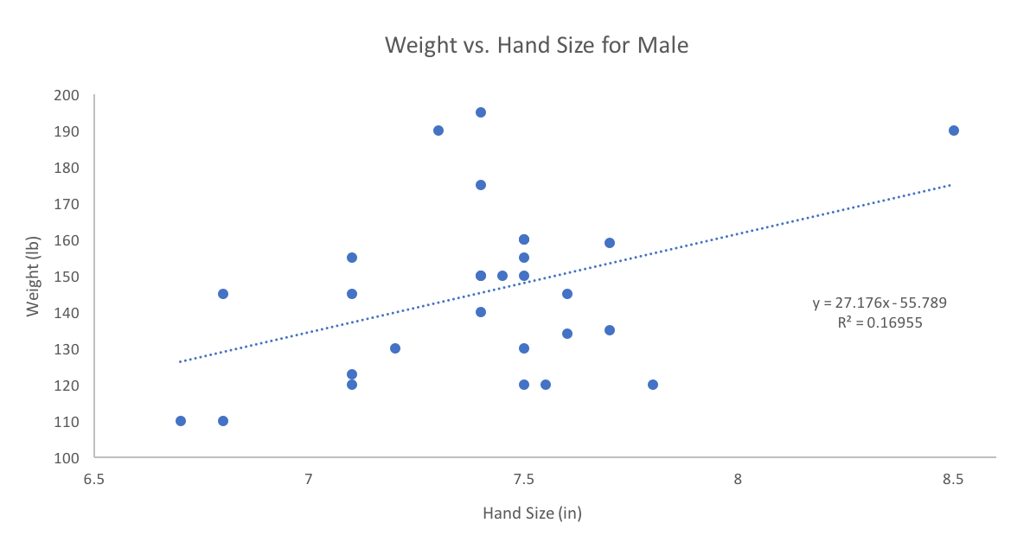
Male Scatterplot
Linear Assumption: Scatterplot is Straight Enough
Independence: Data of individuals shouldn’t affect another

Slide 10
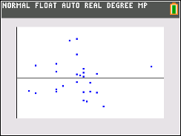
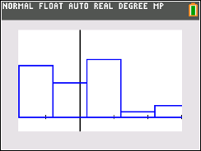
Male Residuals Plot/Histogram
Does the Plot Thicken?: Residuals spread is even.
Nearly Normal: Histogram of Residuals is roughly unimodal and symmetric

Slide 11
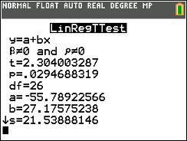
Linear Regression T-Test for Males

Slide 12
Conclusion for Males
With a p value of 0.029 we reject the null hypothesis. There is sufficient evidence to suggest that there is an association between Hand Size and Weight for male students at Lynbrook High School.

Slide 13
Female Raw Data
Gender | Inches | Pounds
Female | 6.7 | 112
Female | 7.4 | 120
Female | 6.8 | 120
Female | 7.1 | 120
Female | 6.4 | 130
Female | 6.6 | 130
Female | 7.05 | 112
Female | 6.1 | 140
Female | 5.9 | 125
Female | 6.15 | 125
Female | 7.2 | 135
Female | 7 | 125
Female | 7.05 | 130
Female | 7 | 123
Female | 7.4 | 180
Female | 6.9 | 125
Female | 6.9 | 130
Female | 6.7 | 110
Female | 6.6 | 110
Female | 6.9 | 108
Female | 6.5 | 113
Female | 6.4 | 110
Female | 6.5 | 130
Female | 6.8 | 122
Female | 7 | 94
Female | 6.9 | 140
Female | 6.5 | 115
Female | 6.1 | 90
Female | 6.4 | 120
Female | 6.8 | 140
Female | 6.8 | 150
Female | 5.6 | 105

Slide 14
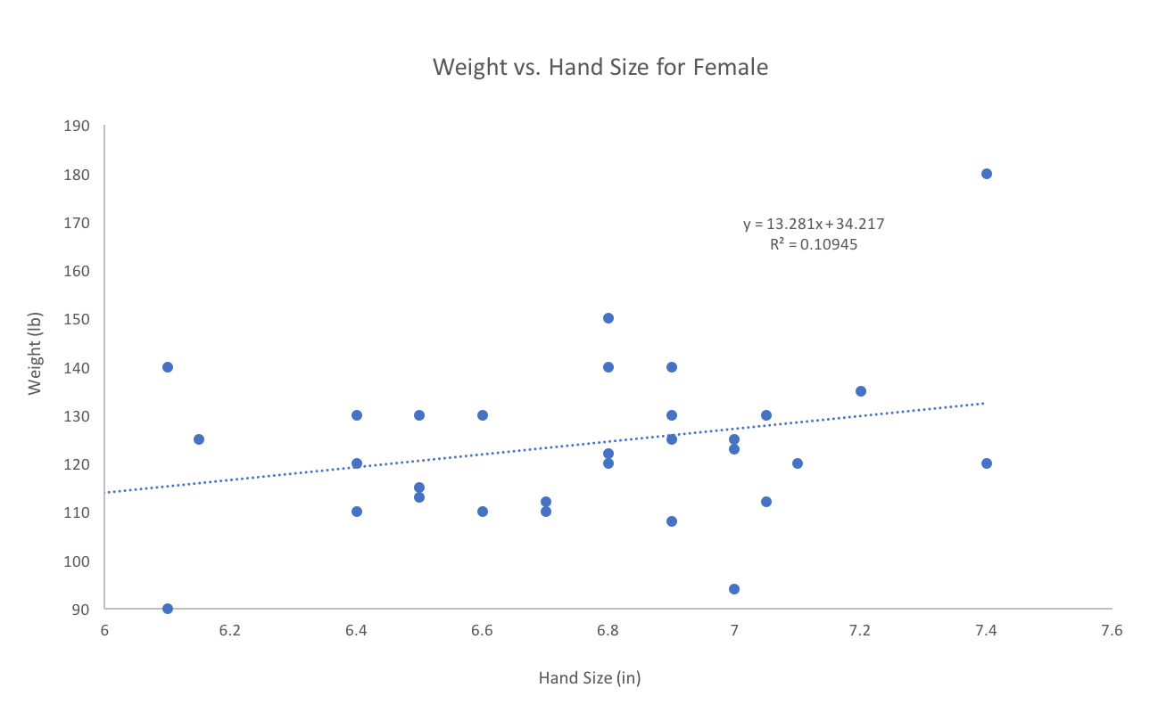
Female Scatterplot
Linear Assumption: Scatterplot is Straight Enough
Independence: Data of individuals shouldn’t affect another

Slide 15
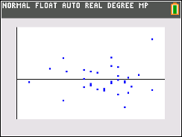
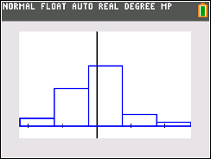
Female Residuals Plot/Histogram
Does the Plot Thicken?: Residuals spread is even.
Nearly Normal: Histogram of Residuals is roughly unimodal and symmetric

Slide 16
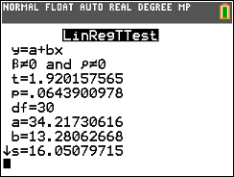
Linear Regression T-Test for Females

Slide 17
Conclusion for Females
With a p value of 0.064 we fail to reject the null hypothesis. There is insufficient evidence to suggest that there is an association between Hand Size and Weight for female students at Lynbrook High School.

Slide 18
Overall Conclusions
Rejected the null hypothesis for Males and failed to reject for females. For males, it’s possible that for males with bigger hands may be more inclined to exercise or work out. Unsure as to why there is possibly no association for females.

Slide 19
Potential Errors
Non-Response Bias — not everyone who’s selected responded to our survey. People with higher than average weight may be underrepresented in this study.
Response Bias — though anonymous, people may be inclined to lie about such a sensitive information

Slide 20
Thank You!
Questions?

