Slide 1


Building minimal containers
by
Brian "redbeard" Harrington
Principal Architect, CoreOS

Slide 2
Getting Weird with Containers
by
Brian "redbeard" Harrington
Principal Architect, CoreOS

Slide 3
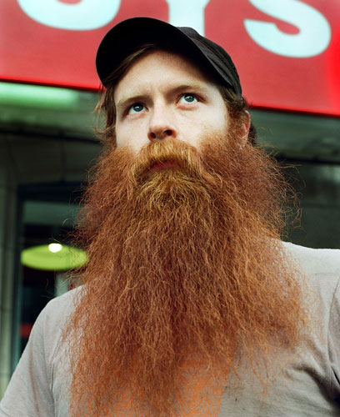
Brian “Redbeard”
Harrington
Principal Architect
CoreOS
redbeard@coreos.com
github.com/brianredbeard
twitter.com/brianredbeard
brianredbeard.com
PHOTO (C) BY JOSHUA YOSPYN
Notes:
I'm Brian Redbeard

Slide 4
Brian “Redbeard”
Harrington
Principal Architect
CoreOS
redbeard@coreos.com
github.com/brianredbeard
twitter.com/brianredbeard
brianredbeard.com
PHOTO (C) BY JOSHUA YOSPYN
Notes:
Just call me redbeard. Here are some of the ways you can stalk me on the internet.

Slide 5
WHO GETS EXCITED ABOUT
TARBALLS

Slide 6
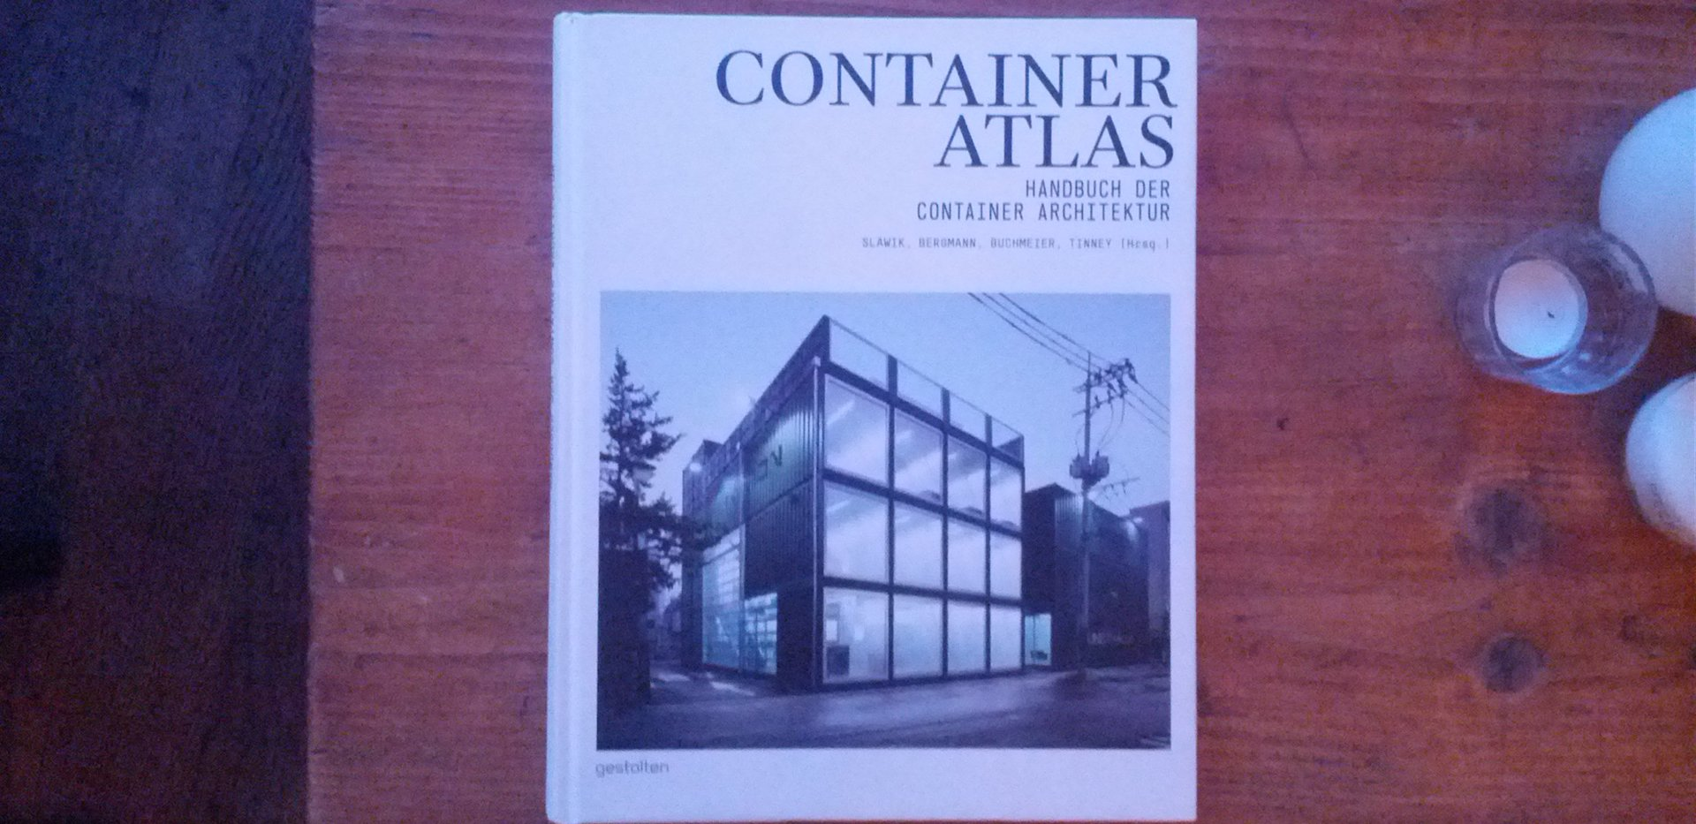

Slide 7
BREAK OUT
THE COOKIES
BEER
IT'S
STORY
TIME

Slide 8
THERE ONCE WAS A LITTLE CONTAINER WHO WANTED TO GET
TO
PRODUCTION

Slide 9
BUT...

Slide 10
MUCH LIKE
REDBEARD

Slide 11
THE CONTAINER WAS
GETTING A LITTLE
TOO BIG

Slide 12
AND ALL THE
PRODUCTION OPS
FOLKS SAID:

Slide 13
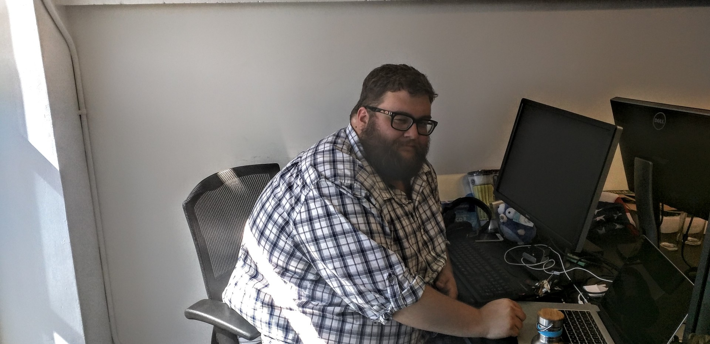
IF YOUR CONTAINERS ARE GETTING DEPLOYED
ON MY INFRASTRUCTURE YOU BETTER
COME CORRECT ON
HOW BIG
THEY ARE

Slide 14
TO WHICH THE
DEVELOPERS
REPLY:

Slide 15
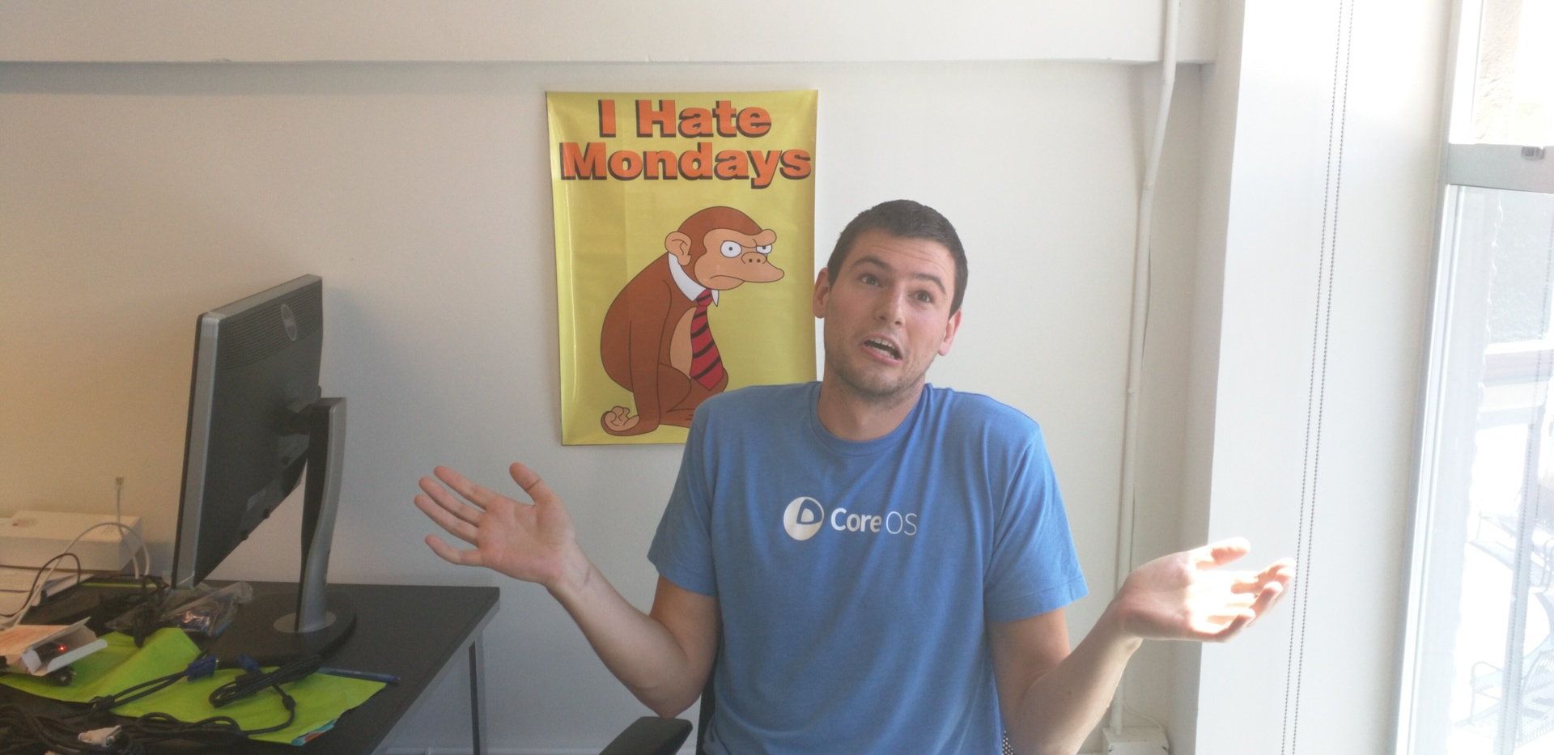
BUT DISK SPACE IS
SO CHEAP

Slide 16
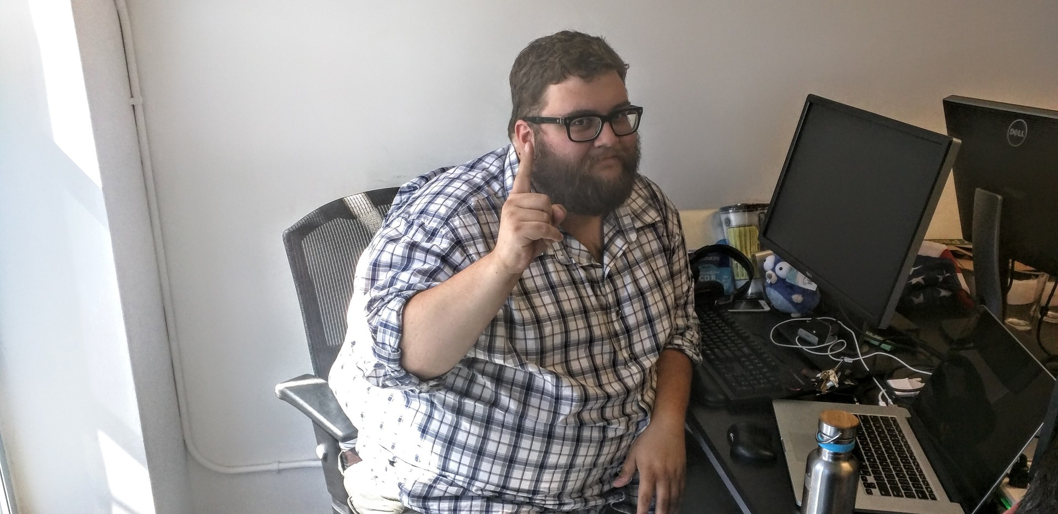
AND SSD WRITE CYCLES ARE
EXPENSIVE

Slide 17
BIG CONTAINERS ARE A
PROBLEM

Slide 18
BIG CONTAINERS:
SLOW DOWN YOUR DEPLOYMENTS
(NETWORK)

Slide 19
BIG CONTAINERS:
SLOW DOWN YOUR DEPLOYMENTS
(NETWORK)

Slide 20
BIG CONTAINERS:
CONSUME MORE SPACE
(STORAGE)

Slide 21
BIG CONTAINERS:
INCREASE COST OF OBJECT STORAGE
(BUDGET)

Slide 22
BIG CONTAINERS:
DECREASE I/O PERFORMANCE
(STORAGE)

Slide 23
BIG CONTAINERS:
ARE HARDER TO AUDIT
(SECURITY)

Slide 24
BIG CONTAINERS:
NEED TO BE PUT ON A DIET

Slide 25

BUT YOU DON'T NEED TO
TAKE MY WORD FOR IT
EXPERT PICKS (C) BY LEVAR BURTON

Slide 26
LETS LOOK AT AN
EXAMPLE:

Slide 27
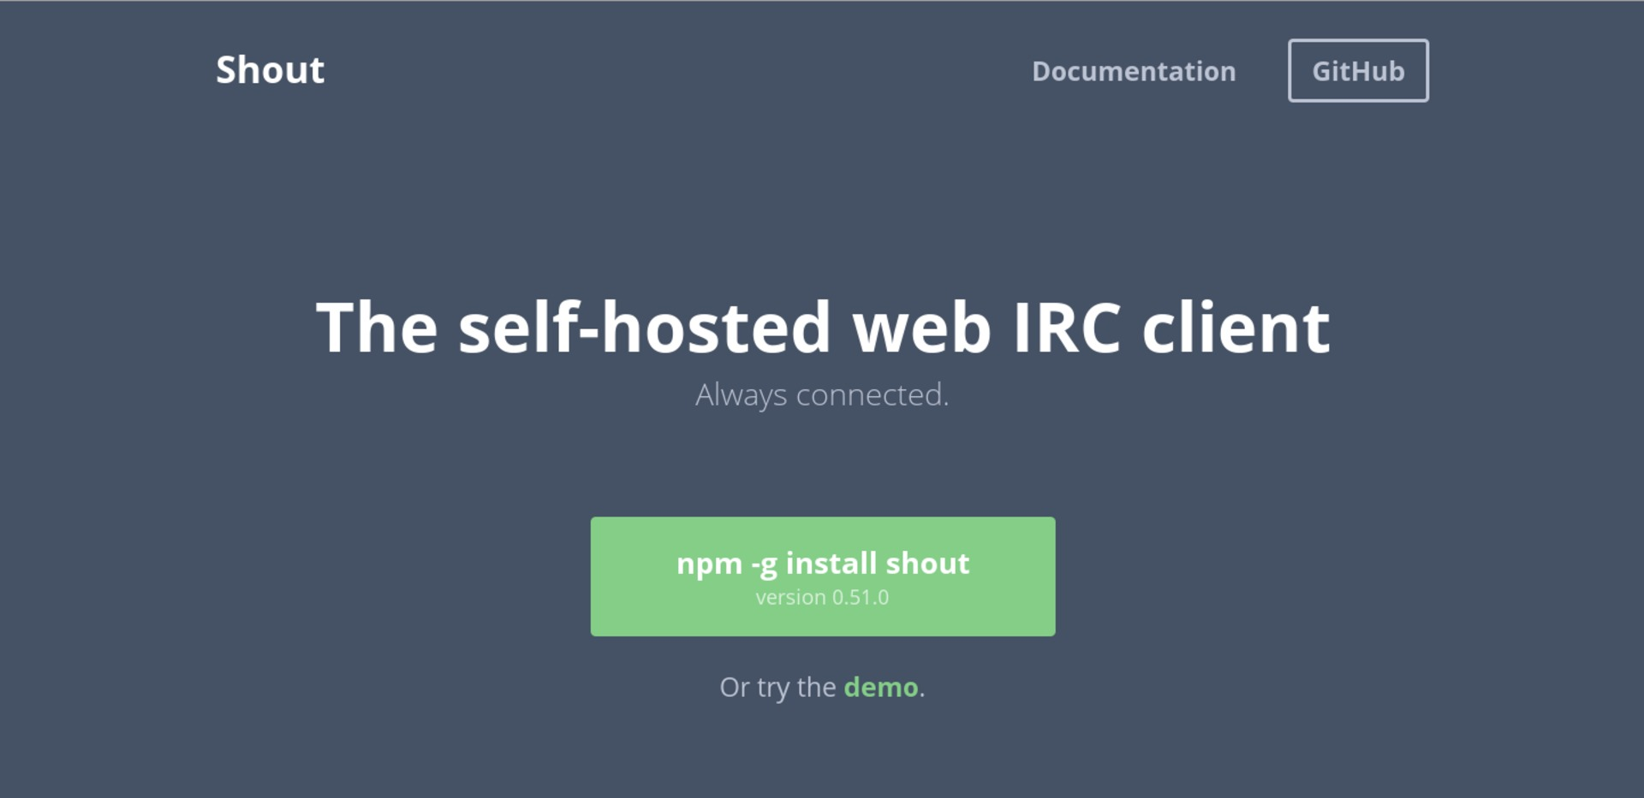
HTTP://SHOUT-IRC.COM

Slide 28
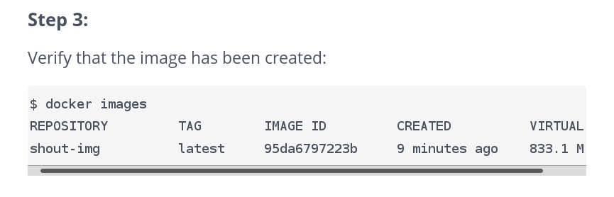

Slide 29


Slide 30
The source?
HTTP/1.1 200 OK
Content-Length: 592371
Access-Control-Allow-Origin: https://render.githubusercontent.com
Content-Security-Policy: default-src 'none'
X-XSS-Protection: 1; mode=block
X-Frame-Options: deny
X-Content-Type-Options: nosniff
Strict-Transport-Security: max-age=31536000
Vary: Authorization,Accept-Encoding
ETag: "7138ca6bda5430d1fdbc9f6e530d9cfd11247bd1"
Content-Type: application/zip
Content-Disposition: attachment; filename=shout-0.51.0.zip
Date: Wed, 29 Jul 2015 23:27:30 GMT

Slide 31
The source?
HTTP/1.1 200 OK
Content-Length: 592371
Access-Control-Allow-Origin: https://render.githubusercontent.com
Content-Security-Policy: default-src 'none'
X-XSS-Protection: 1; mode=block
X-Frame-Options: deny
X-Content-Type-Options: nosniff
Strict-Transport-Security: max-age=31536000
Vary: Authorization,Accept-Encoding
ETag: "7138ca6bda5430d1fdbc9f6e530d9cfd11247bd1"
Content-Type: application/zip
Content-Disposition: attachment; filename=shout-0.51.0.zip
Date: Wed, 29 Jul 2015 23:27:30 GMT

Slide 32
take note:
592KB

Slide 33
FROM node
RUN npm -g install shout
EXPOSE 9000
CMD ["shout", "start"]

Slide 34
FROM ubuntu
RUN apt-get update && apt-get upgrade && \
apt-get -y install nodejs
RUN npm -g install shout
EXPOSE 9000
CMD ["shout", "start"]

Slide 35
FROM ubuntu
ENV DEBIAN_FRONTEND noninteractive
RUN apt-get update && apt-get upgrade && \
apt-get -y install nodejs
RUN npm -g install shout
EXPOSE 9000
CMD ["shout", "start"]

Slide 36
FROM ubuntu
ENV DEBIAN_FRONTEND noninteractive
RUN apt-key adv –keyserver keyserver.ubuntu.com –recv C0A52C50
RUN apt-get update && apt-get upgrade && \
apt-get -y install nodejs
RUN npm -g install shout
EXPOSE 9000
CMD ["shout", "start"]

Slide 37
FROM buildpack-deps:jessie
# verify gpg and sha256: http://nodejs.org/dist/v0.10.31/SHASUMS256.txt.asc
# gpg: aka "Timothy J Fontaine (Work) <tj.fontaine@joyent.com>"
# gpg: aka "Julien Gilli <jgilli@fastmail.fm>"
RUN gpg --keyserver pool.sks-keyservers.net --recv-keys \
7937DFD2AB06298B2293C3187D33FF9D0246406D 114F43EE0176B71C7BC219DD50A3051F888C628D
ENV NODE_VERSION 0.10.38
ENV NPM_VERSION 2.7.3
RUN curl -SLO "http://nodejs.org/dist/v$NODE_VERSION/node-v$NODE_VERSION-linux-x64.tar.gz" \
&& curl -SLO "http://nodejs.org/dist/v$NODE_VERSION/SHASUMS256.txt.asc" \
&& gpg --verify SHASUMS256.txt.asc \
&& grep " node-v$NODE_VERSION-linux-x64.tar.gz\$" SHASUMS256.txt.asc | sha256sum -c - \
&& tar -xzf "node-v$NODE_VERSION-linux-x64.tar.gz" -C /usr/local --strip-components=1 \
&& rm "node-v$NODE_VERSION-linux-x64.tar.gz" SHASUMS256.txt.asc \
&& npm install -g npm@"$NPM_VERSION" \
&& npm cache clear
CMD [ "node" ]

Slide 38
$ docker images node
REPOSITORY TAG IMAGE ID CREATED VIRTUAL SIZE
node latest c03077d1e6a0 2 weeks ago 639.7 MB

Slide 39
what do we do?

Slide 40
what DO we do?
demystify how a container is built
enumerate other ways to do it
demonstrate how it's done

Slide 41
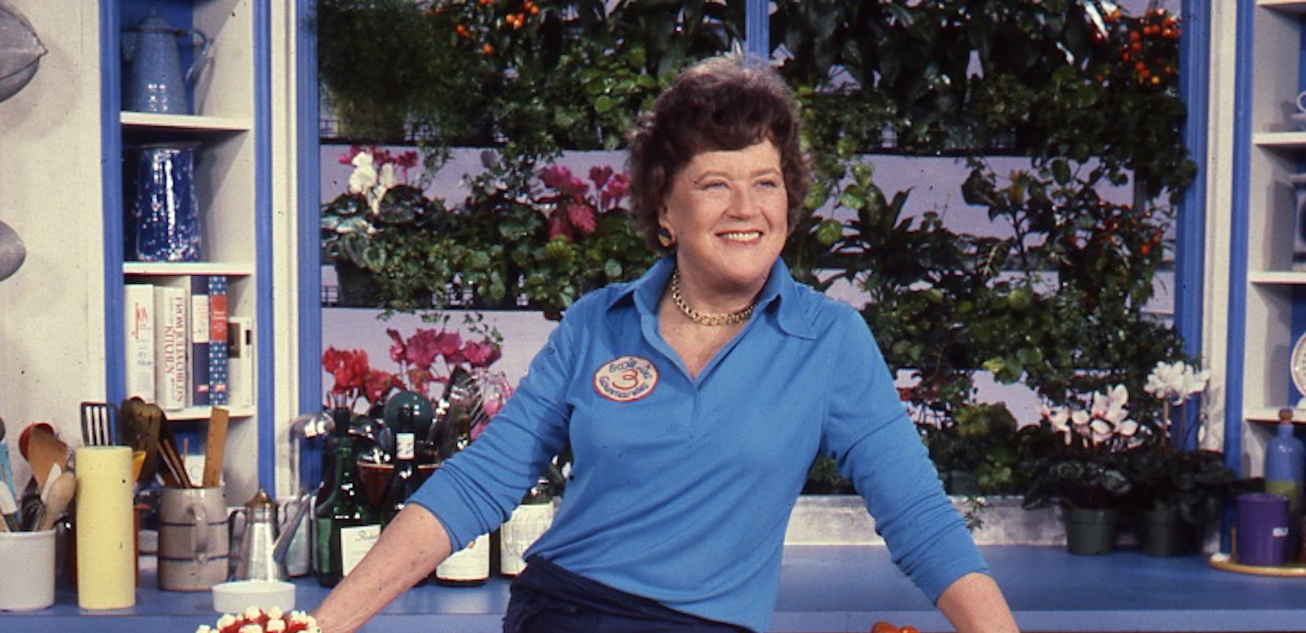
LETS STEP
INTO THE
KITCHEN
JULIA CHILD (PUBLIC DOMAIN)

Slide 42
WHO GETS EXCITED ABOUT
TARBALLS

Slide 43
REPEAT
AFTER REDBEARD

Slide 44
A CONTAINER FILESYSTEM
IS JUST A
TARBALL
A CONTAINER FILESYSTEM ISN'T
MAGIC...
IT'S JUST A TARBALL

Slide 45
anything that can
make a tarball
CAN MAKE A CONTAINER

Slide 46
$ mktemp -d
/tmp/tmp.d3NqCJe2yJ

Slide 47
# grab gpg key:
$ curl -s -o /tmp/fedora.asc https://getfedora.org/static/8E1431D5.txt
# trust gpg key:
$ sudo rpm --import --root=/tmp/tmp.d3NqCJe2yJ/ /tmp/fedora.asc
# install packages signed with gpg key:
$ dnf --installroot=/tmp/tmp.d3NqCJe2yJ --releasever=22 \
install httpd

Slide 48
$ cd /tmp/tmp.d3NqCJe2yJ
$ tar zcvf ../fedora.tar ./

Slide 49
what do i do with this
hunk of junk?

Slide 50
$ cat /tmp/fedora.tar | docker import fedora -

Slide 51
is it really
that simple?

Slide 52
YES

Slide 53
really?

Slide 54
YES
IT IS REALLY
THAT SIMPLE

Slide 55
<demo>

Slide 56
</demo>

Slide 57
Don't I need a
Dockerfile?

Slide 58
NO

Slide 59
But I'll humor you....

Slide 60
$ cat Dockerfile
FROM fedora
CMD ["/bin/bash"]

Slide 61
<demo>

Slide 62
</demo>

Slide 63
And there are a LOT of
tools to do similar
processes...

Slide 64
yum
dnf
debootstrap
buildroot
alpine
gentoo

Slide 65
time for a PSA...

Slide 66


Slide 67
Are you.....
Utilizing framebuffers?
running a window
manager?
Administering users?
Logging in?
Editing files?

Slide 68
these are the purview of
general purpose
computing

Slide 69

http://buildroot.org

Slide 70
BUILDROOT IS AN SDK FOR BUILDING
MINIMAL
LINUX DISTROS

Slide 71
<demo>

Slide 72
</demo>

Slide 73
Agnostic
Works with Docker, rkt, and others.
The idea is to be able to build this through a continuous integration system like Buildbot, Jenkins, etc

Slide 74
Signing
Possible through gpg today with mechanisms for confirmed signing.
Able to be automated by using gpg-agent to handle safe caching of credentials.

Slide 75
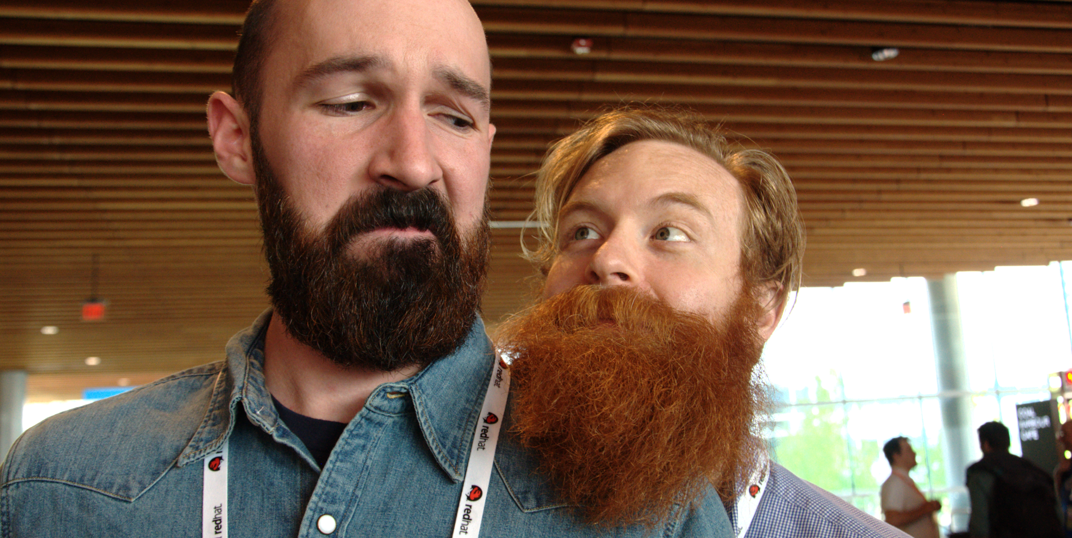
QUESTIONS?

Slide 76

SOME COMPELLING PHOTO (CC) BY A USER

