Slide 1
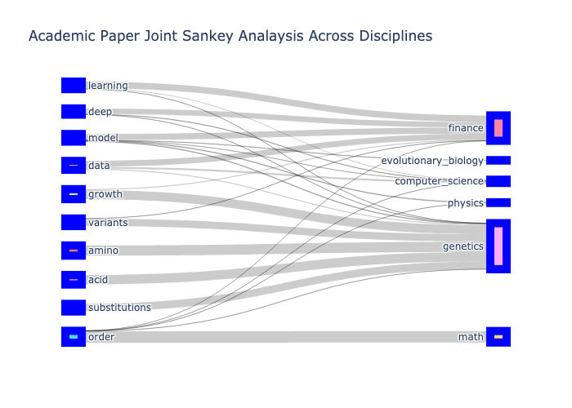
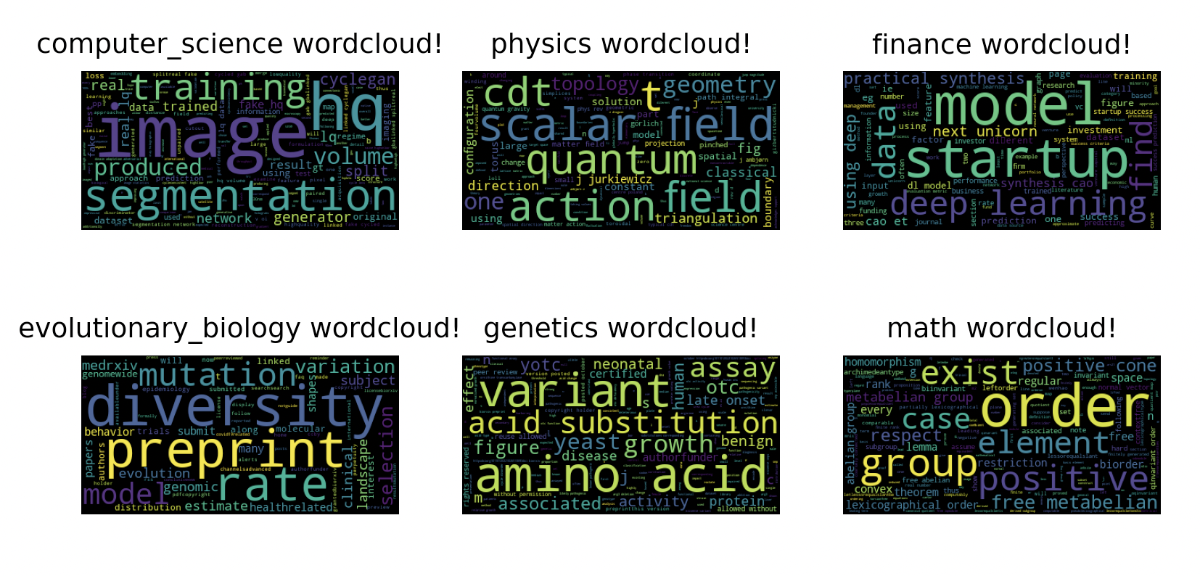

NLP Analysis of Academic Research Papers
Brian Reicher
Fig. 1. Note the shared technology-based nouns across biological, cs, and physical disciplines (i.e. data, model, learning). Implies the critical use of technology across sectors
Fig. 1
Fig. 2
Fig. 2. Displays technological words in each field, but we can now see discipline-specific words rise above (i.e. amino acid in the genetics word cloud)
References:
Ambjørn, J., et al. “Matter-Driven Change of Spacetime Topology.” ArXiv.org, 14 Sept. 2021, https://arxiv.org/abs/2103.00198.
Barroso, Gustavo Valadares, and Julien Y Dutheil. “Mutation Rate Variation Shapes Genome-Wide Diversity in Drosophila Melanogaster.” BioRxiv, Cold Spring Harbor Laboratory, 1 Jan. 2022, https://www.biorxiv.org/content/10.1101/2021.09.16.460667v2.
Cao, Lele, et al. “Using Deep Learning to Find the next Unicorn: A Practical Synthesis.” ArXiv.org, 18 Oct. 2022, https://arxiv.org/abs/2210.14195.
Cao, Lele, et al. “Using Deep Learning to Find the next Unicorn: A Practical Synthesis.” ArXiv.org, 18 Oct. 2022, https://arxiv.org/abs/2210.14195.
Lo, Russell S, et al. “The Functional Impact of 1,570 SNP-Accessible Missense Variants in Human OTC.” BioRxiv, Cold Spring Harbor Laboratory, 1 Jan. 2022, https://www.biorxiv.org/content/10.1101/2022.10.26.513893v1.
Rhoades, Jeff L, et al. On the Topic of Unpaired Image and Segmentation Enhancement of X-Ray Holographic Nanotomography for Connectomics. International Symposium on Biomedical Imaging, 24 Oct. 2022.
Wang, Wenhao. “Orders on Free Metabelian Groups.” ArXiv.org, 26 Oct. 2022, https://arxiv.org/abs/2210.14630.

