Slide 1
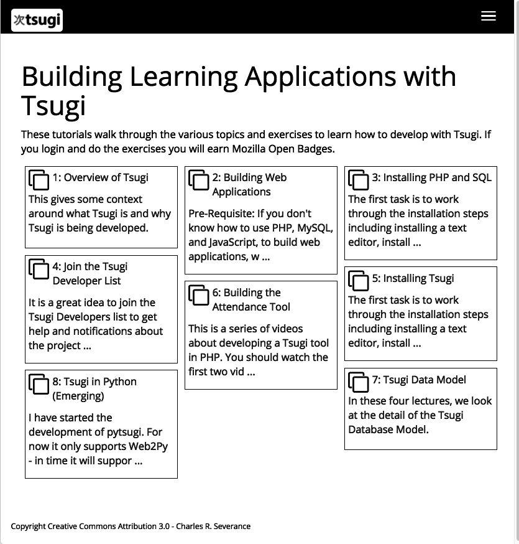
https://www.tsugi.org/lessons

Slide 2
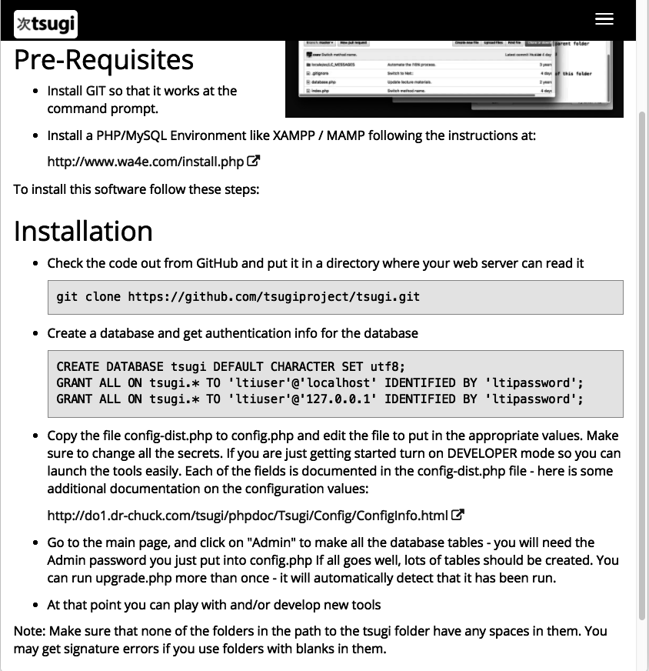
https://www.tsugi.org/docs/install

Slide 3
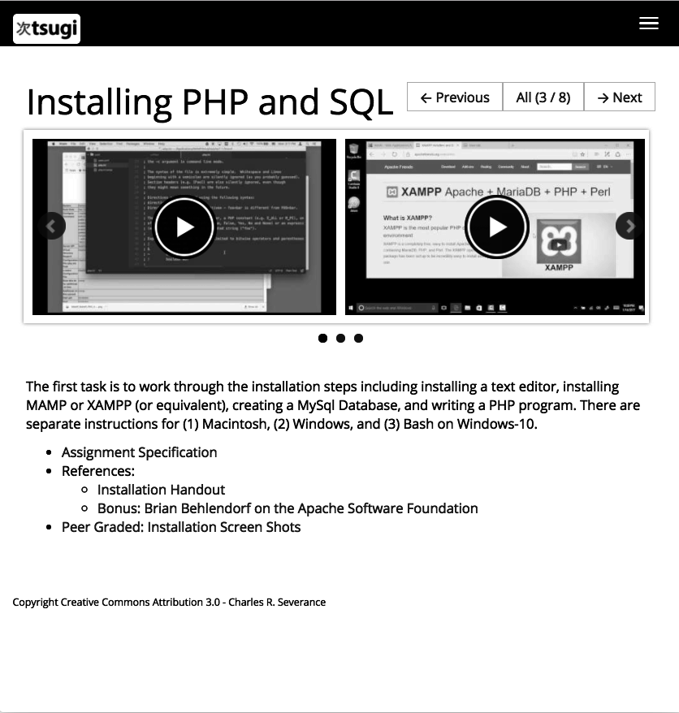
https://www.tsugi.org/lessons/install/

Slide 4
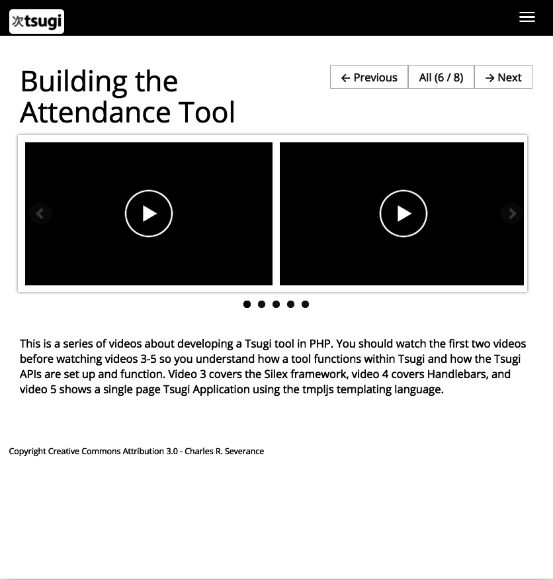
https://www.tsugi.org/lessons/devintro

