Slide 1
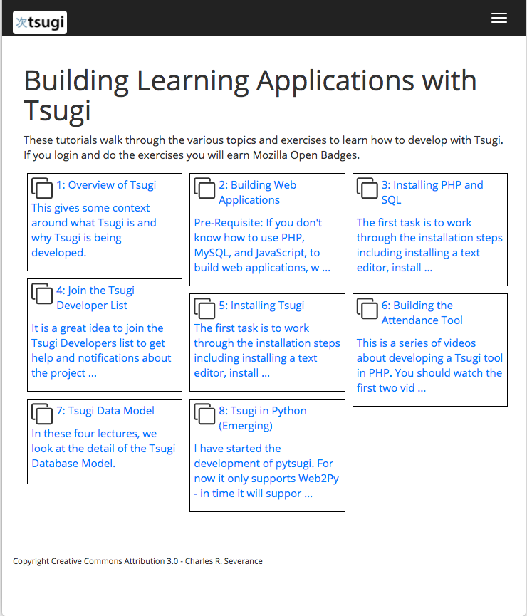
https://www.tsugi.org/lessons/

Slide 2
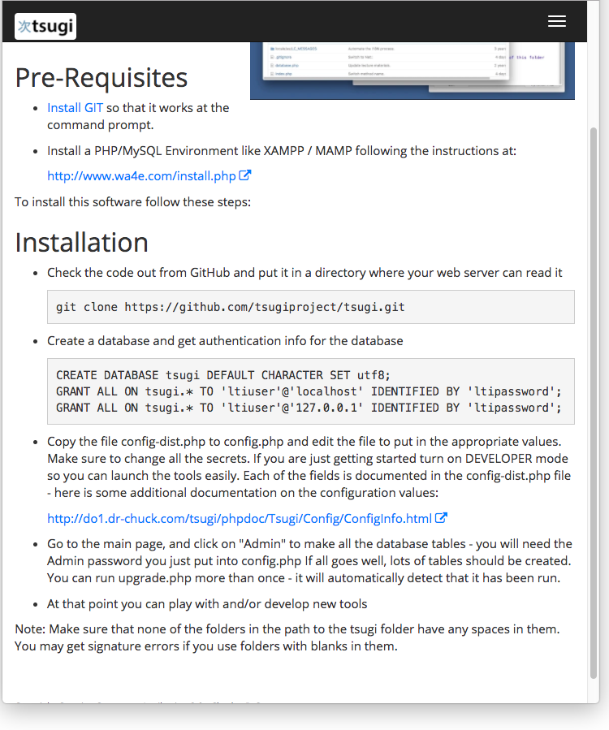
https://www.tsugi.org/docs/install

Slide 3
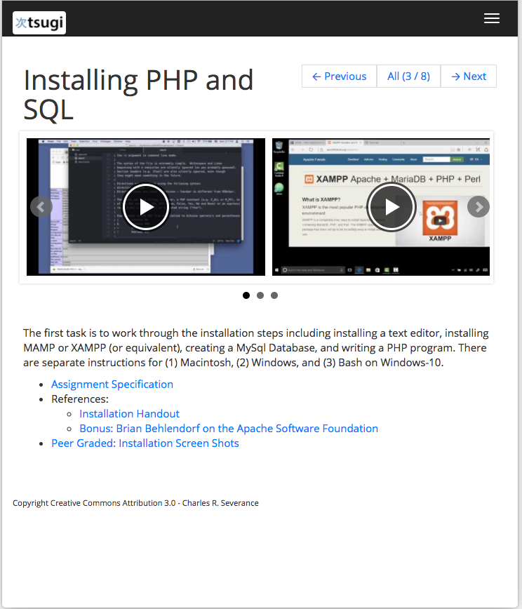
https://www.tsugi.org/lessons/install

