Slide 1
CNN
(Convolutional Neural Network)

Slide 2
CONTENTS
CONV Layer
ReLU
MAX Pooling
Fully Connected Layer
CODE REVIEW

Slide 3
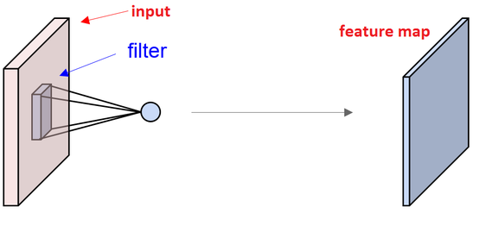
CONV layer(Convolutional Layer)

Slide 4
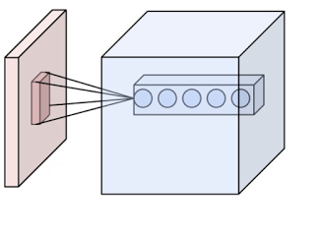
CONV layer(Convolutional Layer)

Slide 5
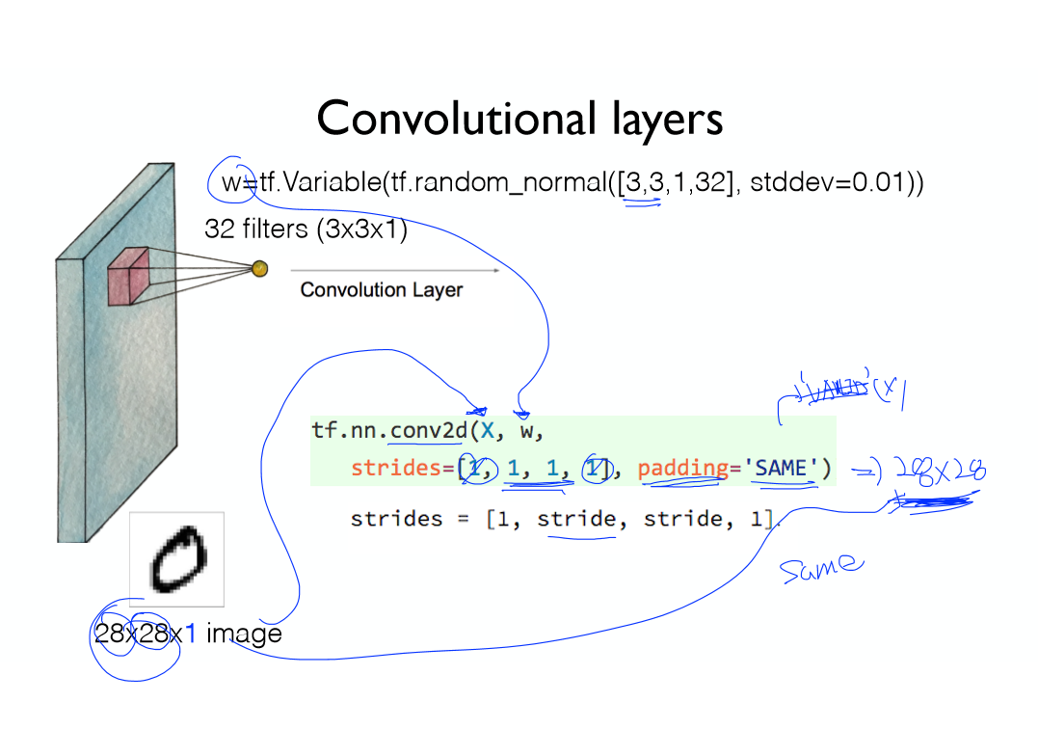
CONV layer(Convolutional Layer)

Slide 6
CONV layer(Convolutional Layer)
l = tf.nn.conv2d(X, w, strides=[1, 1, 1, 1], padding = ‘SAME’)

Slide 7
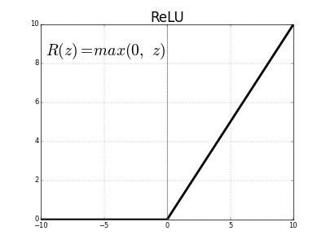
ReLU(Rectified Linear Unit)

Slide 8
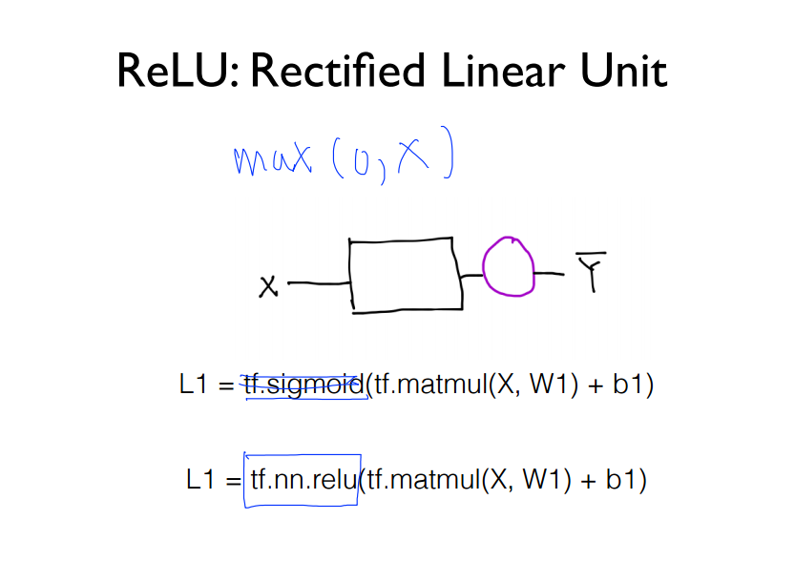
ReLU(Rectified Linear Unit)

Slide 9
ReLU(Rectified Linear Unit)
l = tf.nn.conv2d(X, w, strides=[1, 1, 1, 1], padding = ‘SAME’)
l1a = tf.nn.relu(l)

Slide 10
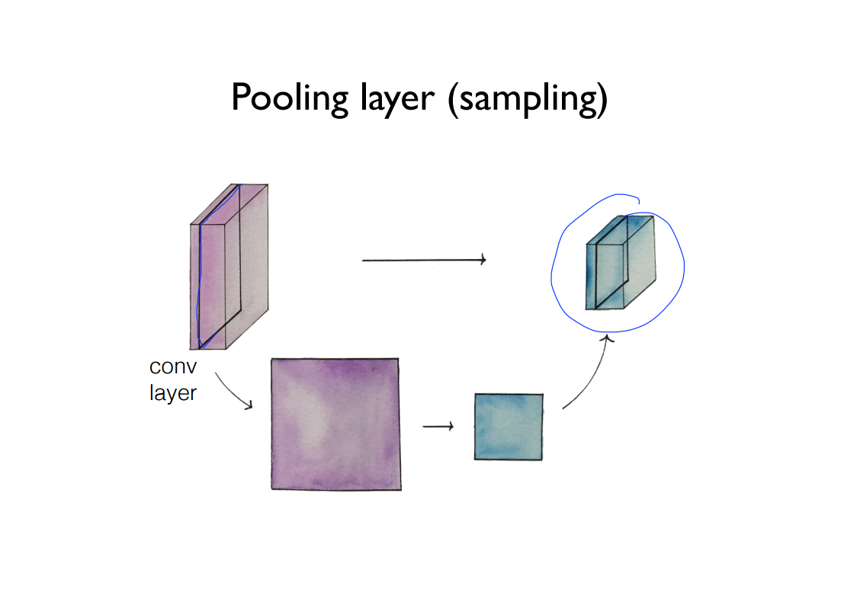
Max Pooling

Slide 11
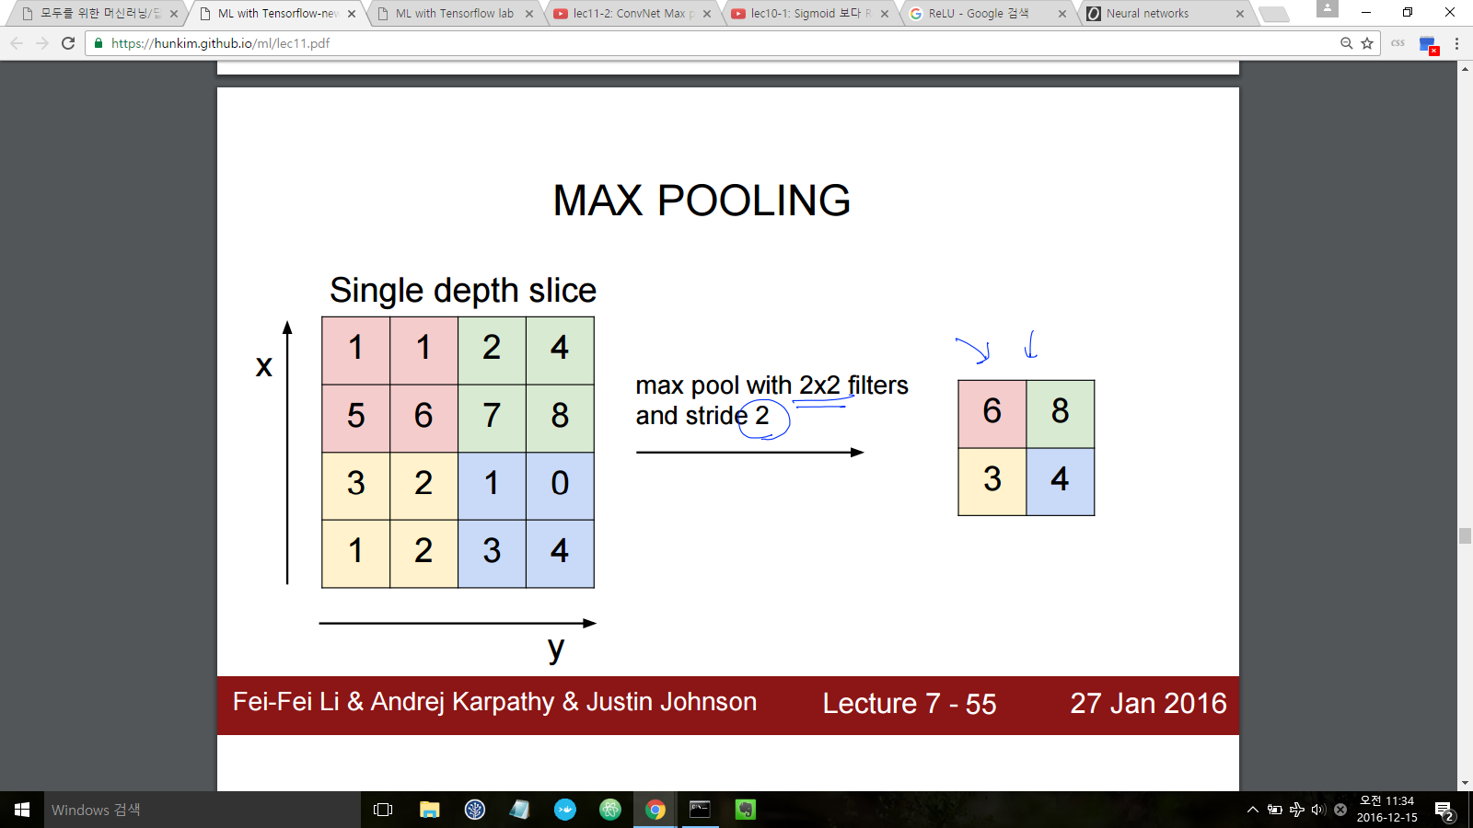
Max Pooling

Slide 12
Max Pooling

Slide 13
Max Pooling
tf.nn.max_pool(c1, ksize=[1, 2, 2, 1], strides=[1, 2, 2, 1], padding=’SAME’)

Slide 14
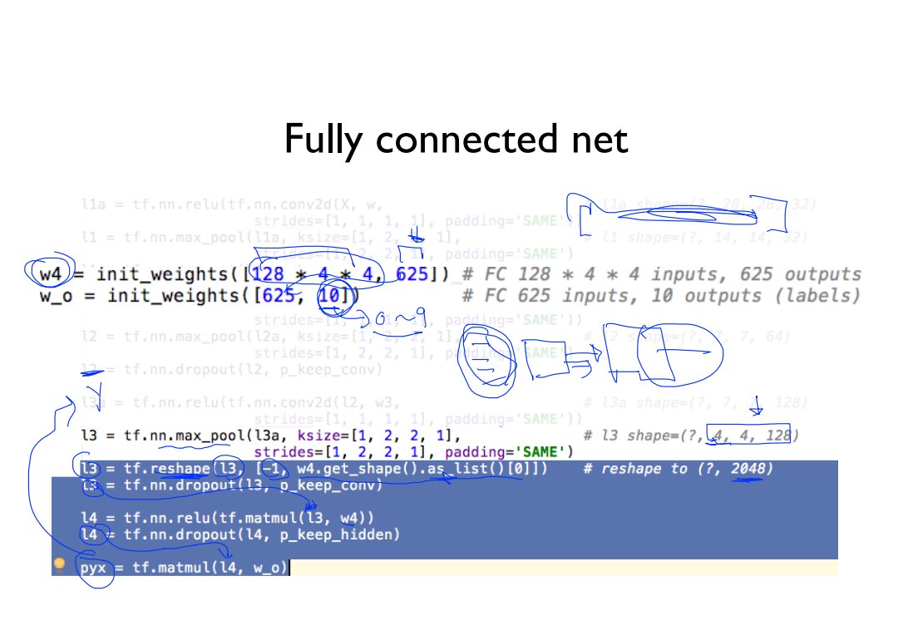
Fully Connected layers
Notes:
쉽게 conv로 나뉜 이미지 데이터를 하나의 전체로 합친다.
matrix -> vector로

Slide 15
REFERENCE
https://ml4a.github.io/ml4a/neural_networks/
https://hunkim.github.io/ml/
<텐서플로 첫걸음, 조르디 토레스, 한빛미디어>

