Slide 1
RNN (Recurrent Neural Network)

Slide 2
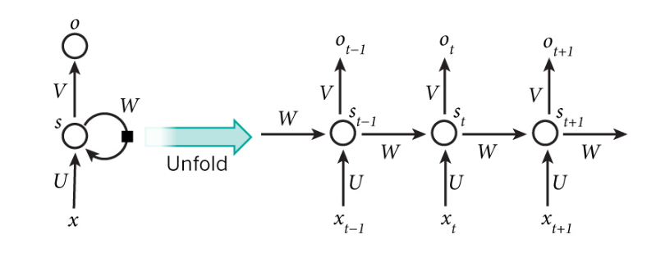
RNN Model

Slide 3
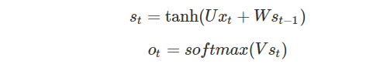
RNN Model

Slide 4
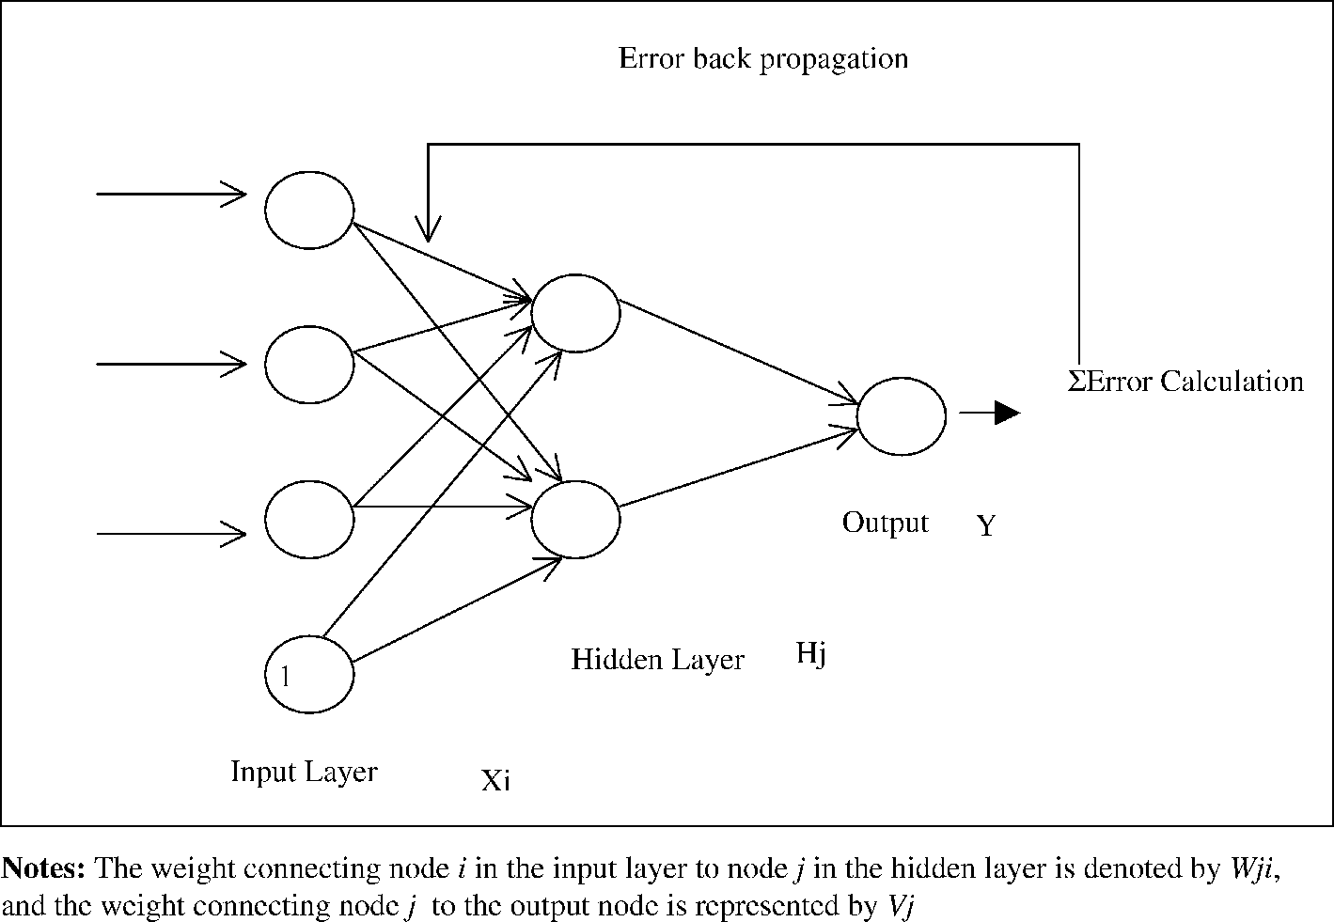
CNN Backpropagation

Slide 5
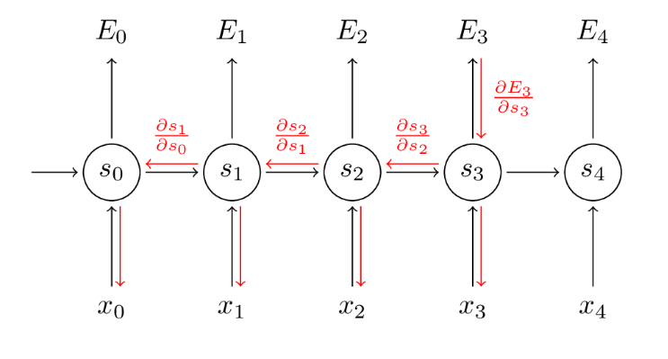
RNN BPTT(Backpropagation Through Time)

Slide 6
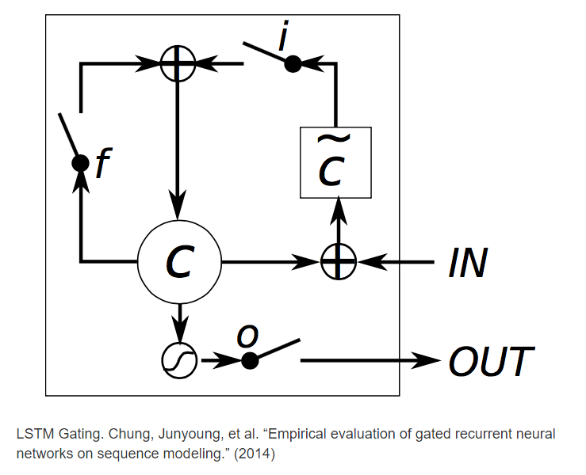
LSTM Model

Slide 7
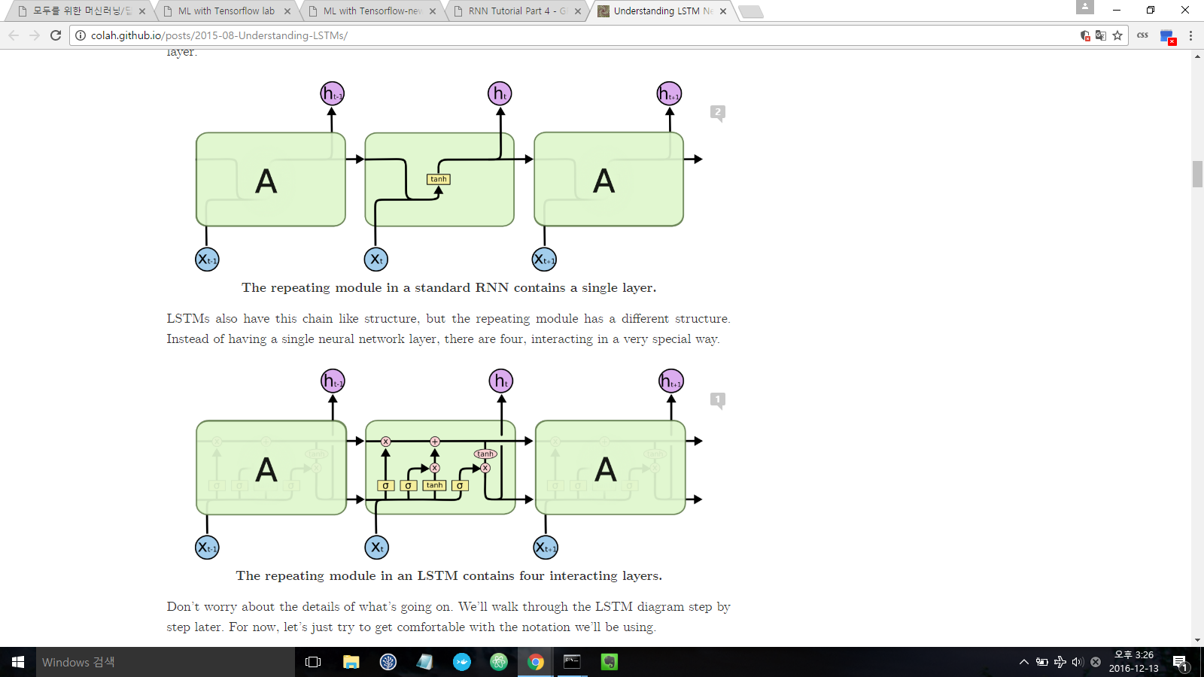
RNN vs LSTM

Slide 8
RNN vs LSTM

Slide 9
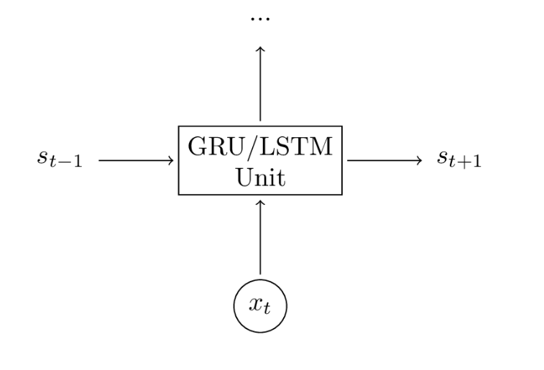
LSTM & GRU Model

Slide 10
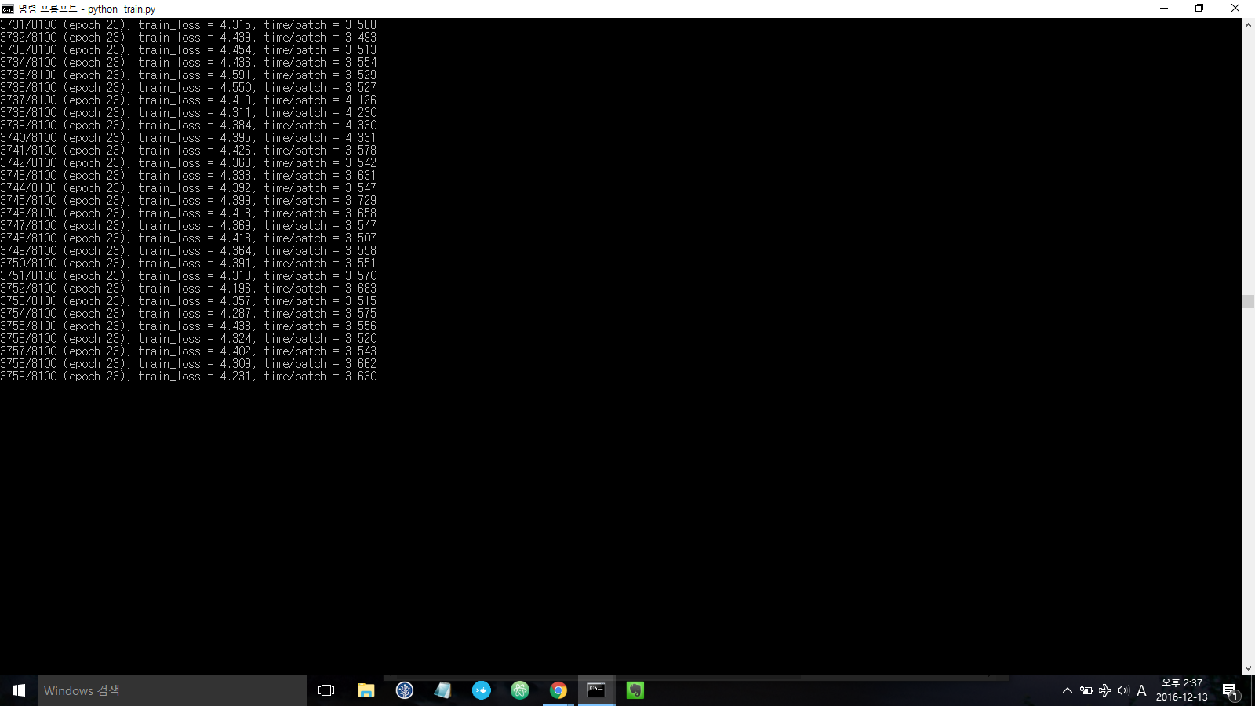

Slide 11
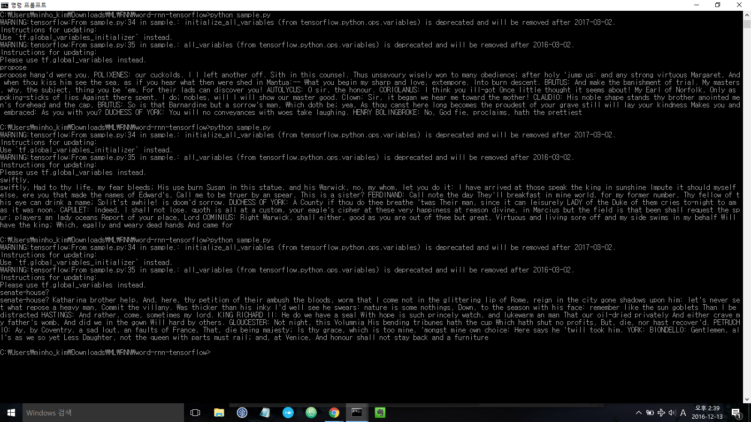
Notes:
breaks
breaks 3 RICHARD KING lords, RICHARD thing, traitor, I let Henry you do Warwick and and twice but shaped and have at thee and That concerns him haven choose More than the Duke of valour. No outrage: old, my boy ago. BAPTISTA: Content me, for all the war, then shall I roundly make it dead? I beseech you Women and wet a shadow of my frost and so too treacherous best; And, answer of our death, Swear past no edges one and left us something e'er he come? PETRUCHIO: O my lord. QUEEN lord,-- KING EDWARD IV: Then see you avoid. CAMILLO: What of Gloucester. cut a fire and the posterns: star it will, I play his model of the king, To grace your dwelling prisoner Rome; or few accusation Than the duke In this garden, The most cools. WARWICK: And we and like it now? Thy MARGARET: Stand, Hold myself, I have falsely saints would have you do pale, HORTENSIO: I beseech you, promise it, him to all that ever war not every times it all of Oxford? be altogether gentlemen, O, say it is on your leave. BAPTISTA: you that that is a behavior, That can Have the patron

Slide 12
REFERENCE
http://colah.github.io/posts/2015-08-Understanding-LSTMs/
https://hunkim.github.io/ml/
http://aikorea.org/blog

