Slide 1
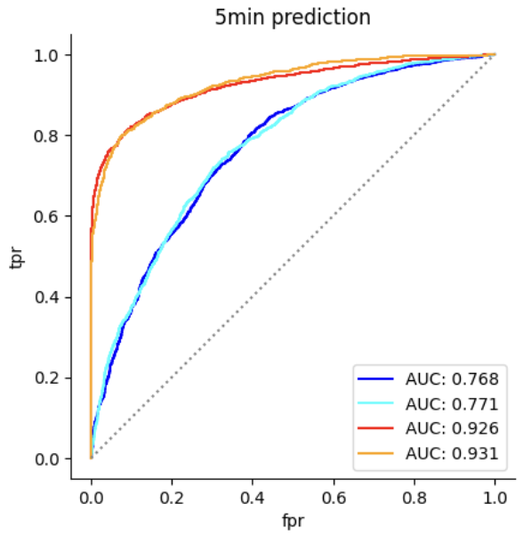
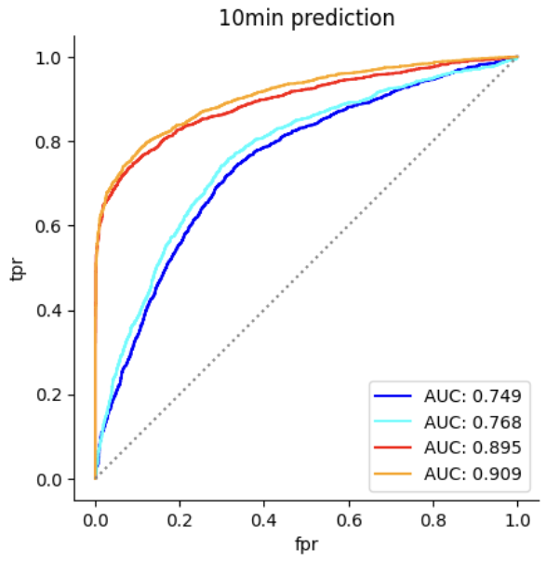
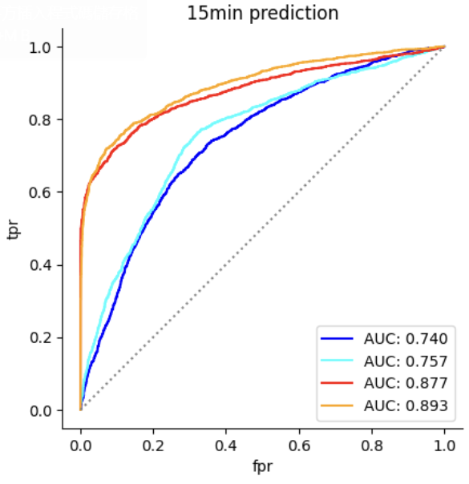
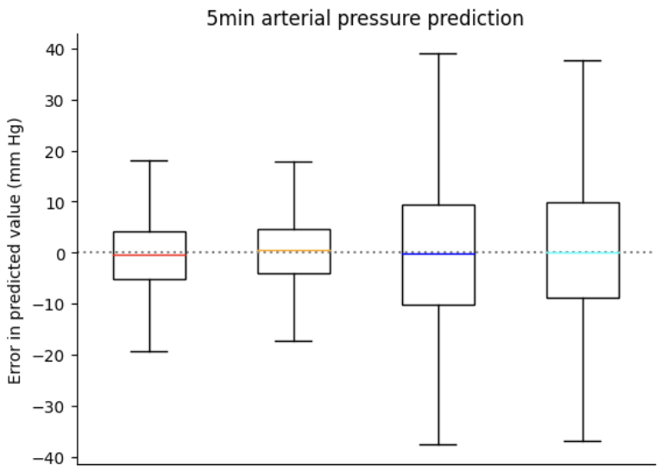
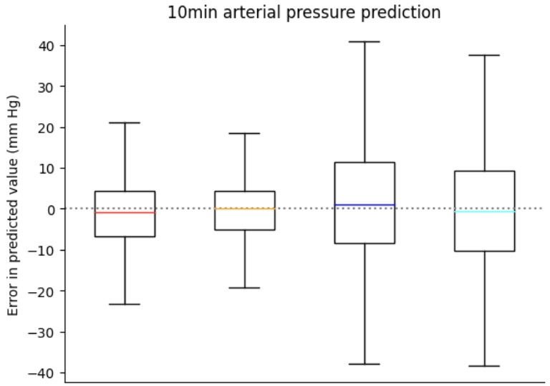
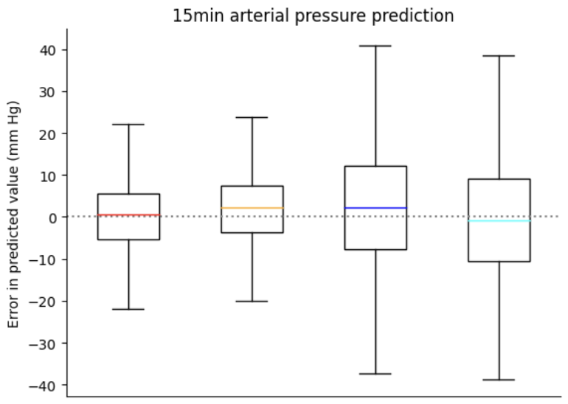
CNN

Slide 2
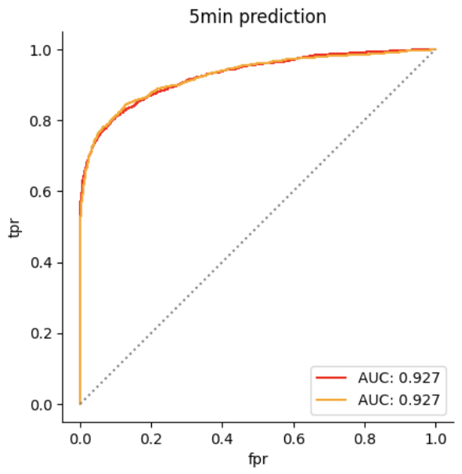
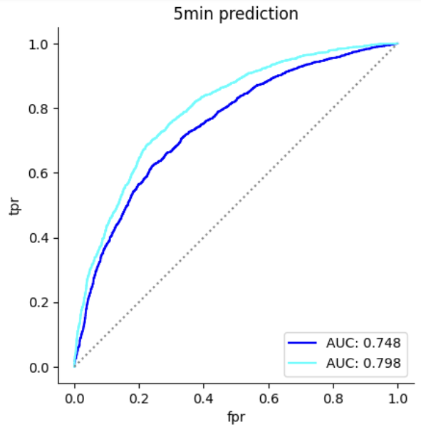
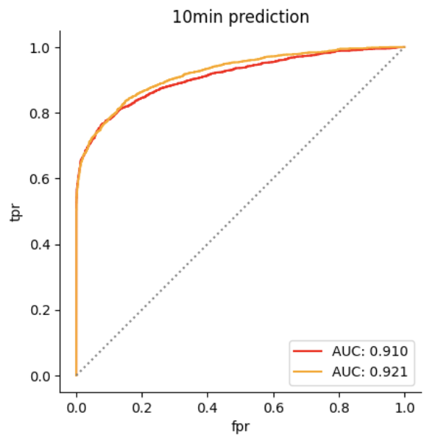
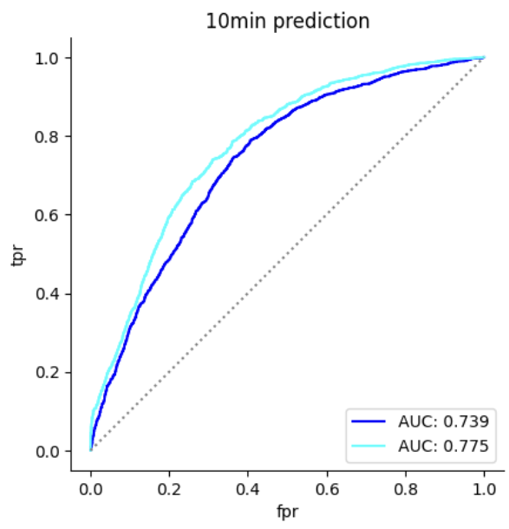
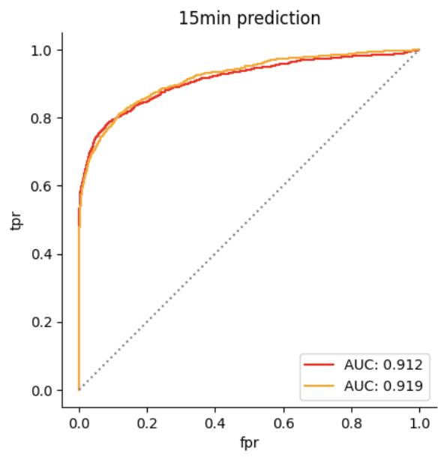
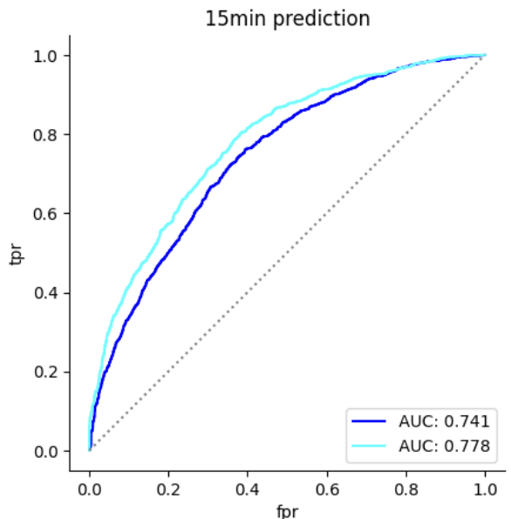
Transformer

Slide 3
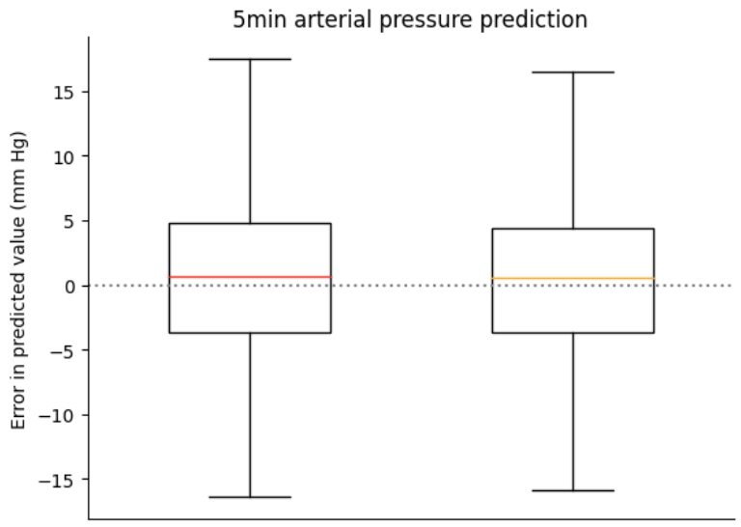
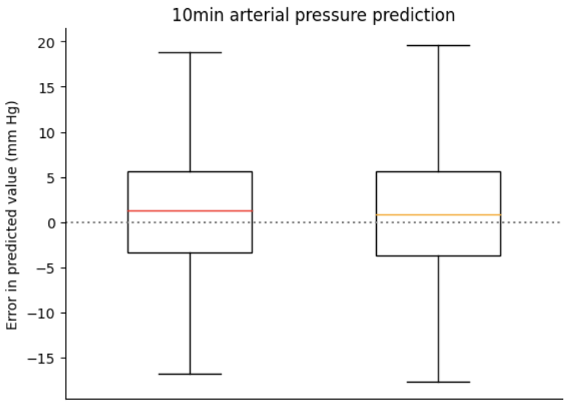
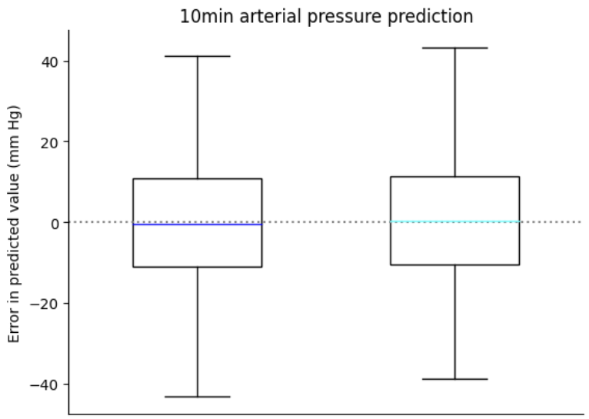
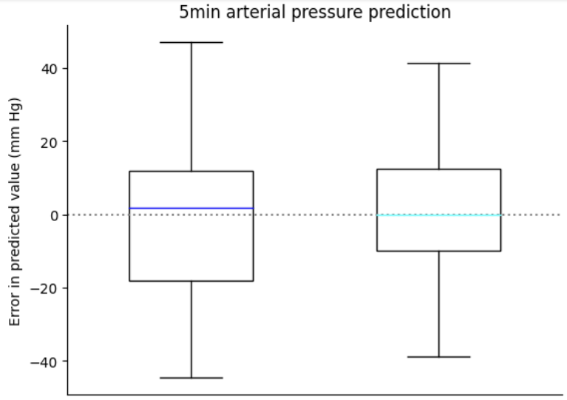
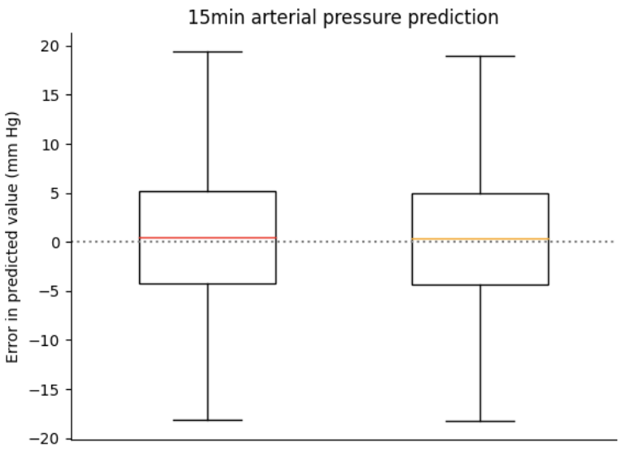
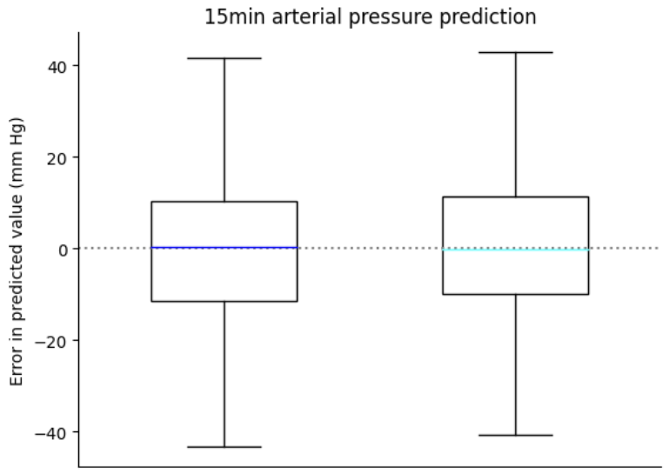
Transformer

Slide 4
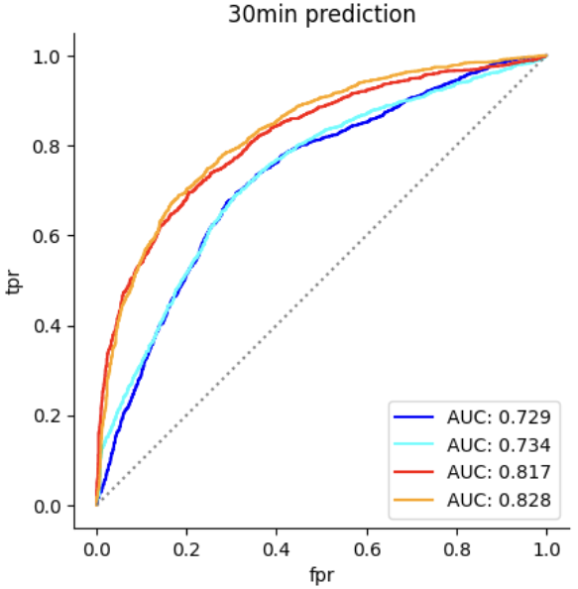
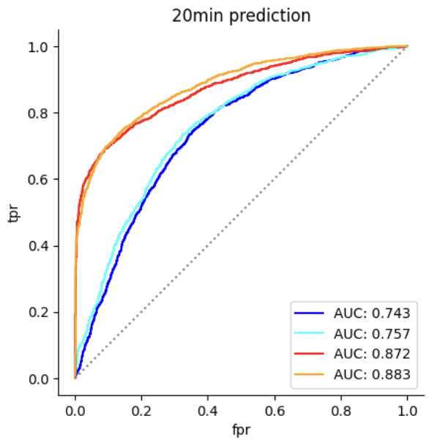
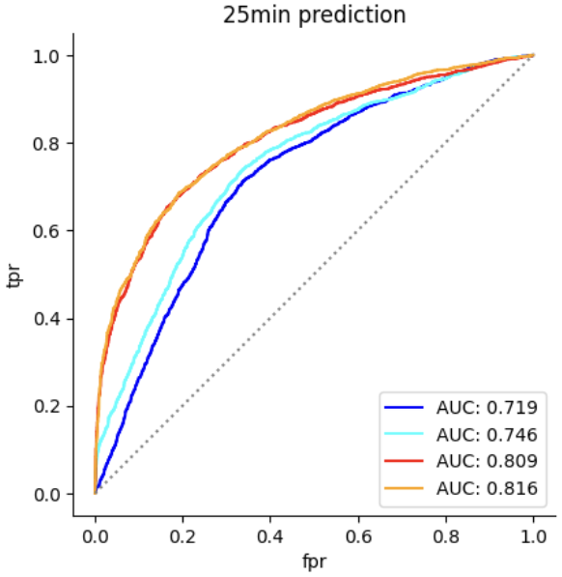
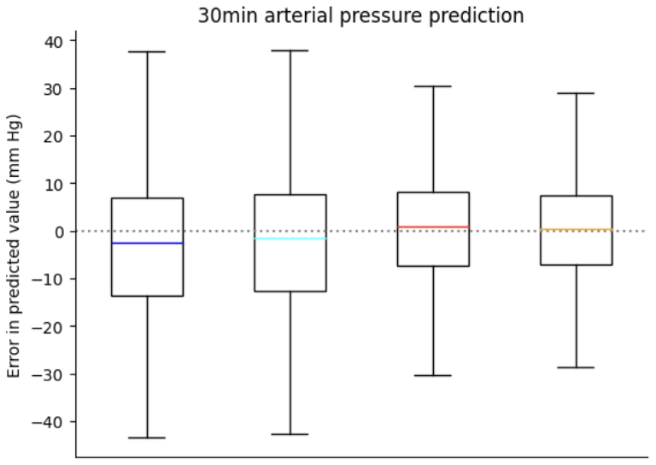
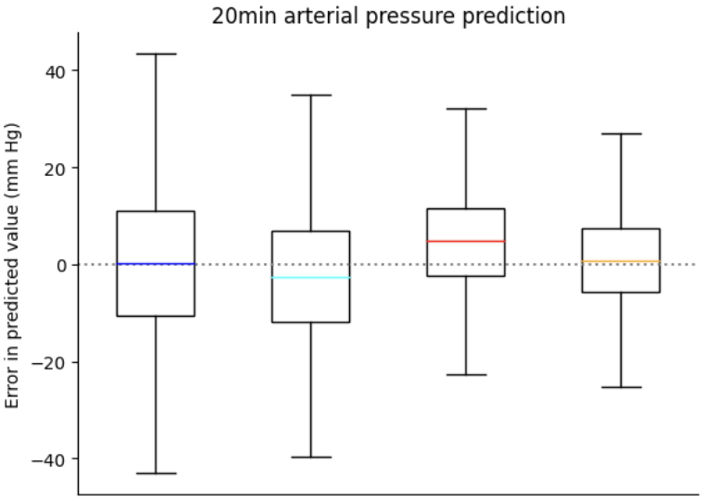
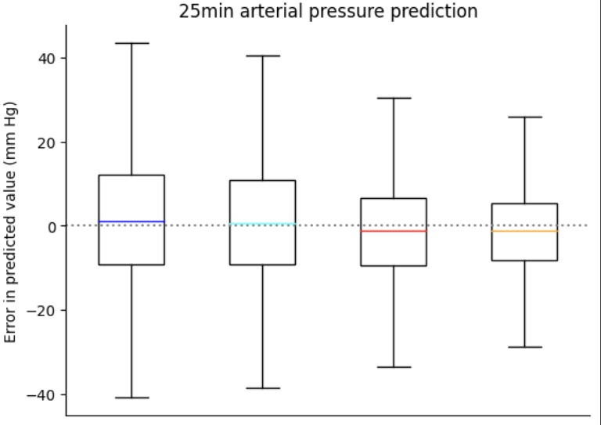
CNN
12.24 11.33 9.69 8.43
12.36 11.6 9.86 9.08
11.86 11.39 9.91 9.21

Slide 5
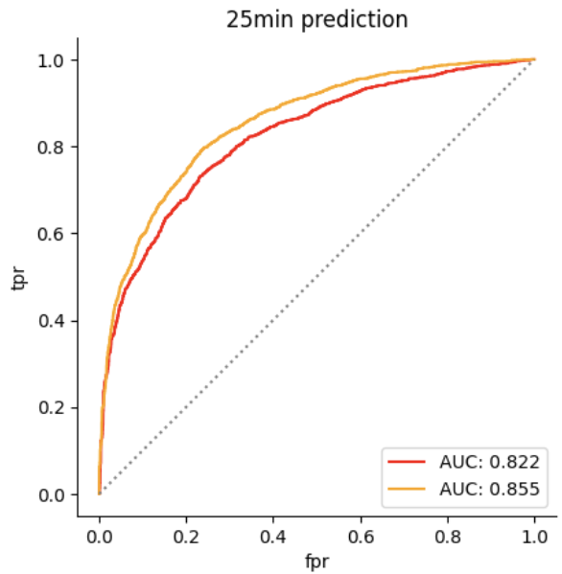
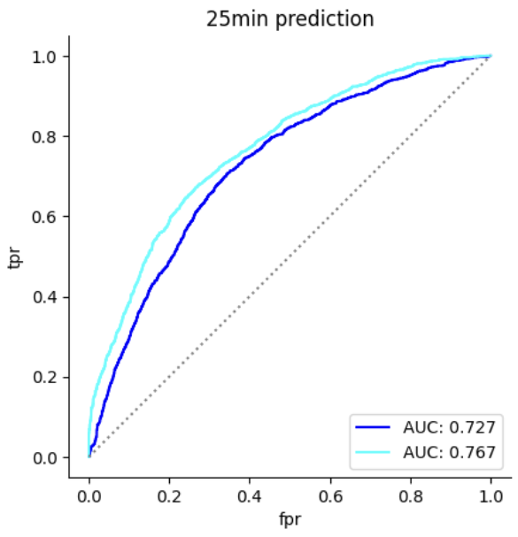
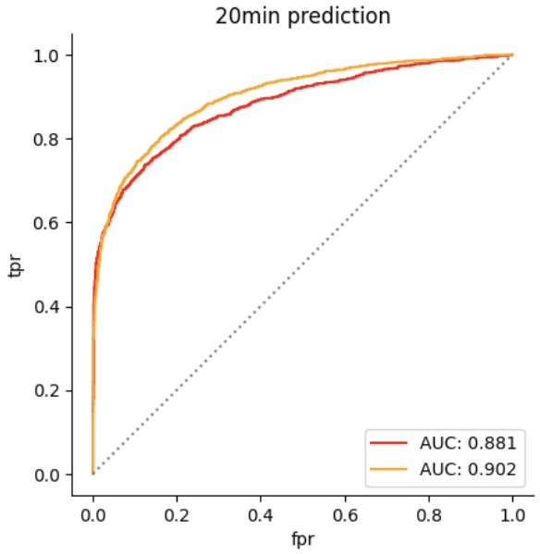
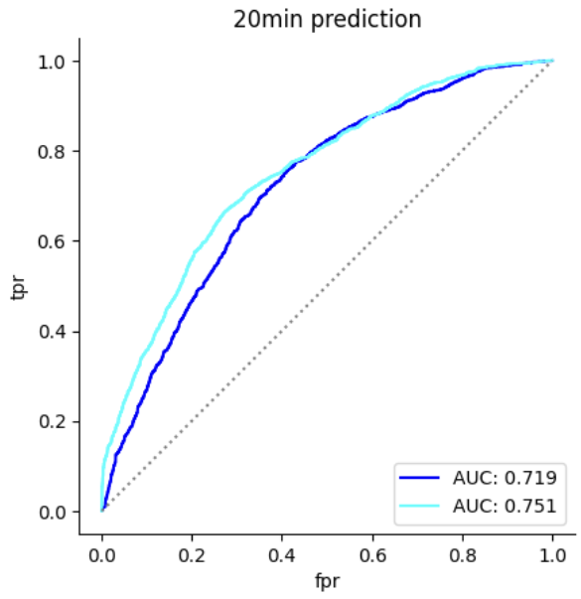
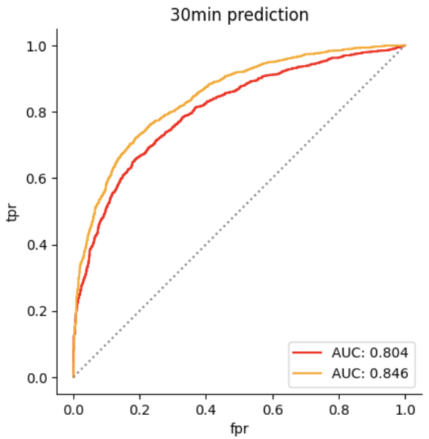
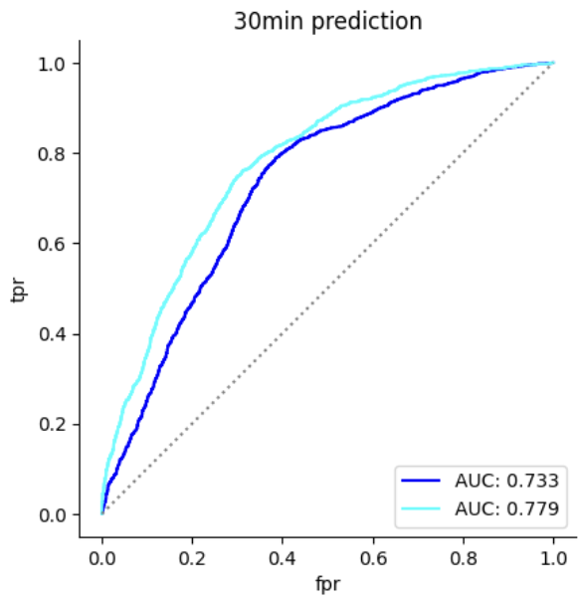
Transformer

Slide 6
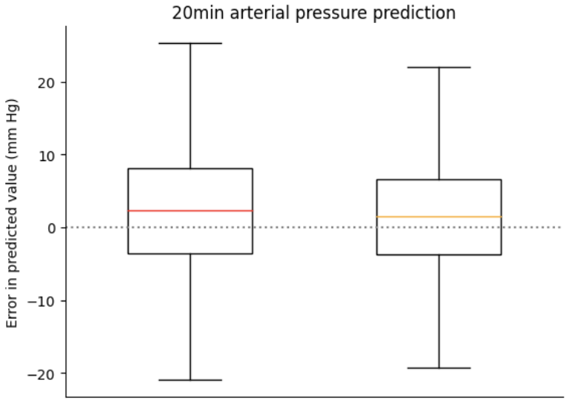
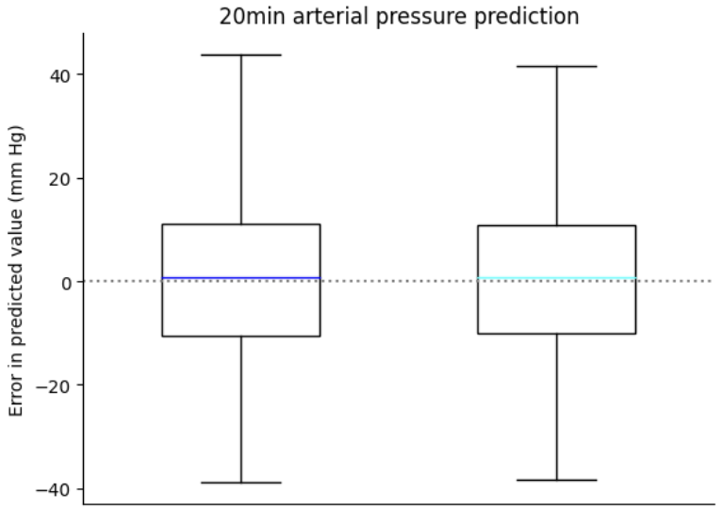
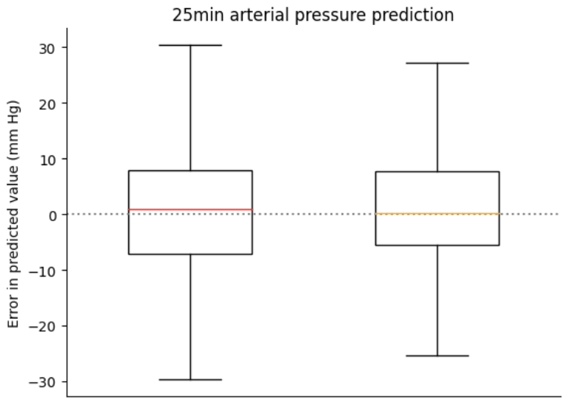
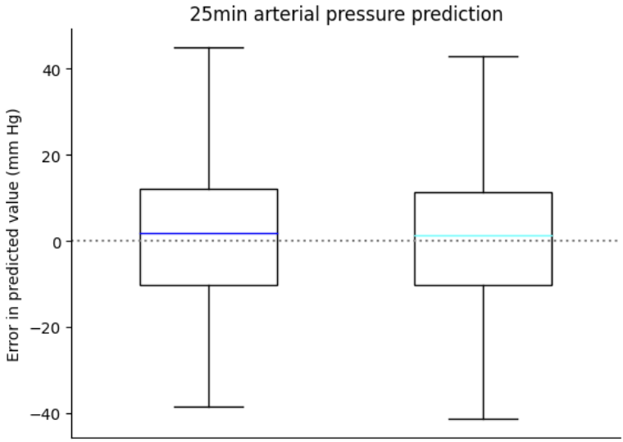
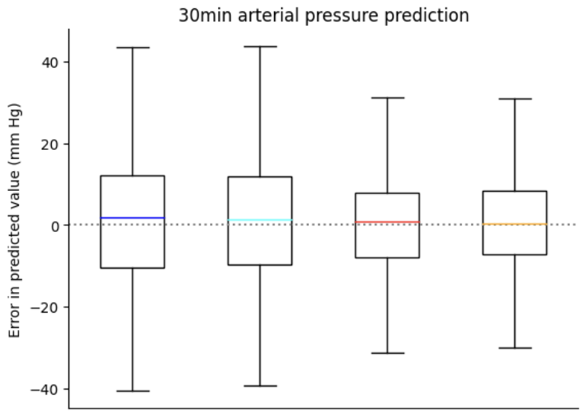
Transformer
8.49 7.76
12.14 11.66
9.44 8.80
12.52 11.89
12.35 11.92 9.96 9.69

Slide 7
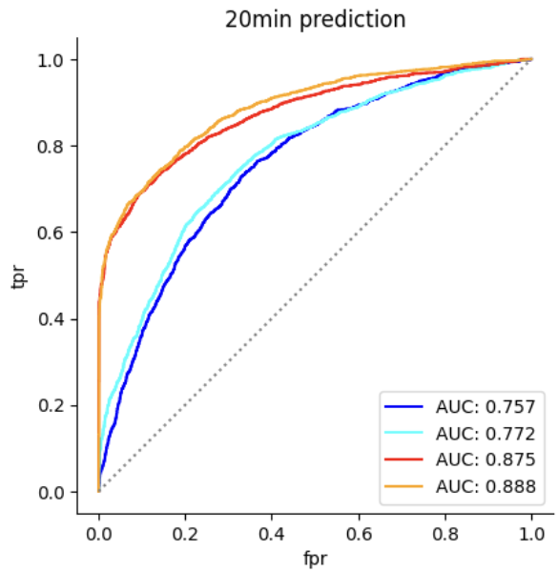
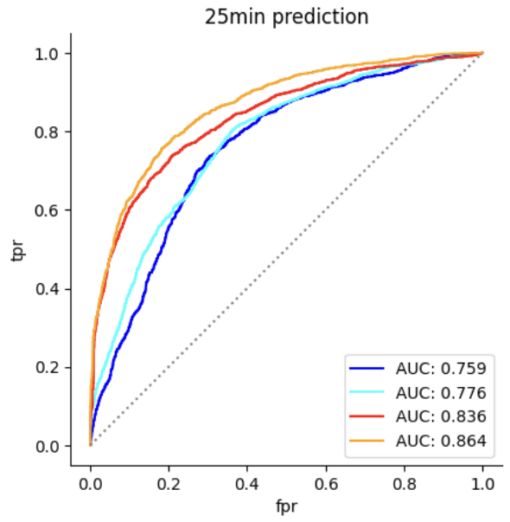
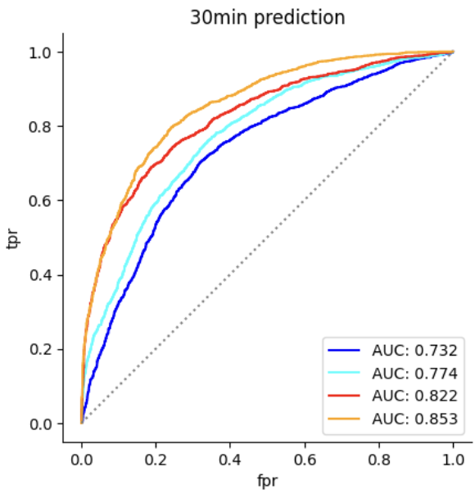
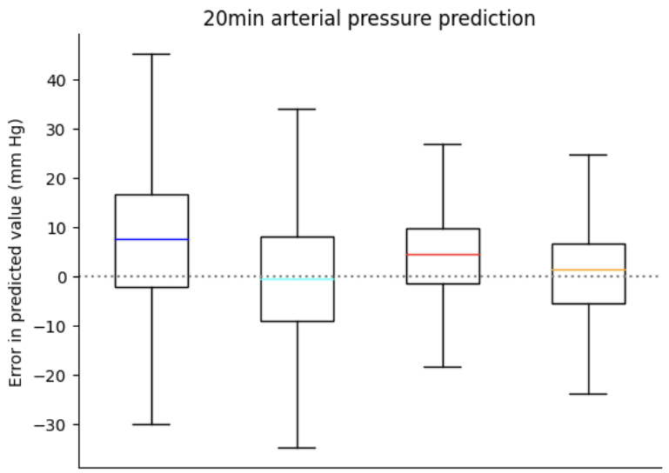
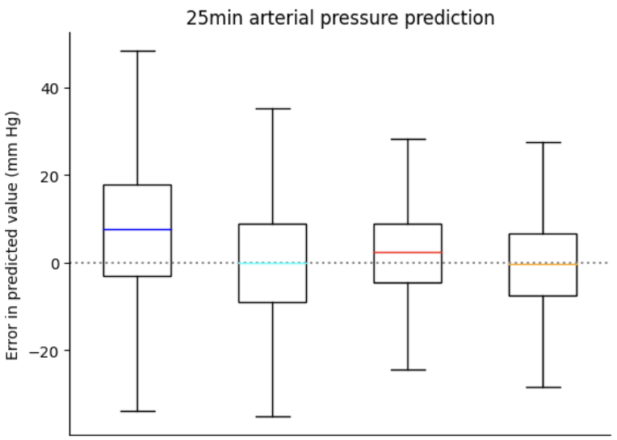
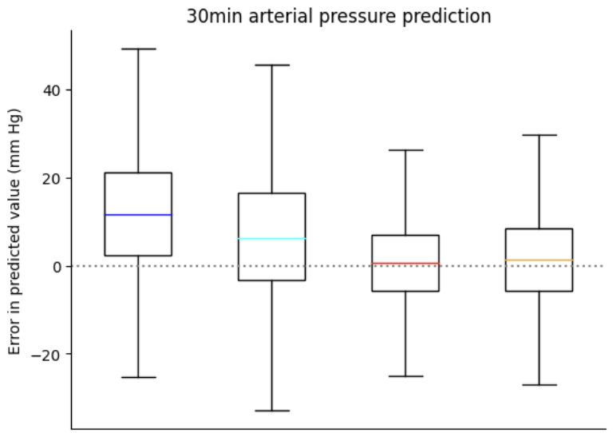
CNN + Transformer
Layer = 1, head = 8
12.94 10.90 8.85 8.13
13.51 11.17 9.26 9.57
15.10 12.23 9.25 9.13

Slide 8
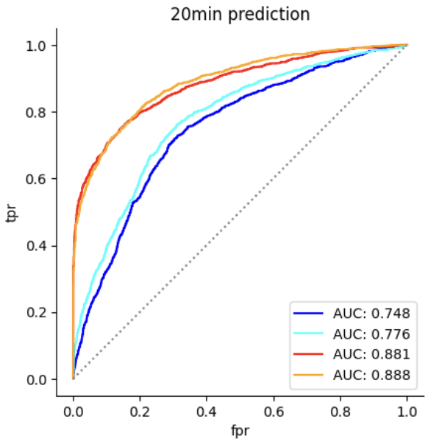
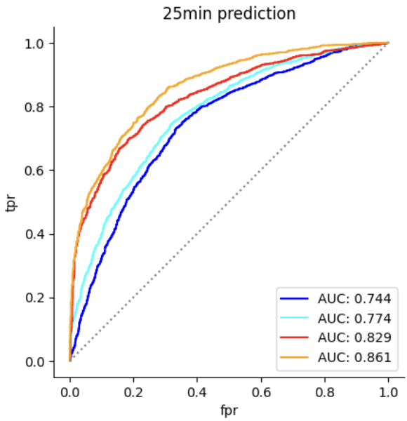
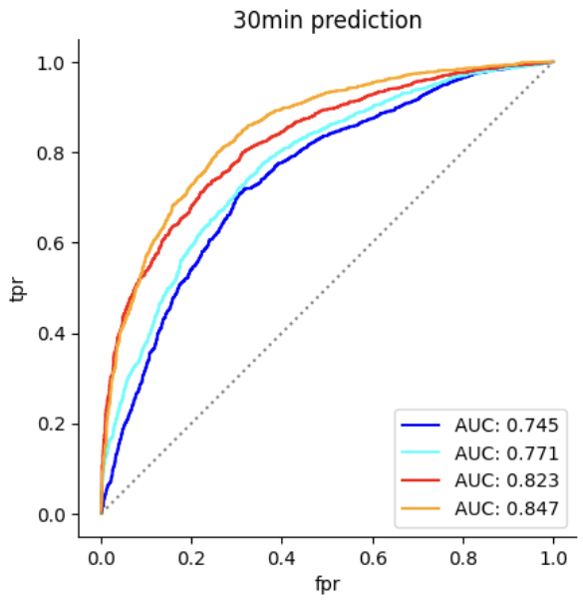
CNN 42
Accuracy: 0.7048611111111112 Sensitivity: 0.37853470437017994 Specificity: 0.8712319790301442 Positive Predictive Value (PPV): 0.59979633401222 Negative Predictive Value (NPV): 0.7333149476006618
Accuracy: 0.7237413194444444 Sensitivity: 0.32519280205655526 Specificity: 0.9269331585845347 Positive Predictive Value (PPV): 0.6941015089163237 Negative Predictive Value (NPV): 0.7293116782675947
Accuracy: 0.8133680555555556 Sensitivity: 0.4640102827763496 Specificity: 0.991480996068152 Positive Predictive Value (PPV): 0.9652406417112299 Negative Predictive Value (NPV): 0.7839378238341969
Accuracy: 0.8157552083333334 Sensitivity: 0.487146529562982 Specificity: 0.9832896461336829 Positive Predictive Value (PPV): 0.9369592088998764 Negative Predictive Value (NPV): 0.7899447222953409
Accuracy: 0.6883680555555556 Sensitivity: 0.7101990049751243 Specificity: 0.6766666666666666 Positive Predictive Value (PPV): 0.540719696969697 Negative Predictive Value (NPV): 0.813301282051282
Accuracy: 0.7092013888888888 Sensitivity: 0.6859452736318408 Specificity: 0.7216666666666667 Positive Predictive Value (PPV): 0.5691434468524251 Negative Predictive Value (NPV): 0.8108614232209738
Accuracy: 0.7760416666666666 Sensitivity: 0.4247512437810945 Specificity: 0.9643333333333334 Positive Predictive Value (PPV): 0.8645569620253165 Negative Predictive Value (NPV): 0.7577265584075432
Accuracy: 0.7801649305555556 Sensitivity: 0.43843283582089554 Specificity: 0.9633333333333334 Positive Predictive Value (PPV): 0.8650306748466258 Negative Predictive Value (NPV): 0.7619298708146586
Accuracy: 0.712890625 Sensitivity: 0.4119537275064267 Specificity: 0.8663171690694627 Positive Predictive Value (PPV): 0.6110581506196378 Negative Predictive Value (NPV): 0.742905310480472
Accuracy: 0.7161458333333334 Sensitivity: 0.6561696658097687 Specificity: 0.7467234600262124 Positive Predictive Value (PPV): 0.5691192865105908 Negative Predictive Value (NPV): 0.8098791755508173
Accuracy: 0.7779947916666666 Sensitivity: 0.4524421593830334 Specificity: 0.9439711664482306 Positive Predictive Value (PPV): 0.8045714285714286 Negative Predictive Value (NPV): 0.7717653361907313
Accuracy: 0.7719184027777778 Sensitivity: 0.4453727506426735 Specificity: 0.9384010484927916 Positive Predictive Value (PPV): 0.7866061293984109 Negative Predictive Value (NPV): 0.7684464716930507

Slide 9
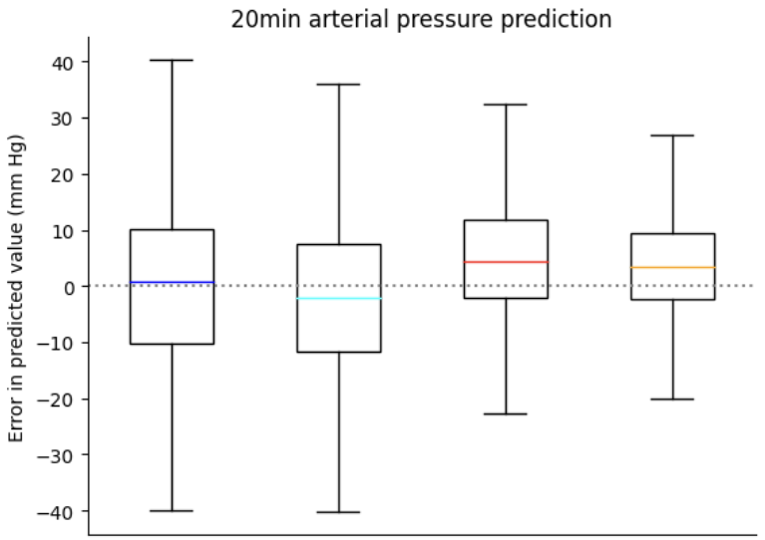
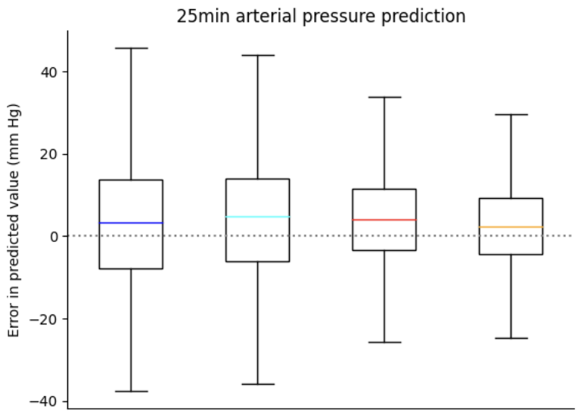
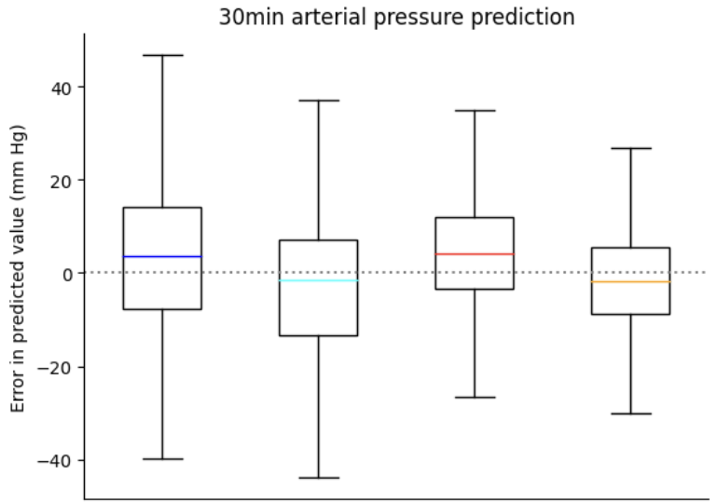
CNN 42
Mean Absolute Error (MAE): 11.82104219607481 Interquartile Mean (IQM): 10.426471756432878
Mean Absolute Error (MAE): 11.462547212273655 Interquartile Mean (IQM): 9.980230512126079
Mean Absolute Error (MAE): 9.864264450569591 Interquartile Mean (IQM): 8.297753604485889
Mean Absolute Error (MAE): 8.574938017462342 Interquartile Mean (IQM): 6.977809947903761
Mean Absolute Error (MAE): 12.434478101504721 Interquartile Mean (IQM): 11.050743277616741
Mean Absolute Error (MAE): 12.00844086799553 Interquartile Mean (IQM): 10.979008814487978
Mean Absolute Error (MAE): 10.253295828394437 Interquartile Mean (IQM): 8.543804847971497
Mean Absolute Error (MAE): 9.205590861753123 Interquartile Mean (IQM): 7.438824524120649
Mean Absolute Error (MAE): 12.650989945699278 Interquartile Mean (IQM): 11.346588404737759
Mean Absolute Error (MAE): 11.851089891021221 Interquartile Mean (IQM): 10.357386021865388
Mean Absolute Error (MAE): 10.56867110947823 Interquartile Mean (IQM): 8.9051708722671
Mean Absolute Error (MAE): 9.340098062312887 Interquartile Mean (IQM): 7.541398447939025

Slide 10
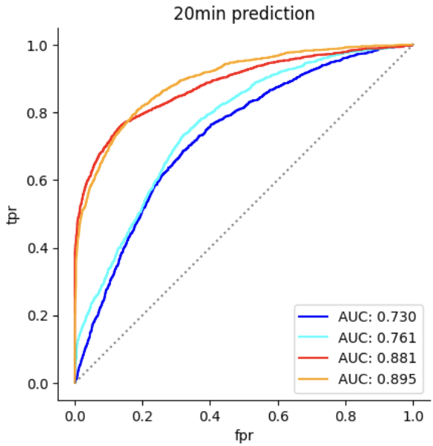
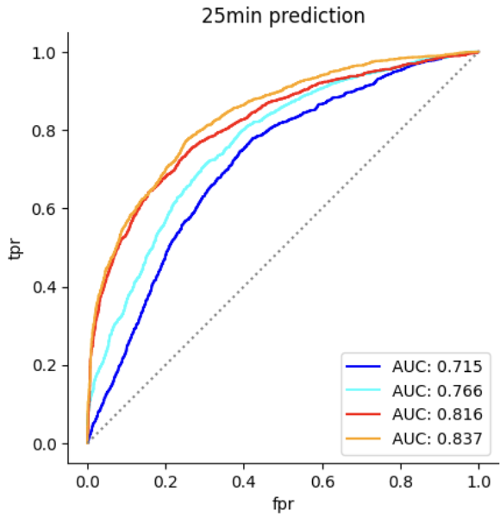
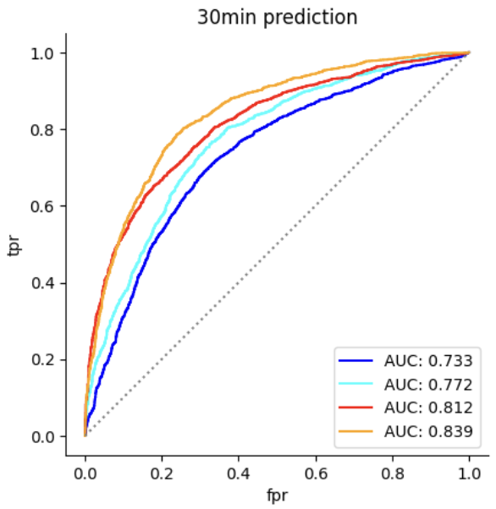
Accuracy: 0.6953125 Sensitivity: 0.6172985781990521 Specificity: 0.738517060367454 Positive Predictive Value (PPV): 0.5666122892876564 Negative Predictive Value (NPV): 0.7770107007248878
Transformer(layer=1, head=8) 42
Accuracy: 0.7022804054054054 Sensitivity: 0.5835308056872038 Specificity: 0.7680446194225722 Positive Predictive Value (PPV): 0.5821513002364066 Negative Predictive Value (NPV): 0.769053876478318
Accuracy: 0.8336148648648649 Sensitivity: 0.7031990521327014 Specificity: 0.9058398950131233 Positive Predictive Value (PPV): 0.805291723202171 Negative Predictive Value (NPV): 0.8464132434089515
Accuracy: 0.8165118243243243 Sensitivity: 0.784952606635071 Specificity: 0.833989501312336 Positive Predictive Value (PPV): 0.7236482796286182 Negative Predictive Value (NPV): 0.8750430292598967
Accuracy: 0.6827713815789473 Sensitivity: 0.472 Specificity: 0.8012202954399487 Positive Predictive Value (PPV): 0.5716262975778547 Negative Predictive Value (NPV): 0.7297455396314712
Accuracy: 0.7142269736842105 Sensitivity: 0.6434285714285715 Specificity: 0.7540141297366731 Positive Predictive Value (PPV): 0.595137420718816 Negative Predictive Value (NPV): 0.7900403768506057
Accuracy: 0.7613075657894737 Sensitivity: 0.6634285714285715 Specificity: 0.8163134232498395 Positive Predictive Value (PPV): 0.6699365262550491 Negative Predictive Value (NPV): 0.8118811881188119
Accuracy: 0.7756990131578947 Sensitivity: 0.5948571428571429 Specificity: 0.8773281952472703 Positive Predictive Value (PPV): 0.7315530569219958 Negative Predictive Value (NPV): 0.7939552455681488
Accuracy: 0.6918402777777778 Sensitivity: 0.2610340479192938 Specificity: 0.9179351422898743 Positive Predictive Value (PPV): 0.6253776435045317 Negative Predictive Value (NPV): 0.7029903699949316
Accuracy: 0.7213541666666666 Sensitivity: 0.4823455233291299 Specificity: 0.8467902051621443 Positive Predictive Value (PPV): 0.6229641693811075 Negative Predictive Value (NPV): 0.7571005917159763
Accuracy: 0.7660590277777778 Sensitivity: 0.6298865069356873 Specificity: 0.8375248180013236 Positive Predictive Value (PPV): 0.6704697986577182 Negative Predictive Value (NPV): 0.8117382937780628
Accuracy: 0.7771267361111112 Sensitivity: 0.7408575031525851 Specificity: 0.7961614824619457 Positive Predictive Value (PPV): 0.6560580681183696 Negative Predictive Value (NPV): 0.8541001064962727

Slide 11



Transformer(layer=1, head=8) 42
Mean Absolute Error (MAE): 13.064388716887677 Interquartile Mean (IQM): 12.02501636658101
Mean Absolute Error (MAE): 11.89536152298604 Interquartile Mean (IQM): 10.769458661605482
Mean Absolute Error (MAE): 8.043185654813389 Interquartile Mean (IQM): 6.025015740023358
Mean Absolute Error (MAE): 8.189792320901693 Interquartile Mean (IQM): 6.451766620738615
Mean Absolute Error (MAE): 12.784349974811882 Interquartile Mean (IQM): 11.991940215530917
Mean Absolute Error (MAE): 11.87812718102396 Interquartile Mean (IQM): 10.646958182009781
Mean Absolute Error (MAE): 9.425530941768086 Interquartile Mean (IQM): 7.8392750758818135
Mean Absolute Error (MAE): 9.510756861283177 Interquartile Mean (IQM): 8.01569762405144
Mean Absolute Error (MAE): 12.507338984437649 Interquartile Mean (IQM): 11.83669060822649
Mean Absolute Error (MAE): 11.546071020990436 Interquartile Mean (IQM): 10.574989177716361
Mean Absolute Error (MAE): 9.762010363111697 Interquartile Mean (IQM): 8.172899551612028
Mean Absolute Error (MAE): 9.797736884926382 Interquartile Mean (IQM): 8.50484260164805

Slide 12















CNN 42 (30epoch)

Slide 13















CNN 43 (30epoch)

Slide 14















CNN 44 (30epoch)

Slide 15















CNN 42 (30epoch)

Slide 16















CNN 43 (30epoch)

Slide 17















CNN 44 (30epoch)

Slide 18















Transformer (no decoder) 42

Slide 19















Transformer (no decoder) 43

Slide 20














Transformer (no decoder) 42

Slide 21















Transformer (no decoder) 43

Slide 22















Transformer (all) 42

Slide 23















Transformer (all) 43

Slide 24















Transformer (all) 44

Slide 25















Transformer (all) 42

Slide 26















Transformer (all) 43

Slide 27















Transformer (all) 44

Slide 28


























Transformer 42

Slide 29
























CNN 42

