Slide 1
2024
Introduction to
Natural Language Processing
HW 1

Slide 2
Task introduction
Product review rating prediction
Rating is from 1 to 5 (5 classes classification task)
Model selection: Only DNN, LSTM, are allowed to be used
Using models other than those listed above will result in 0 points
You can use any visualization tool (e.g. matplotlib, Seaborn), along with data/text processing packages(e.g. pandas, csv, regex, NLTK) to do this assignment
Requirement
Upload your submission to Kaggle
Submit a report and your source code to E3
Deadine is 10/25 (Fri.) 23:59, no late submission
Notes:
In this assignment , you need to predict the product review ratings. The rating is ranged from one to five, which means this is a five classes classification task.
the model selection in this assignment is restricted to DNN, LSTM and BERTs. Using models other than those will result in zero points.
The deadline of this assignment is on 10/25, at 11:59 PM. No late submissions are accepted.
You can use any visualization tool (e.g. matplotlob, Seaborn), along with data processing packages(e.g. pandas, csv) to do this assignment
You can also use transformers package to load pretrained BERT models from huggingface

Slide 3
Dataset Columns
rating - Consumer ratings of this product (the label that you need to predict)
The actual ratings in this dataset are whole numbers without decimal points, and ratings should be outputted directly as integers ranging from 1 to 5
title - title of the review
text - content of the review
verified_purchase - A review is verified_purchase if
Bought the item on this site
Paid a price available to most shoppers.
helpful_vote - the number of people that found this review helpful
Notes:
This is the dataset columns, make sure you know what each column do before processing your training data
Please note that the even though the rating in the dataset shows in float type, actual ratings in this dataset are whole numbers without decimal points, and ratings should be outputted directly as integers ranging from 1 to 5

Slide 4
Dataset Download
Reviews dataset
train.json
link
test.json
link
Notes:
You can download the dataset in this page

Slide 5
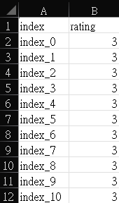
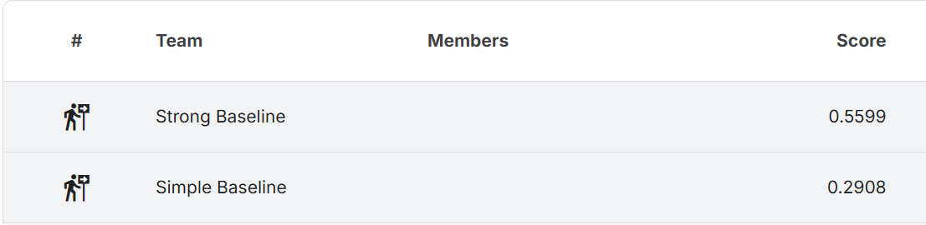
Kaggle Submission
Kaggle link
Display team name : <student ID>
There will be a deduction of 5 points for HW 1 if wrong team name
Submission format
A 35001*2 .csv file
first row is for the column name and others are your predictions.
Column name must be index and rating
Check sample submission
There is one simple baseline and one strong baseline to beat
Notes:
Make sure to enter kaggle competition before you start your assignment. Your team name should be displayed as your student ID, or there will be a deduction of five points for homework two.
your submission format should be a thirty-five thousand and one times 2 csv file. You should include the column name in the first row.
You can check sample submission for example There is one simple baseline and one strong baseline to compete in this assignment, do your best to surpass them.

Slide 6
Kaggle Submission
The scoring metric is macro F1
You can submit at most 5 times each day.
You can choose 3 of the submissions to be considered for the private leaderboard, or will otherwise default to the best public scoring submissions You can only view your private leaderboard score after the competition has ended
Public leaderboard is calculated with 50% of the test data, and private leaderboard is calculated with other 50% of the test data, so the final standings may be different
Please tune your model parameters using your own validation set instead of adjusting parameters based on the public leaderboard. Otherwise, it's easy to overfit, leading to poor performance on the private leaderboard.
Notes:
the submission rule is same as Homework one. Note that the scoring metric in this assignment is F one macro.

Slide 7
Report Submission
Answer the following 3 questions:
How do you select features for your model input, and what preprocessing did you perform to review text?
Please describe how you tokenize your data, calculate the distribution of tokenized sequence length of the dataset and explain how you determine the padding size
Please compare the impact of using different methods to prepare data for different rating categories
Please answer the questions in detail to receive full points for each question.
Notes:
You should answer the following three questions in your report. Please answer them in detail to receive full points for each question.

Slide 8
Grading policy
Kaggle (70%)
30% based on the public leaderboard score and 70% based on the private leaderboard score
Leaderboard score consists of basic score and ranking score
Basic score (55%): Over strong baseline : 55 Over simple bassline : 40 Under simple baseline : 25
Ranking score (15%): 15-(15/N)*(ranking-1), N=numbers of people in the interval
Report (30%)
10 for each quesiton

Slide 9
E3 Submission
Submit your source code and report to E3 before 10/25 (Fri.) 23:59.
No late submission !
Format
source code : HW1_<student ID>.py or HW1_<student ID>.ipynb
report : HW1_<student ID>.pdf
If you have any question about HW 1, please feel free to contact with TA : Min-Kuang, Tsu
through email vctmk.cs13@nycu.edu.tw
Notes:
Remember to submit your source code and your report to E three before deadline.
So thats all for introductions of homework one, if you have any questions, feel free to contact me through email

Slide 10

Have Fun !
Notes:
have fun!

