Slide 1

Audio Synthesis with ChucK

Slide 2
Overview
What is ChucK?
How do we program ChucK?
Make a MIDI synthesizer live.
Resources for further exploration.

Slide 3
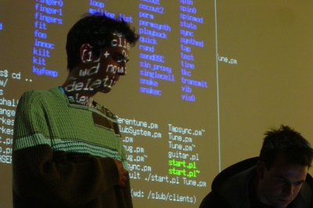
What is ChucK?

Slide 4
Language
Similar syntax to C and Java.
Audio DSL.
Chuck operator: =>
Primitives for dealing with duration, time, and concurrency.
Easy to learn.
Expressive.

Slide 5
Program
Available for Windows, Mac OS X, and Linux.
Works with ALSA, OSS, and Jack.
Easy to build and install on Linux.
  Dependencies: libsndfile, libasound, bison, flex
Runs as a listener and allows dynamic code loading/patching.

Slide 6
Language
“A language that doesn't affect the way you think about programming is not worth knowing.”
- Alan Perlis

Slide 7
Language
Similarities with C:
  Single-line comments start with //, multi-line are surrounded by /* … */.
  Types: int, float, void
  Statements delimited with ; and blocks are surrounded by { }
  Control structures: if/else, while, until, for, break, continue
  Array initialization

Slide 8
Livecoding
Live multimedia performance where the performers screenshare with the audience.
Tools
  ChucK, Supercollider, fluxus, Impromptu (Mac only), Overtone, LuaAV, Pure Data

