Slide 1
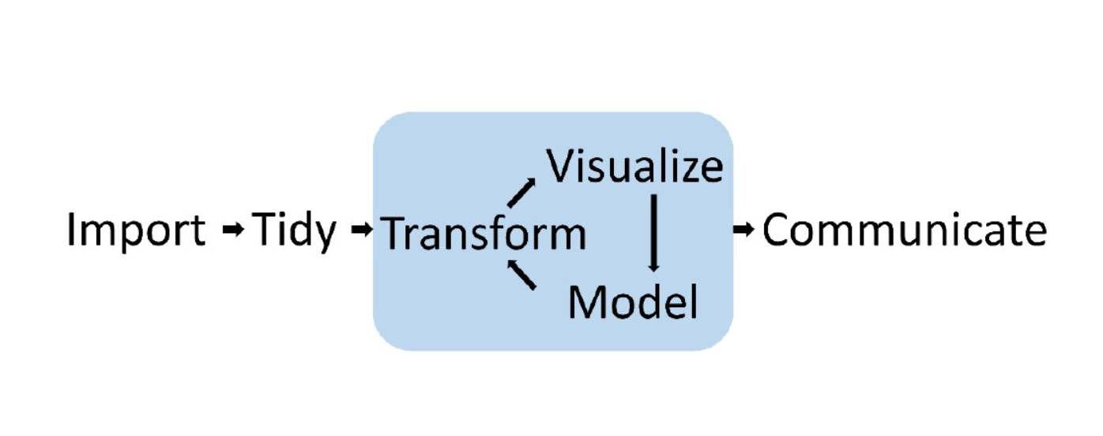
Data Analysis Process Diagrams.
Current: “Hadley Cycle”

Slide 2
Rectangular
Visualize
Transform
Import
Communicate
Model

Slide 3
Circular 1
Visualize
Import
Communicate
Transform
Model

Slide 4
Circular 2
Visualize
Import
Communicate
Transform
Model

Slide 5
Circular 3
Visualize
Import
Communicate
Transform
Model

