Slide 1

Effie

Slide 2


Your adolescence begins today!
A 10th birthday is definitely a milestone. It is a big deal. It’s official crossover into the double digit club. From today, you are not a young kid anymore, you are turning a teenager.
I am so happy for you!

Slide 3
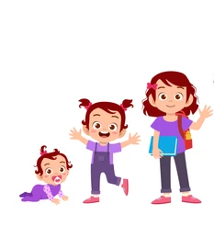

Daddy is so proud of you!
I can't believe how tall, strong and beautiful that you have become.
In the past 9 years, you did very good jobs on growing, learning and playing a very important role in the family.
Everyone loves you!

Slide 4




Wish you good lucks!
Everyone in the family loves you with good wishes!
Daddy wants you to be happy always!
Daddy needs you to be healthy, maybe with more runnings and exercises.
Daddy hopes you will love Math soon! I know you love physics 😄
Daddy likes to see you can master English and French easily, by reading more books for example 😄

Slide 5
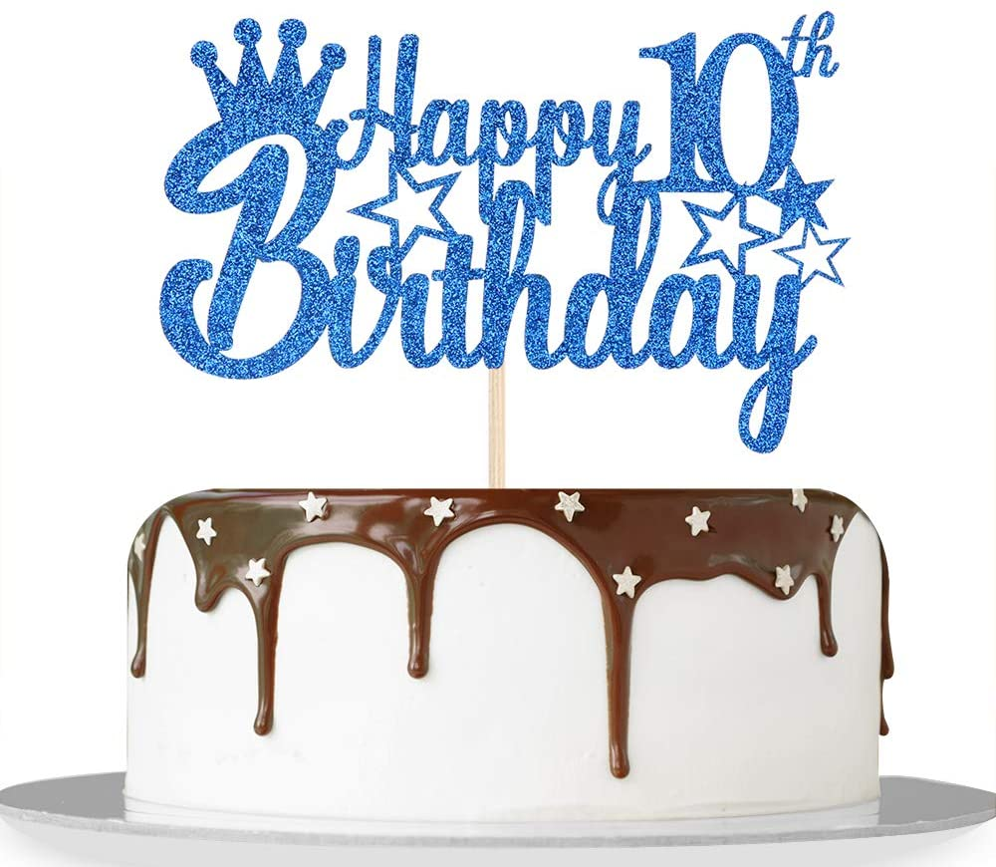
Enjoy the cake, the gift and fun time!
Do you know that it is a new start for every birthday of you?
It is also a good time to review what you have done and achieved in the past year.
Enjoy the cake, your birthday gift, and your fun time!

