Slide 1
PySpark & AWS: Master Big Data With PySpark and AWS
Hands on Big Data course including in demand industry skills
Muhammad Ahmad

Slide 2
BIG DATA

Slide 3
Prerequisites

Slide 4
Website: www.aisciences.io

Slide 5
Applications of Spark

Slide 6
Applications of Spark
Streaming Data

Slide 7
Applications of Spark
Streaming Data
Machine Learning

Slide 8
Applications of Spark
Streaming Data
Machine Learning
Batch Data

Slide 9
Applications of Spark
Streaming Data
Machine Learning
Batch Data
ETL Pipelines

Slide 10
Applications of Spark
Streaming Data
Machine Learning
Batch Data
ETL Pipelines
Full load and Replication on going

Slide 11
What’s Inside?

Slide 12
Methodology

Slide 13
Projects

Slide 14
Student Data Analysis

Slide 15
Employee Data Analysis

Slide 16
Collaborative Filtering

Slide 17
Spark Streaming

Slide 18
ETL Pipeline

Slide 19
Full Load and Replication on Going

Slide 20
Spark

Slide 21
Why Spark?
Speed
Distributed
Advanced Analytics
Real Time
Powerful Caching
Fault Tolerant
Deployment

Slide 22
HADOOP

Slide 23
HADOOP
Map Reduce
SPARK
YARN
HDFS

Slide 24
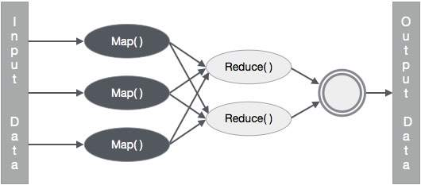

Slide 25
Spark Architecture

Slide 26
Spark Architecture
Workers
Driver Node
Spark Context
Cluster Manager
Workers

Slide 27
Spark Ecosystem

Slide 28
Spark Ecosystem
SPARK SQL
SPARK STREAMING
SPARK MLlib
SPARK GRAPHX
SPARK CORE API
JAVA
SCALA
PYTHON
R

Slide 29
DataBricks

Slide 30
Spark Local Setup

Slide 31
Spark RDDs

Slide 32
Spark RDDs
RDD is the spark’s core abstraction which stands for Resilient Distributed Dataset
RDD is the immutable distributed collection of objects
Internally spark distributes the data in RDD, to different nodes across the cluster to achieve parallelization.

Slide 33
Transformations and Actions

Slide 34
Transformations and Actions
Transformations create a new RDD from an existing one.
Actions return a value to the driver program after running a computation on the RDD
All transformations in Spark are lazy
Spark only triggers the data flow when there’s a action

Slide 35
Creating Spark RDD

Slide 36
Running Code Locally

Slide 37
map()
Map is used as a maper of data from one state to other
It will create a new RDD
rdd.map(lambda x: x.split())

Slide 38
QUIZ

Slide 39
QUIZ
For the quiz you’ll be using this input file
Hi how are you?
Hope you are doing
great
Read this file in the RDD
Write a mapper that will provide the length of each word in the following format
[ [2, 3, 3, 4], [4, 3, 3, 5], [5] ]

Slide 40
QUIZ SOLUTION

Slide 41
flatMap()
Flat Map is used as a maper of data and explodes data before final output
It will create a new RDD
rdd.flatMap(lambda x: x.split())

Slide 42
filter()
Filter is used to remove the elements from the RDD
It will create a new RDD
rdd.filter(lambda x: x != 123)

Slide 43
QUIZ

Slide 44
QUIZ
For the quiz you’ll be using this input file
this mango company animal
cat dog ant mic laptop
chair switch mobile am charger cover
amanda any alarm ant
Read this file in the RDD
Write a filter that will remove all the words that are either starting from a or c from the rdd

Slide 45
QUIZ SOLUTION

Slide 46
distinct()
Distinct is used to get the distinct elements in RDD
It will create a new RDD
rdd.distinct()

Slide 47
groupByKey()
GroupByKey is used to create groups based on Keys in RDD
For groupByKey to work properly the data must be in the format of (k,v), (k,v), (k2,v), (k2,v2)
Example: (“Apple”,1), (“Ball”,1), (“Apple”,1)
It will create a new RDD
rdd.groupByKey()
mapValues(list) are usually used to get the group data

Slide 48
reduceByKey()
ReduceByKey is used to combined data based on Keys in RDD
For reduceByKey to work properly the data must be in the format of (k,v), (k,v), (k2,v), (k2,v2)
Example: (“Apple”,1), (“Ball”,1), (“Apple”,1)
It will create a new RDD
rdd.reduceByKey(lambda x, y: x + y)

Slide 49
QUIZ

Slide 50
QUIZ
For the quiz you’ll be using this input file
this mango company
cat mango ant animal laptop
chair switch mango am charger cover
animalany mango ant laptop laptop
this
Read this file in the RDD
Write a transformation flow that will return the word count of each word present in the file as (key, value) pair

Slide 51
QUIZ SOLUTION

Slide 52
count()
count returns the number of elements in RDD
count is an action
rdd.count()

Slide 53
countByValue()
CountByValue provide how many times each value occur in RDD
countByValue is an action
rdd.countByValue()

Slide 54
saveAsTextFile()
SaveAsTextFile is used to save the RDD in the file
saveAsTextFile is an action
rdd.saveAsTextFile(‘path/to/file/filename.txt’)

Slide 55
RDDs Functions

Slide 56
repartition()
Repartition is used to change the number of partitions in RDD
It will create a new RDD
rdd.repartition(number_of_partitions)

Slide 57
coalesce()
Coalesce is used to decrease the number of partitions in RDD
It will create a new RDD
rdd.coalesce(number_of_partitions)
coalesce is only used to decrease the number of partition

Slide 58
Finding Average

Slide 59
QUIZ

Slide 60
QUIZ
For the quiz you’ll be using this input file
JAN,NY,3.0
JAN,PA,1.0
JAN,NJ,2.0
JAN,CT,4.0
FEB,PA,1.0
Read this file in the RDD
Write a code to calculate the average score in each month

Slide 61
QUIZ SOLUTION

Slide 62
Finding Min and Max

Slide 63
QUIZ

Slide 64
QUIZ
For the quiz you’ll be using this input file
JAN,NY,3.0
JAN,PA,1.0
JAN,NJ,2.0
JAN,CT,4.0
FEB,PA,1.0
Read this file in the RDD
Write a code to calculate the Minimum and Maximum rating given by each city.

Slide 65
QUIZ SOLUTION

Slide 66
Mini Project

Slide 67
Mini Project
For the project you’ll be using this input file StudentData.csv that has following columns
age,gender,name,course,roll,marks,email
Read this file in the RDD

Slide 68
Mini Project

Slide 69
Mini Project
Perform the following analytics on the data
Show the number of students in the file.
Show the total marks achieved by Female and Male students
Show the total number of students that have passed and failed. 50+ marks are required to pass the course.
Show the total number of students enrolled per course
Show the total marks that students have achieved per course
Show the average marks that students have achieved per course
Show the minimum and maximum marks achieved per course
Show the average age of male and female students

Slide 70
Spark DataFrames

Slide 71
DataFrame
DataFrame is a wrapper on the RDD
A DataFrame is a Dataset organized into named columns
It is conceptually equivalent to a table in a relational database or a data frame in R/Python
DataFrames can be constructed from a wide array of sources such as
Structured data files
Unstructured data files
External databases
Existing RDDs

Slide 72
Creating Dataframe

Slide 73
Schema of Dataframe

Slide 74
Providing Schema of Dataframe

Slide 75
Creating DataFrame from RDD

Slide 76
Select DataFrame Columns

Slide 77
withColumn in DataFrame

Slide 78
withColumnRenamed in DataFrame

Slide 79
filter/where in DataFrame

Slide 80
QUIZ

Slide 81
QUIZ
For the quiz you’ll be using StudentData.csv
Read this file in the DF
Create a new column in the DF for total marks and let the total marks be 120
Create a new column average to calculate the average marks of the student.
(marks / total marks) * 100
Filter out all those students who have achieved more than 80% marks in OOP course and save it in a new DF.
Filter out all those students who have achieved more than 60% marks in Cloud course and save it in a new DF.
Print the names and marks of all the students from the above DFs

Slide 82
QUIZ SOLUTION

Slide 83
Count, Distinct, DropDuplicates
in DataFrame

Slide 84
QUIZ

Slide 85
QUIZ
For the quiz you’ll be using StudentData.csv
Read this file in the DF
Write a code to display all the unique rows for age, gender and course column.

Slide 86
QUIZ SOLUTION

Slide 87
sort/orderBy in DataFrame

Slide 88
QUIZ

Slide 89
QUIZ
For the quiz you’ll be using OfficeData.csv
Read this file in the DF
Create a DF, sorted on bonus in ascending order and show it.
Create a DF, sorted on age and salary in descending and ascending order respectively and show it.
Create a DF sorted on age, bonus and salary in descending, descending and ascending order respectively and show it

Slide 90
QUIZ SOLUTION

Slide 91
groupBy in DataFrame

Slide 92
QUIZ

Slide 93
QUIZ
For the quiz you’ll be using StudentData.csv
Read this file in the DF
Display the total numbers of students enrolled in each course
Display the total number of male and female students enrolled in each course
Display the total marks achieved by each gender in each course
Display the minimum, maximum and average marks achieved in each course by each age group.

Slide 94
QUIZ SOLUTION

Slide 95
QUIZ

Slide 96
QUIZ
For the quiz you’ll be using WordData.txt
Read this file in the DF
Calculate and show the count of each word present in the file

Slide 97
QUIZ SOLUTION

Slide 98
UDFs in DataFrame

Slide 99
QUIZ

Slide 100
QUIZ
For the quiz you’ll be using OfficeData.csv
Read this file in the DF
Create a new column increment and provide the increment to the employees on the following criteria
If the employee is in NY state, his increment would be 10% of salary plus 5% of bonus
If the employee is in CA state, his increment would be 12% of salary plus 3% of bonus

Slide 101
QUIZ SOLUTION

Slide 102
Cache and Persist

Slide 103
Cache and Persist
TRANSFORMATION 1
TRANSFORMATION 2
ACTION 1
ACTION 2
TRANSFORMATION 1
TRANSFORMATION 2
CACHE()
ACTION 1
ACTION 2

Slide 104
DF to RDD

Slide 105
Spark SQL

Slide 106
Writing DataFrame

Slide 107
Mini Project

Slide 108
Mini Project
For the project we’ll be using OfficeDataProject.csv
Read data from the file in the DF and perform following analytics on it.
Print the total number of employees in the company
Print the total number of departments in the company
Print the department names of the company
Print the total number of employees in each department
Print the total number of employees in each state
Print the total number of employees in each state in each department
Print the minimum and maximum salaries in each department and sort salaries in ascending order
Print the names of employees working in NY state under Finance department whose bonuses are greater than the average bonuses of employees in NY state
Raise the salaries $500 of all employees whose age is greater than 45
Create DF of all those employees whose age is greater than 45 and save them in a file

Slide 109
Collaborative filtering

Slide 110
Utility Matrix

Slide 111
Utility Matrix
 | Movie 1 | Movie 2 | Movie 3 | Movie 4
User 1 | 1 | 5 | 4 | N/A
User 2 | N/A | 3 | N/A | 4
User 3 | 2 | N/A | N/A | 4
User 4 | 4 | 4 | 2 | 5

Slide 112
Explicit and Implicit Ratings

Slide 113
Expected Results

Slide 114
Expected Results
UserId | MovieId | Rating
1 | 1 | 4.8
1 | 22 | 5
2 | 12 | 4
2 | 11 | 3.9

Slide 115
Hands On

Slide 116
Dataset Overview

Slide 117
Joining DFs

Slide 118
Create Train and Test Data

Slide 119
ALS model

Slide 120
Hyperparameter tuning and cross validation

Slide 121
Best model and evaluate predictions

Slide 122
Recommendations

Slide 123
Spark Streaming

Slide 124
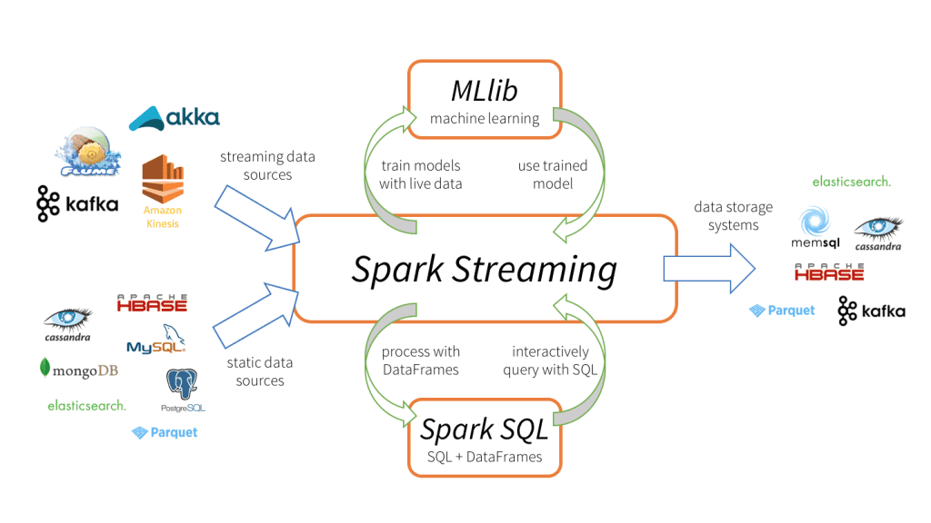

Slide 125
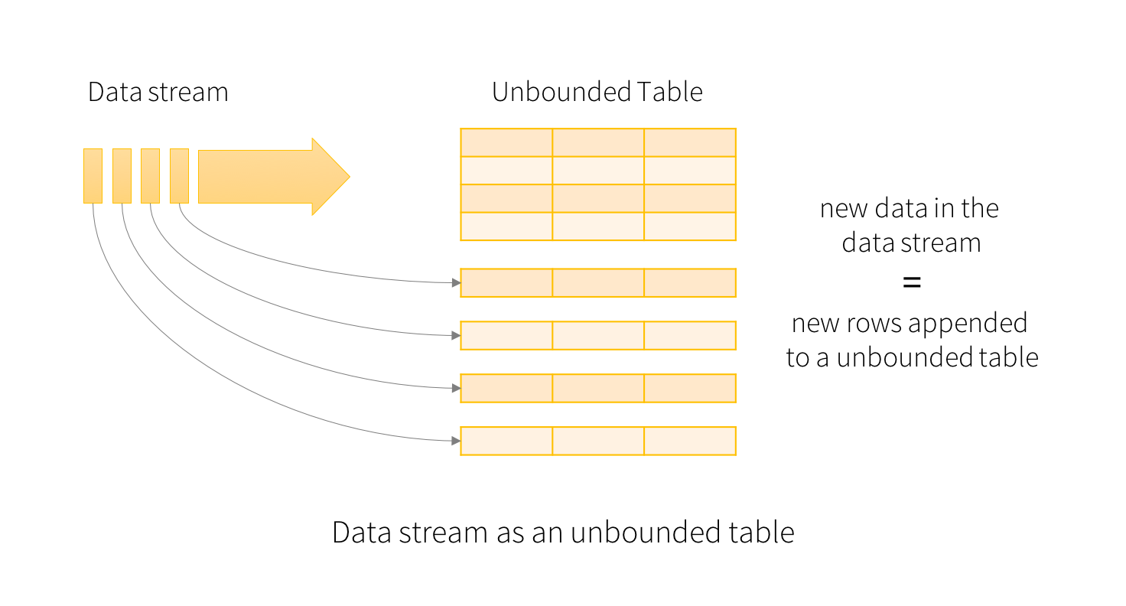

Slide 126
Spark Streaming With RDD

Slide 127
Spark Streaming With DF

Slide 128
ETL Pipeline

Slide 129

csv
Data Extraction
csv
txt
txt
ETL
jdbc
jdbc
…..
Data Load
…..

Slide 130
CSV in DBFS
PySpark on
DataBricks NoteBook
Postgres
Database in AWS RDS
EXT
LD
Transformation

Slide 131
Data Set

Slide 132
Extract

Slide 133
Transform

Slide 134
Installing Postgresql

Slide 135
Load

Slide 136
Project

Slide 137
CDC - Change Data Capture / Replication On Going

Slide 138
Project Architecture

Slide 139
Project Architecture
DMS
RDS -> MySql
Source Endpoint
Destination EndPoint
Temp
HDFS / S3
Lambda
Trigger
Invoke
READ
FINAL
HDFS / S3
READ
WRITE
Glue -> PySpark

