Slide 1

Hotel Demand and Cancellation Forecast
Brian Lui
Notes:
Welcome to my capstone project:
Hotel Demand and Cancellation Forecast

Slide 2


The Hotel Industry
Hotels have daily limited perishable inventory
Unsold rooms = Lost Revenue
Overselling rooms:
Pay for a comparable hotel
Transportation costs
Damage to reputation and loyalty
Notes:
Have you ever wondered how managing a hotel works?
You might think they just need to sell as many rooms as possible every day..
But What if they sell too many or what if they don’t sell them all?
That's the challenge hotels face
Consider this… <click>
A hotel has limited perishable inventory.
Unlike in other industries such as retail, inventory cannot be carried over the next day to be sold.
Any rooms that are left unsold is lost revenue
Why would they oversell more than they have?
Have you ever booked a hotel, but at some point your plans changed?
<click>
Hotels need to account for that, so they sometimes sell more rooms than they have left.
If they are just reactive to a cancellation, they risk having unsold rooms left.
<click>
But...what if they end the day oversold?
Those oversold guests gets refunded, walked to another hotel, (depending on the hotel’s policy):
They have to pay for a “comparable” hotel room, transportation costs, and risk damaging their reputation
If a hotel can accurately predict the final number of guests for each day, it allows them to maximize revenue and help operations teams properly staff their hotel.
This is part of Revenue Management

Slide 3


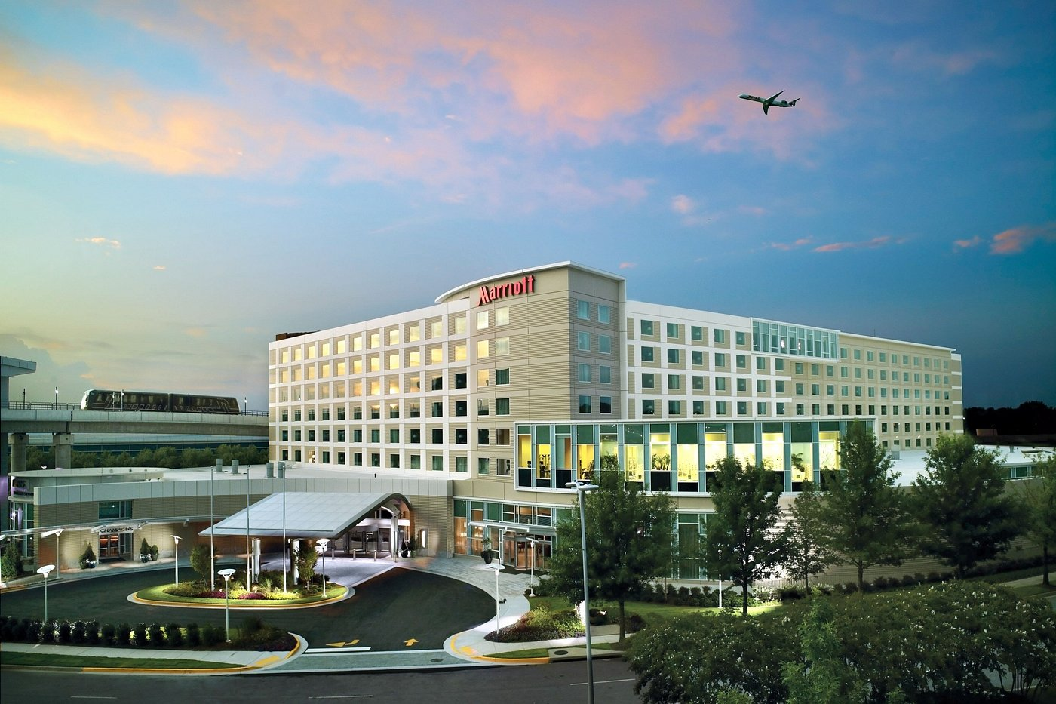
How Machine Learning Can Help
Metrics of Success:
Maximize Revenue Per Available Room (RevPAR)
Reaching a ”perfect sell”
Predicting demand and cancellations to optimize pricing strategies
Notes:
<CLICK>
A revenue managers metrics of success consist of 2 things:
Maximizing the total Revenue for each Room (RevPAR).
Reaching a “perfect sell”.
This means not finishing the day with any rooms unsold.
<CLICK>
The two biggest contributors, room demand and room cancellations.
So that's how machine learning can help
We can utilize ML models to predict demand and cancellation based on patterns from historical data.
Predicting if a reservation would cancel or not, is a binary classification problem that can be solved with simple logistic regression or random forest models.
Another Machine Learning approach we can use is leveraging time series forecasts for demand

Slide 4
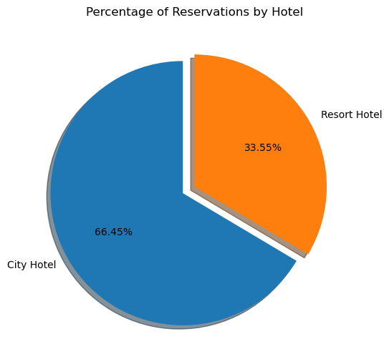
The Dataset
Important Columns:
is_canceled
Arrival_date (year, month, day of month)
Market_segment
Lead_time
Customer_type
Notes:
In my dataset there are 2 hotels, a City and Resort hotel in Portugal
The City hotel has over 79,000 reservations
The Resort hotel has 40,060 reservations
<CLICK>
After my initial look at the dataset, some important columns surfaced, but my main focus was on:
Is canceled
Arrival date (year, month, day of month)

Slide 5
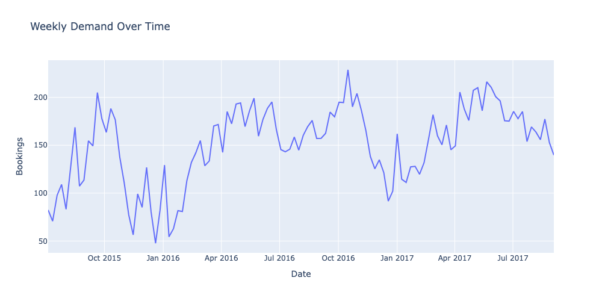
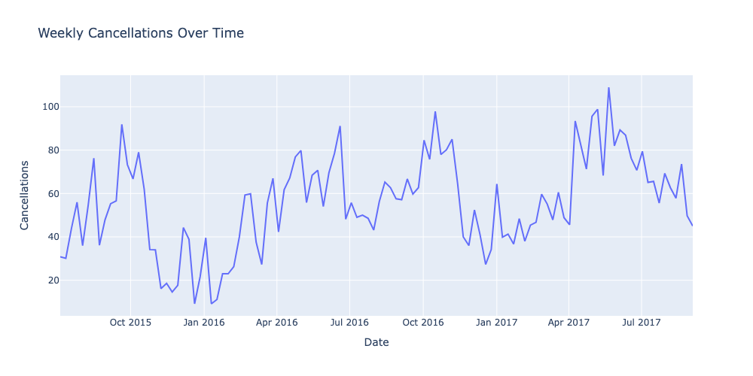
Initial EDA: Cancellation and Demand over Time
Seasonality seen between Demand and Cancellations
Peaks in October
Valleys in January
Increases in April
Notes:
My initial EDA led me to look at:
Weekly Demand(bookings) over time
Weekly Cancellations over time
I could see that seasonality was visible for both Demand and Cancellations
<CLICK> Peaks in October
<CLICK> Valleys in January
<CLICK> Goes back up in April
Only 2 years of data, but this looks like a trend

Slide 6
Model Comparisons
Logistic Regression model outperformed Random Forest models in all metrics
Low Precision:
Walking the guest + guest dissatisfaction
Low Recall:
More unsold rooms
Hotel A: Next closest hotel is far away
Prioritize Precision to prevent walking guests
Hotel B: Centrally located in a big city
Prioritize Recall to maximize selling all rooms
Metric | Logistic Regression | Random Forest
Train Score | 95.50% | 88.90%
Test Score | 95.42% | 88.30%
Train AUC | 99.30% | 95.40%
Test AUC | 99.20% | 94.70%
f1-score: | 93% | 84%
Precision | 100% | 88%
Recall | 87% | 79%
Notes:
The two classification models I’ve run on this dataset were Logistic Regression and Random Forest
<CLICK> The Logistic Regression model outperformed Random Forest in all metrics (see the green)
<CLICK> There are a lot of metrics here, and they’re all important like the Test score and AUC Scores, but I want to focus on a metric that is more important to the business.
<CLICK> That's the f1-score
<CLICK>
F1 score is the balance between Precision and Recall and the two generally have a see-saw relationship
To help understand this, lets look at the Logistic Regression model numbers
With Precision: Out of all the reservations the model said were going to cancel, 100% of them actually cancelled (Note this value was rounded).
With Recall: Out of all the cancelled reservations, the model was able to correctly identify 87% of them.
So, which is more important, Precision or Recall?
<CLICK> What happens with Lower Precision:
If we incorrectly predict a reservation will cancel, we may end up selling that room again in anticipation of that first guest not showing up.
This leads to costs of walking the guest + guest dissatisfaction.
<CLICK> And with Low Recall:
If we miss predicting that a reservation would cancel, we'll have unsold rooms, which will be lost revenue.
Consider this example: There is a hotel that is always selling out and hovers around the ~100% occupancy:
<CLICK> If the hotel knows that the next closest property is 30 miles away or maybe they're a resort in the Maldives and the closest property is on another island...
They may want to prioritize higher precision (correctly predicting a reservation will cancel), so that they don’t end up overselling their hotel
<CLICK> However, if the hotel in the heart of NYC and there are hundreds of properties near by, they may favor higher recall (making sure they catch all cancellations correctly)
They may be willing to risk overselling to maximize revenue and ensure they sell all of their rooms.

Slide 7

Next Steps
Explore baseline models 100% precision
Further Modeling
XGBoost
Time Series Forecasting with Demand
Hyperparameter Tuning
Notes:
For for my next steps:
Explore why my baseline models are getting near 100% precision, this seems a bit suspicious
<CLICK>
Conduct further modeling like XGBoost and explore Time Series Forecasting with Demand
<CLICK>
And I want to continue to optimize hyperparameters for all models before making a final decision on a model

Slide 8

Thank You

Slide 9
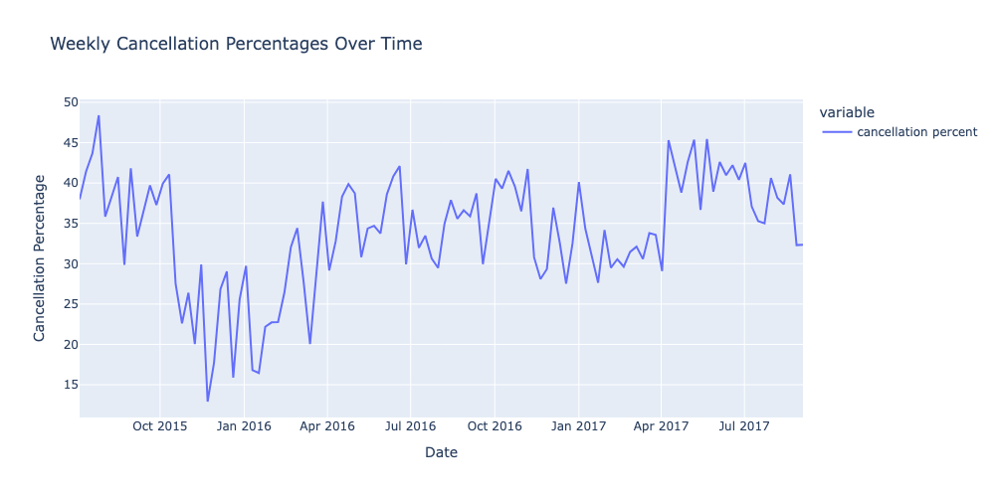
Cancellation Percentages
High cancellation % overall
Between 30-40% throughout the dataset
Identified large cancelled group bookings during EDA
Notes:
Looking at cancellation percentages:
It reaches almost 50%
And stays between 30-40% throughout the dataset
This looked high to me
In my EDA
Some reservations in the dataset were large group bookings that all cancelled
Because of this, I wondered if I should isolate purely transient bookings to see if results will vary

Slide 10
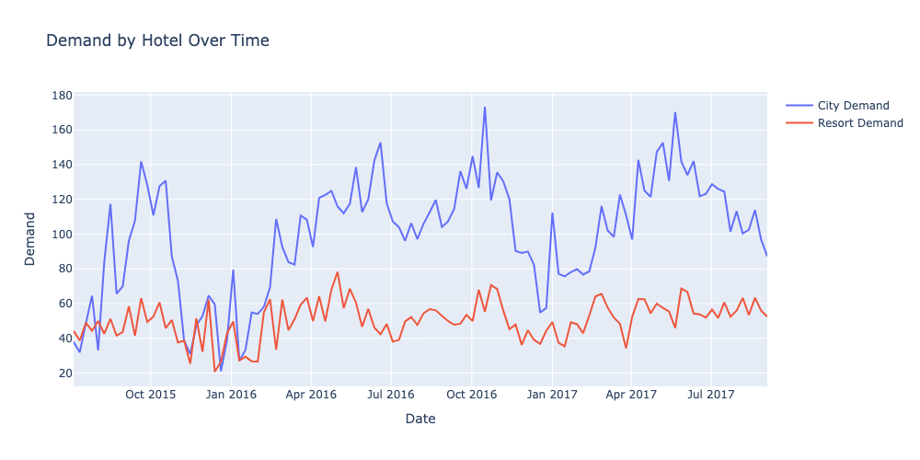
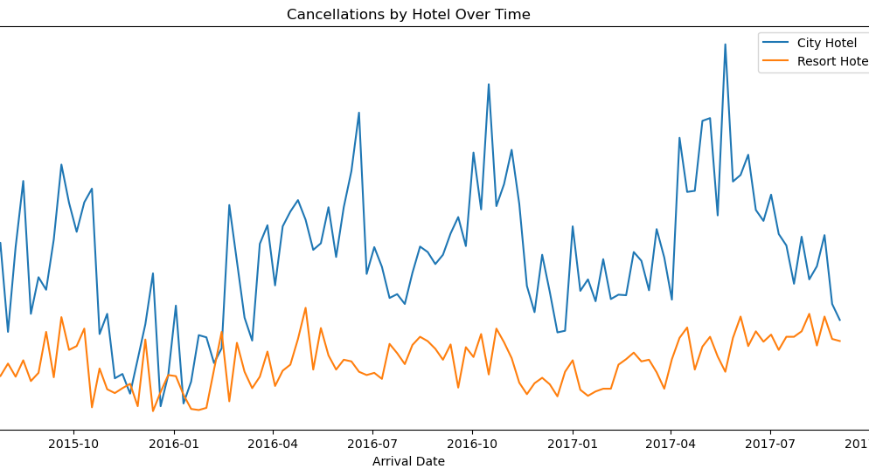
Demand and Cancellation by Hotel Type
City Hotel:
Higher demand and cancellations
Larger peaks and valleys
Likely influences the overall datasets trends
Cancellation Trends:
City hotels have corporate travelers
Last minute cancellations and bookings
Resort hotels have mainly leisure guests
Notes:
When I dove deeper to look at Demand and Cancellation by Hotel Type, I noticed:
<CLICK>
The City Hotel (Blue Lines)
has higher demand and cancellations compared to the Resort Hotel
has larger peaks and valleys compared resort hotel
The peaks and valleys we saw before, are most likely influenced by the city hotel
<CLICK>
The cancellation trends are reasonable because:
City hotels have tend to have higher corporate travelers
Last minute changes to bookings based on needs are frequent, so increased cancellations are expected
This holds true for demand as well, last minute needs to travel generates spikes in demand
Resort hotels target mainly leisure guests
When you’re traveling for vacation, you plan months or even years ahead.
It will take a lot more for you to cancel your travel plans compared to for a business trip

Slide 11
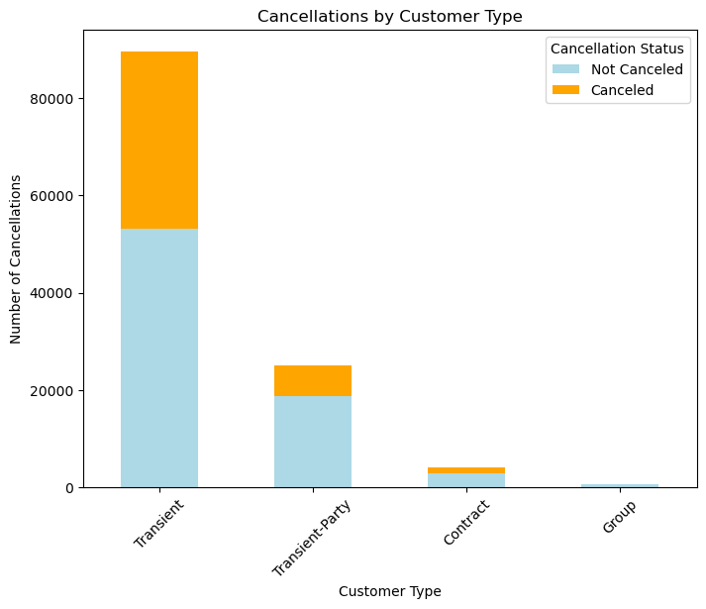
Customer Type
Combined Transient and Transient-Party customer types
Removed Group and Contract rows
Group and Contract patterns are very different than Transient
Notes:
<CLICK>
During Feature Engineering I combined the two Transient customer types because the only difference was if these customers booked together as a party
<CLICK>
Also, since there were very few group and contract in the dataset,
I removed those two customer types.
And my experience in my past roles using revenue management systems, Group and Contract forecasts are very different and much harder to predict compared to transient demand.
Therefore, I decided to focus only on transient customer types for simplicity and clarity.

Slide 12
Model Comparisons
Logistic Regression model outperformed Random Forest models in all metrics
Low Precision:
Walking the guest + guest dissatisfaction
Low Recall:
More unsold rooms
Hotel A: Next closest hotel is far away
Prioritize Precision to not walk
Hotel B: Centrally located in a big city
Prioritize Recall to maximize selling out
Metric | Logistic Regression | Random Forest
Train Score | 95.50% | 88.90%
Test Score | 95.42% | 88.30%
Train AUC | 99.30% | 95.40%
Test AUC | 99.20% | 94.70%
f1-score: | 93% | 84%
Precision | 100% | 88%
Recall | 87% | 79%
Notes:
The two classification models I’ve run on this dataset were Logistic Regression and Random Forest
<CLICK> The Logistic Regression model outperformed Random Forest in all metrics
<CLICK> Let's look at Test and AUC scores first
Test Scores are the model’s accuracy in making predictions
While the AUC score measures the model’s performance, the ability to differentiate between classes, ie: reservations being cancelled or not
With ML models, different parameter configurations may produce different accuracies.
Therefore, the AUC score provides an overall model score.
You can kind of look at this as the parameter “agnostic” score, with some exceptions.
<CLICK>
Another important metric to look at is the f1-score
<CLICK>
F1 score is the balance between Precision and Recall and the two generally have a see-saw relationship
To help understand this, lets look at the Logistic Regression model numbers
With Precision: Out of all the reservations the model said were going to cancel, 100% of them actually cancelled (Note this value was rounded).
With Recall: Out of all the cancelled reservations, the model was able to correctly identify 87% of them.
So, which is more important, Precision or Recall?
<CLICK> What happens with Lower Precision:
If we incorrectly predict a reservation will cancel, we may end up selling that room again in anticipation of that first guest not showing up.
This leads to costs of walking the guest + guest dissatisfaction.
<CLICK> And with Low Recall:
If we miss predicting that a reservation would cancel, we'll have unsold rooms, which will be lost revenue.
Consider this example: There is a hotel that is always selling out and hovers around the ~100% occupancy:
<CLICK> If the hotel knows that the next closest property is 30 miles away or maybe they're a resort in the Maldives and the closets property is on another island...
They may want to prioritize higher precision (correctly predicting a reservation will cancel), so that they don’t end up overselling their hotel
<CLICK> However, if the hotel in the heart of NYC and there are hundreds of properties near by, they may favor higher recall (making sure they catch all cancellations correctly)
They may be willing to risk overselling to maximize revenue and ensure they sell all of their rooms.

Slide 13
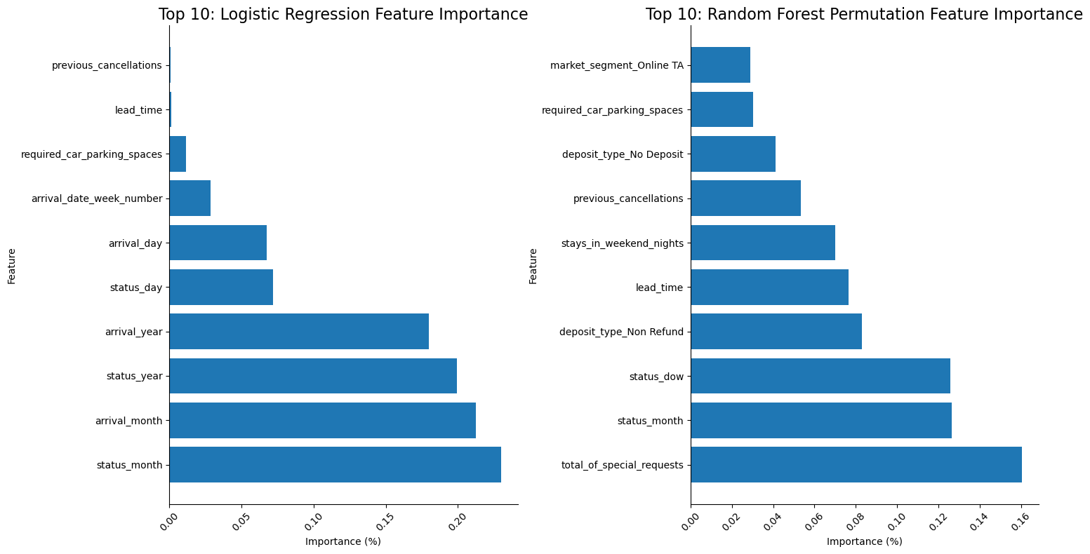
Important Features
Notes:
Compare top most important features that are most influential in predicting the target variable ‘is_canceled’
Logistic Regression
top 3 most important features:
status_month
arrival_month
Status_year
Top 3 with most negative importance:
Random Forest:
top 3 more important features:
total_of_special_requests
status_month
Status_dow
Top 3 with most negative importance
With the Random Forest model, with the highest feature `total_of_special_requests` just over 16% the sum of the first 5 importances is just over 57%, whereas the Logistic Regression model has a highest feature being 22% and the sum of the first 5 importances is over 89%. This means that the logistic regression model indicates that there are fewer features that have a heavier influence in predicting the target variable compared to the random forest model's feature importances are more spread out between more features.

