Slide 1

Hotel Cancellation Forecast
Brian Lui
Notes:
Welcome to my capstone project:
Hotel Cancellation Forecast

Slide 2


The Hotel Industry
Hotels have daily limited perishable inventory
Unsold rooms = Lost Revenue
Overselling rooms:
Pay for a comparable hotel
Transportation costs
Damage to reputation and loyalty
Notes:
Have you ever wondered how managing a hotel works?
You might think they just need to sell as many rooms as possible every day..
But What if they sell too many or what if they don’t sell them all?
Consider this… <click>
A hotel has limited perishable inventory.
Unlike in other industries such as retail, inventory cannot be carried over the next day
Any rooms that are left unsold is lost revenue
So why would they oversell more than they have?
Well, have you ever booked a hotel, but at some point your plans changed?
<click>
Hotels need to account for that, so they sometimes sell more rooms than they have left.
If they are just reactive to a cancellation, they risk having unsold rooms left.
<click>
But...what if they end the day oversold?
Guests get refunded and depending on the hotel’s policy:
They have to pay for a “comparable” hotel room,
transportation costs,
and risk damaging their reputation

Slide 3


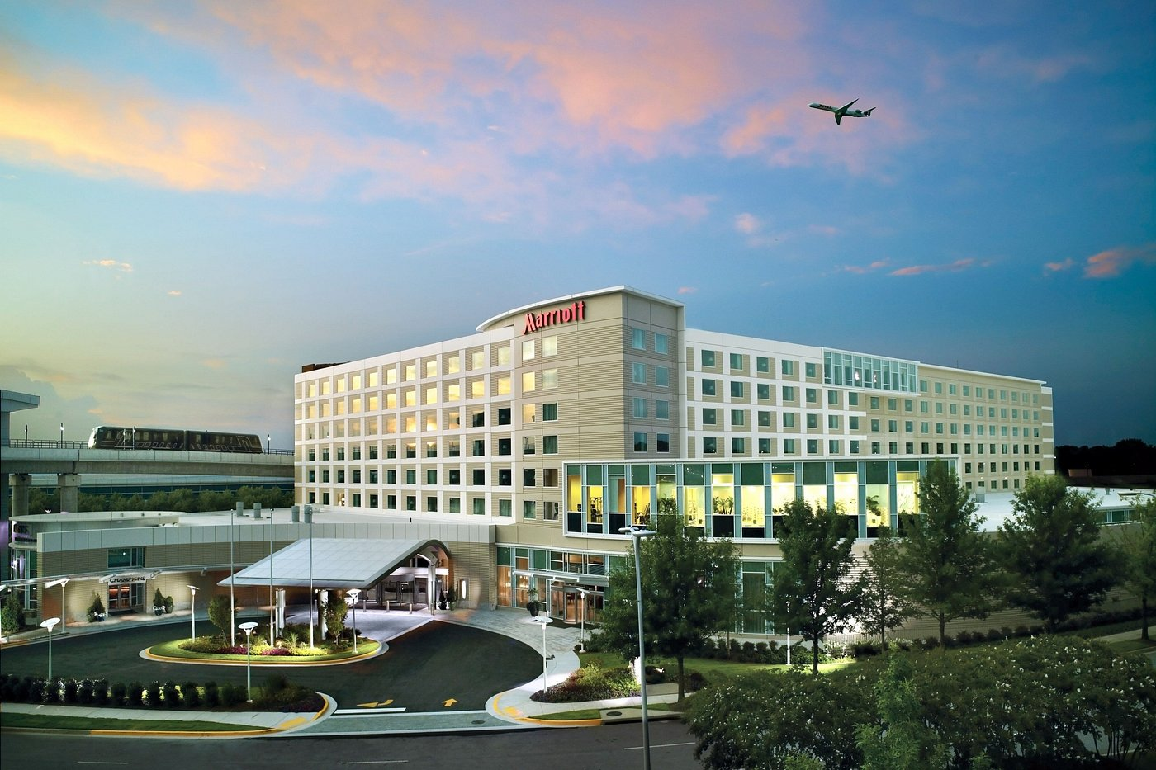
How Machine Learning Can Help
Metric of Success: Reaching a ”perfect sell”
Predicting cancellations to optimize pricing strategies
ML Models to solve classification problems:
Logistic Regression
Random Forest
Goal: Reliability and Generalization
Notes:
If a hotel can accurately predict the final number of guests for each day,
it allows them to maximize revenue and help operations teams staff their hotel properly.
This is part of Revenue Management
<CLICK>
One key 'metric of success' revenue managers have, is reaching a “perfect sell”.
This means not finishing the day with any rooms unsold.
<CLICK>
One of the biggest contributors to reaching a perfect sell, are room cancellations.
<CLICK>
We can utilize ML models to predict if a reservation will cancellation based on patterns from historical data.
<CLICK>
The ultimate goal is to predict hotel cancellations accurately in a variety of scenarios
Not all hotels are the same, so it’s important that the model can perform reliably with different hotels

Slide 4
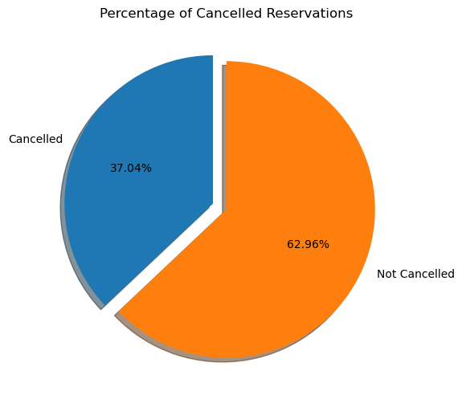
The Dataset
Important Columns:
is_canceled
Market_segment
Lead_time
Customer_type
Target Class Imbalance Identified:
Total reservations: 119,000
Reservations cancelled: 44,000
Notes:
<CLICK>
In my dataset, some important columns surfaced, but my main focus was on:
Is canceled
<CLICK>
There was a minor target imbalance in my data
as there were over 119,000 reservations,
but of those, only 44,000 Reservation cancelled

Slide 5

Obstacles
Overfitting – Initial models had 100% train accuracy or 100% precision
Through exploration, corrected the target class imbalance
Leak identified: Reservation_Status
Notes:
<CLICK>
At first, I ignored that class imbalance…
And therefore, in my earlier iterations of my models, I discovered some overfitting
My models were too perfect...
My train accuracy and precision scores were nearly 100%
<CLICK>
But through my exploration of fixing overfitting
I corrected the Imbalanced target class using SMOTE
This generated artificial samples of cancelled reservations
and basically helps the model not be biased towards the data it's being trained on.
But that still wasnt enough
<CLICK>
Eventually I uncovered a feature called 'Reservation Status' that was causing the overfitting and data leakage
This column indicates if a reservation ultimately was Canceled, Checkout, or No Showed
Essentially, it’s my target variable’s sidekick...and it needed to go

Slide 6
Model Comparisons
Random Forest:
XGBoost:
4% higher accuracy
3% higher AUC
6% higher F-1 score
XGBoost is more overfitted
Goal: Reliability and Generalization
Metric | Train | Test | Overfit Amt
Accuracy | 81.91% | 88.80% | 1.11%
AUC | 90.90% | 87.70% | 3.20%
F1- Score | 80.44% | 72.26% | 8.18%
XGBoost:
Metric | Train | Test | Overfit Amt
Accuracy | 90.80 | 84.33% | 6.47%
AUC | 94.40% | 90.10% | 4.30%
F1- Score | 90.58% | 78.18% | 12.40%
Notes:
After addressing the leak and imbalances, I ultimately narrowed my models down to two:
Random Forest and XGBoost
<CLICK>
When comparing the two, I found that the overall test metrics for the XGBoost model were better across the board.
<CLICK>
However, when I evaluated further, I found that the XGBoost model was more overfitted
<CLICK>
And remembering the goal was to have a model that can perform accurately in a variety of scenarios.
I decided that the random forest model was the better choice
And having less overfitted model, means that I'll have a more dependable performance across diverse datasets

Slide 7
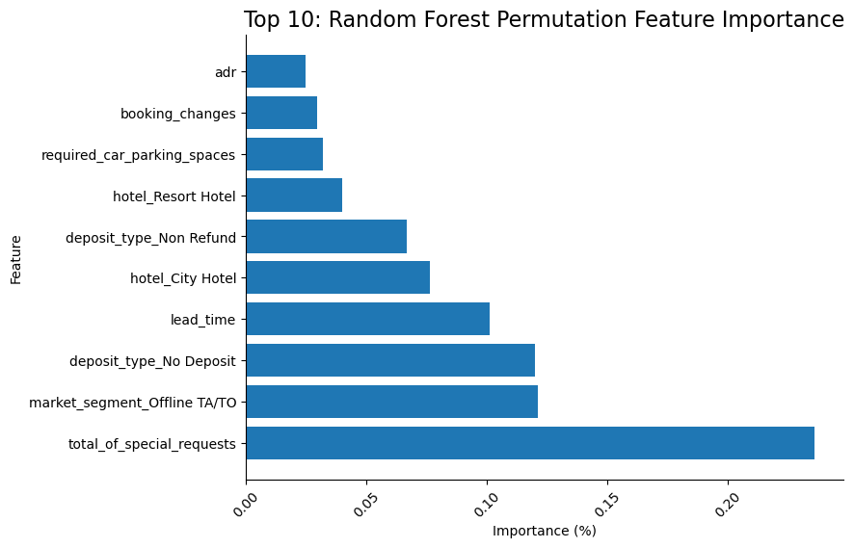
Feature Importance
Permutation Feature Importance
Total Special Requests: 20%
Market Segment TA/TO: 12%
Deposit Type: No Deposit: 12%
Lead Time: 10%
Notes:
After selecting my model,
I explored the features that contributed the most to the model’s performance using permutation feature importance
How this work is that each feature is taken out of the model one at a time
The model is evaluated both before and after that feature is taken out
And the worse the model performs after a feature is taken out, determines how important it is
<CLICK>
To my surprise, the most important feature in my Random Forest model was Total Special Requests
It had an importance over 20%.
<CLICK>
The Travel Agent/Tour Operator Market segment
No Deposit,
and Lead time followed with importances over 10%

Slide 8
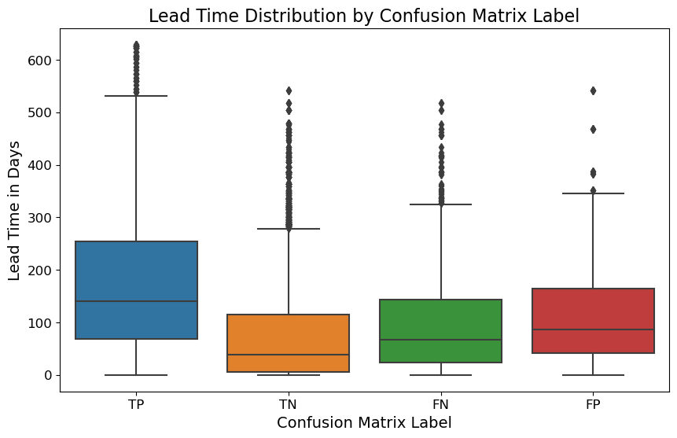
Error Analysis: Lead Time Distribution
True Positives vs. False Positive
TP: Mean is above 100 days
FP: Mean is below 100 days
Model struggles with reservations that have shorter lead times (less than 100 days)
Notes:
Lastly, by using a confusion matrix, I was able to explore errors in my model.
For example: where it incorrectly predicted a reservation to cancel when it actually did not.
When looking at the distributions of the True Positives vs False Positives for the ‘Lead Time’ Feature
<CLICK>
You can see that the mean of the True Positives are above 100
whereas the mean for False Positives are below 100.
<CLICK>
This suggests that the model struggles with reservations that have shorter lead times (<100 days).
And it indicates that the Lead Time impact the model’s ability to distinguish True positives from False positives.

Slide 9

Next Steps
Explore additional Feature Engineering to address errors
Binning features like Lead Time
Removing unnecessary features
Predict daily occupancy
Explore Time Series Forecasting for Demand
Notes:
For for my next steps:
I want to explore and identify other features that my model struggles with
And since my model appears to struggle with False Positives for shorter lead times,
I want to explore feature engineering by binning the lead time into buckets
with the goal of helping the model better learn patterns for short lead times
I also want to Explore Time Series Forecasting with Demand
With the goal to ultimately provide a well rounded prediction model for daily total hotel occupancy

Slide 10

Thank You

Slide 11
Model Comparisons
Logistic Regression model outperformed Random Forest models in all metrics
Low Precision:
Walking the guest + guest dissatisfaction
Low Recall:
More unsold rooms
Hotel A: Next closest hotel is far away
Prioritize Precision to prevent walking guests
Hotel B: Centrally located in a big city
Prioritize Recall to maximize selling all rooms
Metric | Logistic Regression | Random Forest
Train Score | 95.50% | 88.90%
Test Score | 95.42% | 88.30%
Train AUC | 99.30% | 95.40%
Test AUC | 99.20% | 94.70%
f1-score: | 93% | 84%
Precision | 100% | 88%
Recall | 87% | 79%
Notes:
The two classification models I’ve run on this dataset were Logistic Regression and Random Forest
<CLICK> The Logistic Regression model outperformed Random Forest in all metrics (see the green)
<CLICK> There are a lot of metrics here, and they’re all important like the Test score and AUC Scores, but I want to focus on a metric that is more important to the business.
<CLICK> That's the f1-score
<CLICK>
F1 score is the balance between Precision and Recall and the two generally have a see-saw relationship
To help understand this, lets look at the Logistic Regression model numbers
With Precision: Out of all the reservations the model said were going to cancel, 100% of them actually cancelled (Note this value was rounded).
With Recall: Out of all the cancelled reservations, the model was able to correctly identify 87% of them.
So, which is more important, Precision or Recall?
<CLICK> What happens with Lower Precision:
If we incorrectly predict a reservation will cancel, we may end up selling that room again in anticipation of that first guest not showing up.
This leads to costs of walking the guest + guest dissatisfaction.
<CLICK> And with Low Recall:
If we miss predicting that a reservation would cancel, we'll have unsold rooms, which will be lost revenue.
Consider this example: There is a hotel that is always selling out and hovers around the ~100% occupancy:
<CLICK> If the hotel knows that the next closest property is 30 miles away or maybe they're a resort in the Maldives and the closest property is on another island...
They may want to prioritize higher precision (correctly predicting a reservation will cancel), so that they don’t end up overselling their hotel
<CLICK> However, if the hotel in the heart of NYC and there are hundreds of properties near by, they may favor higher recall (making sure they catch all cancellations correctly)
They may be willing to risk overselling to maximize revenue and ensure they sell all of their rooms.

Slide 12
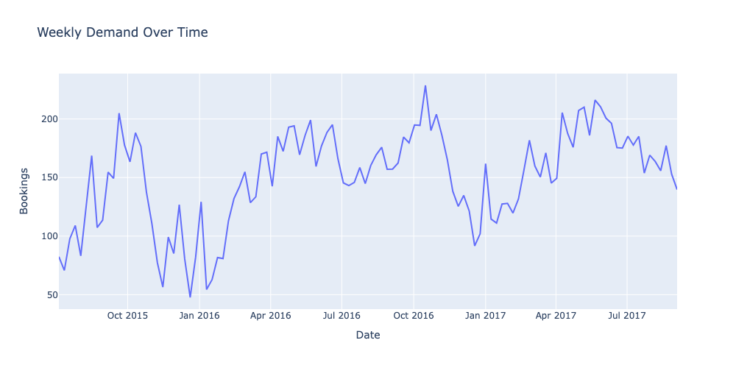
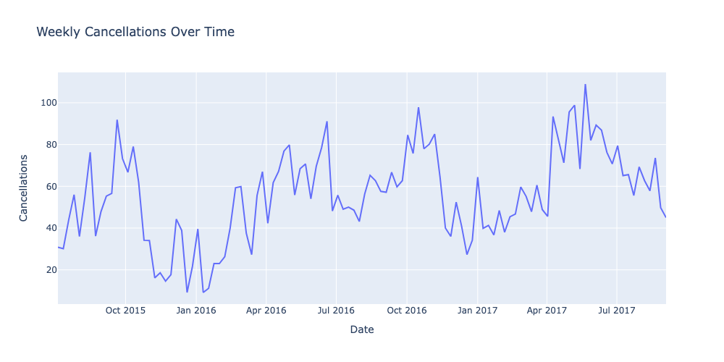
Initial EDA: Cancellation and Demand over Time
Seasonality seen between Demand and Cancellations
Peaks in October
Valleys in January
Increases in April
Notes:
My initial EDA led me to look at:
Weekly Demand(bookings) over time
Weekly Cancellations over time
I could see that seasonality was visible for both Demand and Cancellations
<CLICK> Peaks in October
<CLICK> Valleys in January
<CLICK> Goes back up in April
Only 2 years of data, but this looks like a trend

Slide 13
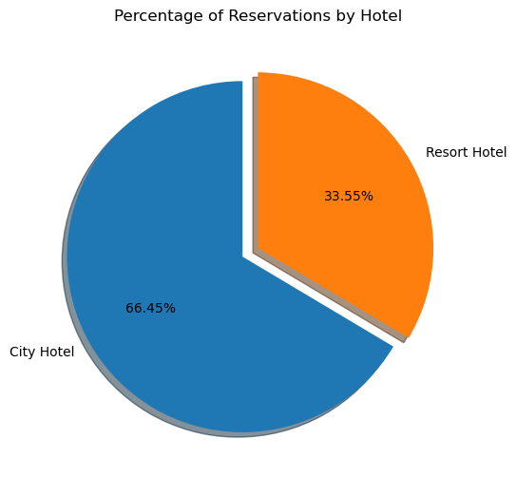
The Dataset
Important Columns:
is_canceled
Arrival_date (year, month, day of month)
Market_segment
Lead_time
Customer_type
Notes:
In my dataset there are 2 hotels, a City and Resort hotel in Portugal
The City hotel has over 79,000 reservations
The Resort hotel has 40,060 reservations
<CLICK>
After my initial look at the dataset, some important columns surfaced, but my main focus was on:
Is canceled

Slide 14
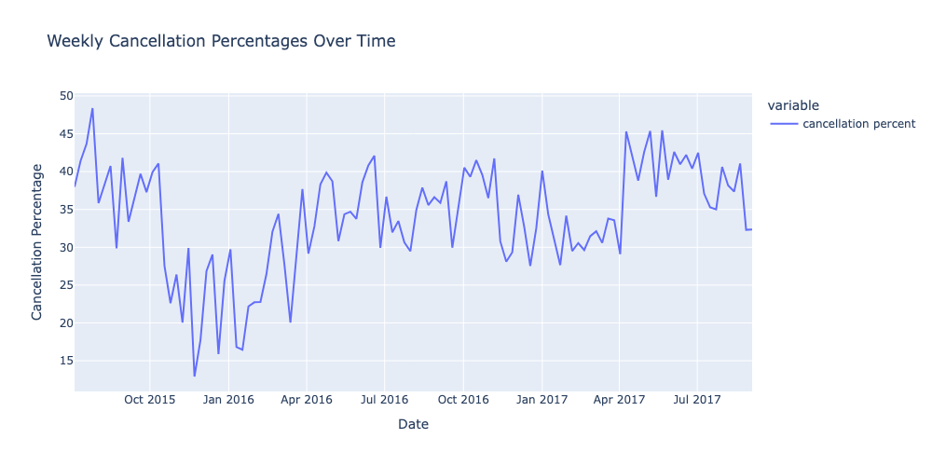
Cancellation Percentages
High cancellation % overall
Between 30-40% throughout the dataset
Identified large cancelled group bookings during EDA
Notes:
Looking at cancellation percentages:
It reaches almost 50%
And stays between 30-40% throughout the dataset
This looked high to me
In my EDA
Some reservations in the dataset were large group bookings that all cancelled
Because of this, I wondered if I should isolate purely transient bookings to see if results will vary

Slide 15
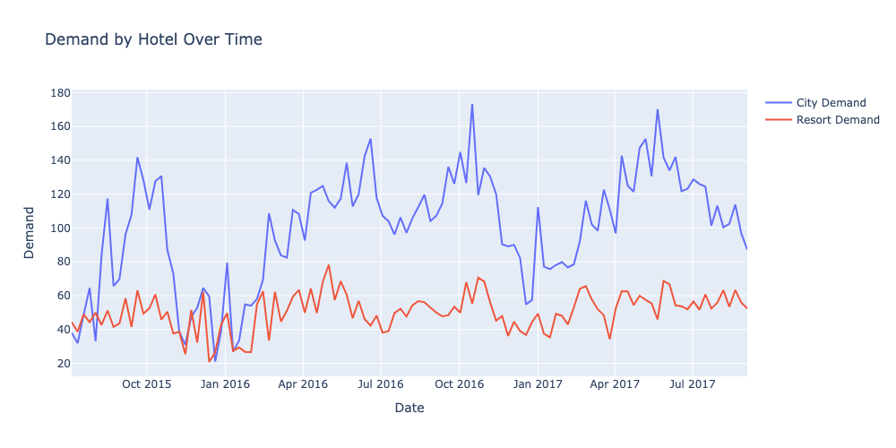
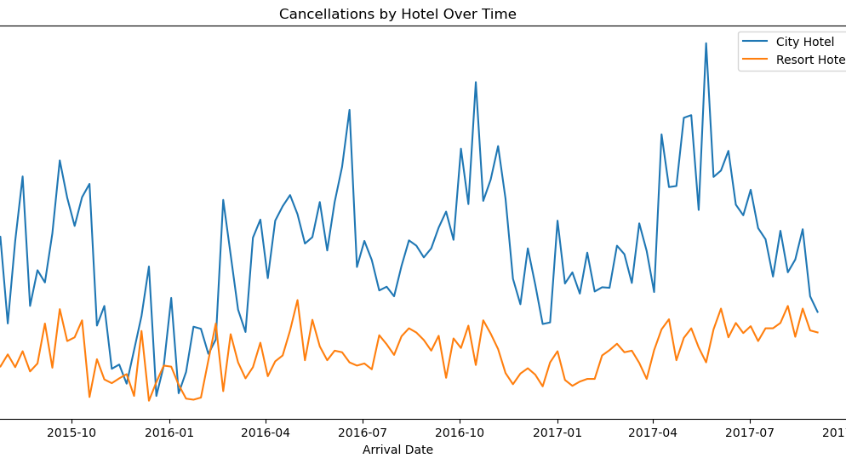
Demand and Cancellation by Hotel Type
City Hotel:
Higher demand and cancellations
Larger peaks and valleys
Likely influences the overall datasets trends
Cancellation Trends:
City hotels have corporate travelers
Last minute cancellations and bookings
Resort hotels have mainly leisure guests
Notes:
When I dove deeper to look at Demand and Cancellation by Hotel Type, I noticed:
<CLICK>
The City Hotel (Blue Lines)
has higher demand and cancellations compared to the Resort Hotel
has larger peaks and valleys compared resort hotel
The peaks and valleys we saw before, are most likely influenced by the city hotel
<CLICK>
The cancellation trends are reasonable because:
City hotels have tend to have higher corporate travelers
Last minute changes to bookings based on needs are frequent, so increased cancellations are expected
This holds true for demand as well, last minute needs to travel generates spikes in demand
Resort hotels target mainly leisure guests
When you’re traveling for vacation, you plan months or even years ahead.
It will take a lot more for you to cancel your travel plans compared to for a business trip

Slide 16
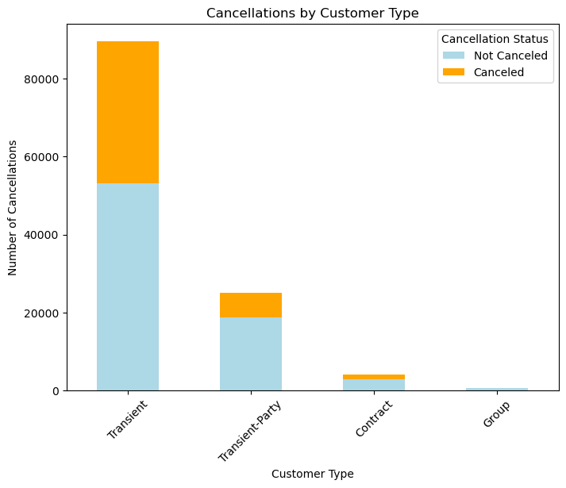
Customer Type
Combined Transient and Transient-Party customer types
Removed Group and Contract rows
Group and Contract patterns are very different than Transient
Notes:
<CLICK>
During Feature Engineering I combined the two Transient customer types because the only difference was if these customers booked together as a party
<CLICK>
Also, since there were very few group and contract in the dataset,
I removed those two customer types.
And my experience in my past roles using revenue management systems, Group and Contract forecasts are very different and much harder to predict compared to transient demand.
Therefore, I decided to focus only on transient customer types for simplicity and clarity.

Slide 17
Model Comparisons
Logistic Regression model outperformed Random Forest models in all metrics
Low Precision:
Walking the guest + guest dissatisfaction
Low Recall:
More unsold rooms
Hotel A: Next closest hotel is far away
Prioritize Precision to not walk
Hotel B: Centrally located in a big city
Prioritize Recall to maximize selling out
Metric | Logistic Regression | Random Forest
Train Score | 95.50% | 88.90%
Test Score | 95.42% | 88.30%
Train AUC | 99.30% | 95.40%
Test AUC | 99.20% | 94.70%
f1-score: | 93% | 84%
Precision | 100% | 88%
Recall | 87% | 79%
Notes:
The two classification models I’ve run on this dataset were Logistic Regression and Random Forest
<CLICK> The Logistic Regression model outperformed Random Forest in all metrics
<CLICK> Let's look at Test and AUC scores first
Test Scores are the model’s accuracy in making predictions
While the AUC score measures the model’s performance, the ability to differentiate between classes, ie: reservations being cancelled or not
With ML models, different parameter configurations may produce different accuracies.
Therefore, the AUC score provides an overall model score.
You can kind of look at this as the parameter “agnostic” score, with some exceptions.
<CLICK>
Another important metric to look at is the f1-score
<CLICK>
F1 score is the balance between Precision and Recall and the two generally have a see-saw relationship
To help understand this, lets look at the Logistic Regression model numbers
With Precision: Out of all the reservations the model said were going to cancel, 100% of them actually cancelled (Note this value was rounded).
With Recall: Out of all the cancelled reservations, the model was able to correctly identify 87% of them.
So, which is more important, Precision or Recall?
<CLICK> What happens with Lower Precision:
If we incorrectly predict a reservation will cancel, we may end up selling that room again in anticipation of that first guest not showing up.
This leads to costs of walking the guest + guest dissatisfaction.
<CLICK> And with Low Recall:
If we miss predicting that a reservation would cancel, we'll have unsold rooms, which will be lost revenue.
Consider this example: There is a hotel that is always selling out and hovers around the ~100% occupancy:
<CLICK> If the hotel knows that the next closest property is 30 miles away or maybe they're a resort in the Maldives and the closets property is on another island...
They may want to prioritize higher precision (correctly predicting a reservation will cancel), so that they don’t end up overselling their hotel
<CLICK> However, if the hotel in the heart of NYC and there are hundreds of properties near by, they may favor higher recall (making sure they catch all cancellations correctly)
They may be willing to risk overselling to maximize revenue and ensure they sell all of their rooms.

Slide 18
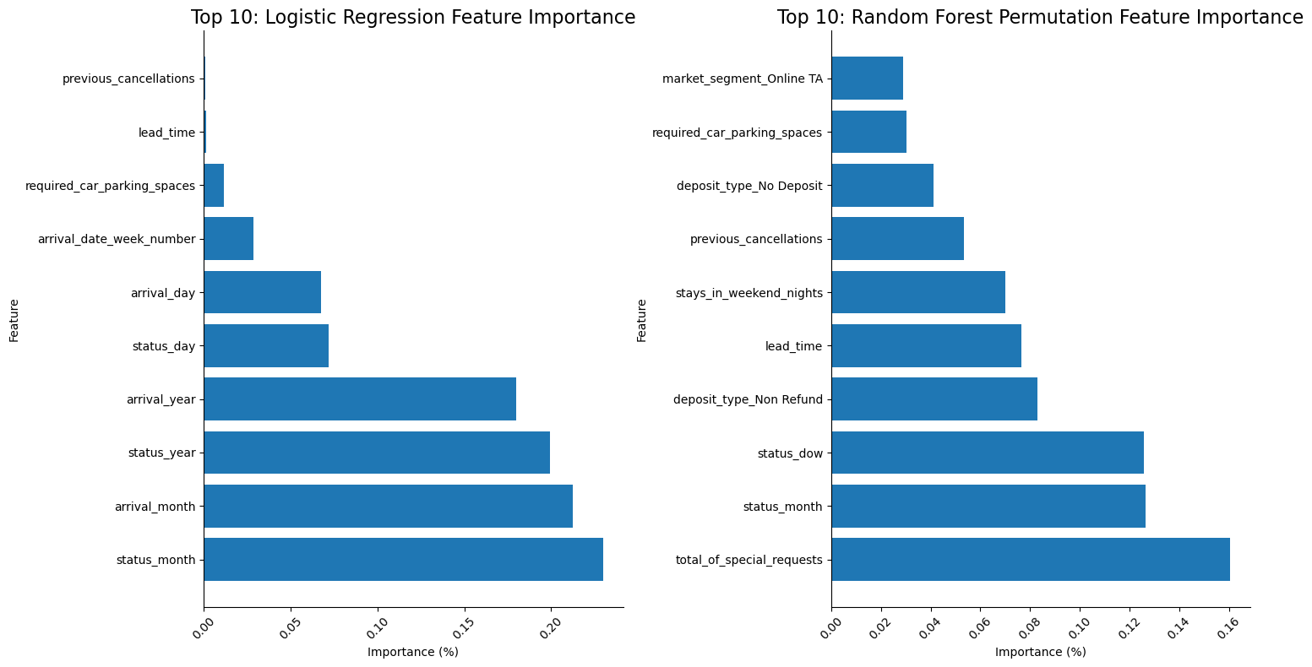
Important Features
Notes:
Compare top most important features that are most influential in predicting the target variable ‘is_canceled’
Logistic Regression
top 3 most important features:
status_month
arrival_month
Status_year
Top 3 with most negative importance:
Random Forest:
top 3 more important features:
total_of_special_requests
status_month
Status_dow
Top 3 with most negative importance
With the Random Forest model, with the highest feature `total_of_special_requests` just over 16% the sum of the first 5 importances is just over 57%, whereas the Logistic Regression model has a highest feature being 22% and the sum of the first 5 importances is over 89%. This means that the logistic regression model indicates that there are fewer features that have a heavier influence in predicting the target variable compared to the random forest model's feature importances are more spread out between more features.

Slide 19
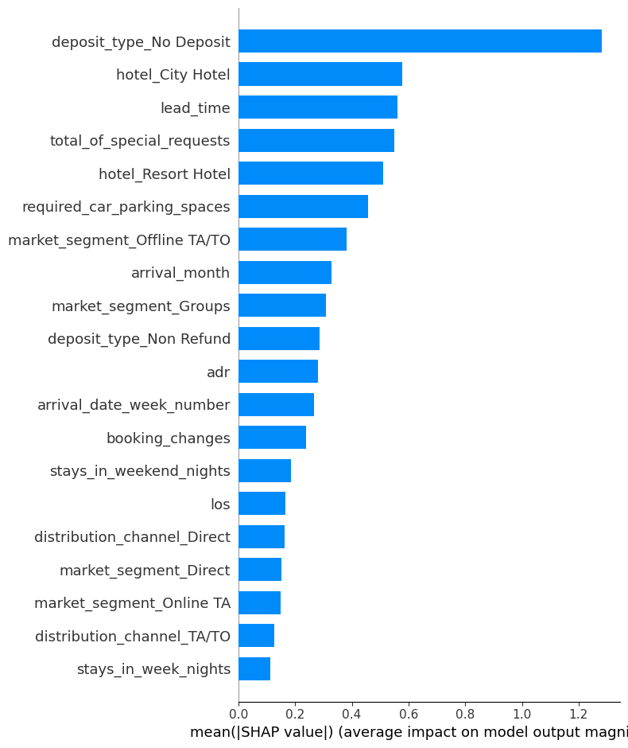
SHAP Values
Notes:
Top 4 Permutation Feature Importance:
Total Special Requests
The Travel Agent/Tour Operator Market segment
No Deposit
Lead time

Slide 20
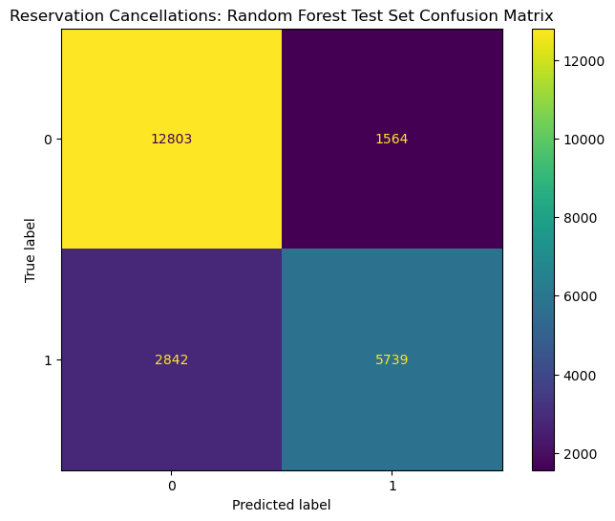
Random Forest Confusion Matrix
Notes:
**True Negatives**: 12,800 of the data points from Class 0 were correctly predicted as reservations that would not cancel
**False Positives**: 1500 of the reservations that the model predicted to cancel, did not cancel
**False Negatives**: 2800 of the reservations that cancelled were missed by our model and predicted that they would not cancel
- **True Positives**: about 5800 of the cancelled reservations were correctly predicted out of the 8500 total cancellations

