Slide 1

JOBHUNTER
JAB Project | Website | Group 4

Slide 2
Project Goals
At Jobhunter, our mission is to help people get jobs and also help the employers to find employees.
We nurture a collaborative workplace that strives to create the best experience for the job hunters and employers.

Slide 3
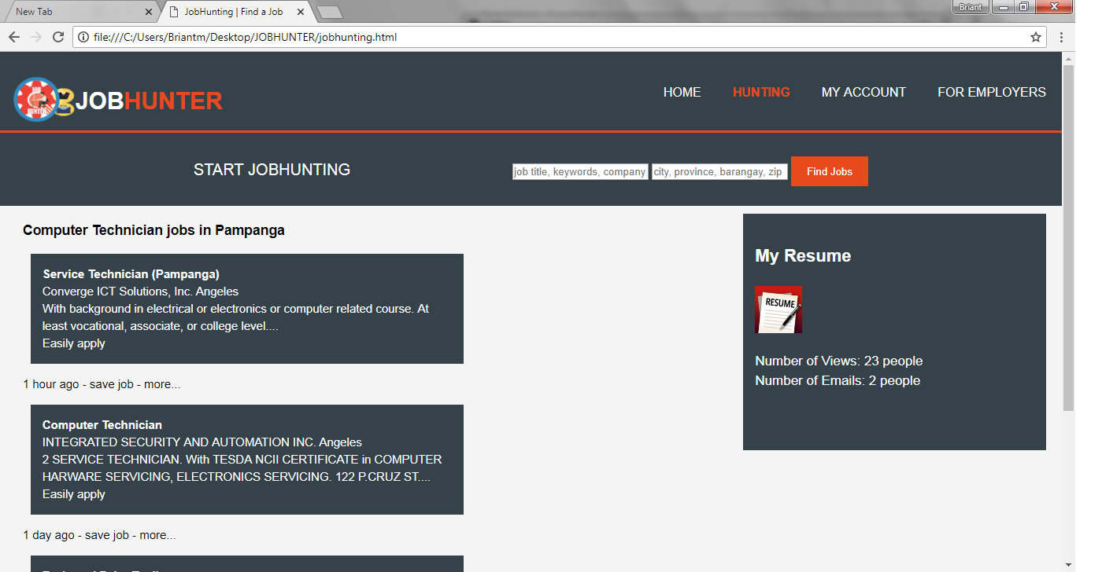
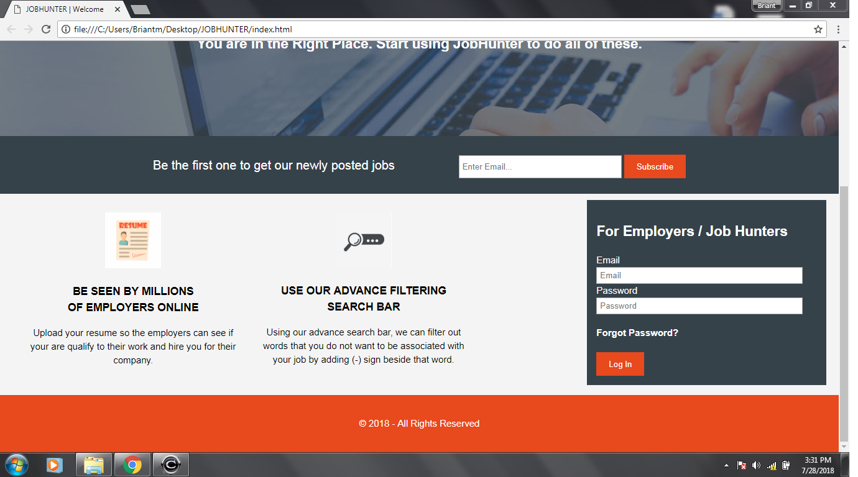
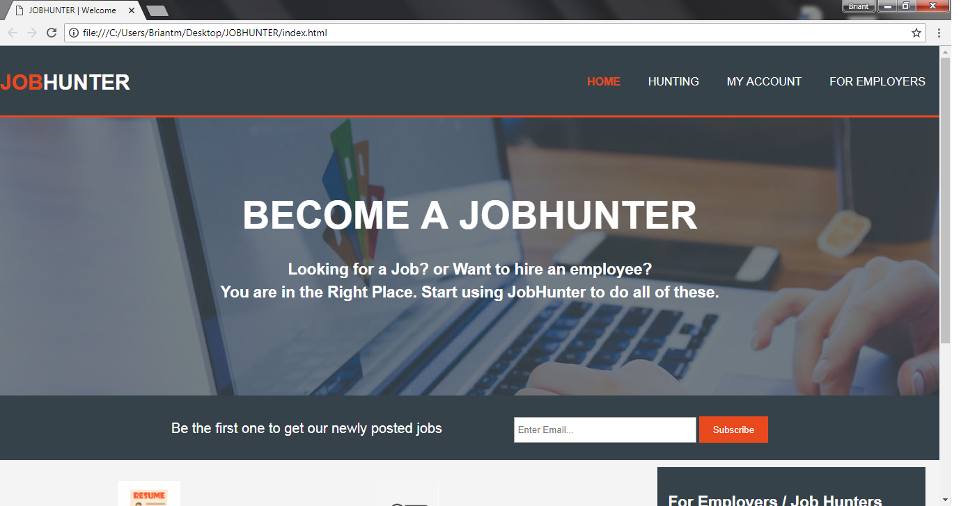
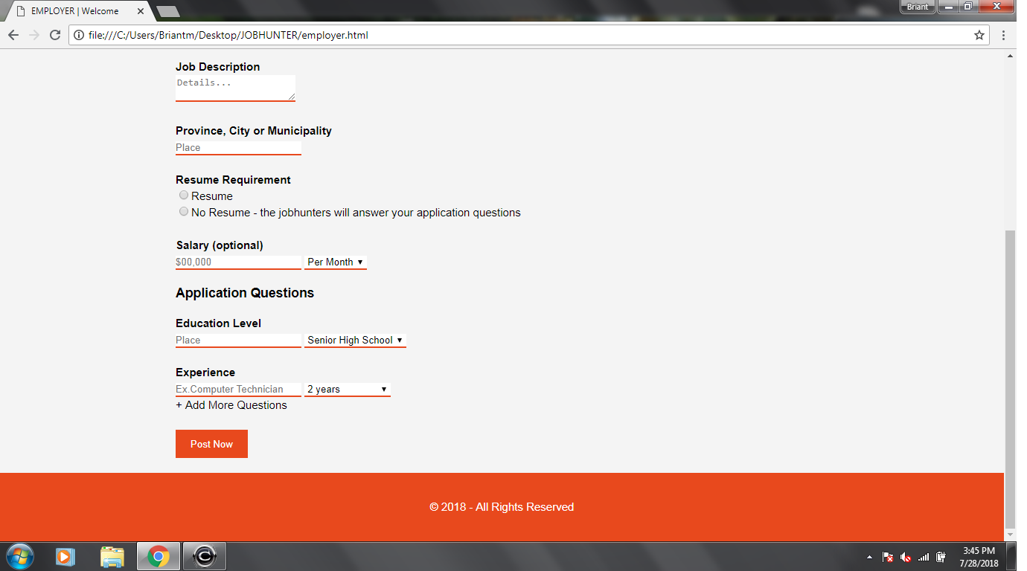
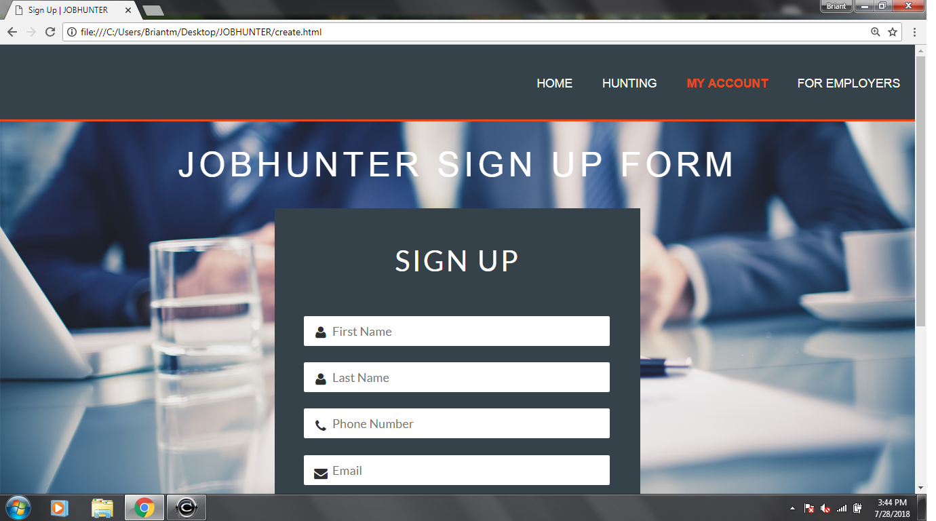
Features
Free Browsing
Apply on-site
Post resume
Advance filtering search bar
Choose a job based on your desired salary
and experience level
Post application questions
Post company’s background and history

