Slide 1
CS5150: Sun in the City Milestone 3
Phillip Tischler, Vera Khovanskaya, Sean Salmon, James McGuinness, Zach Porges, Brian Toth, Lin Xue

Slide 2
Overview
Project Description & Scope
System & Deployment Design
Progress for Milestone 3
Cornell Daily Tech Brand
Website Interface
Database Redesign & Shared Library
RSS & Web Scraping
Data Fusion Algorithm
Drupal Modules
Planning
Issues Arisen

Slide 3
Project Description
“Totally online, totally tech based newspaper for the tech campus” –Joseph Staehle
Client: The Cornell Daily Sun
Website for online newspaper read by the Cornell NYC Tech Campus
Data Fusion: Aggregation of articles from other news sources

Slide 4
Project Scope & Requirements
New website for a new market
Required
Website Front End, Content Management System (CMS), Branding for Newspaper
Optional
Cloud Web Performance & Deployment, Data Fusion Algorithm, Mobile Optimization

Slide 5
System Design
Server Running MySQL, Apache 2, Java, and Varnish (Reverse HTTP Proxy Web Caching)
Drupal CMS with custom extensions (PHP & MySQL) for Data Fusion
Front End out of CSS, XHTML, and PHP
RSS Feed & Website Crawling in Java
Data Fusion using Apache Lucene

Slide 6
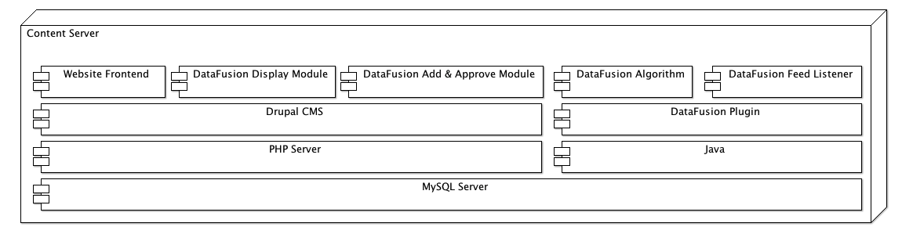
System Architecture

Slide 7
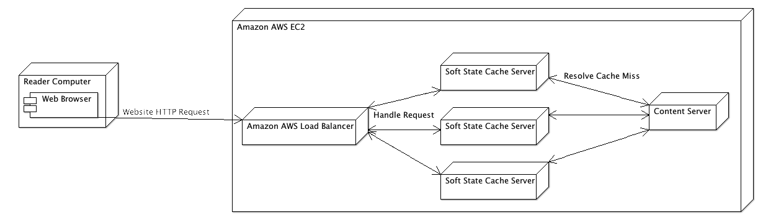
Deployment Design

Slide 8
Progress for Milestone 3
Cornell Daily Tech Brand
Website Interface
Database Redesign & Shared Library
RSS & Web Scraping
Data Fusion Algorithm
Drupal Modules

Slide 9
Cornell Daily Tech Brand
Cornell Daily Tech Identity
Logo Design & Color Scheme
Temporary & Permanent Navigation
Inspired by NYTBits
Grid Layout
Inspired by The Verge

Slide 10
Cornell Daily Tech Brand

Slide 11
Website Interface
HTML / CSS
Featured article & Grid layout for articles
Image resizing / formatting
Fonts, Date & Time Format
Shadow around content
Permanent vs. Trending Navigation
Trending tags italicized, vertical bar, permanent tags bolded
URL Aliasing
Articles have name in URL instead of nodeID for better search engine optimization

Slide 12
Website Interface
Installed Components
Nodes in Block
Featured article on homepage
Menu HTML
<EM> tags for italicized trending tags
Pathauto
Improved URLS for SEO
Special Menu Items
Divider between trending and permanent tags
Views, Views UI
Grid of articles on the homepage
Chaos Tool & Tokens Tool
Required by various modules

Slide 13
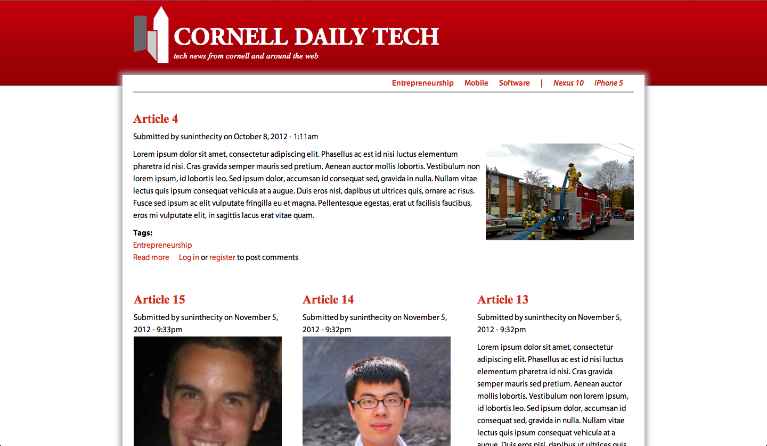
Website Interface

Slide 14
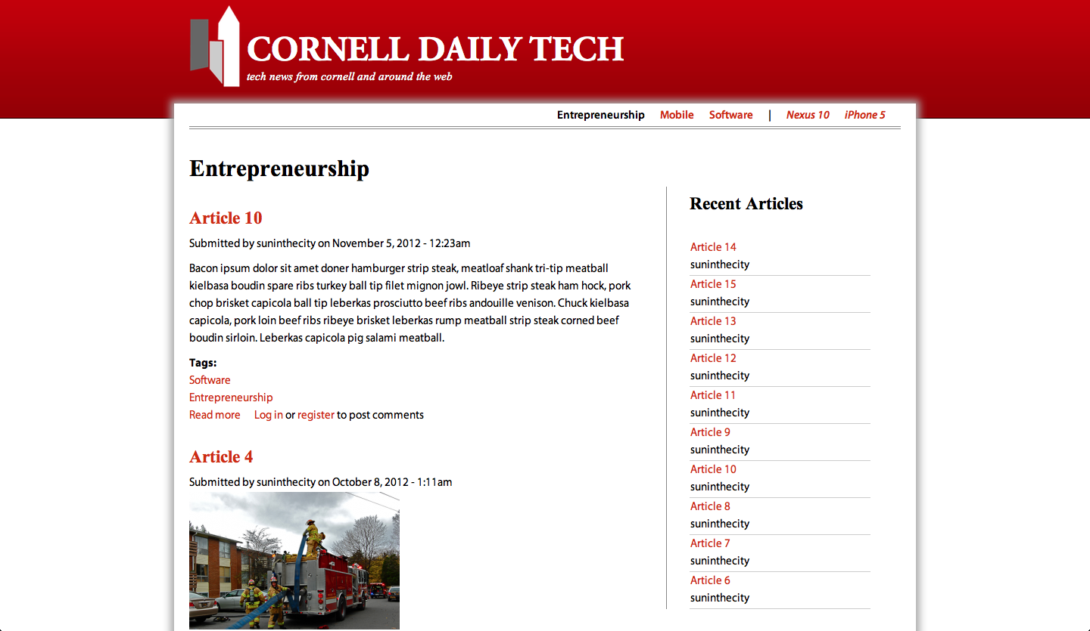
Website Interface

Slide 15
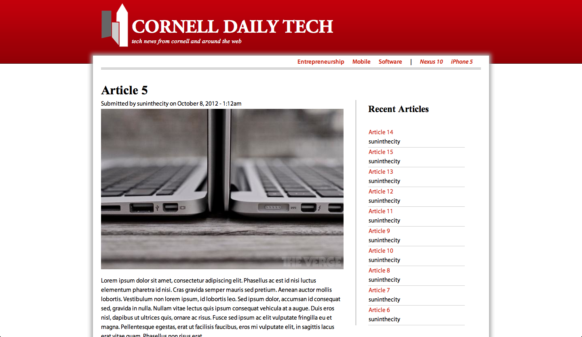
Website Interface

Slide 16
Database Redesign & Shared Library
Database Redesign
Simplify design, improve performance, complete specification
Shared Library
Save redundant code
Make logical separation between algorithms and MySQL database interaction
JConnector for MySQL

Slide 17
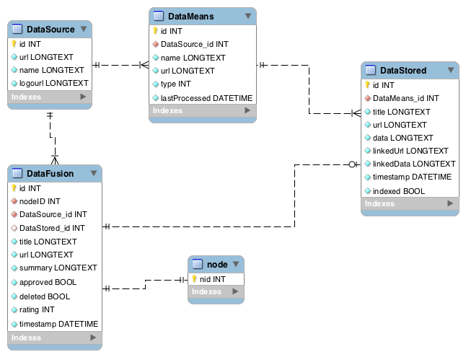
Database Redesign & Shared Library

Slide 18
RSS & Web Scraping
ROME Library
Download RSS feeds and HTML pages
JDOM
XML Parsing of documents in RSS feeds
Process
Get DataMean object to Process
NY Times RSS Feed
Use ROME to get RSS feed
Use JDOM to parse XML
Insert data into MySQL as DataStored

Slide 19
RSS & Web Scraping
Updates
No longer multithreaded
Refactor of objects into Shared Library
DateTime field in DataMeans to determine if RSS posts should be aggregated
Combined many RSS parsing objects into single feed parser

Slide 20
Data Fusion Algorithm
Indexing Process
Get DataStored objects yet to be indexed
Insert them into the Apache Lucene index
Mark the objects as indexed
Data Fusing Process
Get article that hasn’t been fused in awhile
Use tags on article to search Apache Lucene Index
Insert matches as DataFusion objects into system to be approved by editors

Slide 21
Data Fusion Algorithm
Querying Apache Lucene
Returns ranked collection of articles
Scoring Model
Tf: The more frequent a keyword occurs in an article, the greater the score
Idf: Greater the occurrence of a keyword in different articles, the lower its score- common keywords are less important
Multiple Keywords: Articles that match multiple keywords receive a higher score
Length Normalization: Keyword match in short article is more important than long article
Top 10 matches are returned

Slide 22
Drupal Modules
Custom tabs to manage Data Fusion
Appear on any given article
Add / Edit DataSources
Add a source like The New York Times
Add / Edit DataMeans
Add a means like The New York Times RSS Feed
Add / Edit / Approve DataFusion
Approve a New York Times article to be listed as a similar article for the current article shown

Slide 23
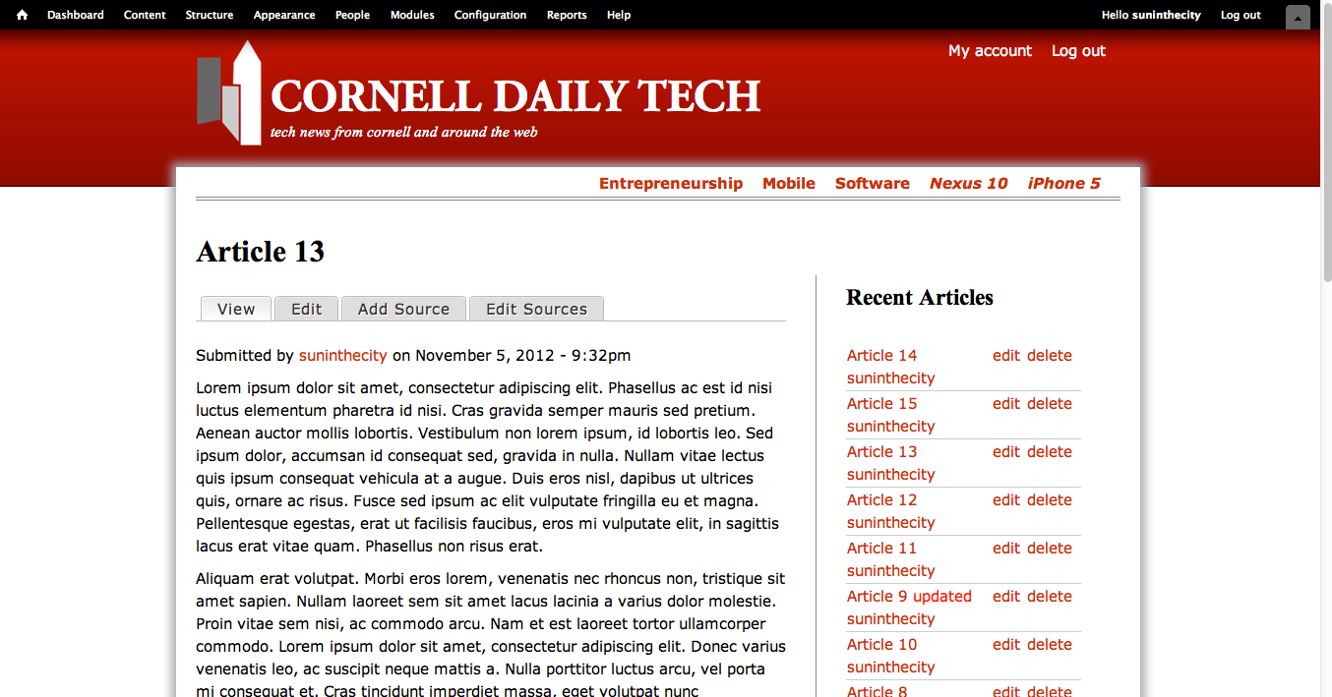
Drupal Modules

Slide 24
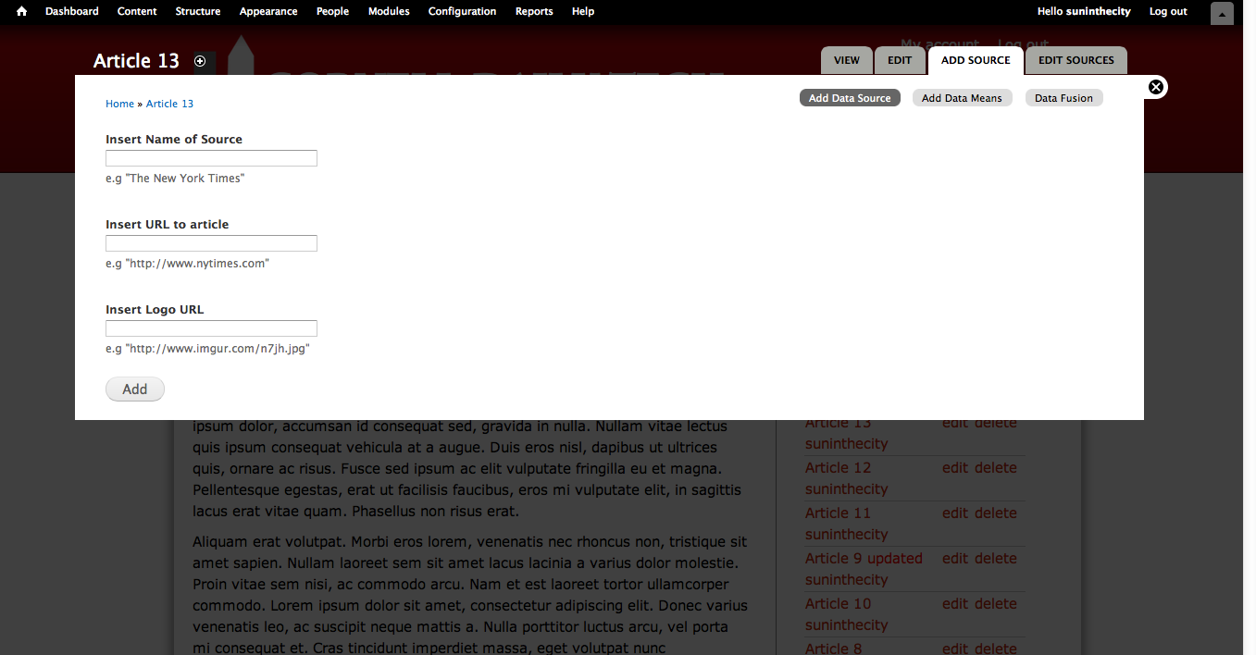
Drupal Modules

Slide 25
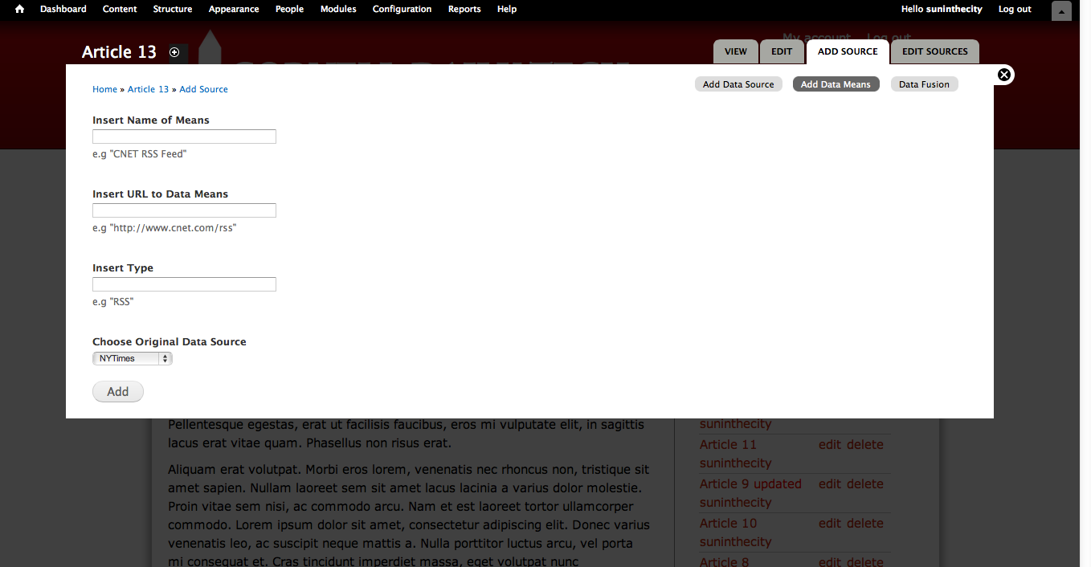
Drupal Modules

Slide 26
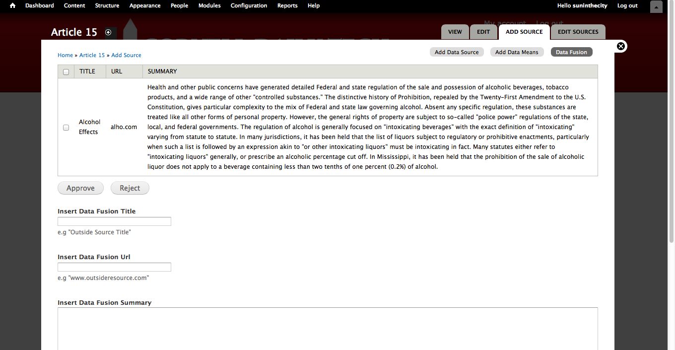
Drupal Modules

Slide 27
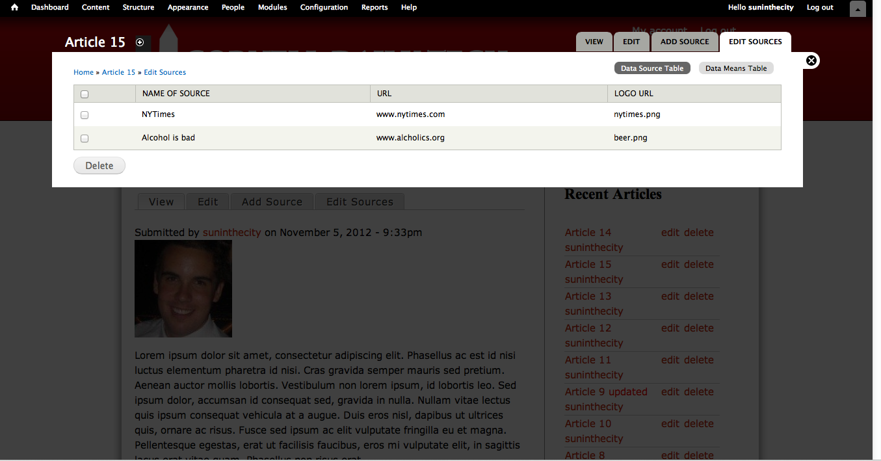
Drupal Modules

Slide 28
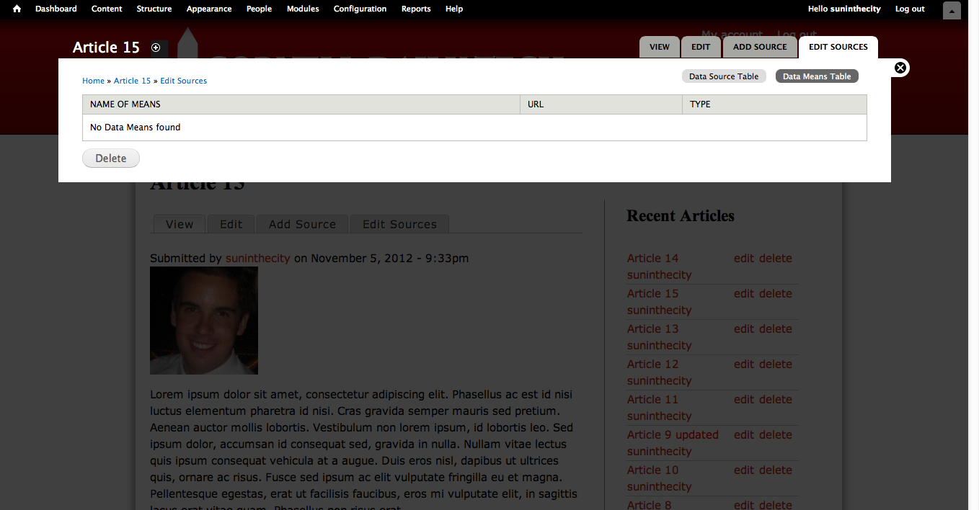
Drupal Modules

Slide 29
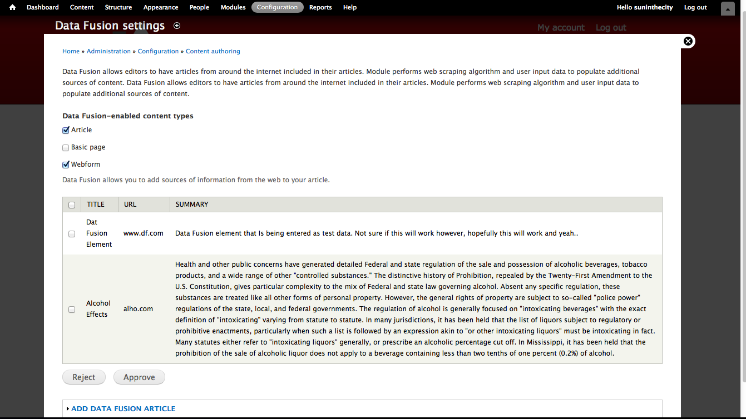
Drupal Modules

Slide 30
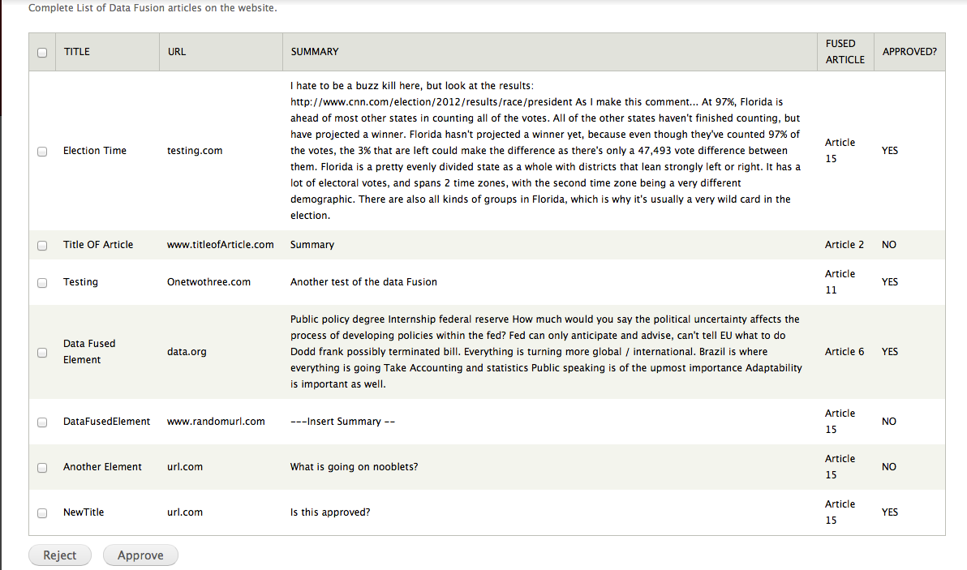
Drupal Modules

Slide 31
Progress Summary
Cornell Daily Tech Brand
Website Interface
Database Redesign & Shared Library
RSS & Web Scraping
Data Fusion Algorithm
Drupal Modules

Slide 32
Project Planning
Deadlines
11/09 - Milestone 4
Brand
Production quality user interface (HTML / CSS)
Data Fusion
RSS Feed obtaining data and storing in database
Algorithm attempting matchmaking
Drupal Modules
Display modules
Data editing modules
12/07- Milestone 5
AWS Deployment
Integration of Varnish Cache server
Demonstration, Documentation, and Handover

Slide 33
Project Planning
Plan
10/28 - 11/4
Finish front end display to user
Finish & test RSS
Finish & test Data Fusion Algorithm
Finish & test Drupal Modules
11/5 - 11/09
Milestone 4 presentation
Milestone 4 document
11/09 - Milestone 4

Slide 34
Project Planning
Plan
11/12 - 11/18
Final touches to all parts of project
Write example articles
Setup necessary accounts & Google ads
User and system testing
11/19 - 11/25
AWS Deployment
Integration of Varnish Server
11/26 - 12/01
Validation of requirements and system
Documentation & Handover
12/02 - Demonstration (Final)

Slide 35
Issues That Have Arisen
None for this milestone
Next milestone: expecting deployment issue
Difficulty setting up accounts & funding
In constant communication with client to resolve
Headaches with AWS servers
Giving enough time to complete deployment

Slide 36
Milestone 3 Summary
Completed
Cornell Daily Tech Brand
Website Interface
Database Redesign & Shared Library
RSS & Web Scraping
Data Fusion Algorithm
Drupal Modules
Next Steps
Finishing touches, testing, deployment, validation, documentation & handover

