Slide 1
CS5150: Sun in the City Final Presentation
Phillip Tischler, Vera Khovanskaya, Sean Salmon, James McGuinness, Zach Porges, Brian Toth, Lin Xue

Slide 2
Overview
Project Description & Scope
System & Deployment Design
Status of Project
Project Components
Testing Steps
Validation Steps
Handover Materials
Final Report, JavaDoc, Screencast Walkthroughs, Deployable System

Slide 3
Project Description
“Totally online, totally tech based newspaper for the tech campus” –Joseph Staehle
Client: The Cornell Daily Sun
Website for online newspaper read by the Cornell NYC Tech Campus
Data Fusion: Aggregation of articles from other news sources

Slide 4
Project Scope & Requirements
New website for a new market
Required
Website Front End, Content Management System (CMS), Branding for Newspaper
Optional
Cloud Web Performance & Deployment, Data Fusion Algorithm, Mobile Optimization

Slide 5
System Design
Server Running MySQL, Apache 2, Java, and Varnish (Reverse HTTP Proxy Web Caching)
Drupal CMS with custom extensions (PHP & MySQL) for Data Fusion
Front End out of CSS, XHTML, and PHP
RSS Feed & Website Crawling in Java
Data Fusion using Apache Lucene

Slide 6
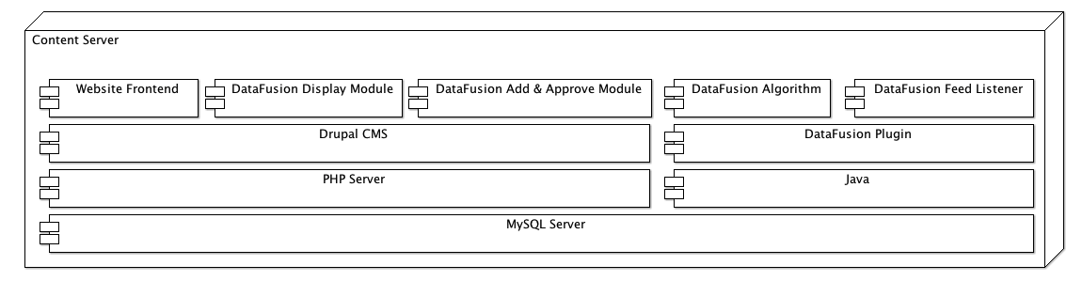
System Architecture

Slide 7
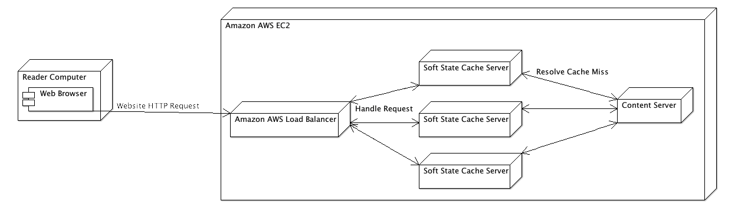
Deployment Design

Slide 8
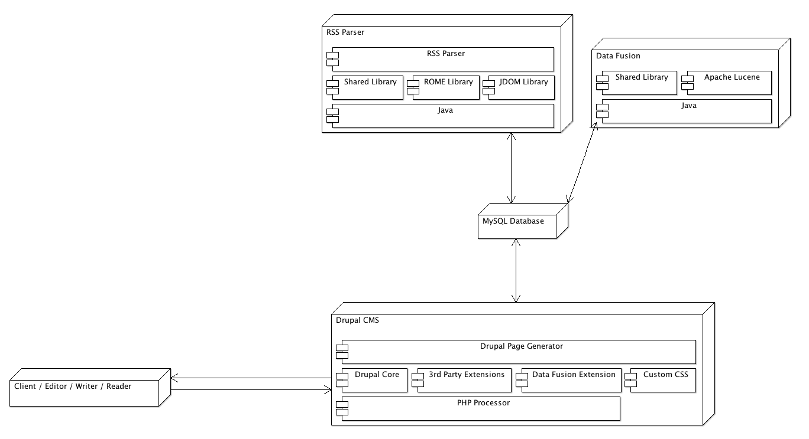
Operation Overview

Slide 9
Project Components
Website, CMS, and Drupal Extensions are complete, tested, and deployed
http://zachporges.com/cornelldailytech
Database, Shared Library, RSS Parser, and Data Fusion Library are complete and tested
Deployment not possible due to lack of servers
Java components that run standalone on server utilize Log4J logging

Slide 10
Testing Steps
Testing Website
Client and user testing, manual testing by visiting and exercising components
Testing Drupal Extensions
Manual testing by exercising all use cases and boundary cases of system
Testing Shared Library
Manual end to end tests as well as Unit testing
Testing RSS Parsing
Manual end to end tests
Testing Data Fusion
Manual end to end tests with example fusion

Slide 11
Validation Steps
Met with Writers and Readers
Comments / changes desired for system
Iterate
Validation Meeting with Client
Demonstrated system to the client
Asked what changes he would like
Iterated until he was 100% happy

Slide 12
Final Report
Project Description
Team, Client, Scope / Requirements, Benefits
Project Design
Interface Design, System Design, Code Design, Testing Design and Walkthrough
Validation
Client, Writers, and Reader Validation
Documentation
Code Walkthrough, User Training, Useful Links
Project Handover

Slide 13
Screencast Walkthroughs
Deployment of System Important
Series of Screencasts Demonstrate How to Deploy, with Narrative
Deployed to a clean install of Ubuntu Virtual Machine
Virtual Machine included in handover material

Slide 14
Deployable System
http://zachporges.com/cornelldailytech/
All mandatory components of project complete
1 out of 3 optional components complete
We were ready to deploy to AWS (other optional component) but servers were not provided by the client in time
Numerous emails, text messages, and meetings
Requested that they be ready by 11/15 at start of project, as of today we still do not have access

Slide 15
Final Summary
Status of Project
Project Components
Testing Steps
Validation Steps
Handover Materials
Final Report, JavaDoc, Screencast Walkthroughs, Deployable System

