Slide 1
CS5150: Sun in the City Milestone 1
Phillip Tischler, Vera Khovanskaya, Sean Salmon, James McGuinness, Zach Porges, Brian Toth, Lin Xue

Slide 2
Overview
Project Description, Scope, & Benefits
System & Deployment Design
Progress for Milestone 1
Space Analysis, Tradeoffs, Actors & Use Cases, Layout Design
Initial Drupal Website
Database Design
Data Fusion Algorithm & Drupal Extensions
Planning
Issues Arisen

Slide 3
Project Description
“Totally online, totally tech based newspaper for the tech campus” –Joseph Staehle
Client: The Cornell Daily Sun
Website for online newspaper read by the Cornell NYC Tech Campus
Data Fusion: Aggregation of articles from other news sources

Slide 4
Project Scope & Requirements
New website for a new market
Required
Website Front End, Content Management System (CMS), Branding for Newspaper
Optional
Cloud Web Performance & Deployment, Data Fusion Algorithm, Mobile Optimization

Slide 5
Project Benefits
New Market
Old website has 80,000 unique quarterly users
New market will eventually have equivalent population
More advertisement opportunities
Larger Population of Readers
New Website System
Potential to integrate into current website

Slide 6
System Design
Server Running MySQL, Apache 2, Java, and Varnish (Reverse HTTP Proxy Web Caching)
Drupal CMS with custom extensions (PHP & MySQL) for Data Fusion
Front End out of CSS, XHTML, and PHP
RSS Feed & Website Crawling in Java
Data Fusion using Apache Lucene

Slide 7
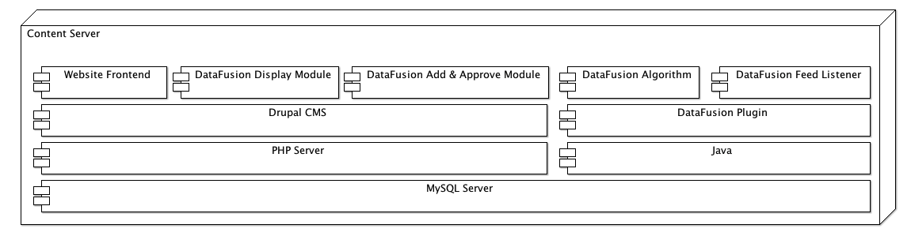
System Architecture

Slide 8
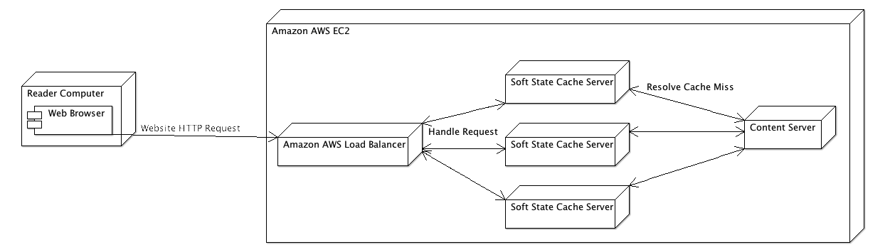
Deployment Design

Slide 9
Progress for Milestone 1
User Experience
Space Analysis
Tradeoffs
Actors & Use Cases
Layout Design
CMS & Front End
Development Server with Drupal Website and Custom CSS
Data Fusion Algorithm
Database Design
RSS Feed Scraping & Text Search Libraries
Drupal Extensions: Example extension code

Slide 10
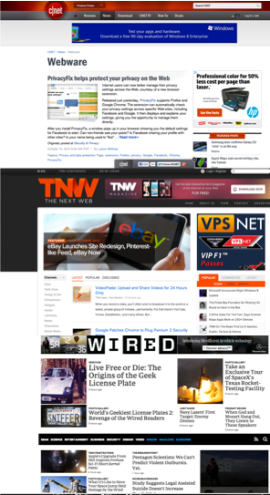
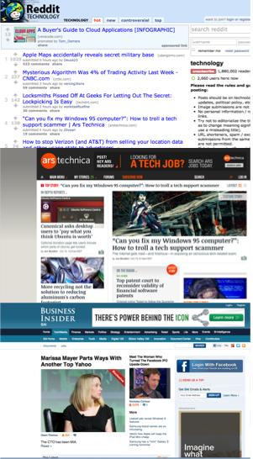
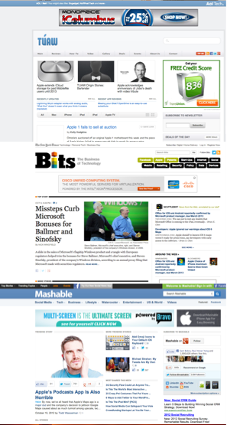
Space Analysis

Slide 11
Tradeoffs
Designing for editorial control vs. popularity
Blog content: tech hacker vs. tech curious
Data Fusion vs. Singular Identity
Dynamic vs. static data organization

Slide 12
Actors & Use Cases
Writers: interviewed a couple sun writers, learned about their technical ability and experience of using existing site and alternative tools that they use

Slide 13
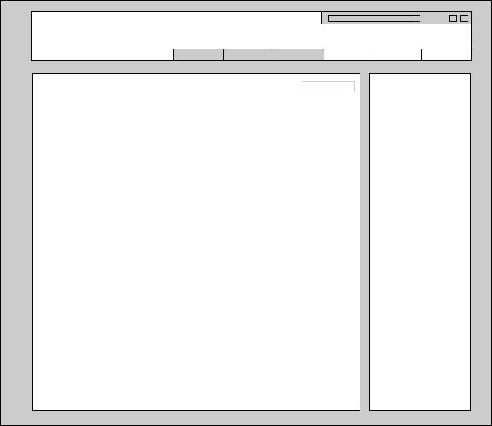
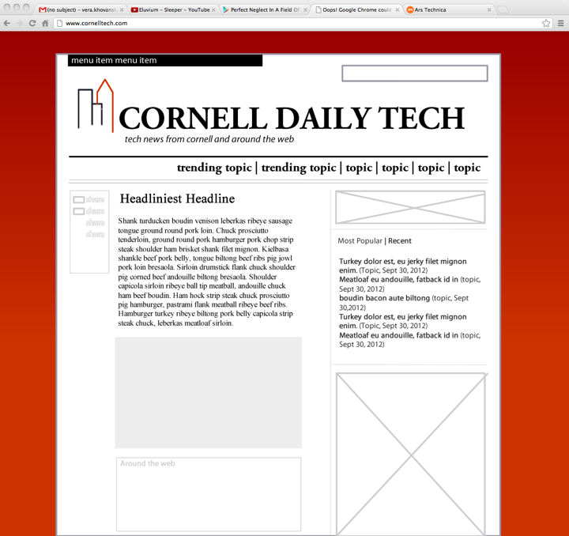
Layout Design

Slide 14
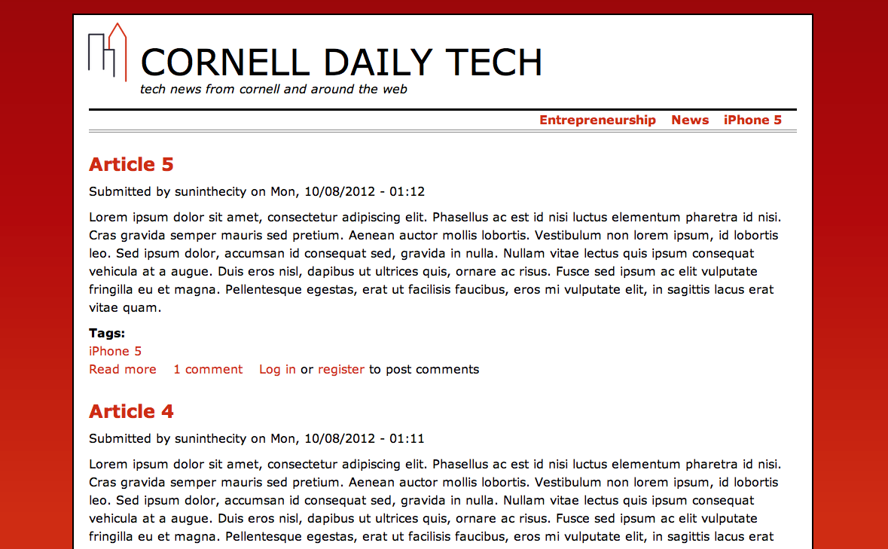
Initial Drupal Website
Notes:
Our website has three views: the home page, a collection of articles with a common tag, and a news article. This is a screenshot of the home page, but note that we’re planning on enhancing the formatting/design.

Slide 15
Initial Drupal Website
Notes:
In the top right corner of each page, we show links to collections of articles that have received popular tags. It is extremely easy to modify these links using drupal, and we will provide documentation so that Sun editors can do so.

Slide 16
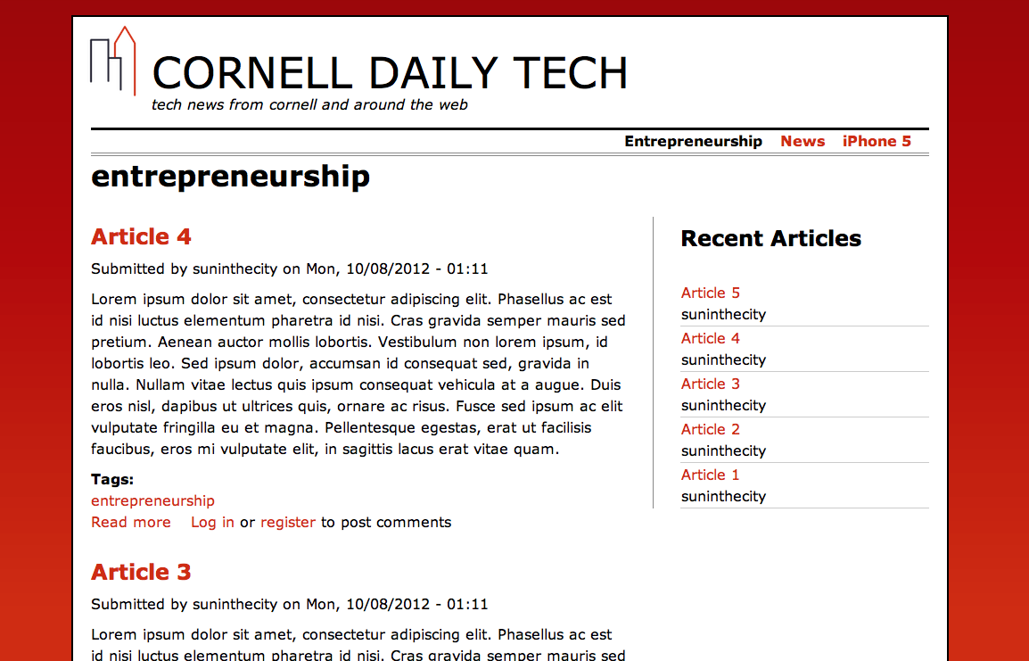
Initial Drupal Website
Notes:
This page shows all articles tagged with entrepreneurship. Note that the right column of this page, and all other pages except for the home page, contains links to articles that were recently published. There is additional space in this column for ads or other content.

Slide 17
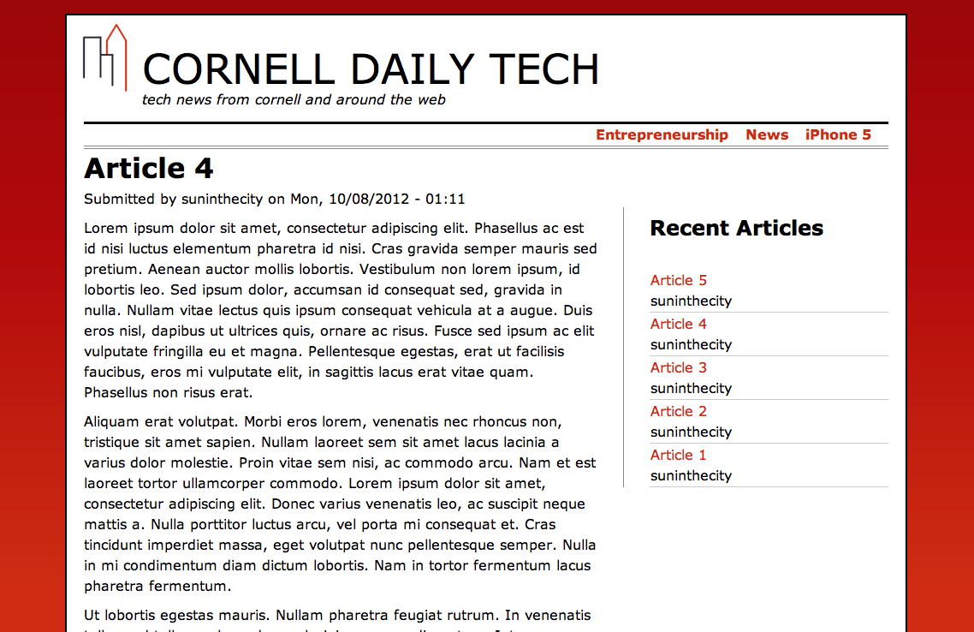
Initial Drupal Website
Notes:
Finally, this is the article view. Articles are easy for editors to add/modify using drupal, and contain drupal’s commenting system.

Slide 18
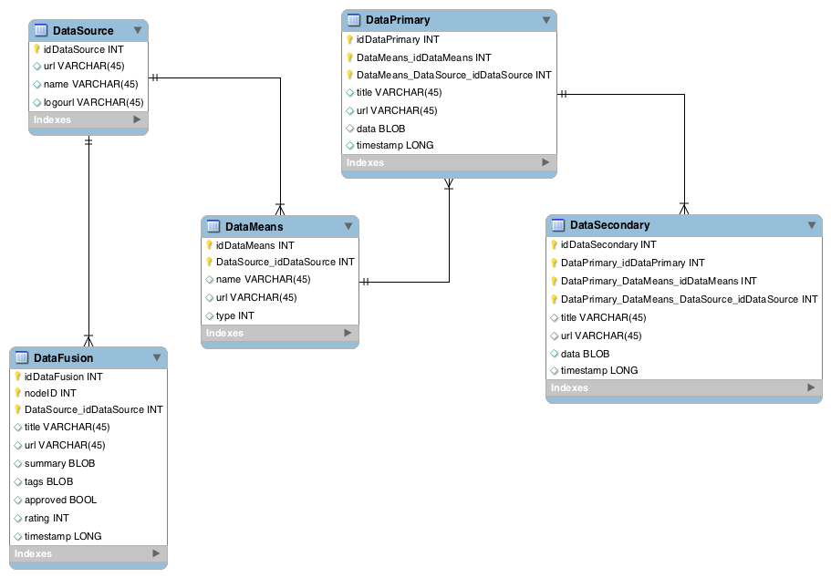
Database Design

Slide 19
RSS & Website Scraping
Uses MySQL Java driver to connect to SQL database for reading/writing
ROME Java library for RSS Scraping (under Apache 2.0 license)
Basic Java URL libraries used for Website scraping
Thread pool to run scraping on updated RSS feeds as they occur
Data is read only once at runtime, data written as updates occur

Slide 20
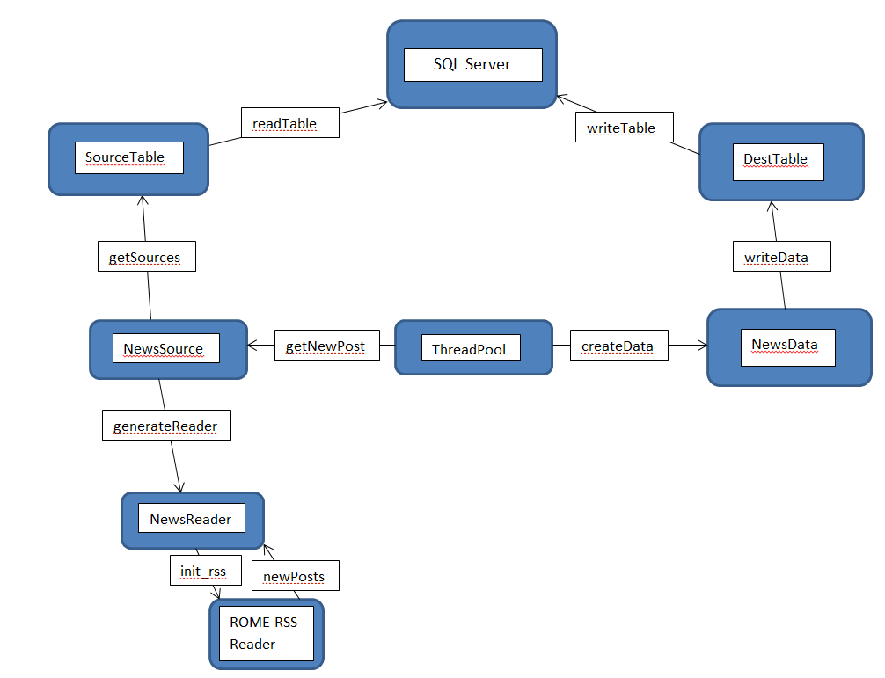
RSS & Website Scraping (Diagram)

Slide 21
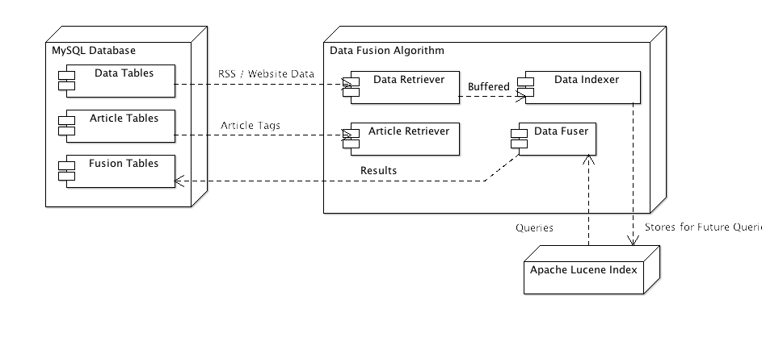
Data Fusion Algorithm

Slide 22
Drupal Extensions
Create module with easy to use UI
Written within PHP
Access nodes on website to extrapolate data
Allow editors to input/update and reject data sources
Use data fusion to populate suggestions for editor to select

Slide 23
Example Editor UI
Graphical User
Interface
Data Sources
Link to Data
The Wall Street Journal
www.online.wsj.com
The Economist
www.economist.com/
+
The New York Times
www.nytimes.com/
MySQL Database:
Node ID | Data Source | Link to Source
1938148 | The Wall Street Journal | www.online.wsj.com
1938149 | The Economist | www.economist.com
1938150 | The New York Times | www.nytimes.com
Notes:
This is the graphical representation of one of our databases holding the Data Source information. This representation is also similar to the one for data means. Displaying the choices from data fusion results is this process in reverse with similar UI and database structure.

Slide 24
Project Planning
Off Plan
Development Server -> Individual Servers
Branding & Ad placement not complete- decisions taking longer than expected
On Plan
Development testing, Drupal setup
Initial User Interface, Initial code base & database design for the Data Fusion
Milestone 2 (11/09): Initial RSS, Data Fusion Algorithm, and Drupal Extension Running
Milestone 3 (12/07): Deployed on Amazon AWS, Elastic Cloud & Caching, Documentation & Handover

Slide 25
Issues That Have Arisen
Individual Development Servers
LAMP != WAMP != MAMP != XAMP != ?
User Permissions, Enable Apache MODS, Rewrite URLs & Symlinks

Slide 26
Milestone 1 Summary
Project
Online Tech Newspaper for The Cornell Daily Sun
Progress
Space Analysis, Tradeoffs, Actors & Use Cases, Layout Design
Initial Drupal Website
Database Design
Data Fusion Algorithm & Drupal Extensions
Next Steps
Full Design (HTML / CSS) of Website & Brand
RSS & Website Scraping Algorithm
Apache Lucene Indexing & Searching
Drupal Extensions For Data Fusion Integration

