Slide 1
RSS & Website Scraping
Uses MySQL Java driver to connect to SQL database for reading/writing
ROME Java library for RSS Scraping (under Apache 2.0 license)
Basic Java URL libraries used for Website scraping
Thread pool to run scraping on updated RSS feeds as they occur
Data is read only once at runtime, data written as updates occur

Slide 2
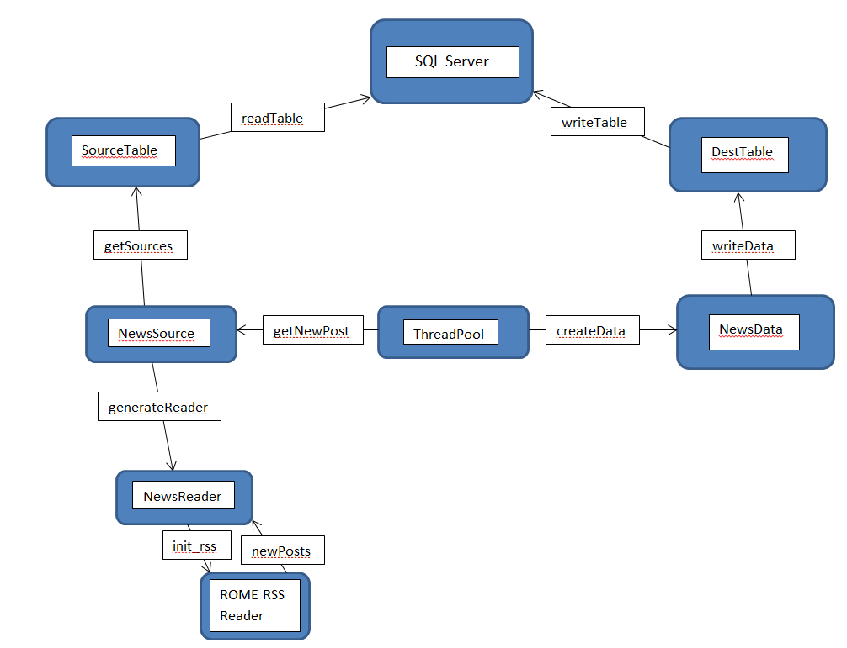
RSS & Website Scraping (Diagram)

