Slide 1
Seasonal Time Series Forecasting
4/16/2020

Slide 2


Forecasting Overview
Goal – Use time-based trends in past data to create a distribution of possible values for the future
General steps:
Visual analysis of data
Choose and fit appropriate model for type of time series data you have
Forecast and model evaluation
Mean Absolute Percentage Error (MAPE)

Slide 3
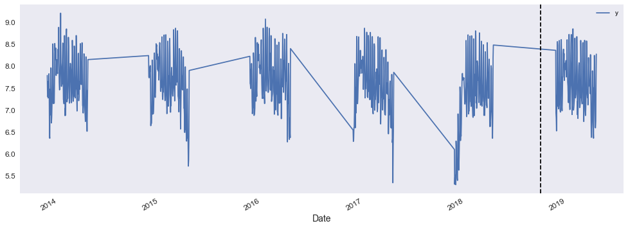
Forecasting Overview
Vail Local Core Pass Visits
2013/14 – 2018/19 Seasons
There are a lot of missing values – many time series models will need them interpolated (or interpolate themselves). I use a resort-specific fiscal calendar (147 days for Vail) to eliminate the off-season

Slide 4
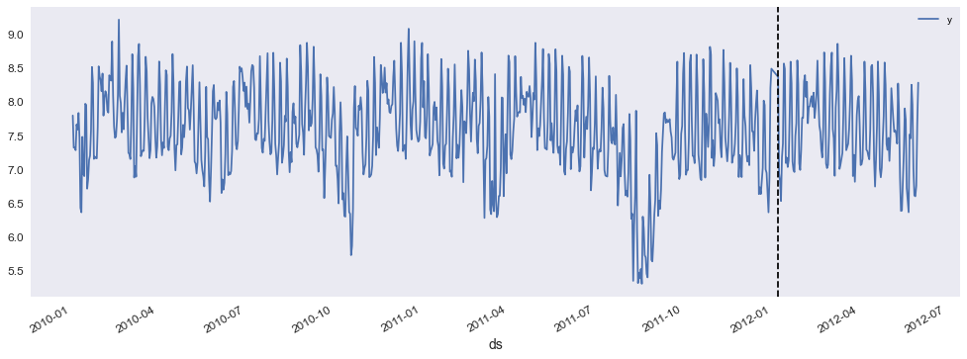
Forecasting Overview
Vail Local Core Pass Visits – Custom Calendar
2013/14 – 2018/19 Seasons
Additional regressors in dataframe – Snow Base Depth (in), 72hr Snowfall (in), # of acres open, ALT/Window prices

Slide 5
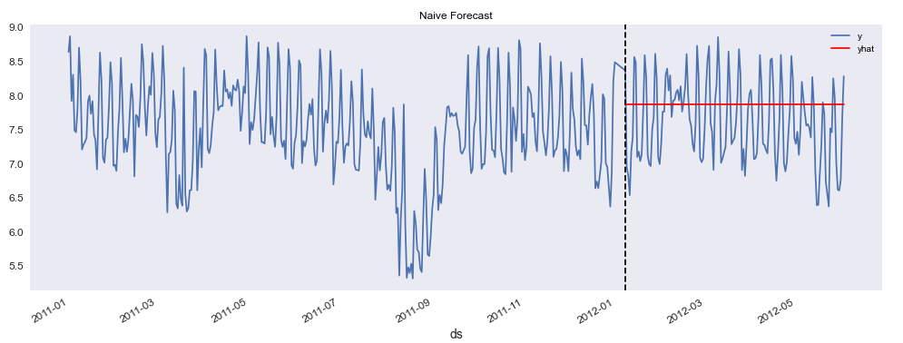

Simple Forecasting Methods
Naïve
Set all forecasts to value of last observation
Viable when data follows a random walk
$${\hat{y}}_{T+h|T}=y_{T}$$
Naïve MAPE = 75.4%

Slide 6
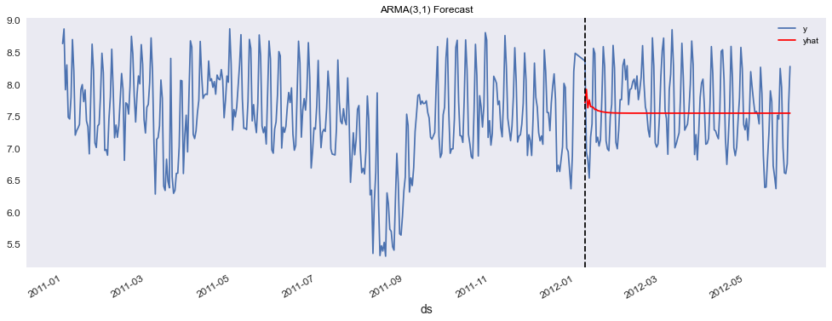
Simple Forecasting Methods
ARMA(p,q)
Auto-regressive
Moving Average
2) ARMA (Auto-Regressive Moving Average)
Value is a function of a) its own past values and b) past error terms
Requires stationary data - ARIMA(p,d,q)
ARMA(1,1)
ARMA(3,1) MAPE = 52.9%

Slide 7
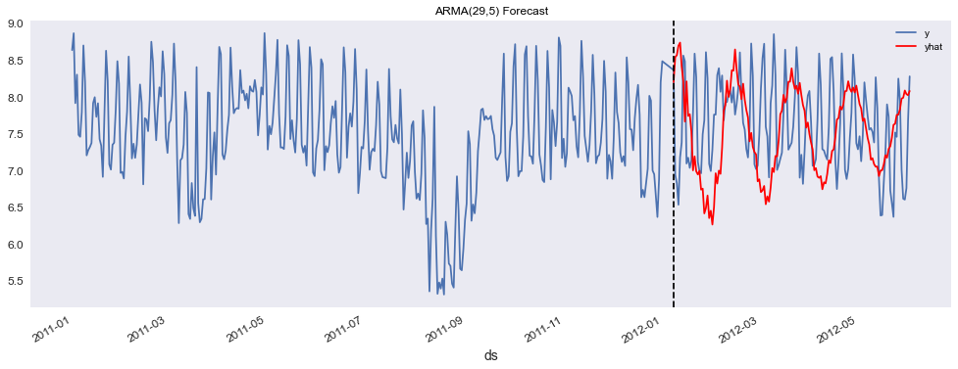
Simple Forecasting Methods
ARMA(p,q)
Auto-regressive
Moving Average
2) ARMA (Auto-Regressive Moving Average)
Value is a function of a) its own past values and b) past error terms
Requires stationary data - ARIMA(p,d,q)
ARMA(1,1)
ARMA(29,5) MAPE = 79.4%

Slide 8

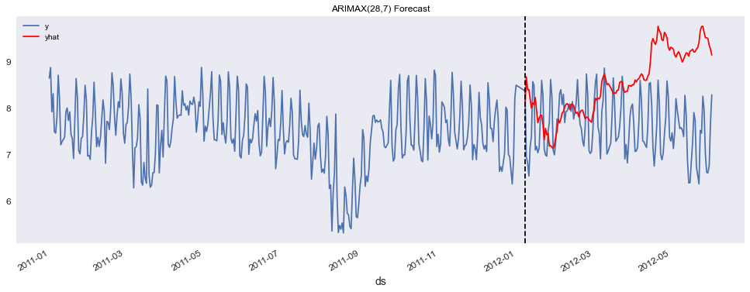
Simple Forecasting Methods
ARIMAX(p,d,q)
3) ARIMAX
ARMA with external regressors
AR
MA
External Regressors
ARIMAX(28,7) MAPE = 309.1%

Slide 9
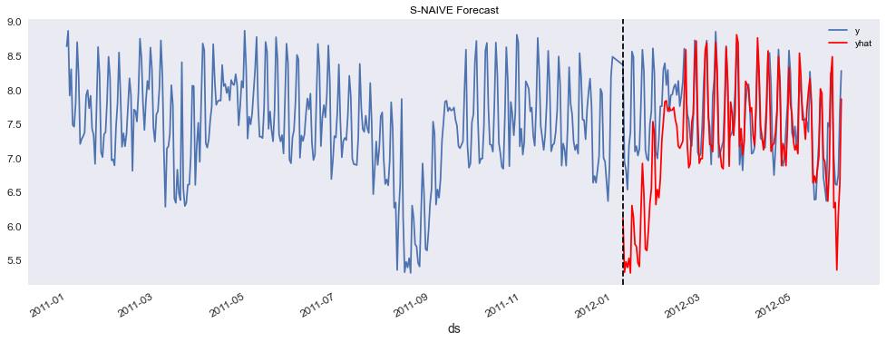
Seasonal Forecasting
1) S-Naïve
Set a seasonal forecast to the last observation of that season
Can do this in a variety of ways (week, month, quarter, fiscal day)
S-NAÏVE MAPE = 36.8%

Slide 10
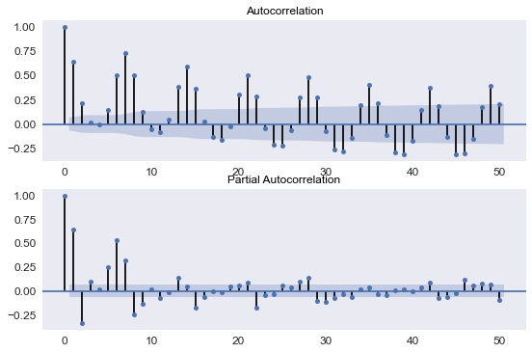
Seasonal Forecasting
2) SARIMA
Seasonal Arima: (p,d,q) x (P,D,Q)s
Use a combination of grid search and visual inspection to pick parameters
Only one “s” can be chosen, does not allow for multiple seasonalities
The strongest seasonality here clearly is 7 days

Slide 11
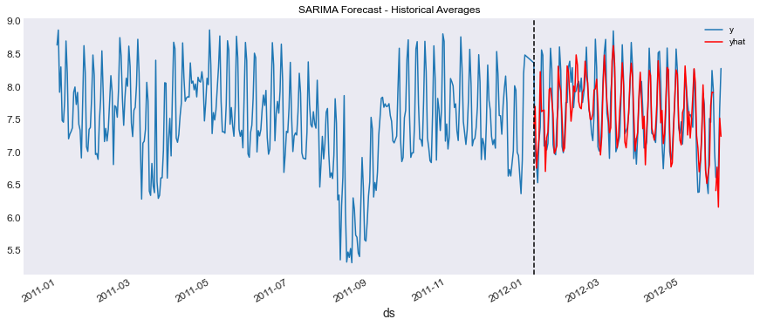
Seasonal Forecasting
2) SARIMA – (6,0,6) x (6,0,6)7
SARIMA MAPE = 28.14%

Slide 12
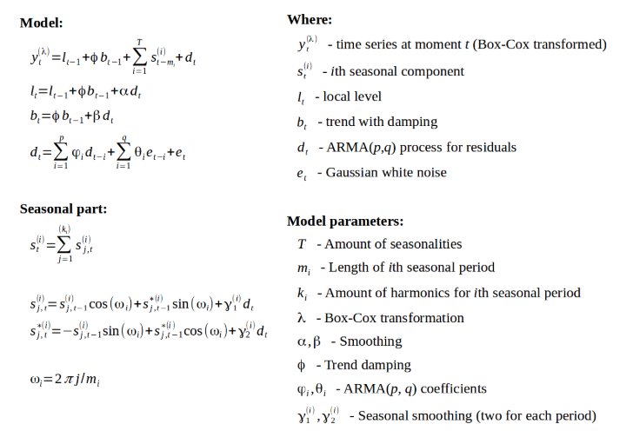
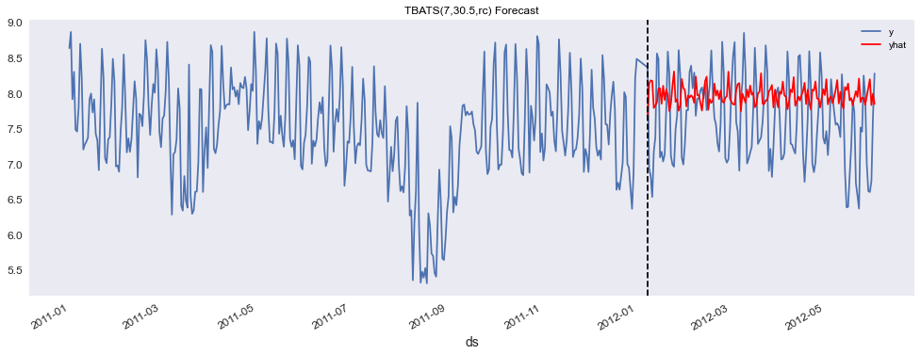
Seasonal Forecasting
TBATS
Trigonometric seasonality, Box-Cox transformation, ARMA errors, Trend & Seasonal components
TBATS MAPE = 166.3%

Slide 13
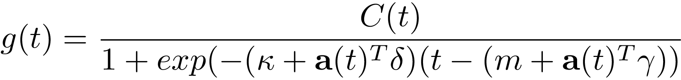
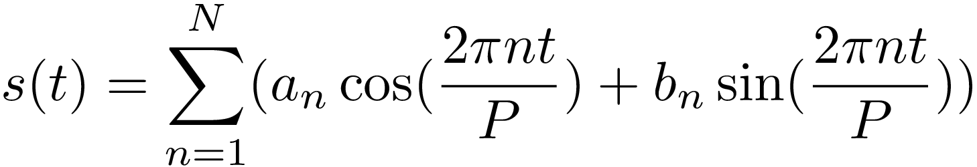
Seasonal Forecasting
Facebook Prophet
Holistic approach that combines growth trend, seasonality, holidays/changepoints, and external regressors
Quickly becoming one of the most widely used seasonal forecasting methods

Slide 14
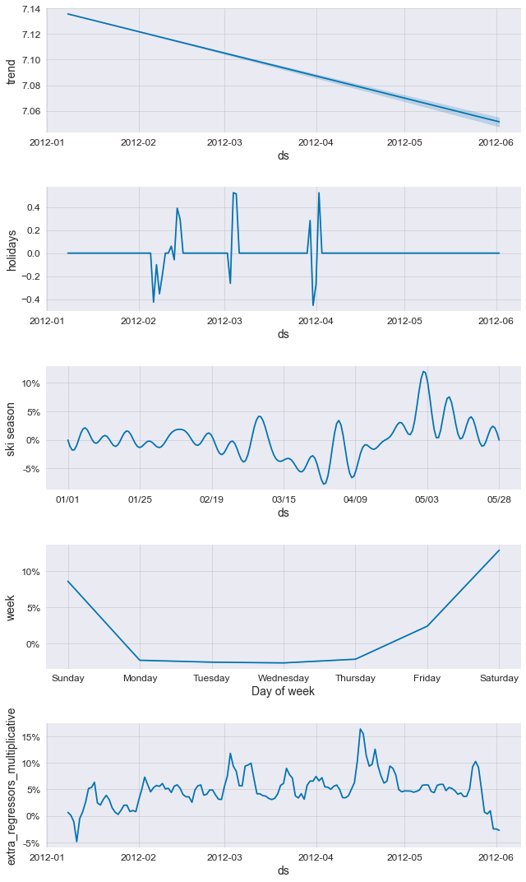
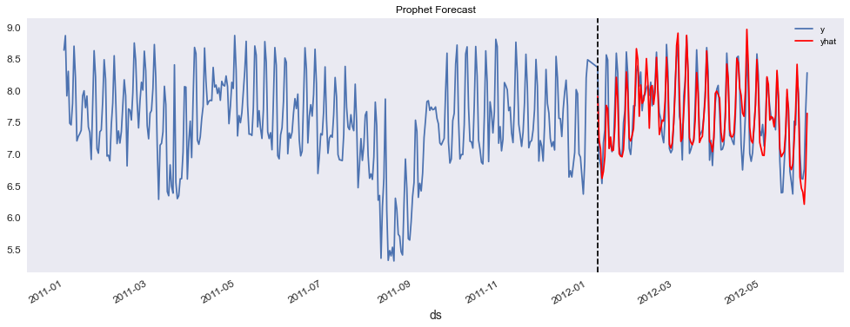
Seasonal Forecasting
Facebook Prophet
Prophet MAPE = 21.5%

Slide 15

Other Forecasting Methods
1) LSTM
“I grew up in France. I had a good childhood with a loving family. I speak fluent ______.”

Slide 16
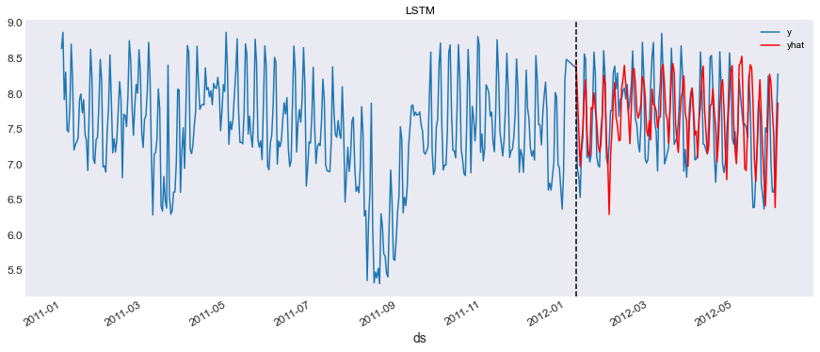
Other Forecasting Methods
1) LSTM
LSTM MAPE = 39.3%

Slide 17
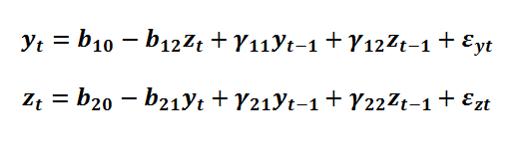
Other Forecasting Methods
VAR
- Similar to the AR(p) setup, but y also depends on the lags of another time series
- Popular in time-series econometrics, primarily in finance
Works best when the dependent time series primarily follow a random walk

Slide 18
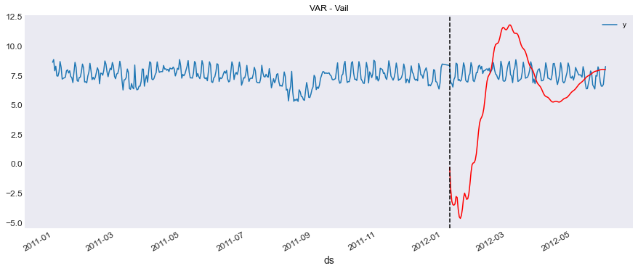
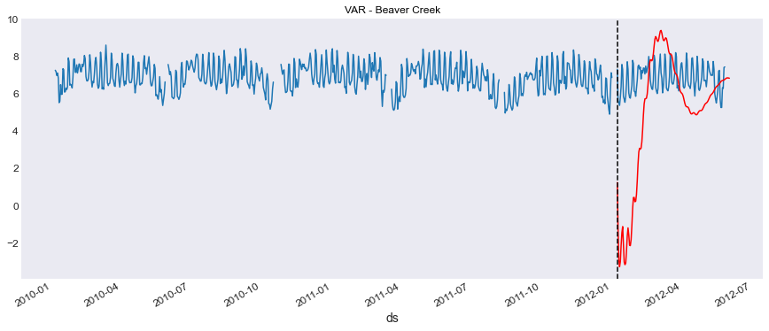
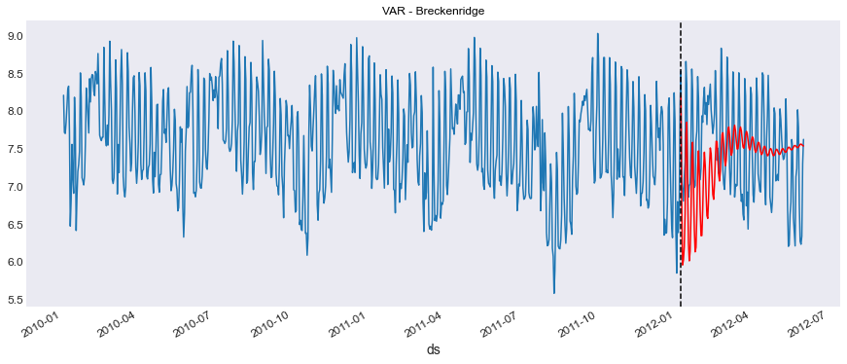
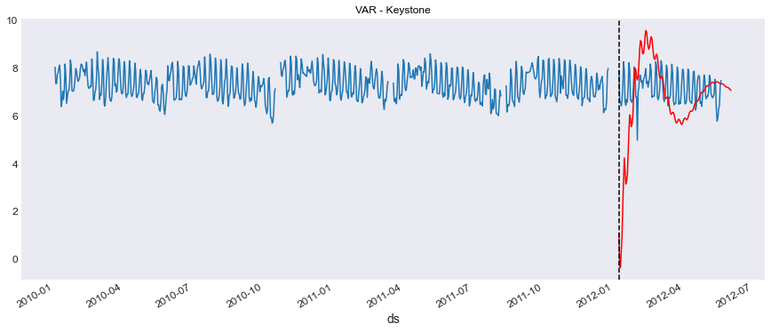
Other Forecasting Methods
VAR
VAR MAPE – Vail = 716.3%
VAR MAPE – Beaver Creek = 716.3%
VAR MAPE – Breckenridge = 67.6%
VAR MAPE – Keystone = 716.3%

