Slide 1
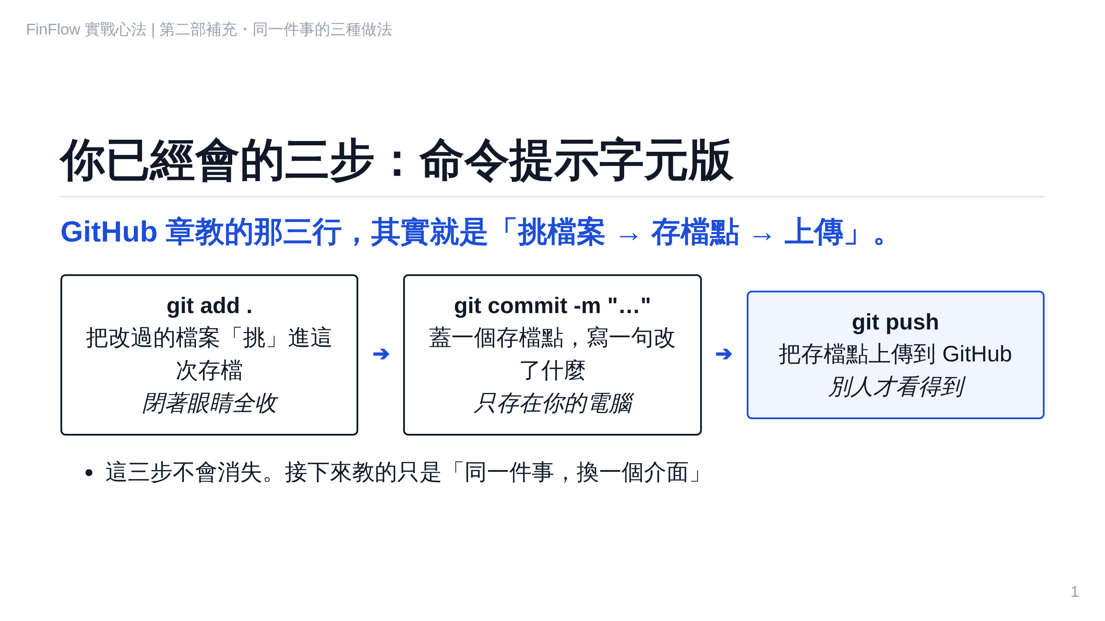
Notes:
S2-1

Slide 2
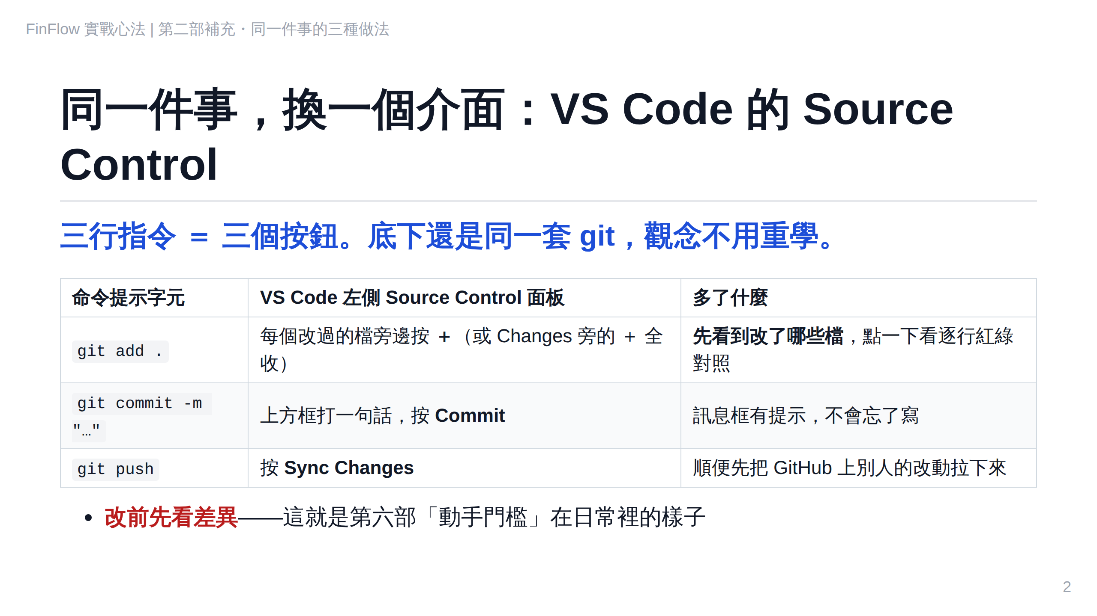
Notes:
S2-2

Slide 3
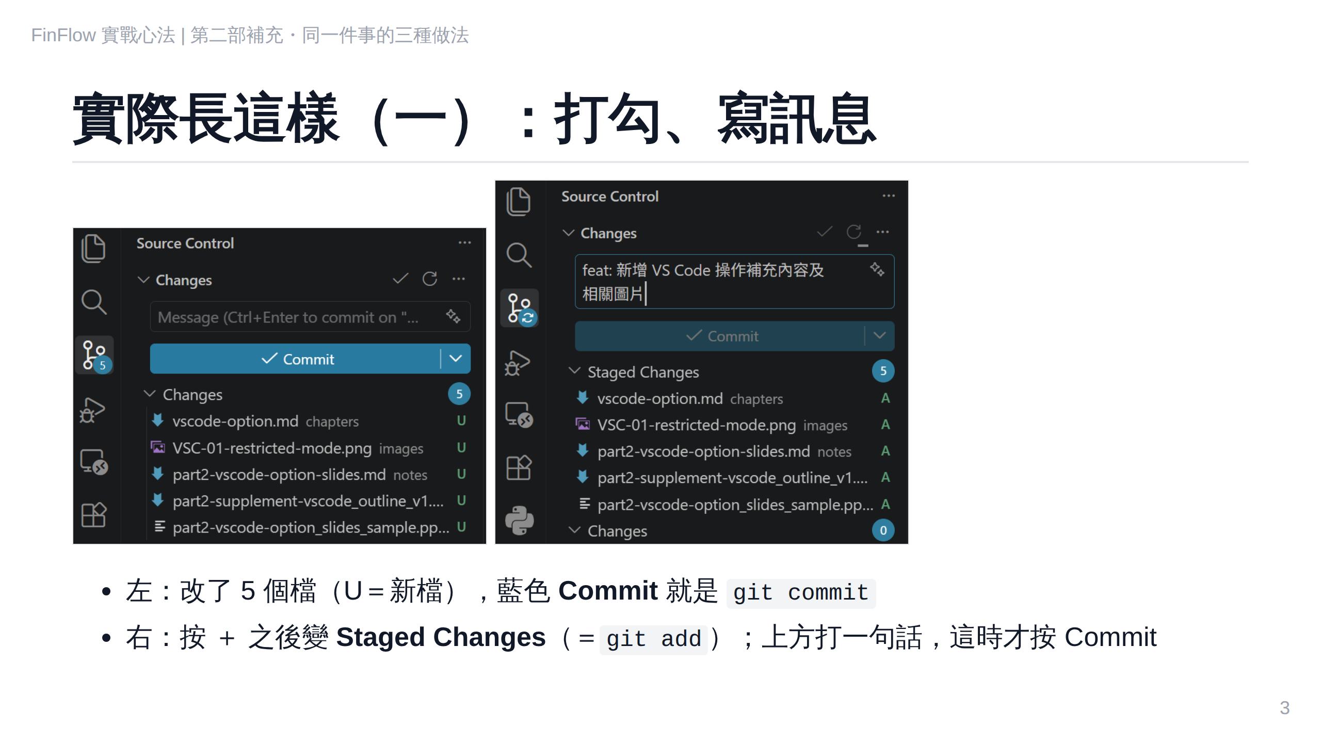
Notes:
S2-2b

Slide 4
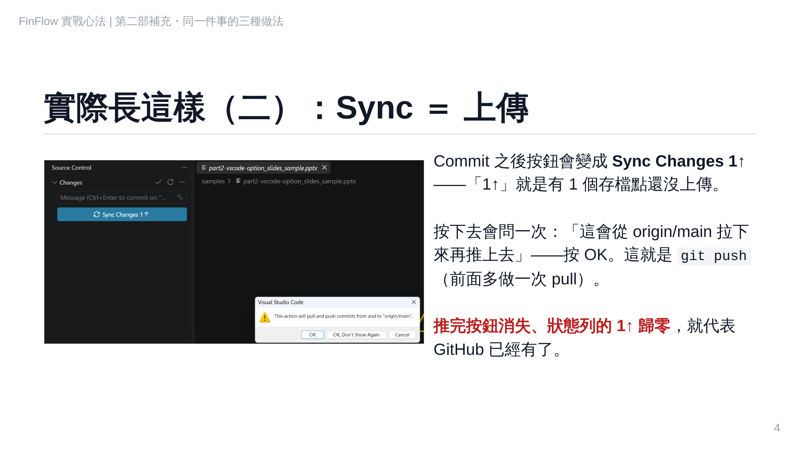
Notes:
S2-2c

Slide 5
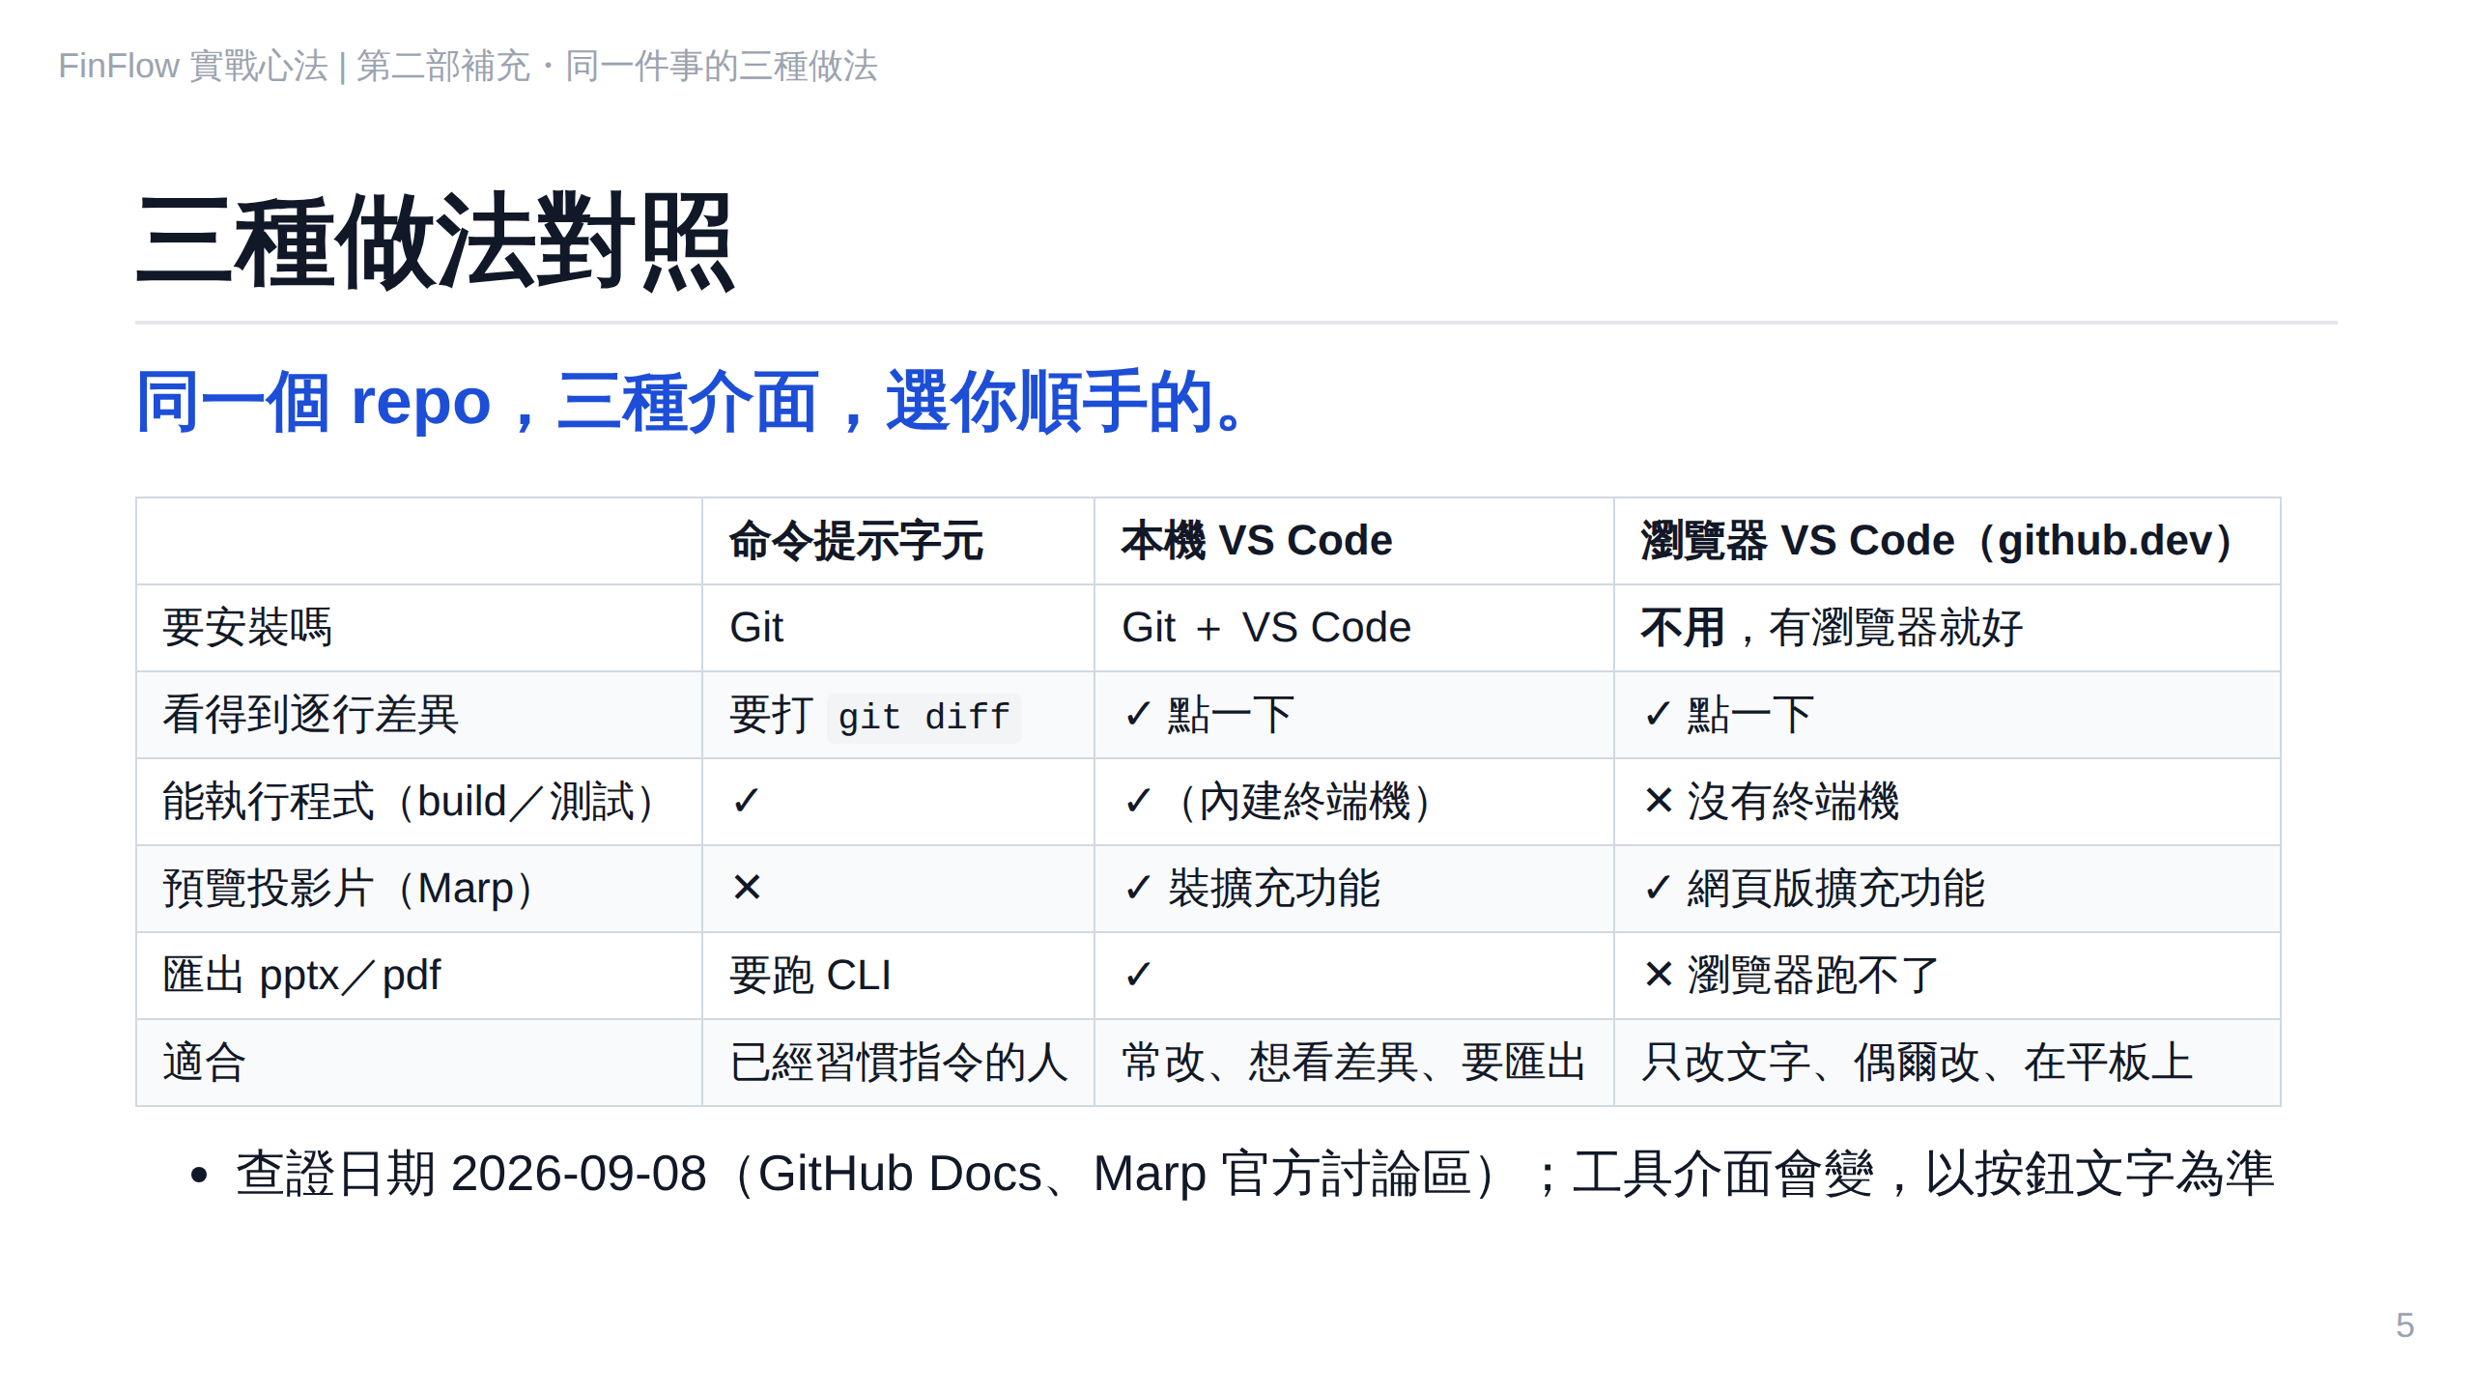
Notes:
S2-3

Slide 6
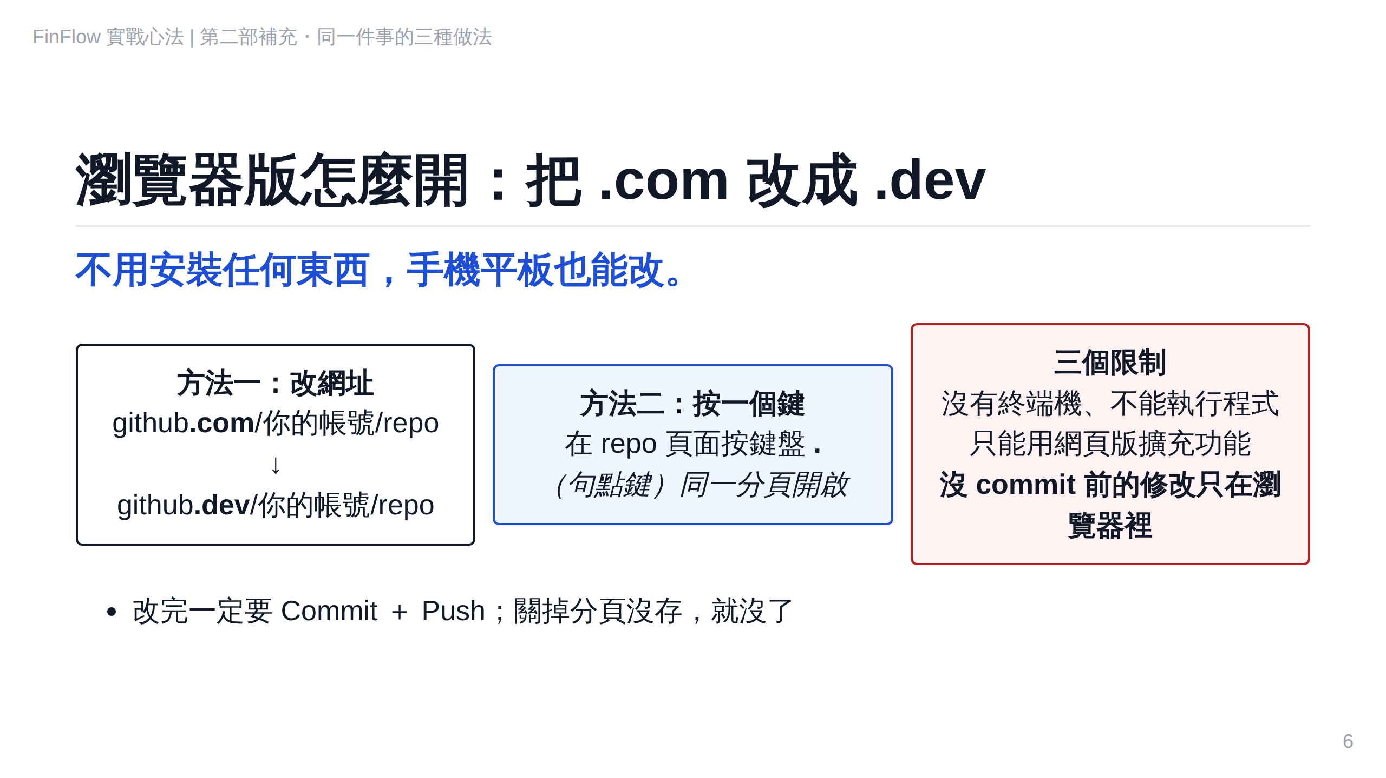
Notes:
S2-4

Slide 7
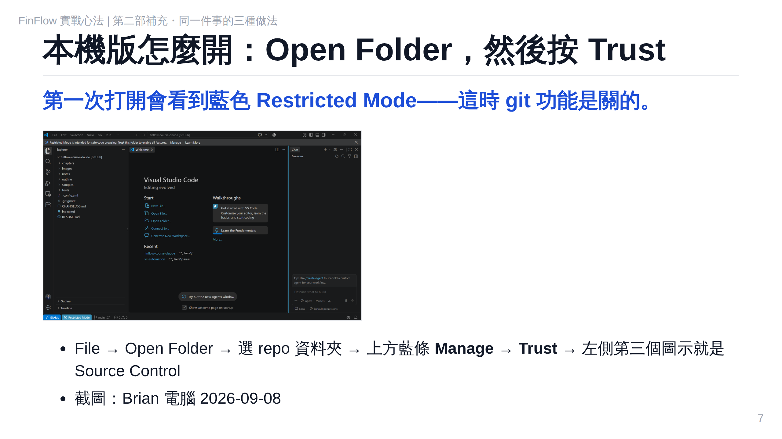
Notes:
S2-5

Slide 8
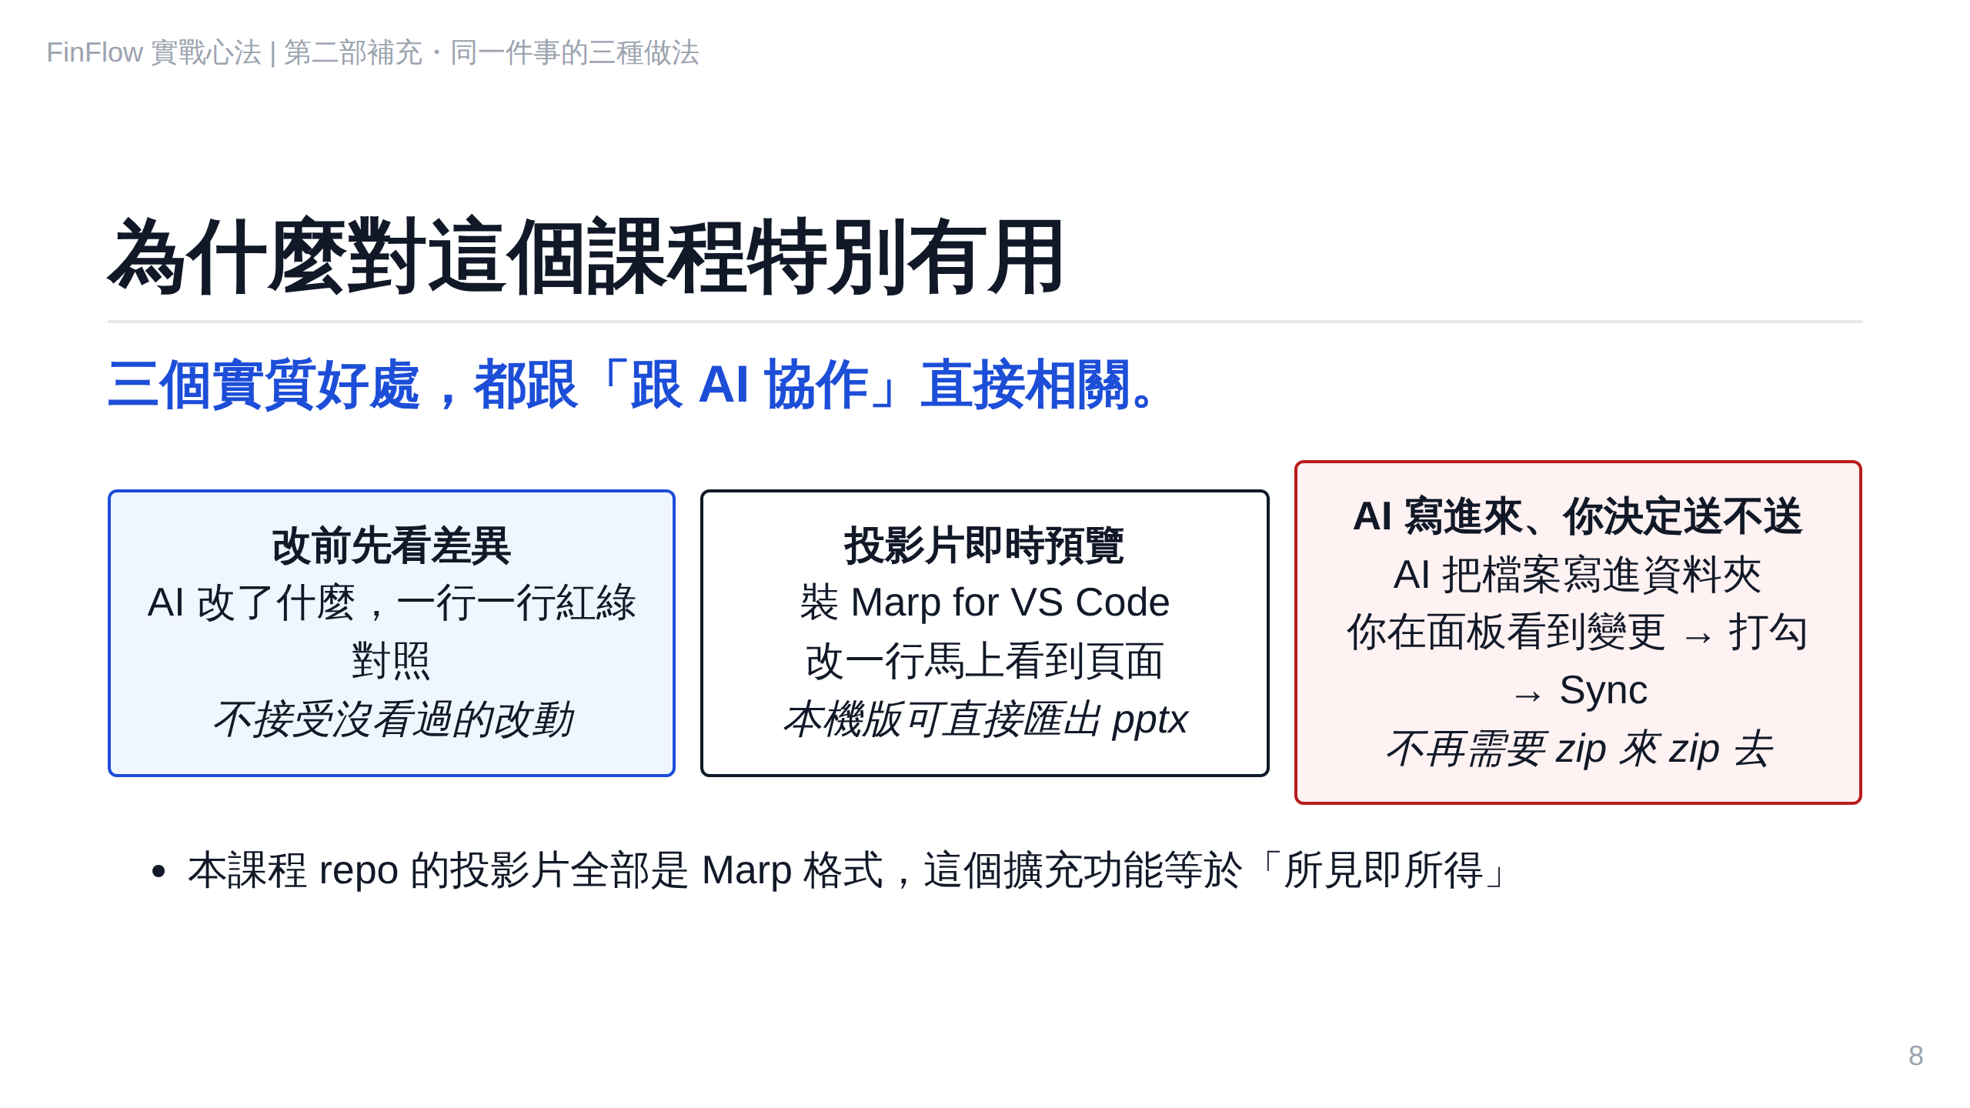
Notes:
S2-6

Slide 9
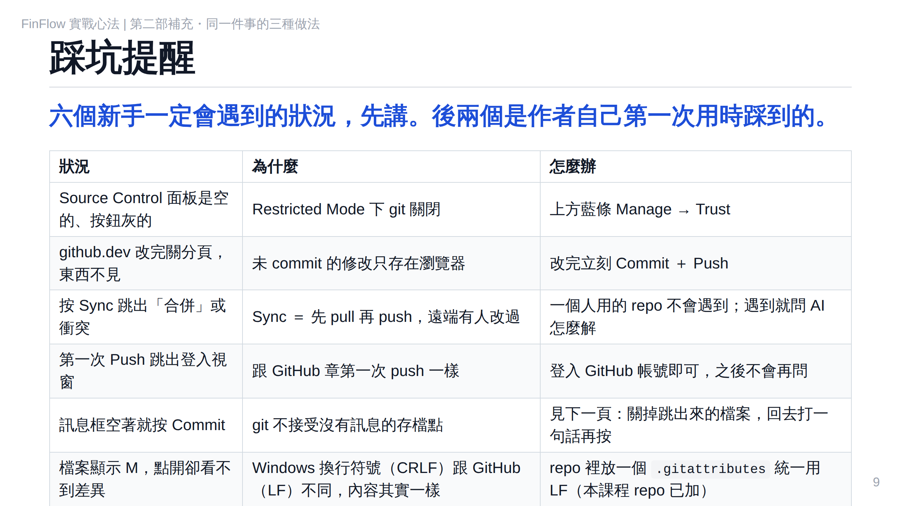
Notes:
S2-7

Slide 10
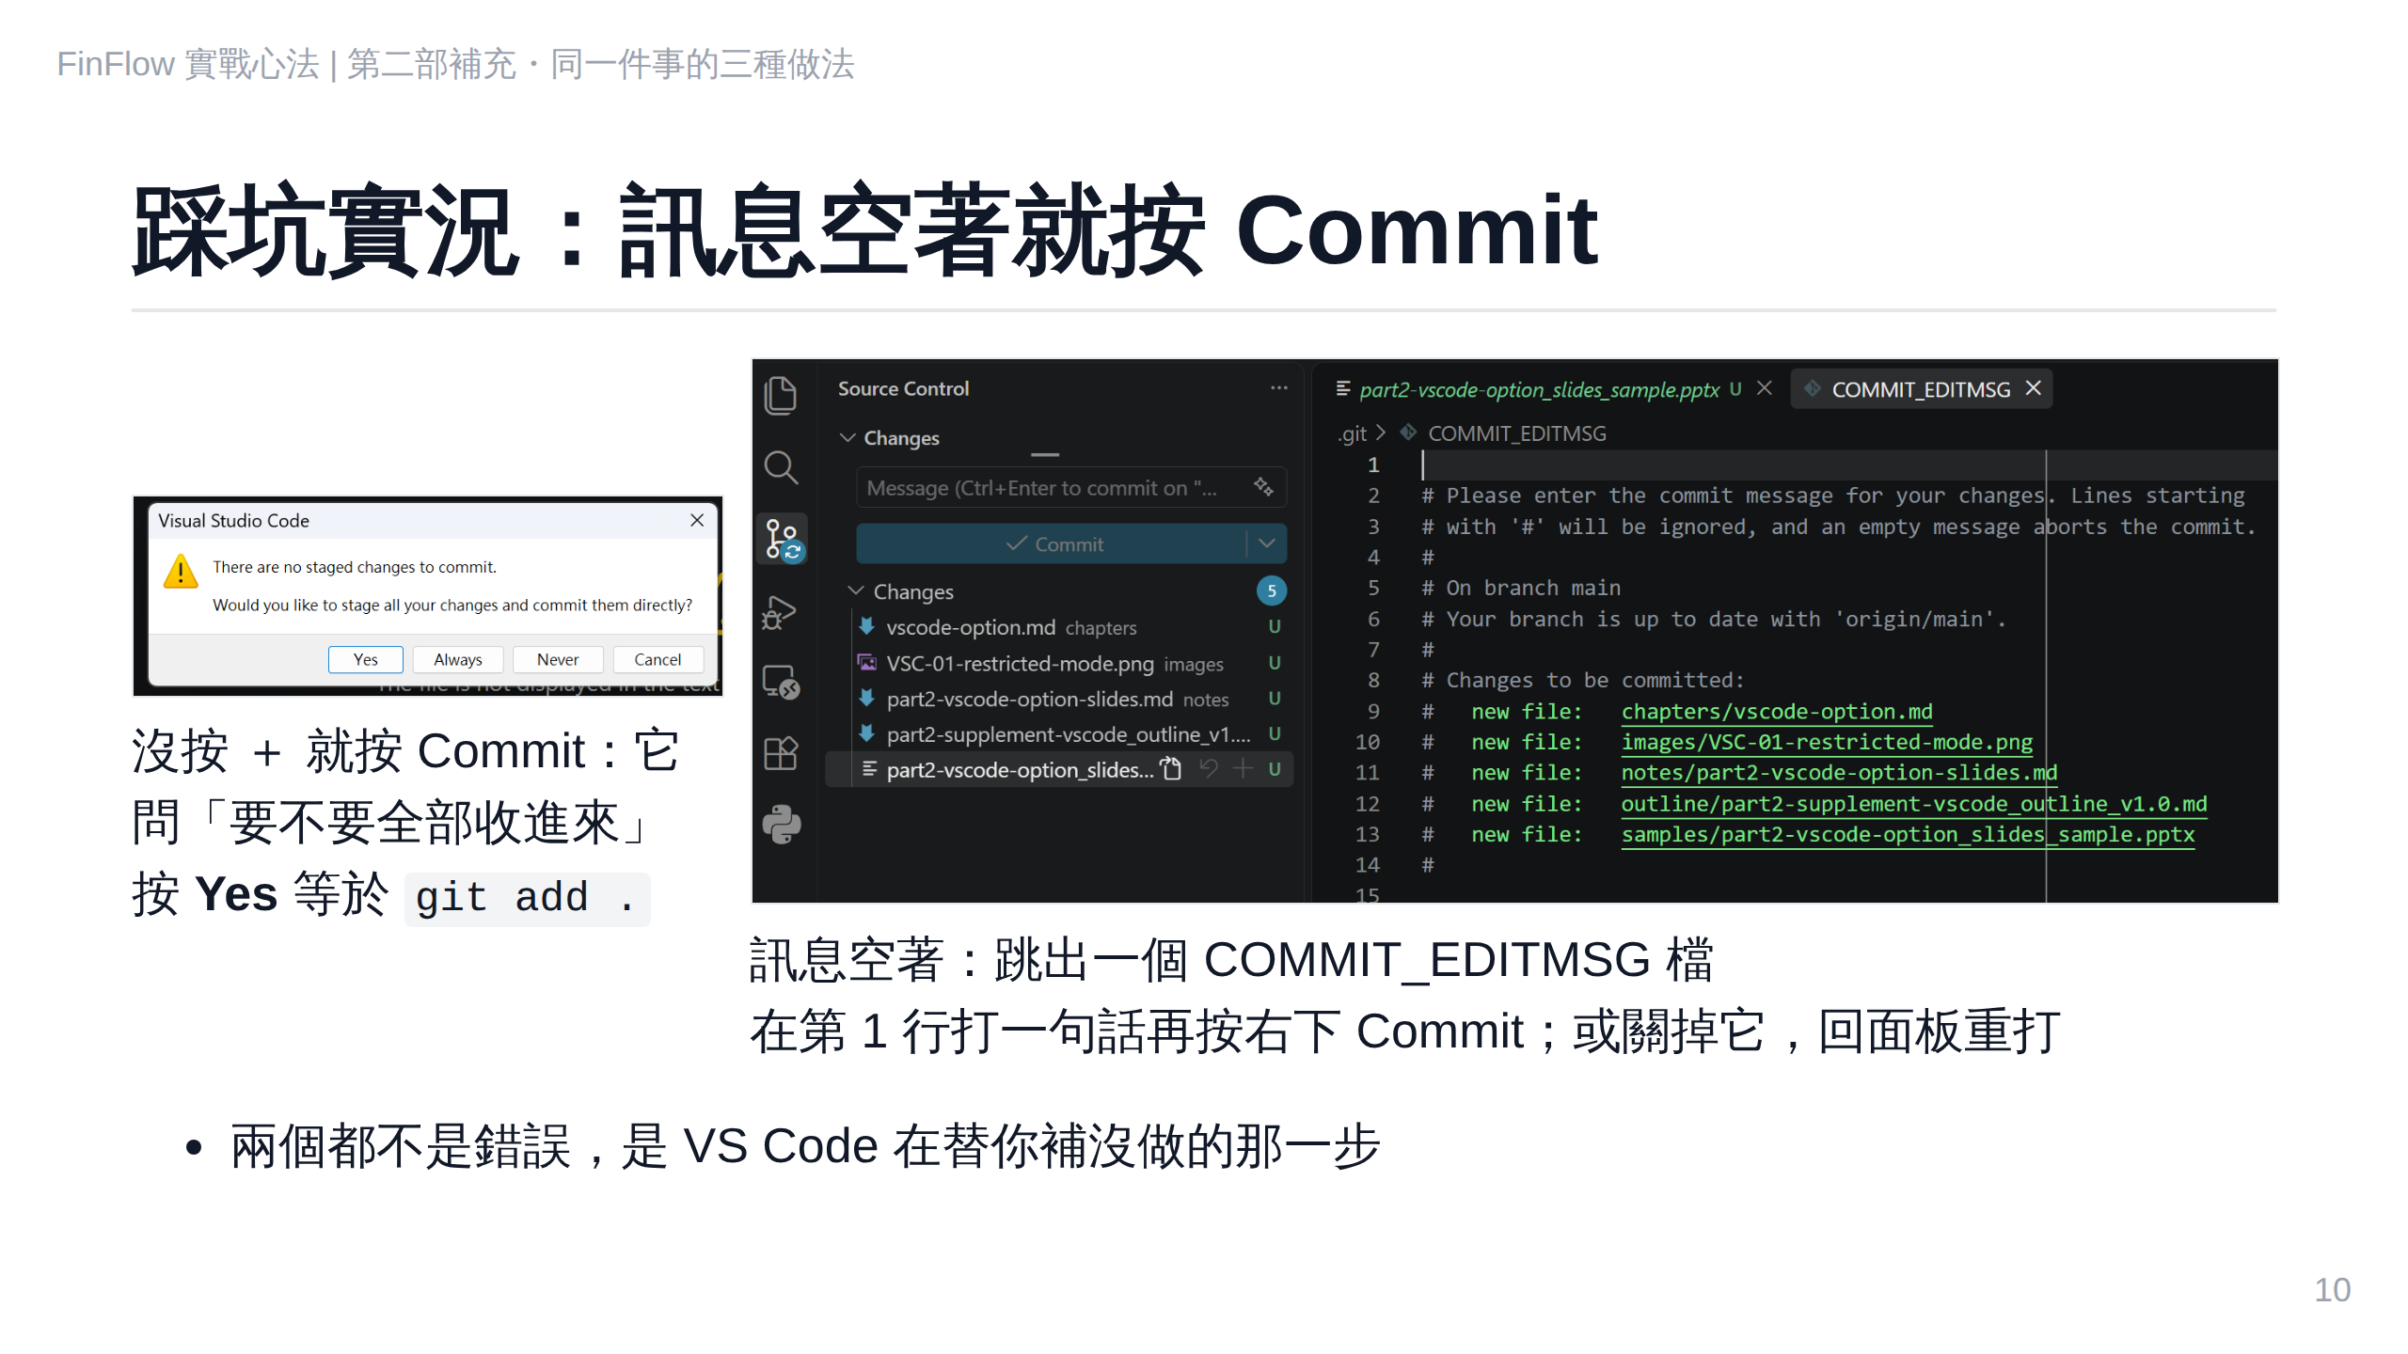
Notes:
S2-7b

Slide 11
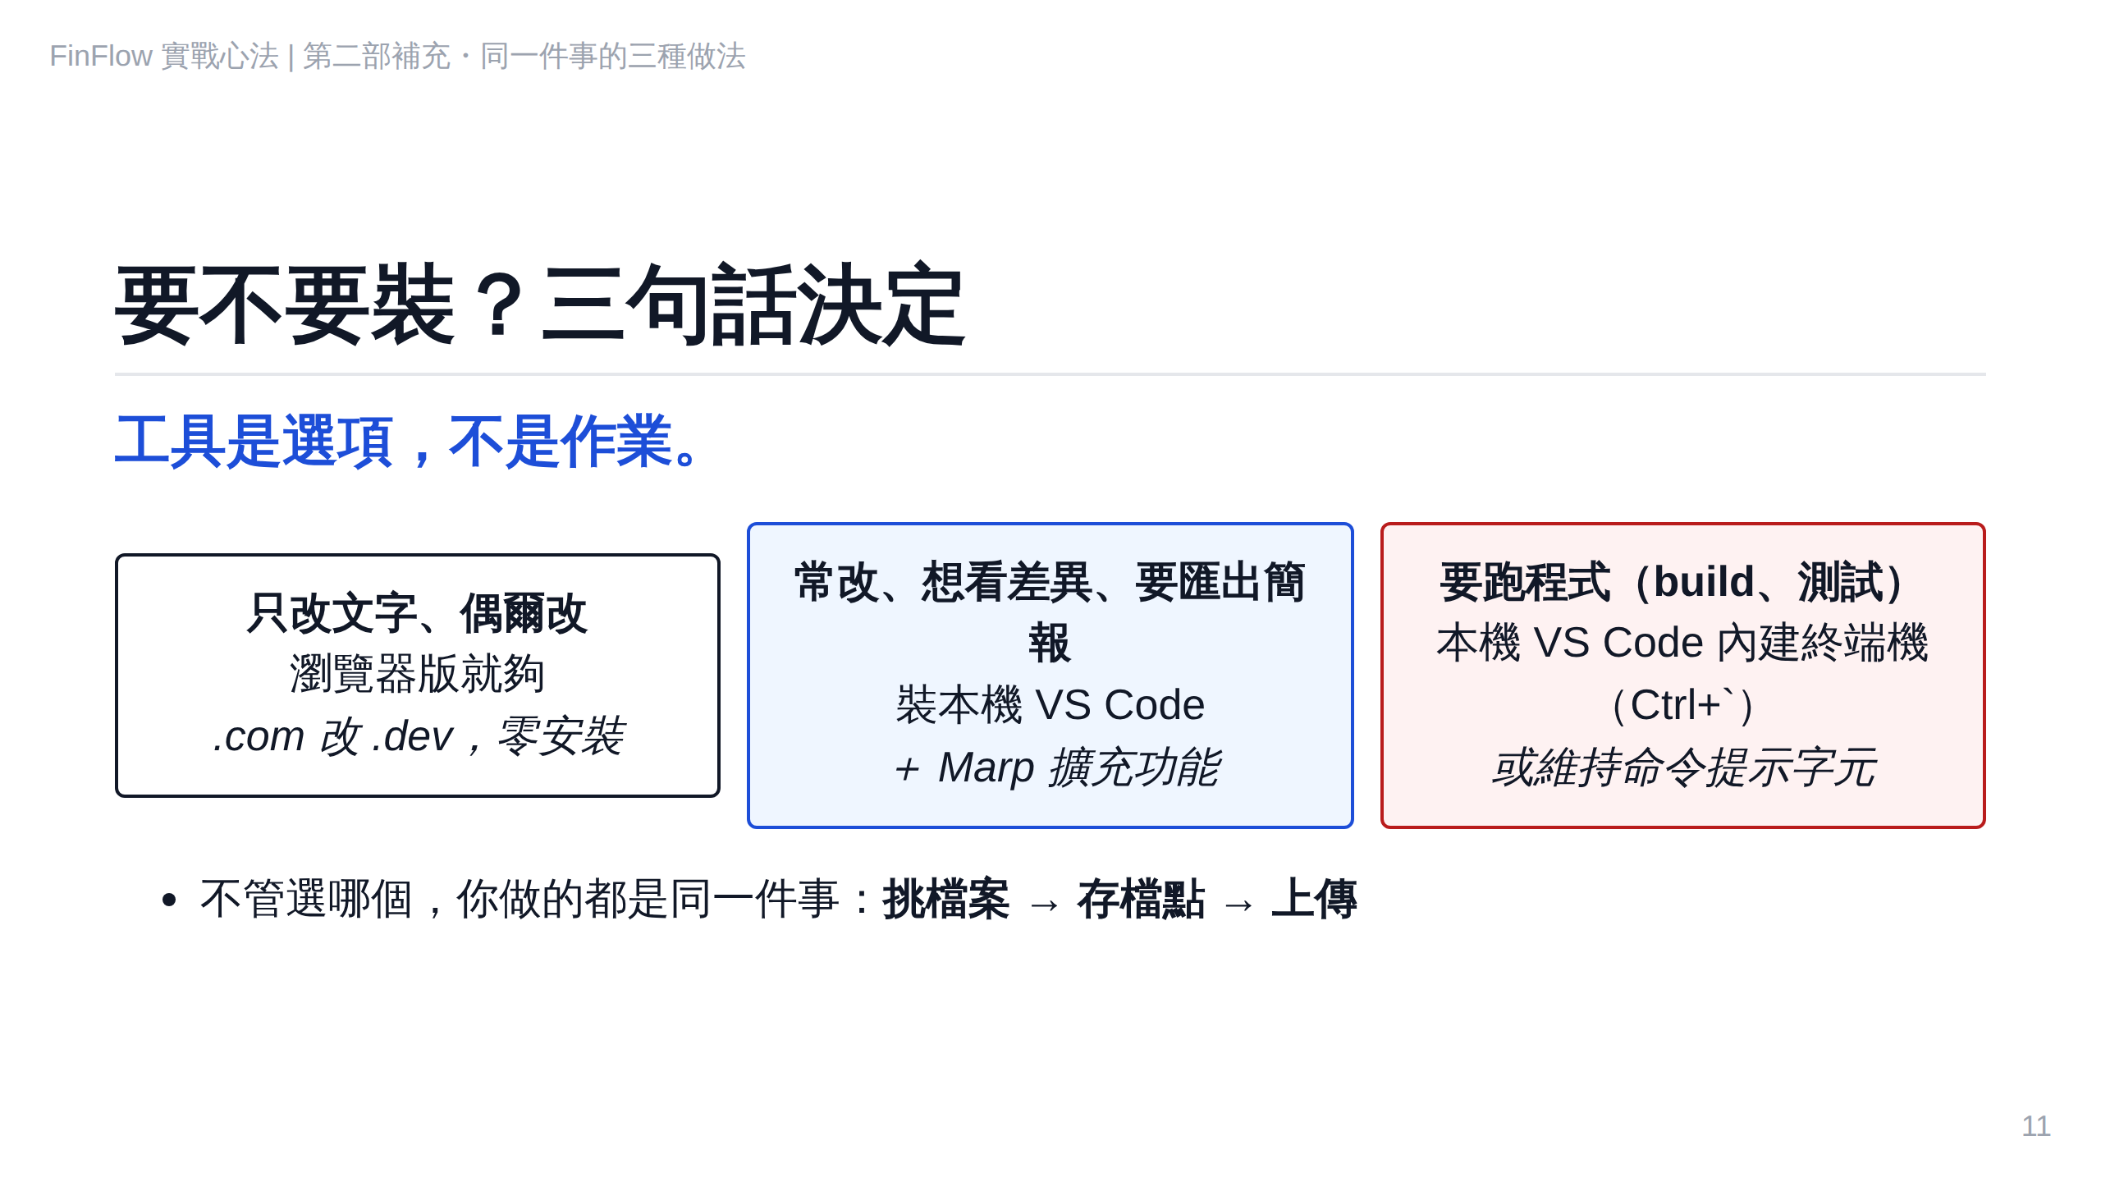
Notes:
S2-8

