Slide 1
Decentralized social media design training episode 1: training intro.

Slide 2







The Aim Of The Course
Trying to establish a decentralized social media platform for everyone,so that we can connect to each other directly, as the name says peer-to-peer. Such that we protect our privacy and prevent censorship
I know too
Social media vendor:
www.YouHaveToUseMe.com
Let meet at usual place
“Gate” server
For setting up p2p connection
“Gate” server
For setting up p2p connection
Okay,I know
VS
Li Lei
Han MeiMei
Li Lei
Han MeiMei
P2P connection
Centralized social media
All user data goes thru social media vendor’s data center,vendor gets access to private data
decentralized social media
No social media vendor is required!
Peer to peer secure connection
No one can easily collect our private data
After we finish this project you will be able to learn：
1. full stack web development for various kind of websites
2. integrating deep learning and IOT with website

Slide 3
Course Schedule
Introduction
Part 1：Getting started with basic front-end(Reactjs) and backend design
Part 2：peer to peer video call
Part 3：Blog design and notification
Part 4：photo album
Part 5：basic video streaming system
Part 6：Integration with NLP(Nature Language Processing)
Part 7 ：IOT, controlling demo boards or cameras at home
Coming later：embedded device and FPGA design

Slide 4
网站已建和待建模块介绍
https://decensormedia.org/

Slide 5
About me
伍成和 ChengHe Wu, grassroot. A target of China fox hunting, looking for political asylum, need help for a job.
Linkedin : https://www.linkedin.com/in/brianwchh
Twitter: @brianwchh
Parler: @brianwchh
Github: https://github.com/brianwchh
have been working for over 13+ years, have been working in the following fields: wireless communication algorithm design and implementation on FPGA, computer vision, deep learning, previously focusing on embedded devices using verilog HDL, C/C++, python. Recently working as web developer.
I will be make following tutorials：
1. decentralized social media web develop
2. my startup project when I was in China : 3D sensor on FPGA ： https://youtu.be/bsx7o-PnaLA https://youtu.be/se1tIy5UWpE

Slide 6
Today’s agenda
The secret hunting & torture from CCP
Short connection VS long connection
Frontend framework and its evolution
languages for backend
Lifecycle of backend request-response
Backend framework
We should be able to write a framework
System diagram of DeCensorMedia
Micro data center will be a future market
Cellphone will be a remote controller
The encryption market for frontend and backend

Slide 7
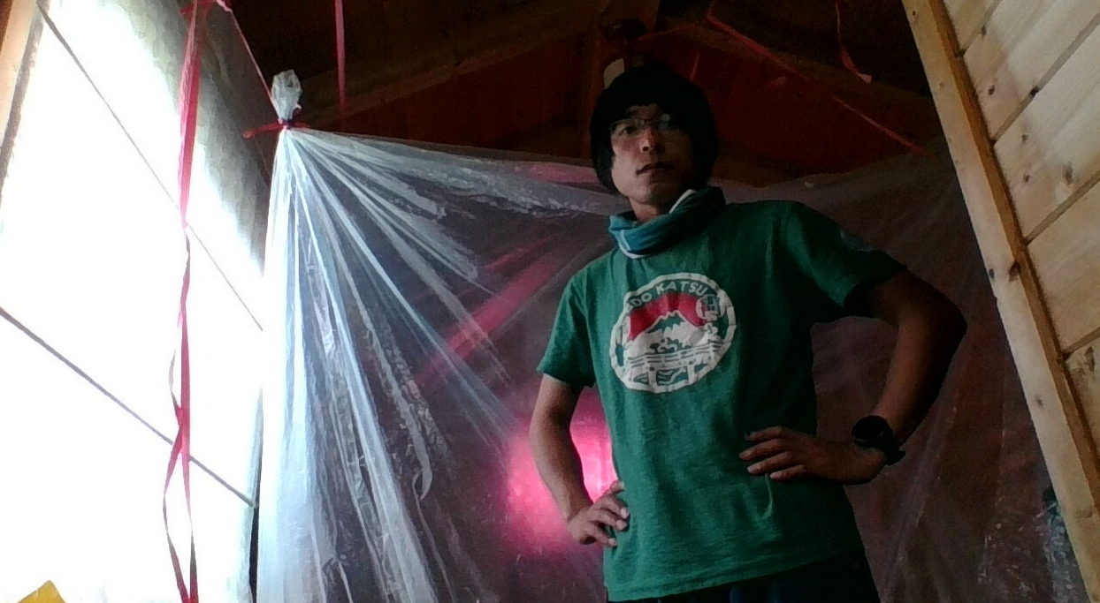
Secret hunting & torture from CCP
Chemical gas : a high-tech weapon of chemical !? subtle smell, not easy to notice, because human nose will get used to it after roughly 30 minutes, especially when you never heard of such ugly trick! It took me about more than 1 year to discover that my sleepless problem was caused by the chemical gas! The long exposure of yourself to the chemical gas in the room will arise the heart problems, it is partially why so many certain people strangely died from heart attack! A very cunning method to torture and kill person! The chemical gas make you don’t have a sense of tiredness, even thought you are exhausted, if one exhaust his body often like this, he is very likely to have a sudden heart attack! I have to end up sleeping in a big plastic bag as below as if I am living in a submarine for a good sleep!
Sonic attack (ultra-sound / infra-sound). A high-tech weapon of physics !? It will also cause sleepless problem! This is also almost impossible for the victim to discover this ugly trick. I happened to record the sound which was I did not heard physically, but somehow the laptop has imperfect signal processing design, it shift the frequency of the ultra-sound/infra-sound to an audible area. This is the link to the sound: https://youtu.be/L_dbZssEKas?t=770 , please maximize the volume of your headphone. It sounds like one driving a car with window open.

Slide 8
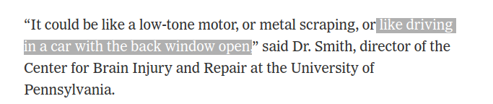
Secret hunting & torture from CCP
Sonic attack (ultra-sound / infra-sound). A high-tech weapon of physics !? It will also cause sleepless problem! This is also almost impossible for the victim to discover this ugly trick. I happened to record the sound which was I did not heard physically, but somehow the laptop has imperfect signal processing design, it shift the frequency of the ultra-sound/infra-sound to an audible area. This is the link to the sound: https://youtu.be/L_dbZssEKas?t=770 , please maximize the volume of your headphone. It sounds like one driving a car with window open as the news says : https://www.nytimes.com/2019/01/04/science/sonic-attack-cuba-crickets.html

Slide 9
Secret hunting & torture from CCP
Hospital ! They make hospital in China a secret battle field, many people got illness such as cancer, dying slowly! It is hard possible for them to know who kill them ! Doctors are not always angels, some are butchers ! They can export such good successful experience oversea as well since they are now very rich! This is the reason they like torturing victims, and distract his attention to looking for reasons from their own health reasons, with the help of hacker technology they know the victims each move,and waiting for a opportunity when he visits hospital.
Death looks like accident or suicide! It proves in HongKong, with so many innocent people jumping from high floor with so called suicide letters.
They are no human, they are something that does not belong to earth. If you read this, please kindly tell these important information to people who are liked to be a target of CCP. No matter you are Chinese or not,if you are doing or saying something good but against CCP, you need to know this, so that you won’t end up like me! Thanks for your kind heart,and keep doing good things, but please do be aware of these ugly and dirty tricks,be safe and be good. May God bless you and me, bless the world!

Slide 10
Short connection VS long connection
http/https is short connection. After the server receive a request, it should return the response ASSP, otherwise if it takes long time like several seconds or minutes,that is a bad design, the browser will give time out error. For task like this which will take the server much longer time to process, we should return a response with unique sequence as lookup code, the browser can fire another request with the code and look for the result in database or cache!
Websocke is long connection ! Video call/ messaging chat have to use websocket! So that client and server can sent data to each other, while in https/http short connect, only client can initiate a request to server!

Slide 11
Front-end app
It includes ：
1. web browser。web browser provider has developed almost all kind of version for different OS (operation system)。development language: html, css, javascript .
  Pros : fast development period,can actually replace a lot of Apps for general applications.
  Cons: not efficient for hardware resource consuming applications.like image processing, deep learning...etc, but there is a solution for this in the future if we off load complicated tasks to home server and return the result to phone device,in this case, phone will be just like a remote controller device, the only critical requirement is adequate speed of data network!
2. customized App on android/IOS/computer os etc…
  Pros : can maximize the hard resources.
  Cons: much longer time of development.

Slide 12


Front-end server and evolution
A traditional web structure is as below
request
Rendered
Web page
response
Web server
Cons: have to reload the whole page from server when even a small change => bad user experience.
Evolution, SPA framework, such as Angular, React, Vue…

Slide 13
Frontend + backend server
front-end server
Request
Post data to database
back-end server
request
Response
Download
SPA
Response
Get data from database
Front-end browser render.
In real project,we hide back-end sever behind nginx server via proxy

Slide 14
Cons of frond-end app rendering
Bad for SEO, search engine get blank page from front-end server.
In order to satisfy SEO, people come up with front-end server rendering
Response
Get data from database
front-end server
Request
Post data to database
back-end server
Request
Get/Post a
page
Response
Rendered page
front-end server render

Slide 15
Recap of three type of rendering
Traditional
Server-end
Rendering
Front-end
Browser
rendering
Front-end
Server
rendering
Front-end & Back-end
is not decoupled
Front-end & Back-end is decoupled
Still no framework satisfy both ：
1. user experience
2. search engine

Slide 16
Our front end solution
In this project we are going to use both frontend server rendering and front-end browser rendering, certain pages for SEO are rendered at server end, rest are rendered in browser

Slide 17
Languages for backend
People used to design back-end mostly with C++
Cons of C++, slow development time, requires much higher skills, need to be very careful with memories 。
PHP, Javascript, Java and python run on engines which runs on OS .
  Pros : engines are much stable with good teams maintaining. Speed up the development time, easy to start with.
PHP code
Zend
OS
Golang
  Pros: the compiled code is an executable file which runs directly on OS, same as C++, but with fast development time

Slide 18
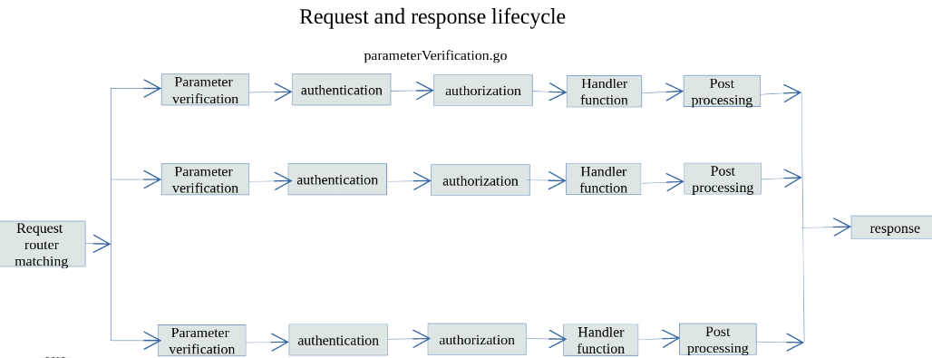
Backend request-response life cycle

Slide 19
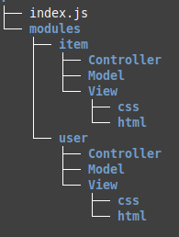
Backend frameworks
MCV
Controller : connects request to its handler function
Model : dealing with database
View。dealing with web page rendering, for instance, html,css file, some framework adds functions to get data for variables in html files.

Slide 20
We should be able to write framwork
Not all frameworks satisfy our own project requirement, we need to develop our own
In this project we will going to write a framework with golang
github: https://github.com/brianwchh/buildGoFrameWork.git

Slide 21
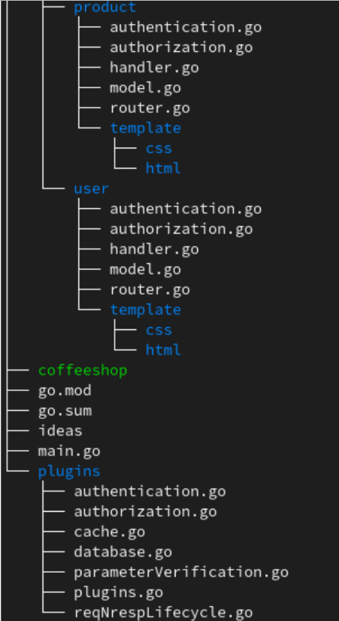
我們要能夠自己寫一個框架(2)

Slide 22


DeCensorMedia系統框圖
Micro data center
Front-end server
Micro data center
Front-end server
Static public IP
Static public IP
Static public IP
Static public IP
Offload job to
home server
Offload job to
home server
IOT
IOT
Peer to Peer
Dot line means: if firewall is not penetrable,fallback to cloud server proxy
Home Server
Home Server
IOT
Internet Of Things for home device control

Slide 23
Micro data center
Data center will never be private garden for big companies. Every one has to opportunity to run micro data center.
何爲機房？一個價格稍貴的public static IP + 服務器，何爲服務器？就是不需要顯示器的規格稍高的電腦。可以幾個人合夥買或者租，作爲私人使用，非商業級別，放在一個人家裏即可實現外網的訪問和轉發等功能的微型雲端機房。
機房最終要的品質是信任！社區裏的機房，或是相識之人的機房，或許會比遠在天邊的機房更讓人有信任感覺！人之常情！
做FPGA的朋友可以往微機房設備方向發展。

Slide 24
Cell phone is a remote controller
Our cell phone will be a remote controller for our home IOT system
Time and hardware consuming tasks can be uploaded to home server.
we no longer have to upload our voice to others cloud server for free translation. Free is not free of price, our privacy is more valuable and important!

Slide 25
The market for encryption
There is no absolute safe device in the world. Security is not free, same as freedom!
There is huge need for front-end device and backend server

