Slide 1

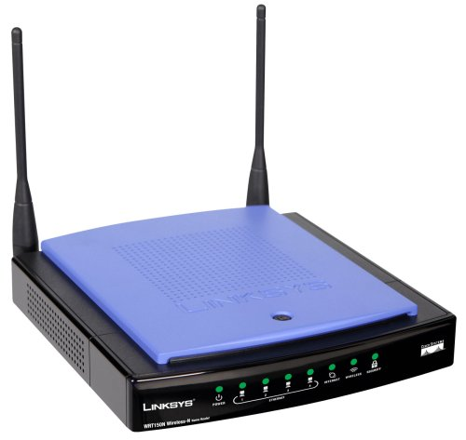
Sliding Window Protocols
Group 2
Aswi Patel, Blake Patterson, Brain Weber, Caleb Snider, Cameron Falls, Cameron Lengyel

Slide 2
Recap
Everything in class today runs on the Data Link Layer
Bridges the Network and Physical layers.
In a real-world application, this would be the code that runs on an NIC

Slide 3
Background
What are the limitations of the Simplex Protocols discussed thus far?
What if the receiver does not receive acknowledgment?
Not bandwidth efficient
Sliding window is a set of protocols that solve these problems
Allows bidirectional communication
Piggybacks acknowledgment
Tracks received frames

Slide 4
Background: Question
What does sliding window do that simplex cannot?

Slide 5
Bandwidth-Delay Product
Is used to find the appropriate value for W or the window size
Is measured in bits/sec multiplied by the one-way transit time
This quantity is called BD

Slide 6
BD Formula
W is then equal to 2BD + 1
Twice the bandwidth-delay and an extra frame for the frame needed to be used for acknowledgement for a round trip continuous frame sending
The formula represents all the data needed to send through the entire protocol

Slide 7
Question
If the BD is 12.5 frames, what is the W?
A) 25
C) 49
B) 12.5
D) 26

Slide 8
Pipelining
The technique of keeping multiple frames in flight
Pipelining reduces the wait time of a process
Pipelining over an unreliable communication channel can raise some serious issues over what happens when a frame gets damaged or lost
To fix this issue, multiple protocols were introduced to decide what to do with the frames that are lost.

Slide 9
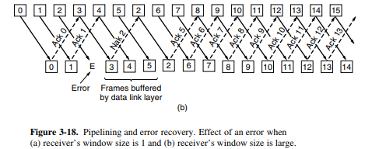
Go-Back-In
Allows the sender to transmit up to “W” frames before blocking, instead of just one
This allows the sender to send a continuous stream without being blocked
The value of “W” is based on bandwidth

Slide 10
Video
https://www.youtube.com/watch?v=9BuaeEjIeQI

Slide 11
Question
Go-back-in creates a ____ stream?
insidious
C) condescending
B) continuous
D) prestigious

Slide 12
Using Selective Repeat
The Go-Back-N protocol can have some errors that wastes bandwidth.
Selective Repeat allows the receiver to accept and buffer the frames following a damaged or lost packets.
The sender and receiver maintain the window based on each computers specifications.
A buffer is used to keep both sender and receiver in sync.

Slide 13
Differences
Go-back in is inefficient compared to Selective Repeat Protocol
Go-back protocol is named that because it has to go back in to window whenever there is an error
Selective Repeat has a buffer on both the sender and receiver
Selective Repeat has a negative acknowledgment

Slide 14
Question
Selective Repeat prevents the loss of packets by using what ?
A) a pauser
C) a bunter
B) a buffer
D) a stopper

Slide 15
Examples
Point-to-Point Protocol (PPP)
Is used to send packets over links between modems and leased lines
SONET
Is a physical layer that provides a bitstream to carry packets
Serial Line Internet Protocol (SLIP)
Similar to PPP, is used to handle error detection links, support multiple protocols, and permit authentication

Slide 16
3 Main Features of PPP
A framing method that delineates the end of one frame and the start of another one. Also handles errors.
A link control protocol for bring lines up, testing them, and negotiating options. This protocol is called Link Control Protocol (LCP) and brings down links when they are no longer being used.
A way to negotiate network-layer options in a way that is independent of the network layer protocol to be used. This is called the Network Control Protocol (NCC).

Slide 17
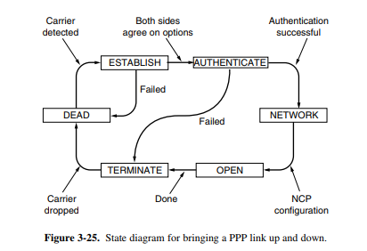

Slide 18
Question
Which is not a step of PPP?
A) a link control protocol for bring lines up, testing them, and negotiating options
C) a way to negotiate network-layer options in a way that is independent of the network layer protocol to be used
B) a framing method that delineates the end of one frame and the start of another one
D) A way to navigate the frames within the protocol while calling the tests

Slide 19
Examples
High-Level Data Link Control (HDLC)
Is a widely used instance of an earlier family of protocols, was used to help choose the PPP frame format
Asymmetric Digital Subscriber Loop (ADSL)
ADSL connects millions of homes to an internet service

Slide 20
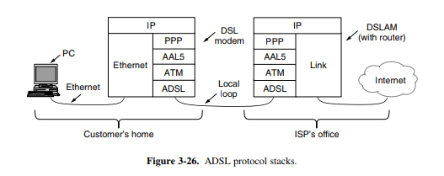

Slide 21
Question
What is HDLC?
Hyper-Light Data Conduit
C) High-Definition Lan Cable
B) High-Level Data link Control
D) Heavy-Duty Laser Collider

Slide 22
Code Demo
Simulated the physical layer with a file on disk
Simulated the network layer with the command line
Limitations:
Only sends in multiples of MAX_SEQUENCE_NUMBER
Receiver sends acknowledgments for groups, not individual frames
unidirectional

Slide 23
Source
Computer Networks Textbook, by A Tanenbaum
youtube.com/watch?v=9BuaeEjIeQI
Code is hosted at github.com/brianweber13/itcs3116-sliding-window

