Slide 1
Length Bias And Search Limitations In Cartesian Genetic Programming
Brian W. Goldman and William F. Punch
BEACON Center for the Study of Evolution In Action
Michigan State University

Slide 2
MOTIVATION
Search Is Most Efficient When Bias Matches Problem
Incorrect Bias Can Prevent Search Success
Impossible
Improbable
Bias Hidden By Complex Interactions
Representation
Operators

Slide 3
Cartesian genetic programing
Directed Acyclic Graphs (DAGs)
Fixed Maximum Size
DAG of size N+1 impossible
Flexible Actual Size
Active – Part of solution
Inactive – Currently unused
Exclusively Uses Mutation
Mutated Genes Randomly Reset
Valid Values Only
Neutral Elitist Selection
Parent replaced if offspring is at least as fit

Slide 4
Genome ordering
Input
Active
Inactive
Active
Inactive
Active
Inactive
Output

Slide 5
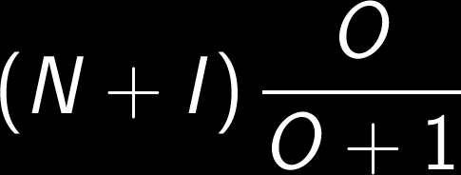
Rightmost Active
Non Uniform Active Node Location
Equation Variables:
O = Number of Outputs
I = Number of Inputs
N = Number of Nodes
Example: I=2, O=1, N=2000
Expected Rightmost = 1001

Slide 6
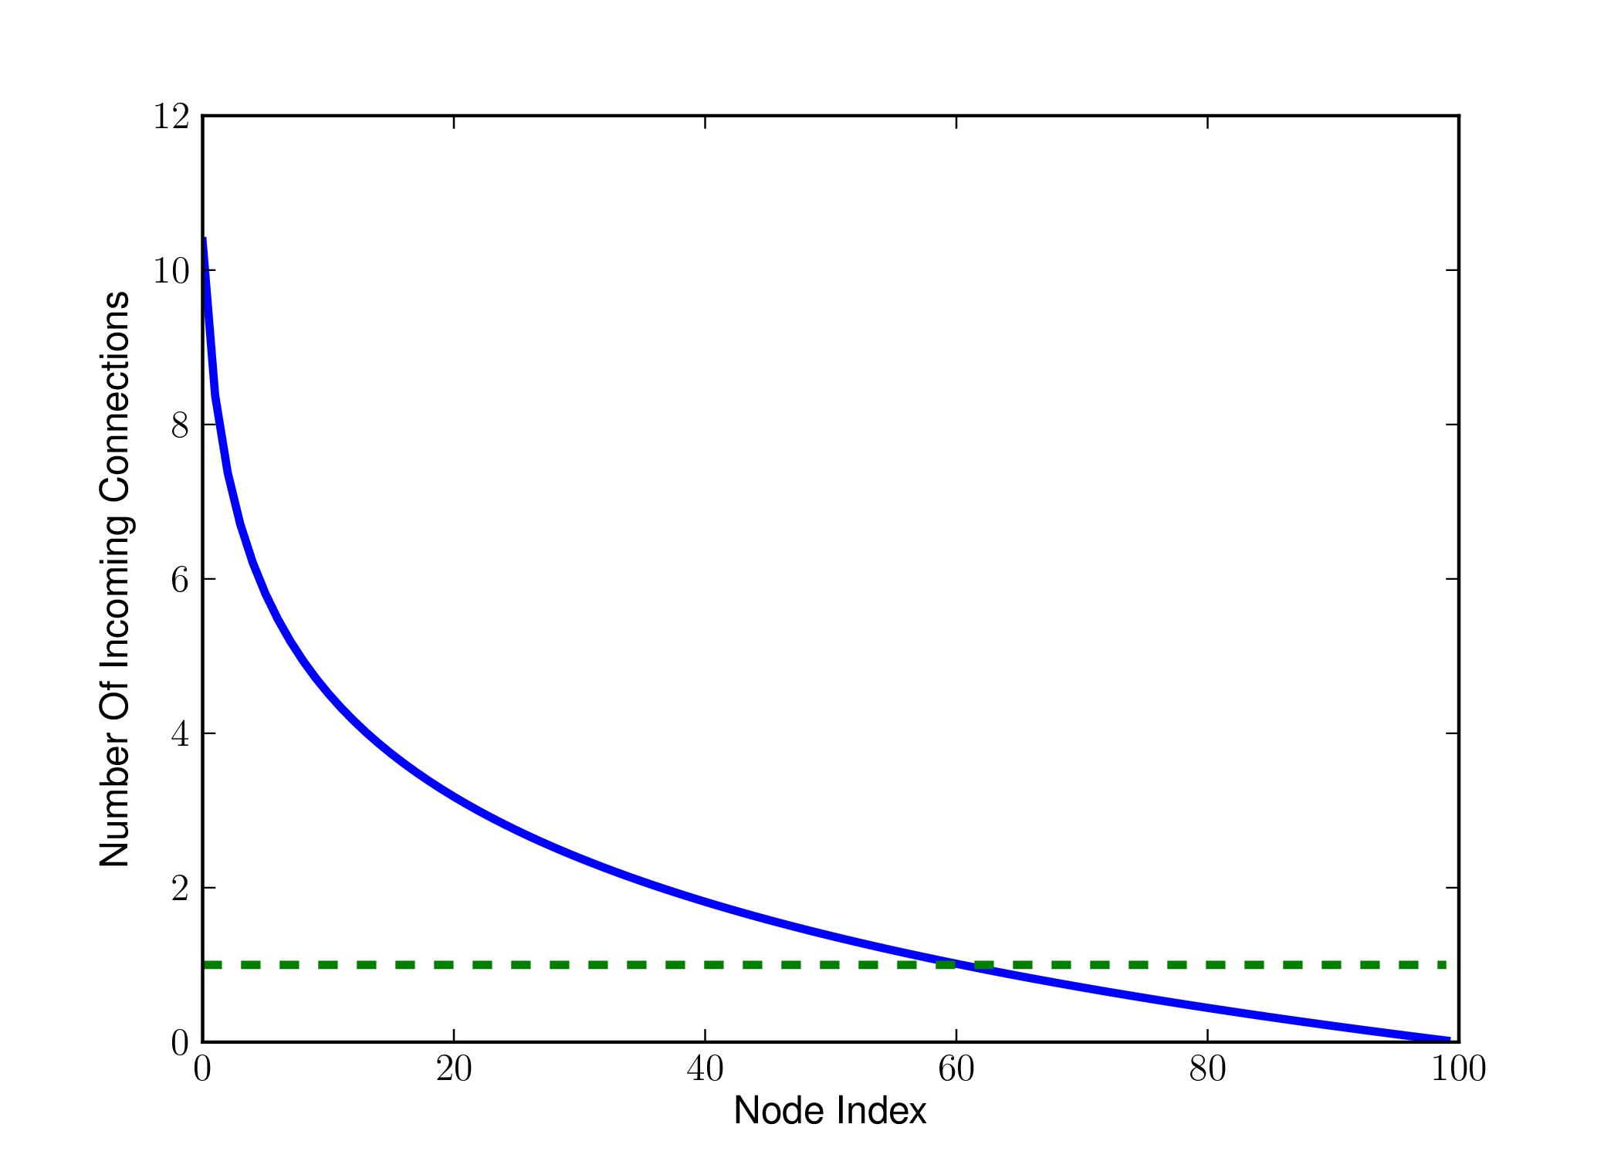
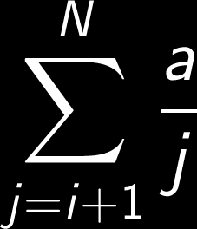
Incoming Connections
Non Uniform Incoming Connections
Non Linear
Equation Variables:
N = Number of nodes
i = Node index
a = Node arity

Slide 7
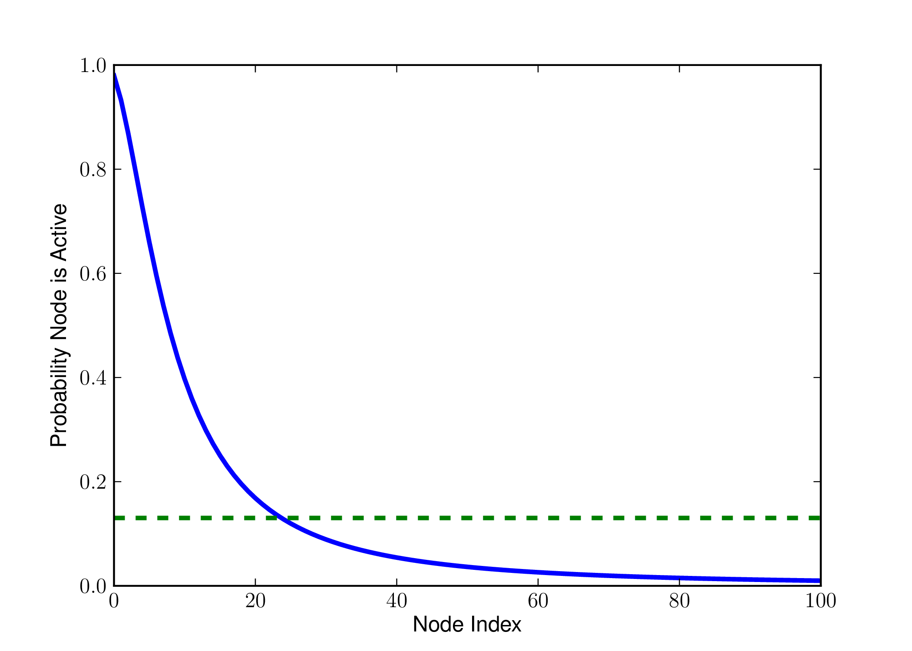
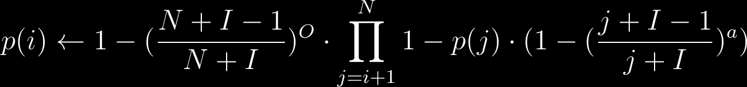
Probability That A Node Is Active

Slide 8
Thought experiment
Input
X
Inactive
Y
Inactive
Z
Inactive
Output

Slide 9
Alternative: Reorder
Input
A
B
C
D
E
F
Output
Input
E
A
F
B
D
C
Output

Slide 10
Alternative: Dag
Input
A
B
C
D
E
F
Output

Slide 11
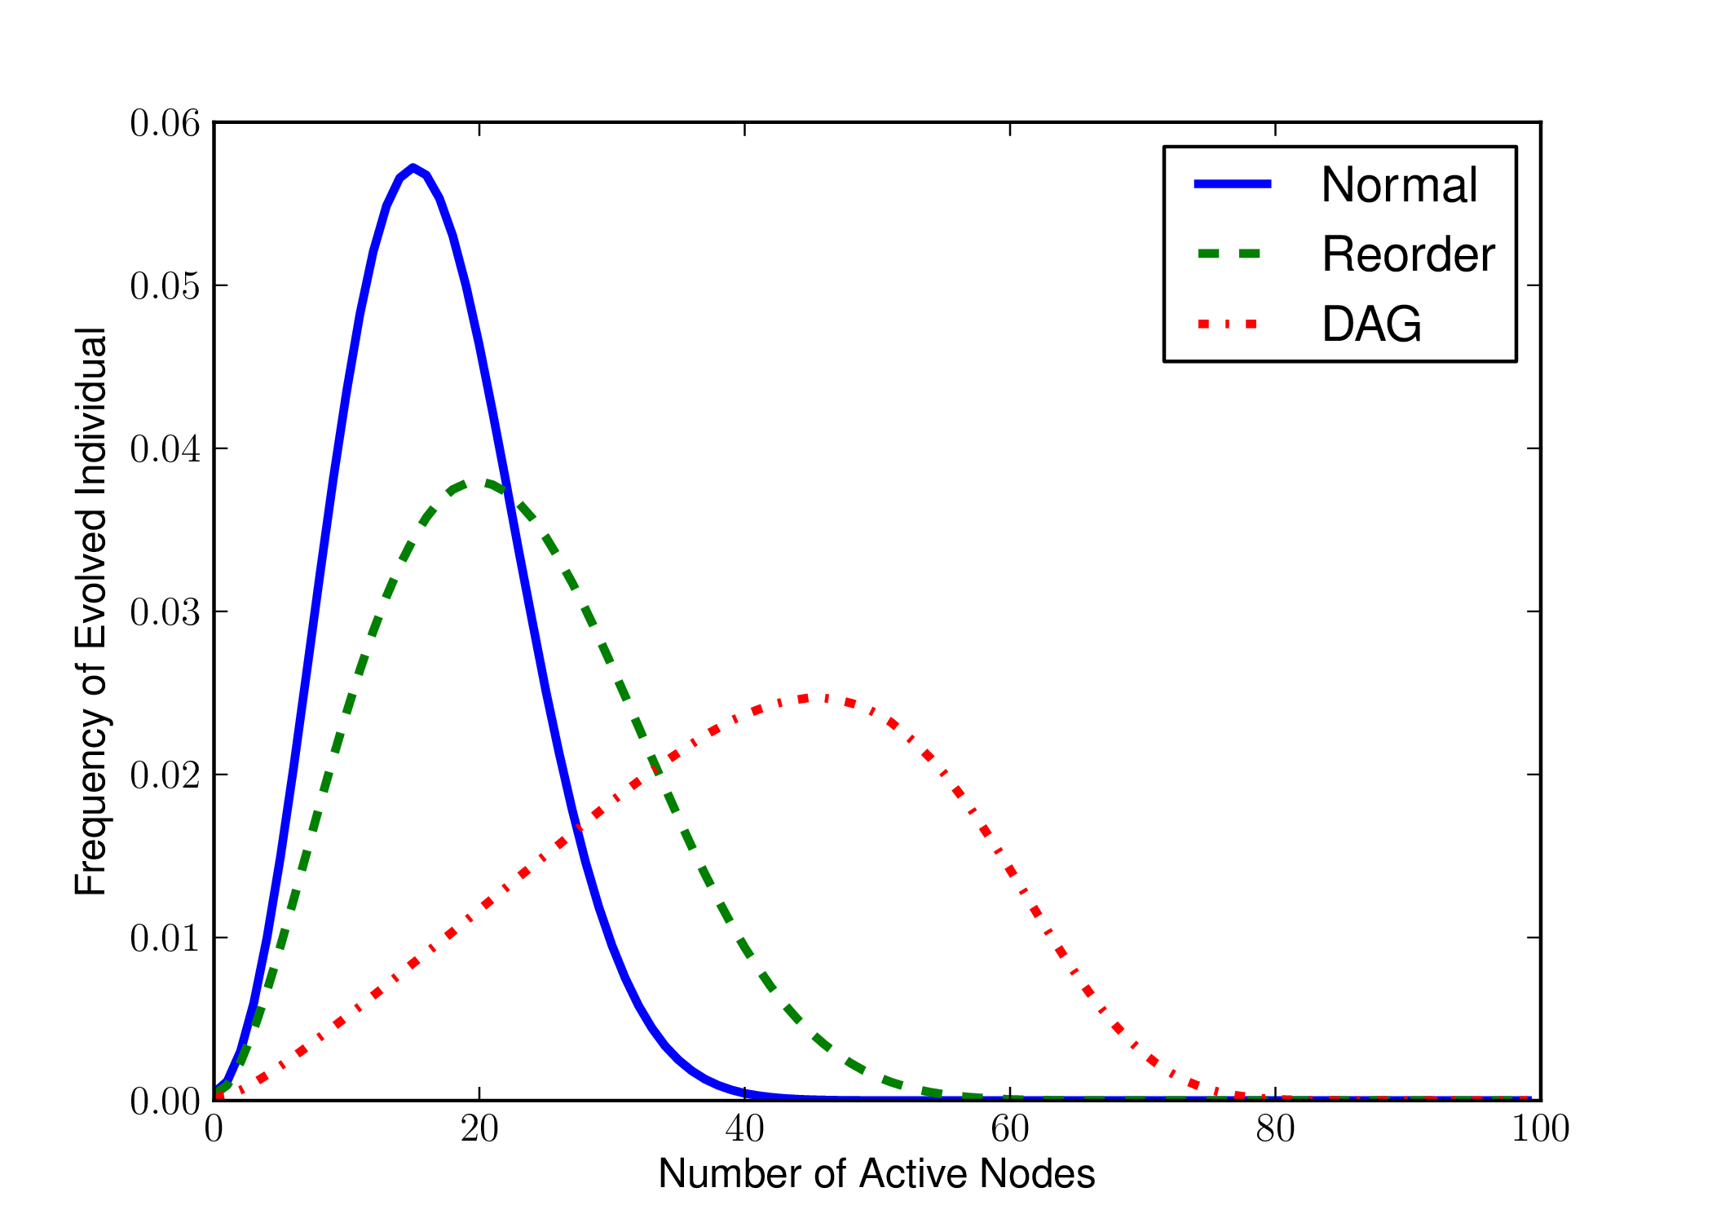
Length Frequency
Evolution With No Landscape
Only Neutral Drift
Shows Problem Independent Bias

Slide 12
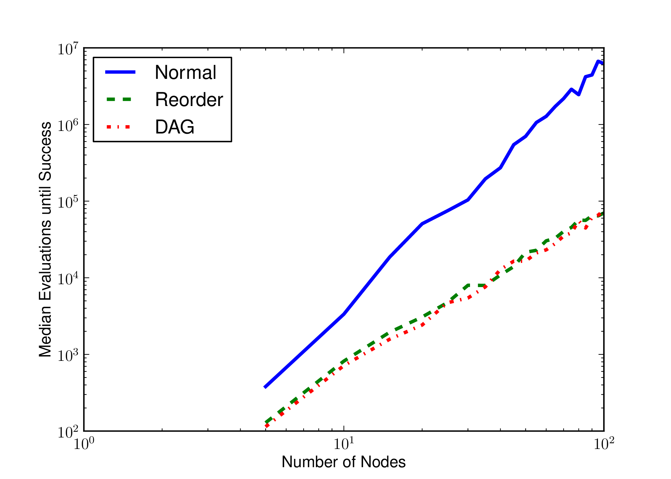
Problem: Breadth
Connect N+1 Inputs Using N Nodes
Node Function Set: {OR}
Test Inputs: All Single Bit Set Options
Normal: O(N^3.24)
Reorder: O(N^2.06)
DAG: O(N^2.09)

Slide 13
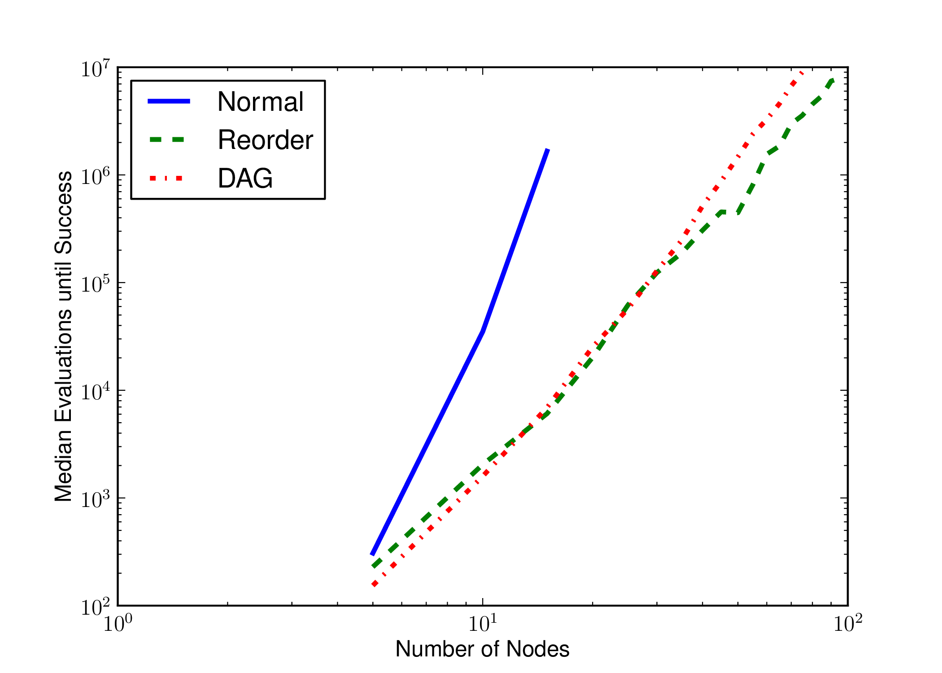
Problem: Depth
Maximize Node Reuse
Function Set: {min(X, Y) + 1}
Test Inputs: {0}
Normal: O(N^7.72)
Reorder: O(N^3.66)
DAG: O(N^4.17)

Slide 14
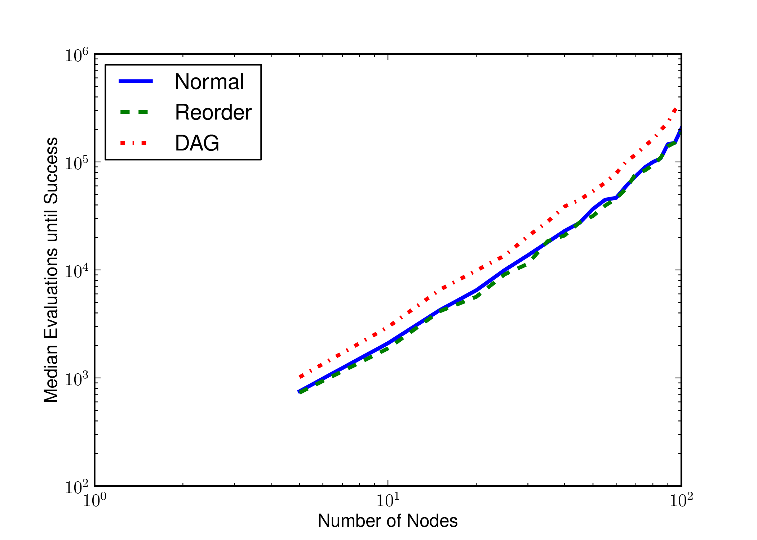
Problem: Flat
All Nodes Connected To Input
Genome Evaluated Directly
Normal: O(N^1.86)
Reorder: O(N^1.87)
DAG: O(N^1.94)

Slide 15
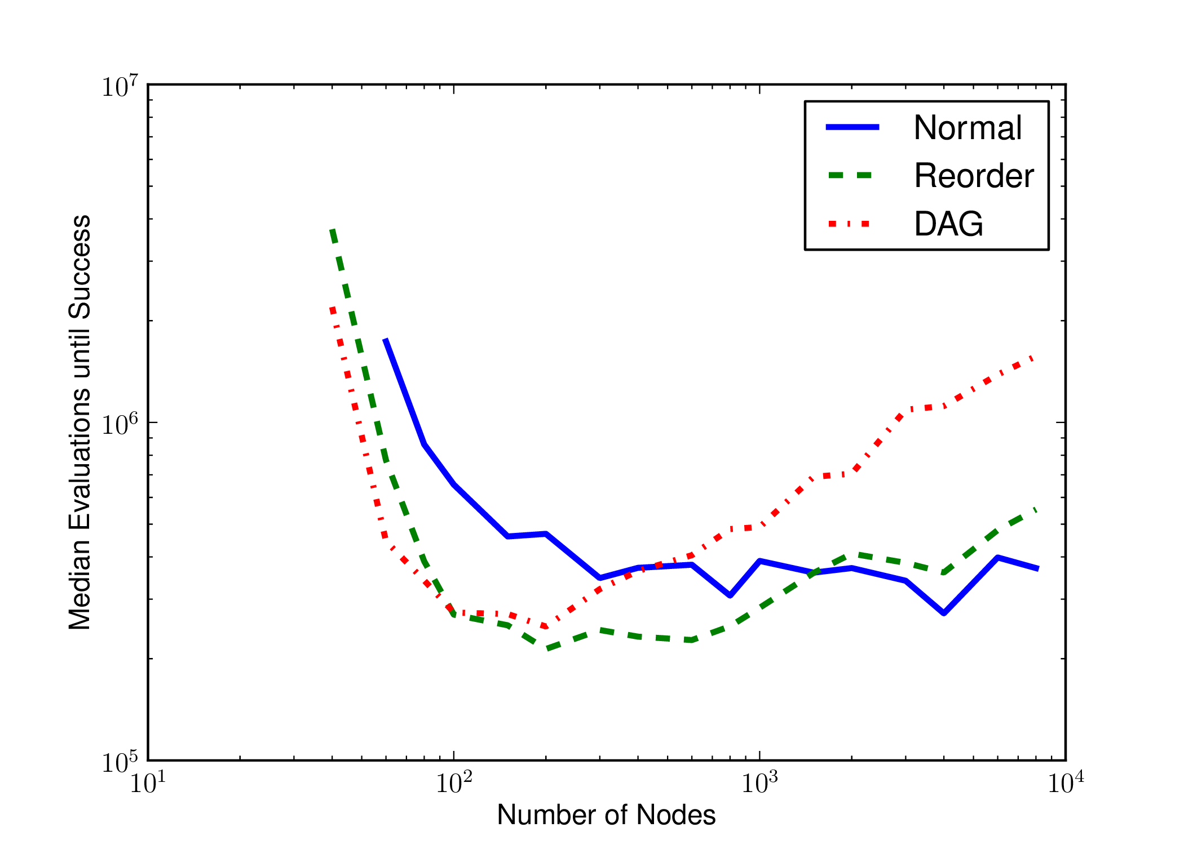
Problem: Multiply
 | Normal | Reorder | DAG
Evaluations | 467,621 | 236,438 | 265,997
Genome | 4,000 | 200 | 200
Active | 245 | 115 | 116
3-Bit Multiplication
6 Input Bits
6 Output Bits
Function Set: {AND, OR, NAND, NOR}

Slide 16
Conclusions and Future Work
Highly Inactive Genomes Cause By Search Limitations
Mutation’s Random Reset + Node Ordering
Normal CGP Cannot Evolve Highly Active Genomes
Reorder and DAG Overcame These Limitations
Need Further Testing

Slide 17
Questions?
Code: https://github.com/brianwgoldman/LengthBiasCGP

Slide 18
Reorder Algorithm
Requires O(aN) time, where a = Arity, N = Genome Size
Select and remove a node ALPHA from the ADDABLE set
If ALPHA is not an input location map it to the next genome location
For each node BETA that takes input from ALPHA:
Mark BETA’s dependency on ALPHA satisfied
If all of BETA’s dependencies have been satisfied, put BETA into ADDABLE

Slide 19
DAG dependency algorithm
Requires O(m a^2 N^2), where m = mutation rate, a = Arity, N = Genome Size
Normal and Reorder Mutation Requires O(maN) time.
If a node’s dependency is already known, return stored information
If this node takes input from a dependent node, it is dependent
If none of this node’s inputs are dependent, it is not dependent

Slide 20
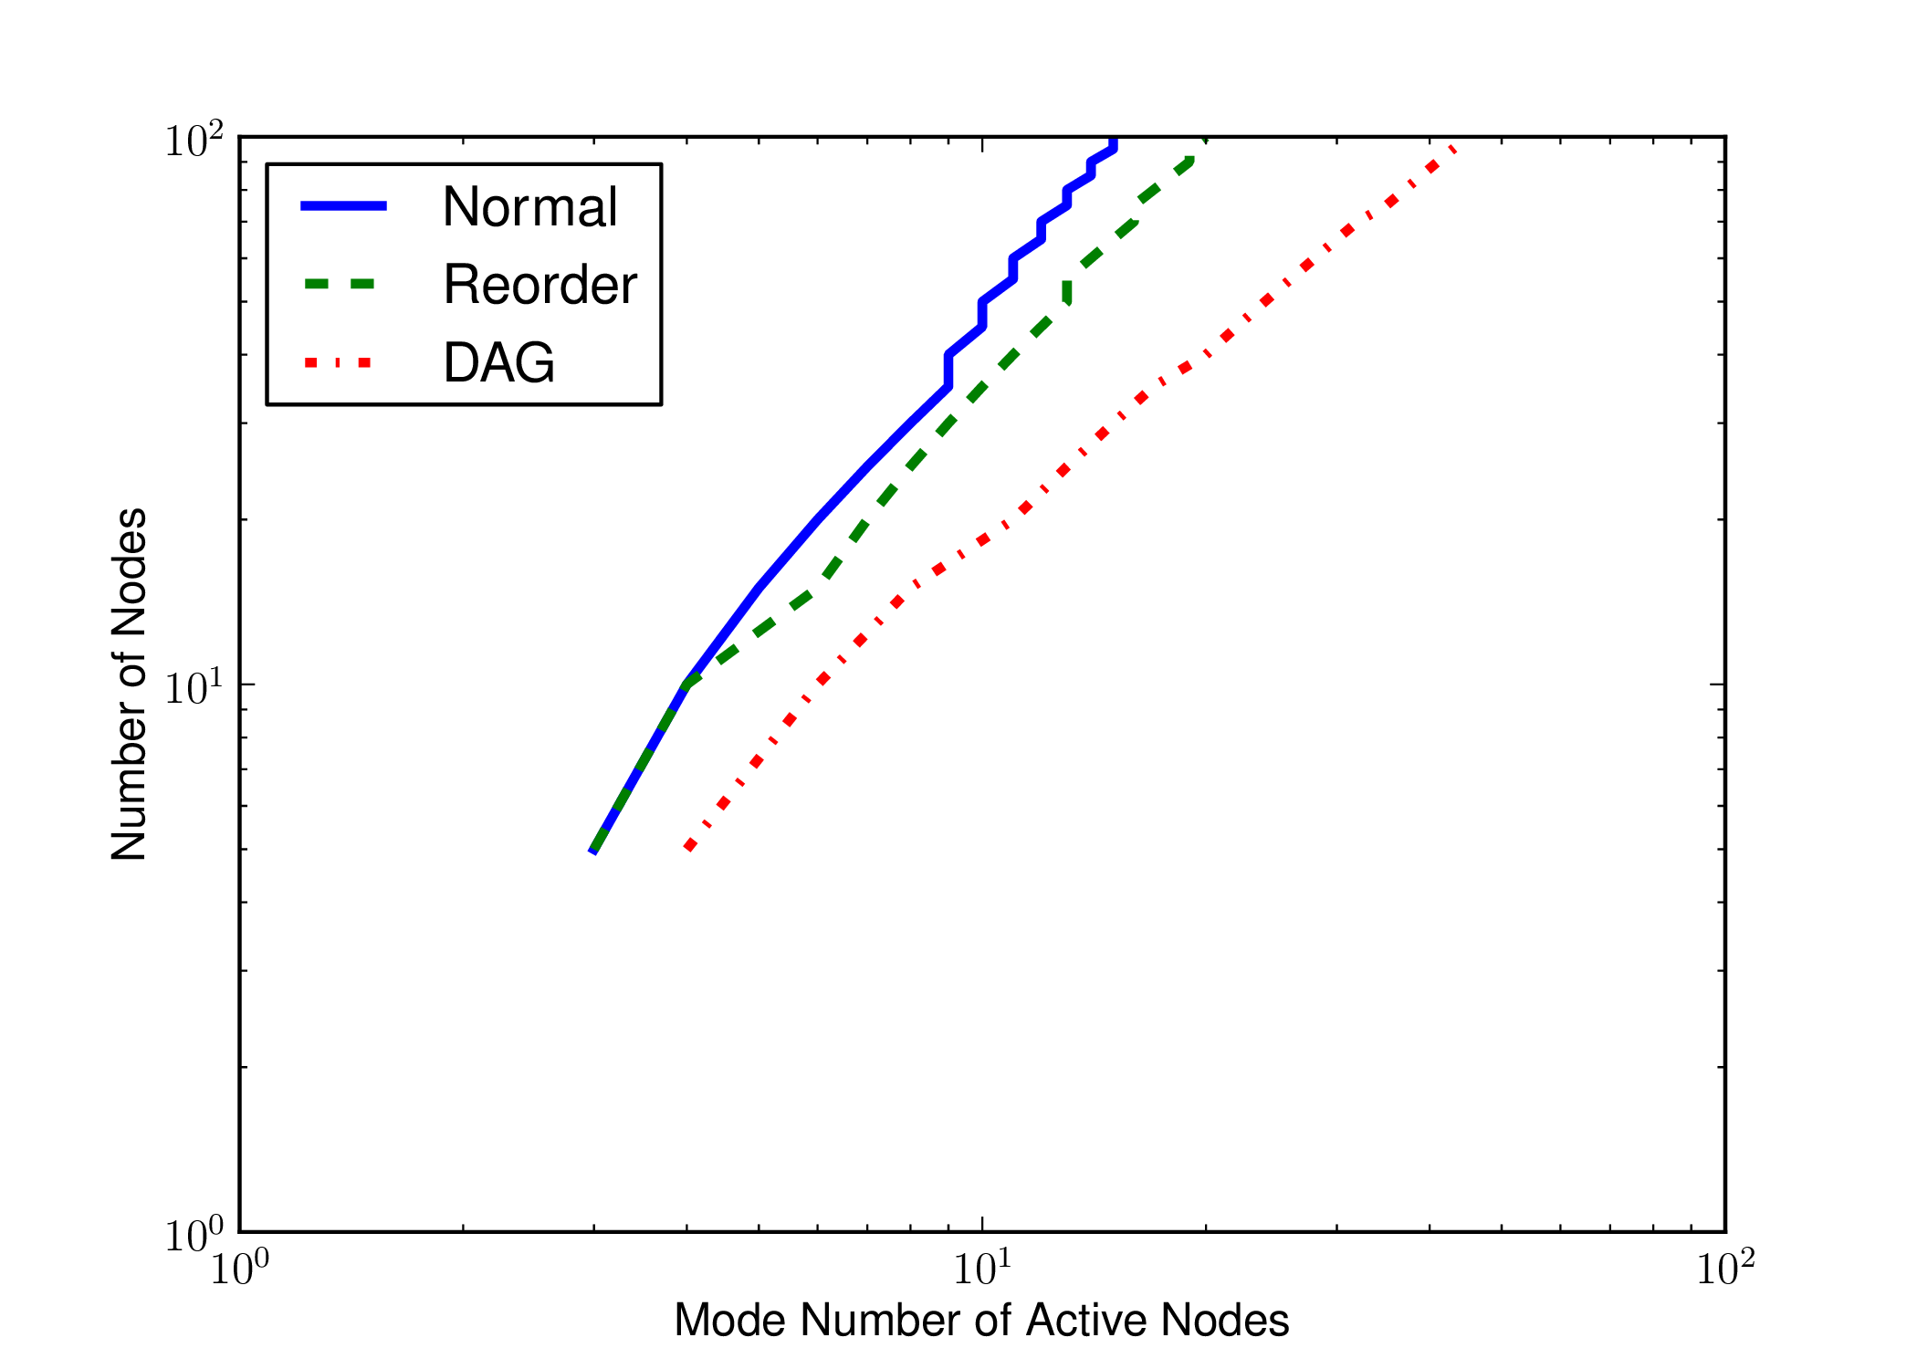
Scaling

Slide 21
default genome
Input
X
Inactive
Y
Inactive
Z
Inactive
Output

