Slide 1
Reducing Wasted Evaluations in Cartesian Genetic Programming
Brian W. Goldman and Bill Punch
BEACON Center for the Study of Evolution in Action - Michigan State University

Slide 2
Motivation
Why Cartesian Genetic Programming (CGP)?
Human Competitive Designs
Outperforms Tree GP in Some Domains
Why Care About Evaluations?
Black Box Search Limited By Evaluations
Real World Problems Are Expensive to Evaluate

Slide 3
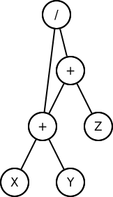
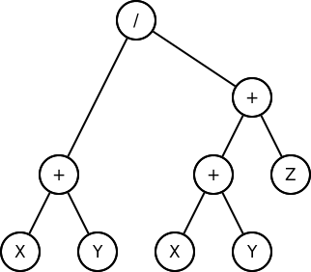
Cartesian Genetic Programming (CGP)
Graph Based
Directed Acyclic Graphs (DAGs)
Value Reuse
Example:
(X+Y) / (X+Y+Z)

Slide 4

CGP Representation
Genome Broken Up Into Nodes
Similar to Codons
Each Node Contains
Gene For Node Function
Genes For Input Locations
Additional Genes Specify Output

Slide 5
Active VS Inactive Nodes
Some Nodes May Be Disconnected From Output
These Are “Inactive”
Canonical CGP Uses Highly Inactive Genomes
As Much As 95% Inactive
Enables Genetic Drift

Slide 6
Evolutionary Mechanisms
Stochastic Hill Climber
One Parent, Many Offspring
Replace Parent If No Worse
Allows For Genetic Drift
Offspring Produced Using Mutation
Probability To Mutate Each Gene
Genes Must Change If Selected

Slide 7
Detecting Wasted Evaluations
Normal CGP Evaluates All Offspring
Set of Active Genes Known
Improves Evaluation Efficiency
Pairwise Comparison
O(|active_genes|)
Compare With Parent Only
Catches Most Cases

Slide 8
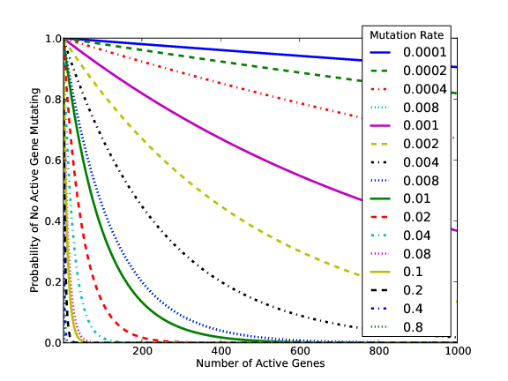
Predicting Frequency

Slide 9
Duplicate Avoidance – Skip
If Offspring Actively Identical To Parent:
Skip Evaluation, Assign Parent’s Fitness To Offspring

Slide 10
Duplicate Avoidance – Accumulate
While Offspring Actively Identical To Parent:
Create More Offspring, Compare Final Two

Slide 11
Duplicate Avoidance – Single
While Active Gene Not Mutated:
Choose Gene At Random To Mutate

Slide 12
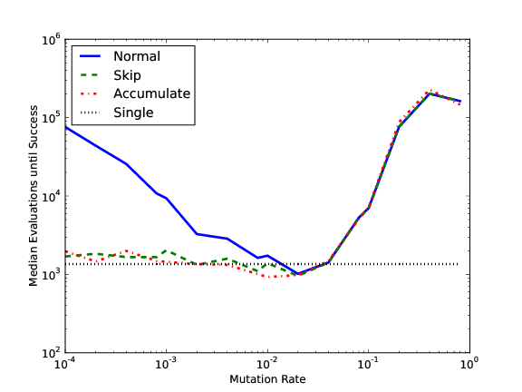
3-Bit Parity

Slide 13
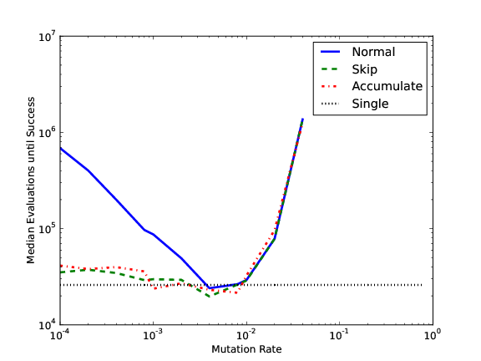
16-4-Bit Encode

Slide 14
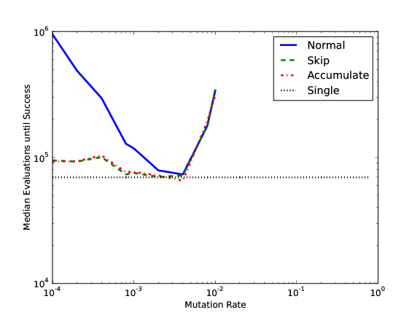
4-16-Bit Decode

Slide 15
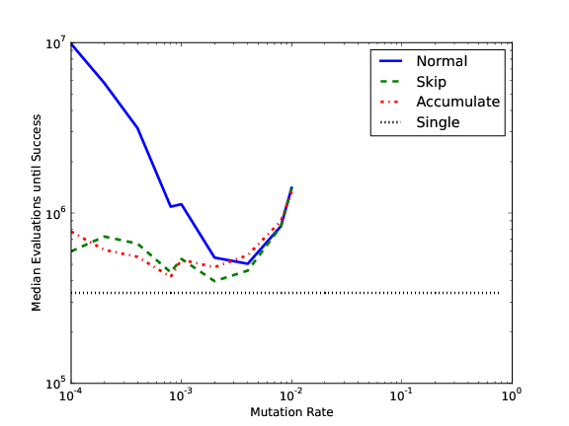
3-bit Multiplier

Slide 16
Results

Slide 17
3-Bit Multiplier
 | Normal | Skip | Accumulate | Single
Mutation | 0.004 | 0.002 | 0.0008 | N/A
Evaluations | 503,424 | 398,354 | 421,859 | 340,165
MAD | 191,037 | 184,979 | 165,218 | 151,063
Relative Time | 1.000 | 0.907 | 0.843 | 0.706

Slide 18
Conclusions
Skip and Accumulate
Better Than Normal
Less Sensitive To Mutation Rate
Relatively Similar To Each Other
Single
Improves With Problem Difficulty
Effective Without Tuning
Least Computationally Expensive
Overall
Relatively Problem Independent
Matched Theoretical Expectations
Potentially Improves Performance by Orders of Magnitude

Slide 19
Questions?
Code: github.com/brianwgoldman/ReducingWastedEvaluationsCGP
Thanks to BEACON Center for the Study of Evolution in Action

