Slide 1
binarySearch(array, first, last, item) {
…
}
binarySearch(array, first=0, last=array.length, item)
local variable: middle=Math.floor(array.length/2)
binarySearch(array, first=0, last=Math.floor(array.length/2), item)
Local variable: middle= Math.floor(Math.floor(array.length/2)/2)
binarySearch(array, first=Math.floor(array.length/2) + 1, last= array.length, item)
middle=Math.floor((Math.floor(array.length/2) + 1 + array.length)/2)

Slide 2
((6 + 2) / 4) * (16 + 1)
Expression
Operand
Operator
+, −, *, /
Operand
Number
Operand
(
Expression
)

Slide 3
Formal Syntax of An Arithmetic Expression
EXPRESSION ::= OPERAND OPERATOR OPERAND
OPERAND ::= NUMBER
| “(” EXPRESSION “)”
OPERATOR ::= “+”
| “-”
| “*”
| “/”
NUMBER ::= <number>

Slide 4
Object members
Binary Tree
Binary Tree
data
left
right
data: “6”
left: Binary Tree
String “6”
Binary Tree
Binary Tree
right: Binary Tree
Binary Tree
Binary Tree

Slide 5
(Single) Linked List
this
node
head
tail
data
next
Linear structure like an array
No direct access (access == read/write)
Fast insert and delete (tradeoff)
data
next
data
next
seeker
hello
helper
() { … }
head
tail
5
next
data
next
data
next
data
next
data
next
[1, 2, 3]
“Tuesday”
Date
Customer

Slide 6
Double Liked List
child
this
head
tail
data
n
data
n
data
n
data
n
data
n
p
p
p
p
p
1
2
3
4
5

Slide 7
List (Linear – like a line): LinkedList (single/double), array
Tree
Map (mapping table, dictionary)

Slide 8
Software Reuse: API, Libraries, Modules, Classes, Functions
My Software/Application
Webkit – basic browser
(open source volunteers)
Apple -> Safari
Chromium
Google -> Chrome
Microsoft -> Edge
Javascript Language
D3 Library/API
Array
Arrays
Brushes
Date
String
Axes
Colors
Math
My own library
D3x (source file)
D3ShapeSeries
API = application programming interface
D3x

Slide 9
SVG Shapes and D3 Tools
Rectangles
D3x(“rect”, …)
Circles
D3x(“circle”, …)
Ellipses
D3x(“ellipse”, …)
Lines
D3x(“line”, …)
Polylines/Polygons
D3x(“polyline”, …)
D3x(“polygon”, …)
Regular Polygon
D3x(“polygon”…) + RegularPolygon(vertices, skipping)
Path
D3x(“path”, …)

Slide 10
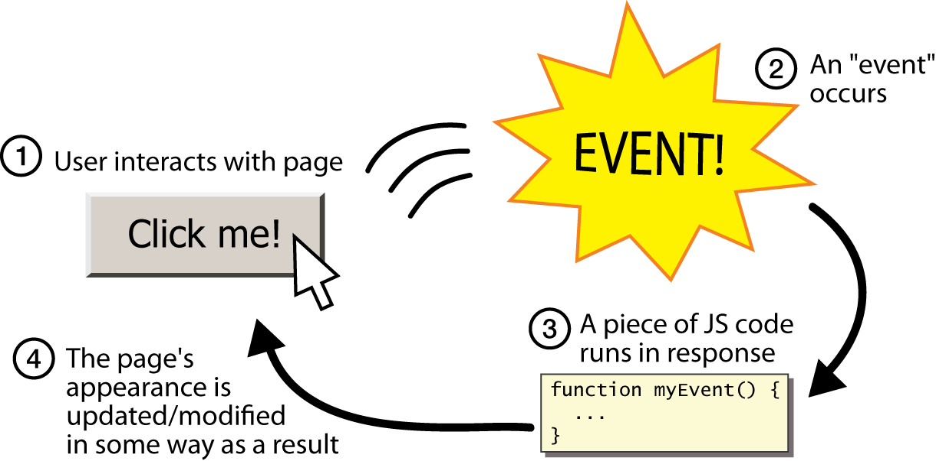
Events – Asynchronous Activities

Slide 11
Events Summary
Events are defined by the platforms (MacOS UI, browsers, etc.)
Some platforms allow developer-defined events (custom events)
Events are results of asynchronous activities
User actions (mouse click, keyboard, etc.)
Others (network, timer, other IO devices, etc.)
A developer/app registers listeners/handlers/functions on the events
Events are detected by the platform
The platform executes all registered listeners on the event
A piece of data, also called event, is passed to the listeners

Slide 12
Connect Four – the game frame
Y margin
x=2y=1
spacing
X margin
spacing

Slide 13



Back to Modules, Classes, and Methods
Divide
and
Conquer
Class Properties are like
Shared Resources
Reuse
Separation
of
Concerns
Structure
And
Cooperation
Modules
are like
Classrooms
Classes
are like
Teams
Class Methods
are like
Kids
Awesome Software

Slide 14
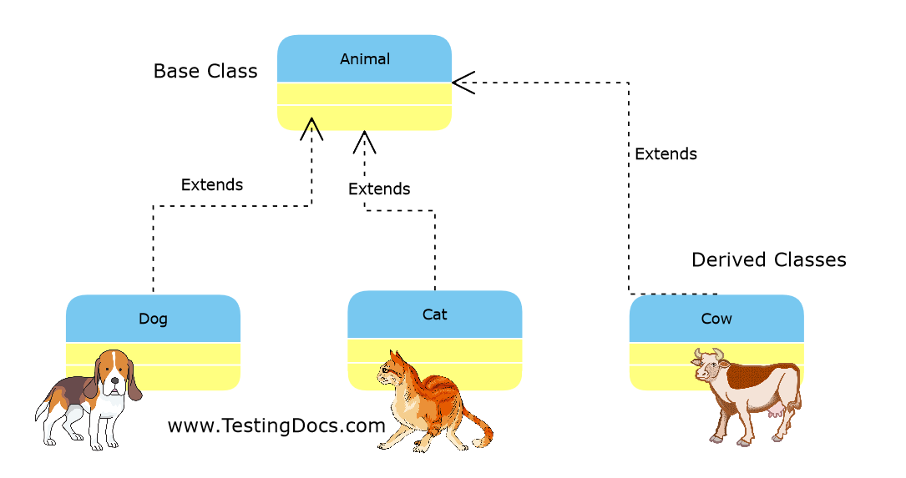
Something about Classes – Inheritance!
Reuse (no copy & paste)
Polymorphism
class Animal {
eat() { ... }
move(area) { ... }
}
class Dog extends Animal {
bark() { ... }
}
class Cat extends Animal {
meow() { ... }
}
class Cow extends Animal {
giveMilk() { ... }
}
class AnimalCafe {
feed(animals) {
animals.forEach(a => a.eat());
}
}
let animals = [
new Cat(), new Dog(), new Dog()
];
let café = new AnimalCafe();
café.feed(animals);
let steve = new Dog();
steve.move(playground);
steve.bark();
steve.eat();
let leslie = new Cat();
leslie.meow();

Slide 15
Class(static) vs instance(object) members
Class
static A
int x
static M()
m()
new
Object
let c = new Class()
c.x
c.m(5)
Class.A
Class.M(3)
c.A
Class.x
int x
m()

Slide 16
Towards Better Design and Coding
Put your code in classes
1
Create objects from classes
2
Let the objects interact via methods
3

Slide 17
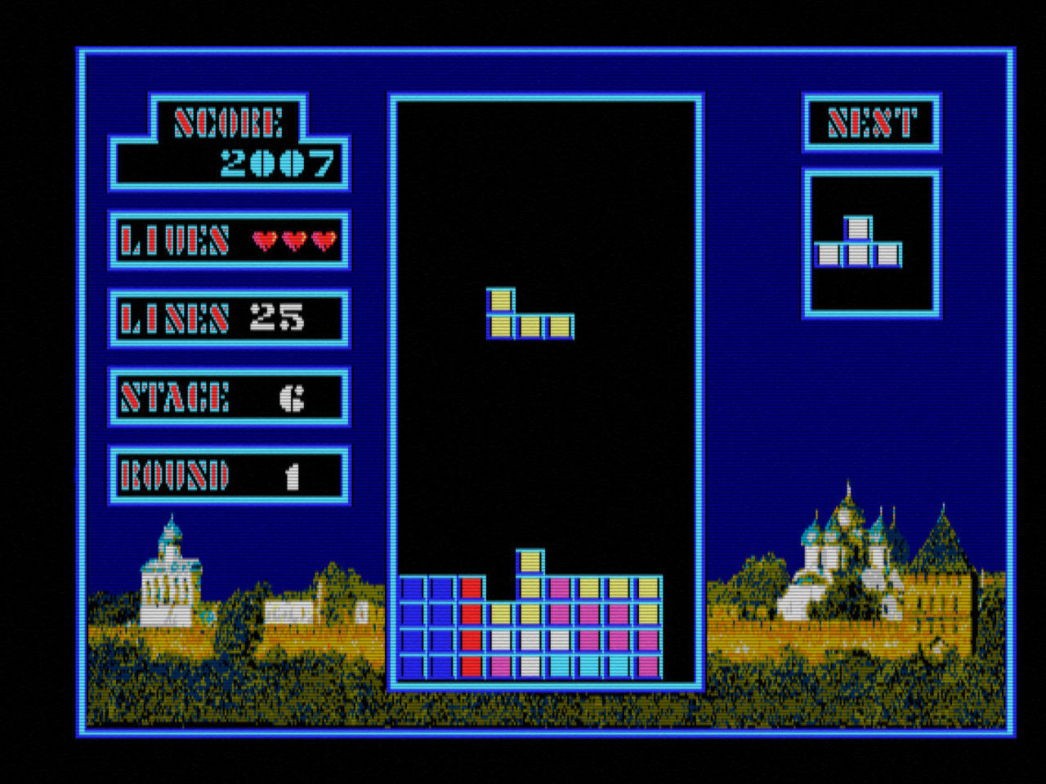
Classic Video Game – Tetris https://www.youtube.com/watch?v=SHBYOCl8Ogg

Slide 18
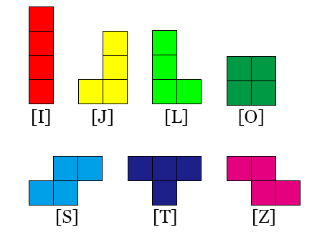
Video Game – Tetris

Slide 19
Tetris Game Play Rules
7 types of pieces (I, J, L, O, S, T, Z)
A piece drops down at a given speed which cannot be reduced
When a piece lands on another piece or the bottom it stops and stays there
When a line is completed (filled with no gap) it disappears
When the game space is filled up the game ends
Player control: LEFT, RIGHT, ROTATE, DOWN, DROP

Slide 20
Tetris Game Play – Product Requirements
Pieces controlled by computer
Moves down at a given speed (0.5 second per grid @ level 2)
Make sure the piece stays in the “game space”
Detect when the piece touches “ground”
Continue to generate a new piece randomly at the same chance
Compute game score
Player controls
Left, right, rotate counter-clockwise, speedup (down 3 grids), drop
Game space
10 columns x 20 rows

Slide 21
High Level Design
[ Shape… ]
Score Display
Piece Factory
Piece
make()
update(level, score)
Game Space
control(key)
Piece Forecast
tick()
update(piece)
Timer
Keyboard Input

Slide 22
Game play states
Welcome
Play
Ready
Game Over
Play Again
start
again
Active
over
Over
resume
pause
Paused

Slide 23
Piece Study – J, L, T (bounding box)
L is the same as J
(0,0)
(1,0)
(2,0)
(0,1)
(1,1)
(2,1)
(0,2)
(1,2)
(2,2)

Slide 24
Let sheet = new Array(this.size)
For (…) {
Sheet[i] = new Array(this.size)
Sheet
(array)
(array)
i = 0
i = 1
i = 2
“ “(string)
“ “
j = 0
“ “
“ “
“ “
j =1
“ “
“ “
“ “
j = 2
“ “

Slide 25
Pieces – S, Z
// J itself
J = {
color: ‘red’,
size: 3,
grid: [
{x = 1, y = 0},
{x = 1, y = 1},
{x = 1, y = 2},
{x = 0, y = 2}
]
};
// adding J to game space:
space.add(J, {x0 = 4, y0 = 0})
// change color in space:
for(let i = 0; i < J.length; ++i) {
space.setColor(
x0 + J[i].x,
y0 + J[i].y,
J.color
);
}

Slide 26
Pieces – I, O

Slide 27
White board: 20 x 10, book: 1 x 2
x
yMargin
3
Book center: x = 0.5, y = 1
Book position: x0 = 5, y0 = 3
Book center in the board:
Xc = x0 + x = 5.5
Yc = y0 + y = 4
xMargin
0,0
1,0
2,0
5
spacing
1,0
1,1
2,1

Slide 28
Array – imagined as folding into a rectangle
index
0
n-1
index
y
x

Slide 29
yMargin = forecastYMargin
“Scores”
GameSpace
“Next”
forecastTitleHeight
forecastXEdge
forecastTitleDisplayGap
Score
Level
Completed
forecastXMargin
Display
n by n
(n >=4)
forecastXMargin
1250
1
6
xMargin
?
yMargin = forecastYMargin

Slide 30
Placing a Piece at the Center of the Display
Piece
size x size
displaySizeInGrid
x
displaySizeInGrid
Piece, size: 3 x 3
Piece, shape: [
{0, 0},
{1, 0},
{1, 1},
{1, 2}
]
Copy the shape(points)
{x, y} → {x + margin, y + margin }
margin
margin
margin
Piece
size x size
margin
{x, y}
{x + margin, y + margin}

Slide 31
Further improvements of Tetris
Increment play level based on score or time
How to record time played by the user: count the number of ticks
Update level in the appropriate part of the program
Continue till we reach the maximum level (9)
Make sure the maximum level is very difficult

Slide 32
Star-Spangled Banner
Hoist (height) of the flag: A = 1.0
Fly (width) of the flag: B = 1.9
Hoist (height) of the canton ("union"): C = 0.5385 (A × 7/13, spanning seven stripes)
Fly (width) of the canton: D = 0.76 (B × 2/5, two-fifths of the width)
E = F = 0.0538 (C/10, One-tenth of the height of the canton)
G = H = 0.0633 (D/12, One twelfth of the width of the canton)
Diameter of star: K = 0.0616 (L × 4/5, four-fifths of the stripe width, the calculation only gives 0.0616 if L is first rounded to 0.077)
Width of stripe: L = 0.0769 (A/13, One thirteenth of the flag height)

Slide 33
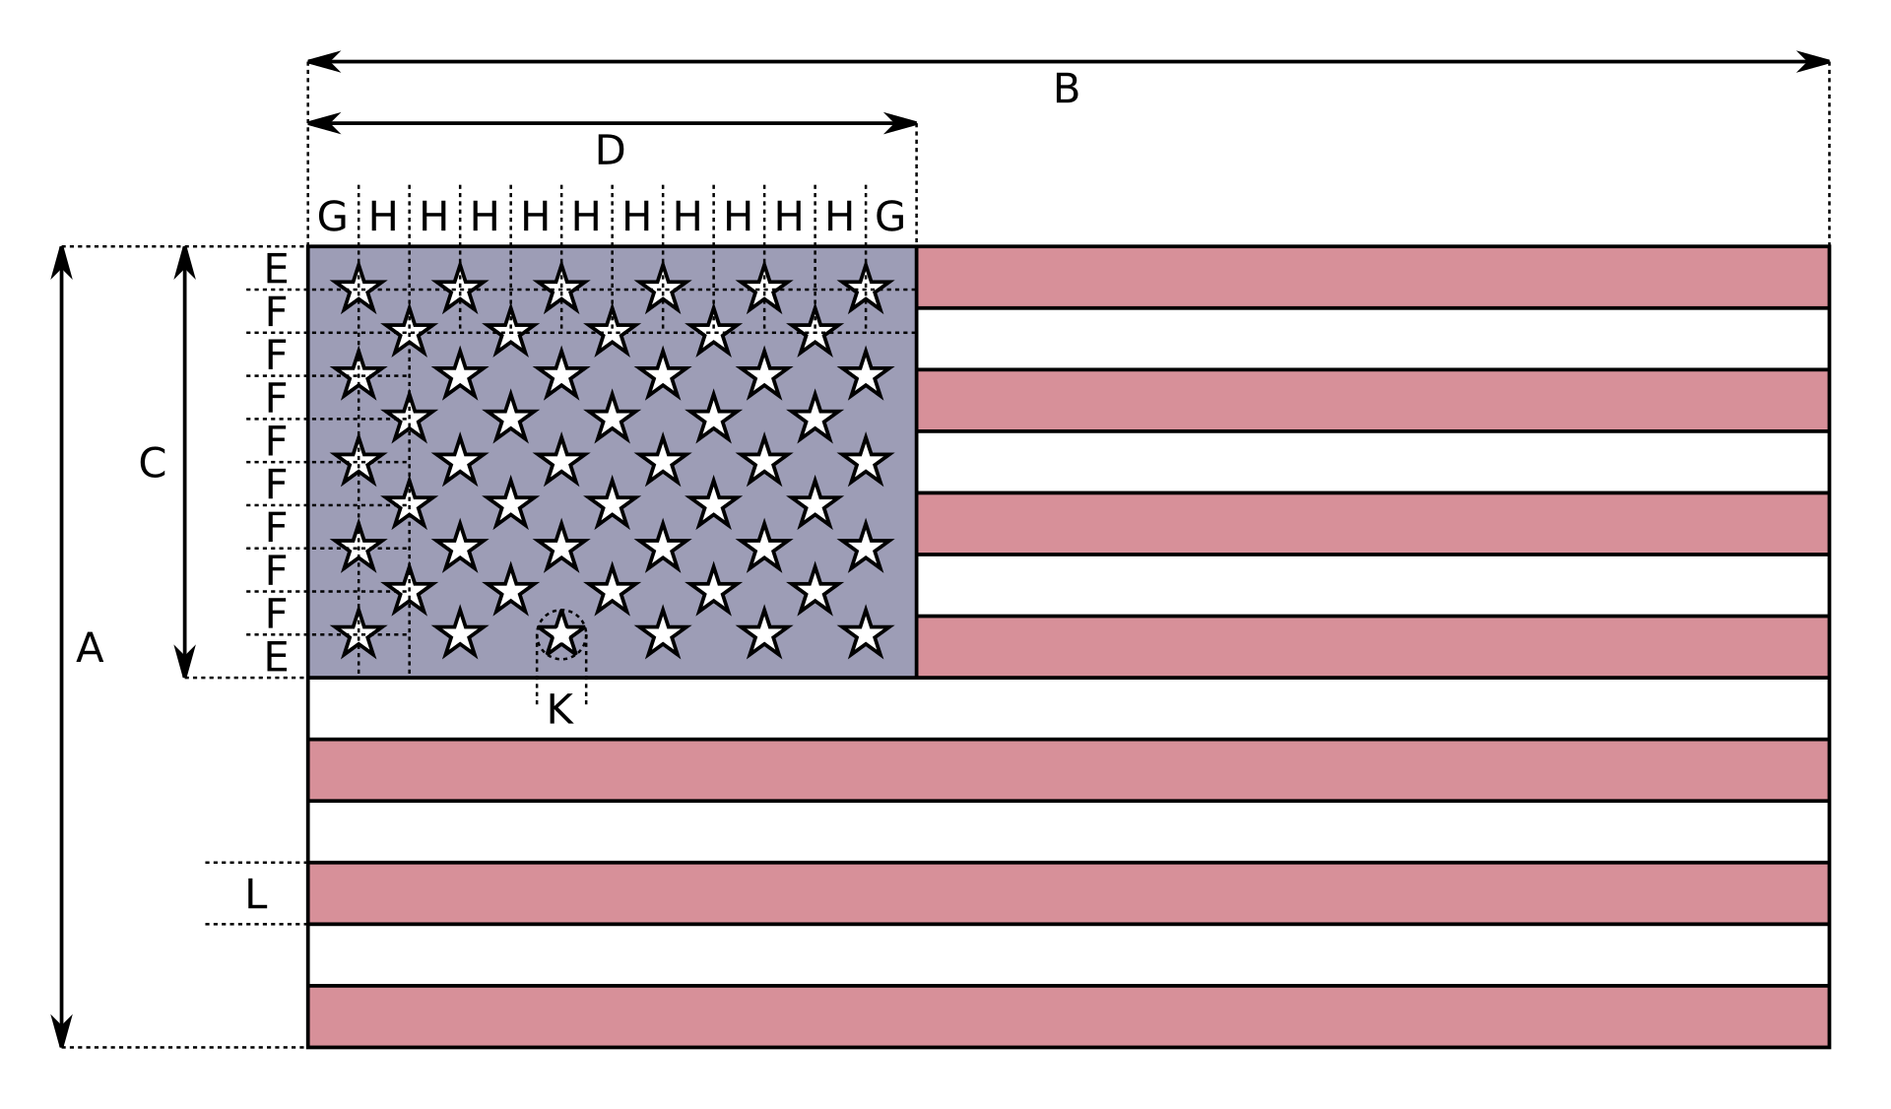
Star-Spangled Banner https://en.wikipedia.org/wiki/Flag_of_the_United_States
Dimensions
A = 1.0 * unit = unit
B = 1.9
C = 0.5385 (A×7/13)
D = 0.76 (B×2/5)
E = F = 0.0538 (C/10)
G = H = 0.0633 (D/12)
K = 0.0616 (L × 4/5)
L = 0.0769 (A/13)
Colors
White: #FFFFFF
Old Glory Red #B22234
Old Glory Blue #3C3B6E

Slide 34
Back to Component Design and Reuse
In JavaScript the components are
Classes: data + behavior
Functions: 100% pure behavior

Slide 35
Bulletin Board – A reusable component
Area Dimensions: pixels
Y Margin: pixels (computed)
X Margin: pixels (computed)
Board Width: 40%=0.4
Board Height = sum of
Title Height: 0.2
Gap: 0.1
Display Height: : 0.6
Area
Bulletin Board
Title
Display

Slide 36
Bulletin Board in the Browser Display
(0, 0)
y0
(x0, y0)
Area
yMargin
(x, y)
xMargin
Board
x0
x = x0 + xMargin
Y = y0 + yMargin

Slide 37
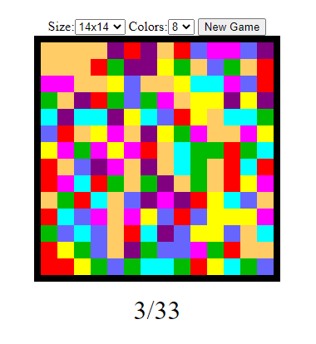
Color Flood

Slide 38
High Level Design
Ready
restart
Score Display
restart
Active
update(steps)
Color Flood Game
restart()
flood()
Mouse

Slide 39
Flooding a grid from a starting point
x,y-1
From a starting point (x, y)
If new color == old color, return
Paint myself with the new color
Go through my 4 neighbors
If the neighbor has the same old color, do the same
x-1,y
x,y
x+1,y
x,y+1

Slide 40
Source Code Control System (SCCS)
Server on the network (github.com)
Laptop
Laptop

Slide 41
Random number generation

Slide 42
Game of Life - Neighbors
x-1, y-1
x,y-1
-1, -1
0, -1
+1, -1
x-1,y
x,y
x+1,y
-1, 0
x, y
+1, 0
x,y+1
-1, +1
0, +1
+1, +1

Slide 43
Programming Languages
Computer
Instructions
0x34 1, 0x23029DE0
0x65 0x23029DE0, 5
JavaScript Interpreter
(Instructions)
Instructions
0x34 1, 0x23029DE0
0x65 0x23029DE0, 5
Compiler
High Level
Interpreted Language (JavaScript)
int a, b;
b = a + 20;
Assembler
Assembly Language
MOVE 1, 0x23029DE0
ADD 0x23029DE0, 5
High Level
Compiled Language (C)
int a, b;
b = c + 20;

Slide 44
Memory and Variables – Arrays, Objects
A piece of memory = many bytes one next to the other
Each byte has an address: 0, 1, 2, …
Decimal: 0,1, … 9; 12, 312
Binary: 0, 1; 10, 11, 100
7(10) = 111(2)
8(10) = 1000(2)
Physical
Highest bit,
Or bit 7
Lowest bit, or bit 0
Memory: many binary bits (位)
Bits are grouped into 8-bit group: byte(字节)
Byte: 00000000, 00000001, … 11111111(255)
Word(字): a few bytes together to store bigger numbers
On 32-bit computer, a word = 32bit = 4 bytes
On 64-bit computer, a word = 64bit = 8 bytes
128-bit computers are coming
Byte
Logical representation of a continuous piece of memory: Array
Each element has an index
Structure: a combination of simpler/smaller elements into bigger an element
let a = [ 5, 1, 3, “Brian” ]; let b = { school: “KinderCare”, age: 5 }

Slide 45
What about a number
let a = 12;
On a 32-bit computer: 00000000000000000000000000001100
Sometimes, we use a number as a group of binary/logical/Boolean flags
We can use a byte to represent 8 yes/no flags: 00010010

Slide 46
Variable
a
0x05678a66ef00
x
0x05678a66ef80
text
0x05678a66eff0
A variable is a “memory block” with a name
let a = 16
let x = 5
let c = x + a
let text = “Brian Hu from Tampa likes bananas”
let person = { name: …, address: … }
Let result = Cat.eat(a, x, text)
Physically, “JavaScript interpreter/OS” finds a free 64-bit (8-byte) memory block at 0x05678a66ef00
In JavaScript, we always use “64-bit” variables
Storing the value directly if possible
Storing the address/reference to the large value
16
5
0x0020390
Brian Hu from Tampa likes bananas
0x0020390

Slide 47
Arrays
a
0x05678a66ef00
b
0x05678a66ef80
let a = [ 1, 2, 3 ]
let c = new Array(3)
a[3] = 4
a[8] = 6
let b = a;
Array elements are addressed by indexes from 0 to (length – 1)
0x0020390
0
1
2
3
8
11
2
3
4
6
0x0020390

Slide 48
Structures – organization of variable
Array – a linear arrangement of element(no names)
let data = [ 1, 3, 7, 2 ]
Accessed by index: data[1]
Object – a mapping from a name (key) to a value
let data = { size: 10, level: 5, weight: 120 }
Scientist call this an “associative array”
Most call this a “map”
Accessed by key: data[“size”] or data.size
data.id = student;
sun

Slide 49
More structures
left
right
Tree
Binary tree node: { left:…, right: …}
N-ary tree (a tree with n children)
left
left
right
right
0
1
2
3
…
n - 1
left
left
right
right
data
0
1
2
3
…
n - 1
0
1
2
3
…
n - 1
0
1
2
3
…
n - 1

Slide 50
Bits and bit operations
Let look at a “word” on an 8-bit computer
01001001
= decimal 73
= hexadecimal 49
One 8-bit word can store 8 yes-no answers
Let answers = 0b01001001
Let answers = 0x49
Alternatively, you can do
Let answers = [ false, true, false, false, true, false, false, true ]
8(10) = 2^3 = 1000(2)
1000(10) = 10^3
Max 4-bit number: 1111 = 15(10) = F(16)

Slide 51
Logical (true or false) operations
AND (&&) – Statement1 AND statement2 ::= statement1 is true and statement2 is true
1 AND 1 = 1
1 AND 0 = 0
0 AND 1 = 0
0 AND 0 = 0
OR (||) – Statement1 OR statement2 ::= either statement1 is true or statement2 is true
1 OR 1 = 1
0 OR 1 = 1
1 OR 0 = 1
0 OR 0 = 0
NOT (!) – NOT Statement ::= the statement is false
NOT 0 = 1
NOT 1 = 0

Slide 52
Bit operations are similar to logical operations
BIT AND (&)
1 & 1 = 1
0 & 1 = 0
1 & 0 = 0
0 & 0 = 0
BIT OR (|)
1 | 1 = 1
1 | 0 = 1
0 | 1 = 1
0 | 0 = 0
BIT NOT (!)
! 1 = 0
! 0 = 1
BIT shift (<<, >>)
Let a = 0b01001001
Let b = a << 2 (0b00100100)
Let c = a >> 5 (0b00000010)
Use bit shift to compute the number represents a position
Give me an 8-bit with n^{th} bit from the right being 1
Answer = 0b00000001 << (n – 1)

Slide 53
Answers to questionnaire
let a = 0b01001001;
let b = 0b11010011;
To know if they have answered the same question “yes”
Let both = a & b (0b01000001)
Same as
Let a = [ false, true, false, false, true, false, false, true ];
Let b = [ true, true, false, true, false, false, true, true ];
Let both = new Array(8)
for (let i = 0; i < answer.length; ++i) {
If (a[i] && b[i]) both[i] = true;
}

Slide 54
Game of Life
Rule
Survive: if count is 2 or 3 or 4
Birth: if count is 3
Using bits, we observe that there are 8 neighbors, so
Survive: 0b00001110
Birth: 0b00000100
Survive logic (code) using bits
Start with count = number of lives in the neighborhood
let bitmask = 1 << (count – 1) (if count = 2, we get mask = 0b00000010
(if count = 5, we get mask 0b00010000)
So the rule becomes: if (mask & survive != 0) then survive;

Slide 55
Containers – list (array) & map (object)
Account #:
Balance: 120
Student information system
Café: look up a student by id, or by name and birthday
byId
23990
ref
Student id: 23992
First: Joe
Last: Doe
Birthday: 3/1/2011
Account #:
Id:
Student id: 23991
First: Joe
Last: Doe
Birthday: 3/1/2011
Account #:
Id:
Student id: 23990
First: Joe
Last: Doe
Birthday: 3/1/2011
Account #:
Doe
byLast
Joe Doe
Doe
ref
Jane Doe
Last:
Steve Doe
Last:
Jessica Doe

Slide 56
Operations on data structure
Data structure
let studentInformationSystem = StudentInformationSystem.get()
New student arrives
let joe = new Student(“Joe”, “Doe”, “3/1/2011”, …)
Insertion – map by id
studentInformationSystem.byId[‘22901’] = joe
Insertion – list by last name
let list = studentInformationSystem.lists[“Doe”]
If (list === null) {
list = new Array();
studentInformationSystem.lists[“Doe”] = list
}
list.push(joe)
Look up
Let buyer = studentInformationSystem[‘22901’]
If (buyer !== null) { … } else { throw Error (“student number not in system”) }

Slide 57
Information Update/Deletion
Let studentInformationSystem = SystemInformationSystem.get()
Let map = studentInformationSystem.byId;
Let joe = map(“34002”)
joe.grade = 630
Let map = studentInformationSystem.byId;
delete map[“34002”] (only deletes the reference in this map)

Slide 58
Information structure and relationship (real world)
History - hierarchical
Ancient
West, Near Nest, Far East
Medieval
West, Near Nest, Far East
Modern
Contemporary
Story
Timeline
Event (characters A, B, G)
Event (characters A, T, Y)
Data = raw facts – material to build tools
Info = knowledge - tools
Hierarchical – objects inside objects (maps inside maps)
Network
All these can be combined
A
B
C
Fight

Slide 59
Special Topic on Arrays
Theoretically, an array has a fixed size, as in C, C++, and some other languages
Fast for random access
However, in JavaScript, the array is more dynamic

Slide 60
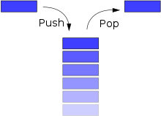
Roles of an Array
List – some kind of sequence
Unrestricted access (read & write)
Stack - FILO
First In, Last Out – there is only 1 opening
Array methods: push(), pop()
Queue - FIFO
First In, First Out – there are 2 opening
Array methods: push(), shift()
unshift
push
JavaScript Array
shift
pop

Slide 61
Stack example: function calls
f() {
…
g()
}
g() {
…
h()
}
h() {
…
i()
j()
}
...
f(23)
...
...
f(23)
...
f() {
...
g()
...
}
g() {
…
h()
}
h() {
...
i()
j()
...
}
i() {
...
}
Call Stack
j() {
...
}
Return after i
Return after h
Return after g
Return after f

