Slide 1
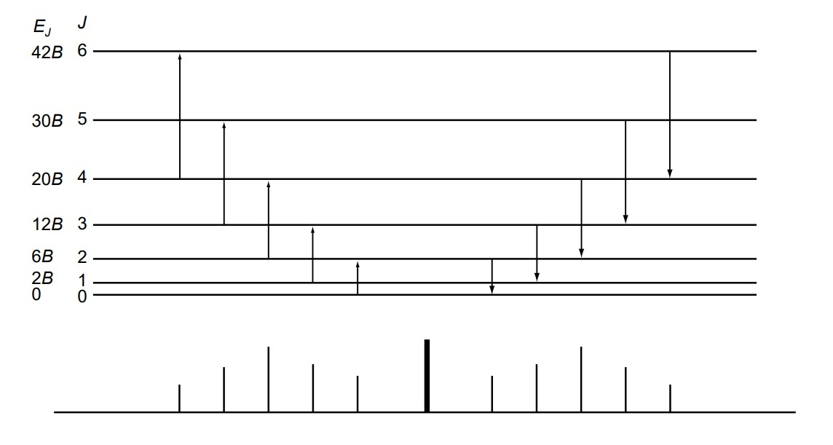
S₄
S₃
S₂
S₁
S₀
Q
S₀
S₁
S₂
S₃
S₄
Stokes (ΔJ = +2)
Anti-Stokes (ΔJ = -2 )
Energy

Slide 2
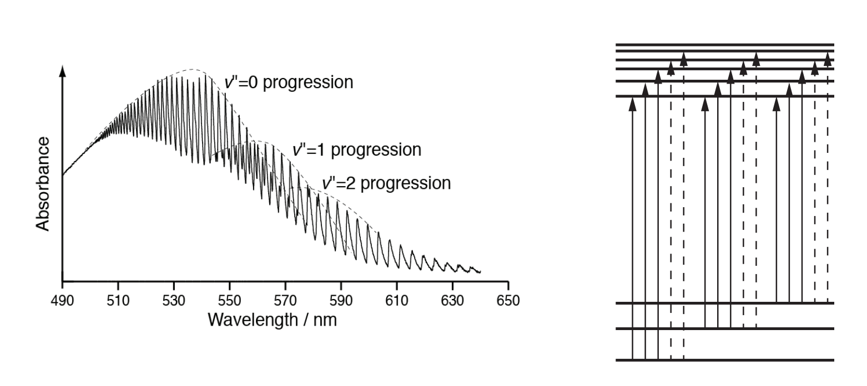
v’’= 2
v’’= 1
v’’= 0

