Slide 1
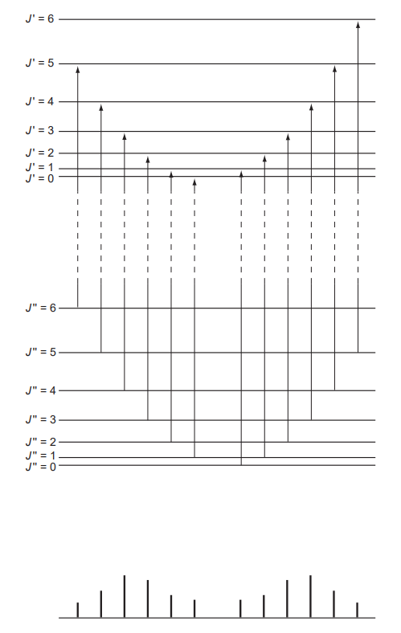
P-branch (ΔJ = -1)
R-branch (ΔJ = +1)
P₆
P₅
P₄
P₃
P₂
P₁
R₀
R₁
R₂
R₃
R₄
R₅
Energy

Slide 2
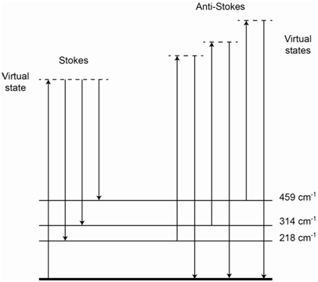
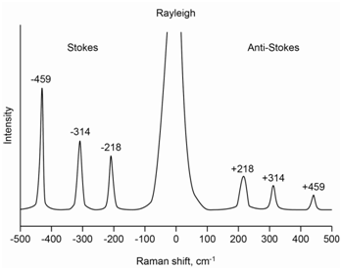

Slide 3

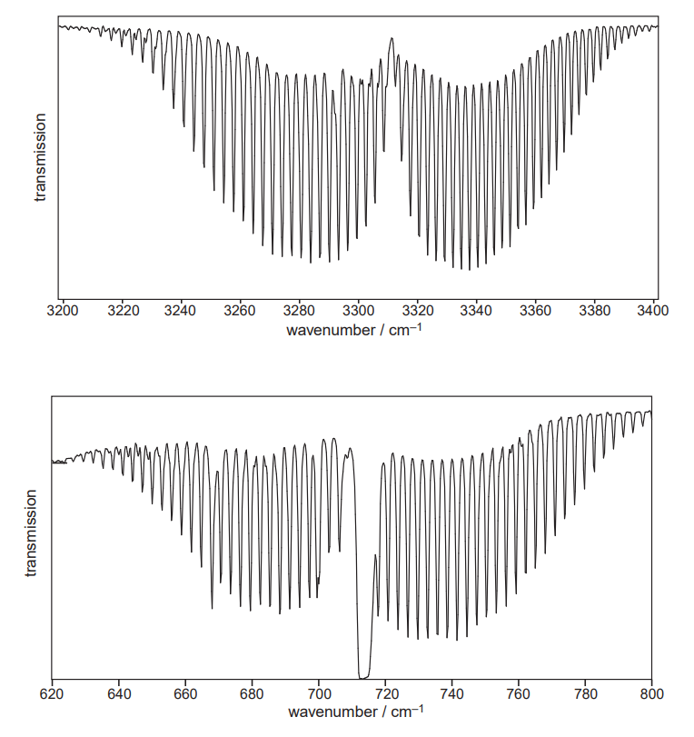
Parallel stretch
S-branch, spread out
R-branch, compressed
2-degenerate perpendicular bend
Q-branch, spread towards high wavenumbers
S-branch, compressed
R-branch, spread out

