Slide 2
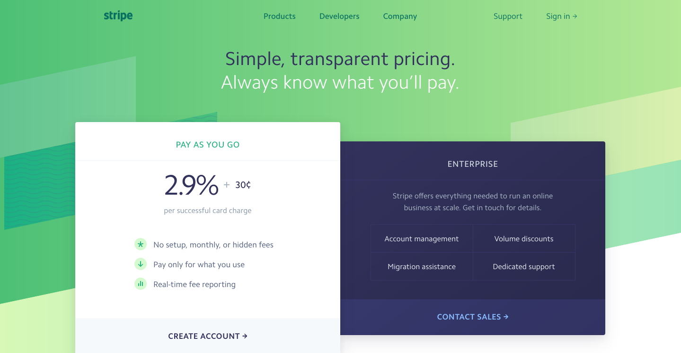
https://stripe.com/us/pricing

Slide 3
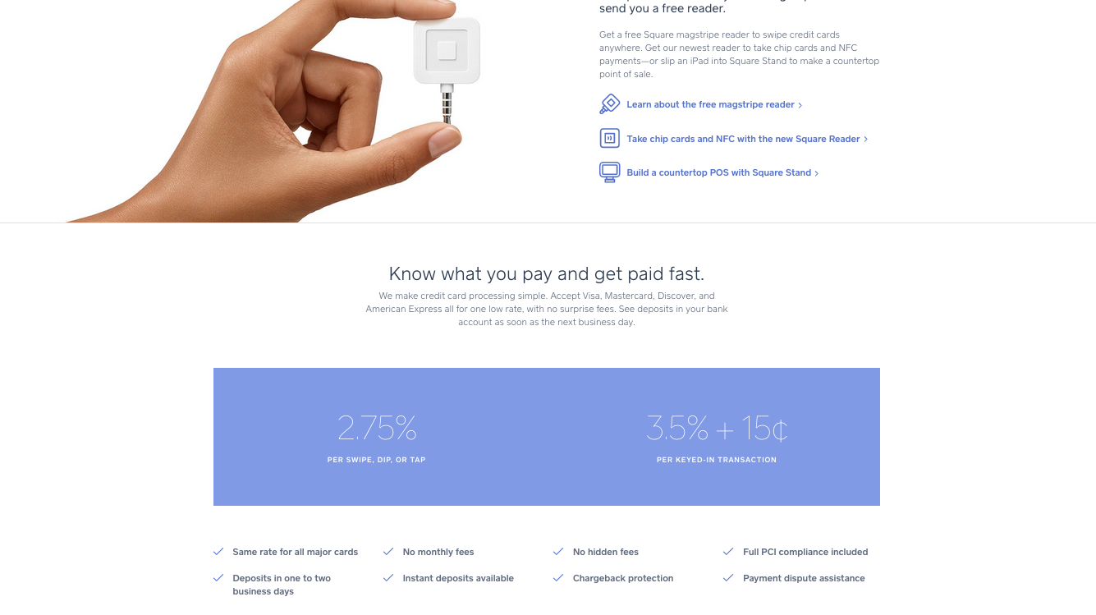
https://squareup.com/under-250k

