Slide 1
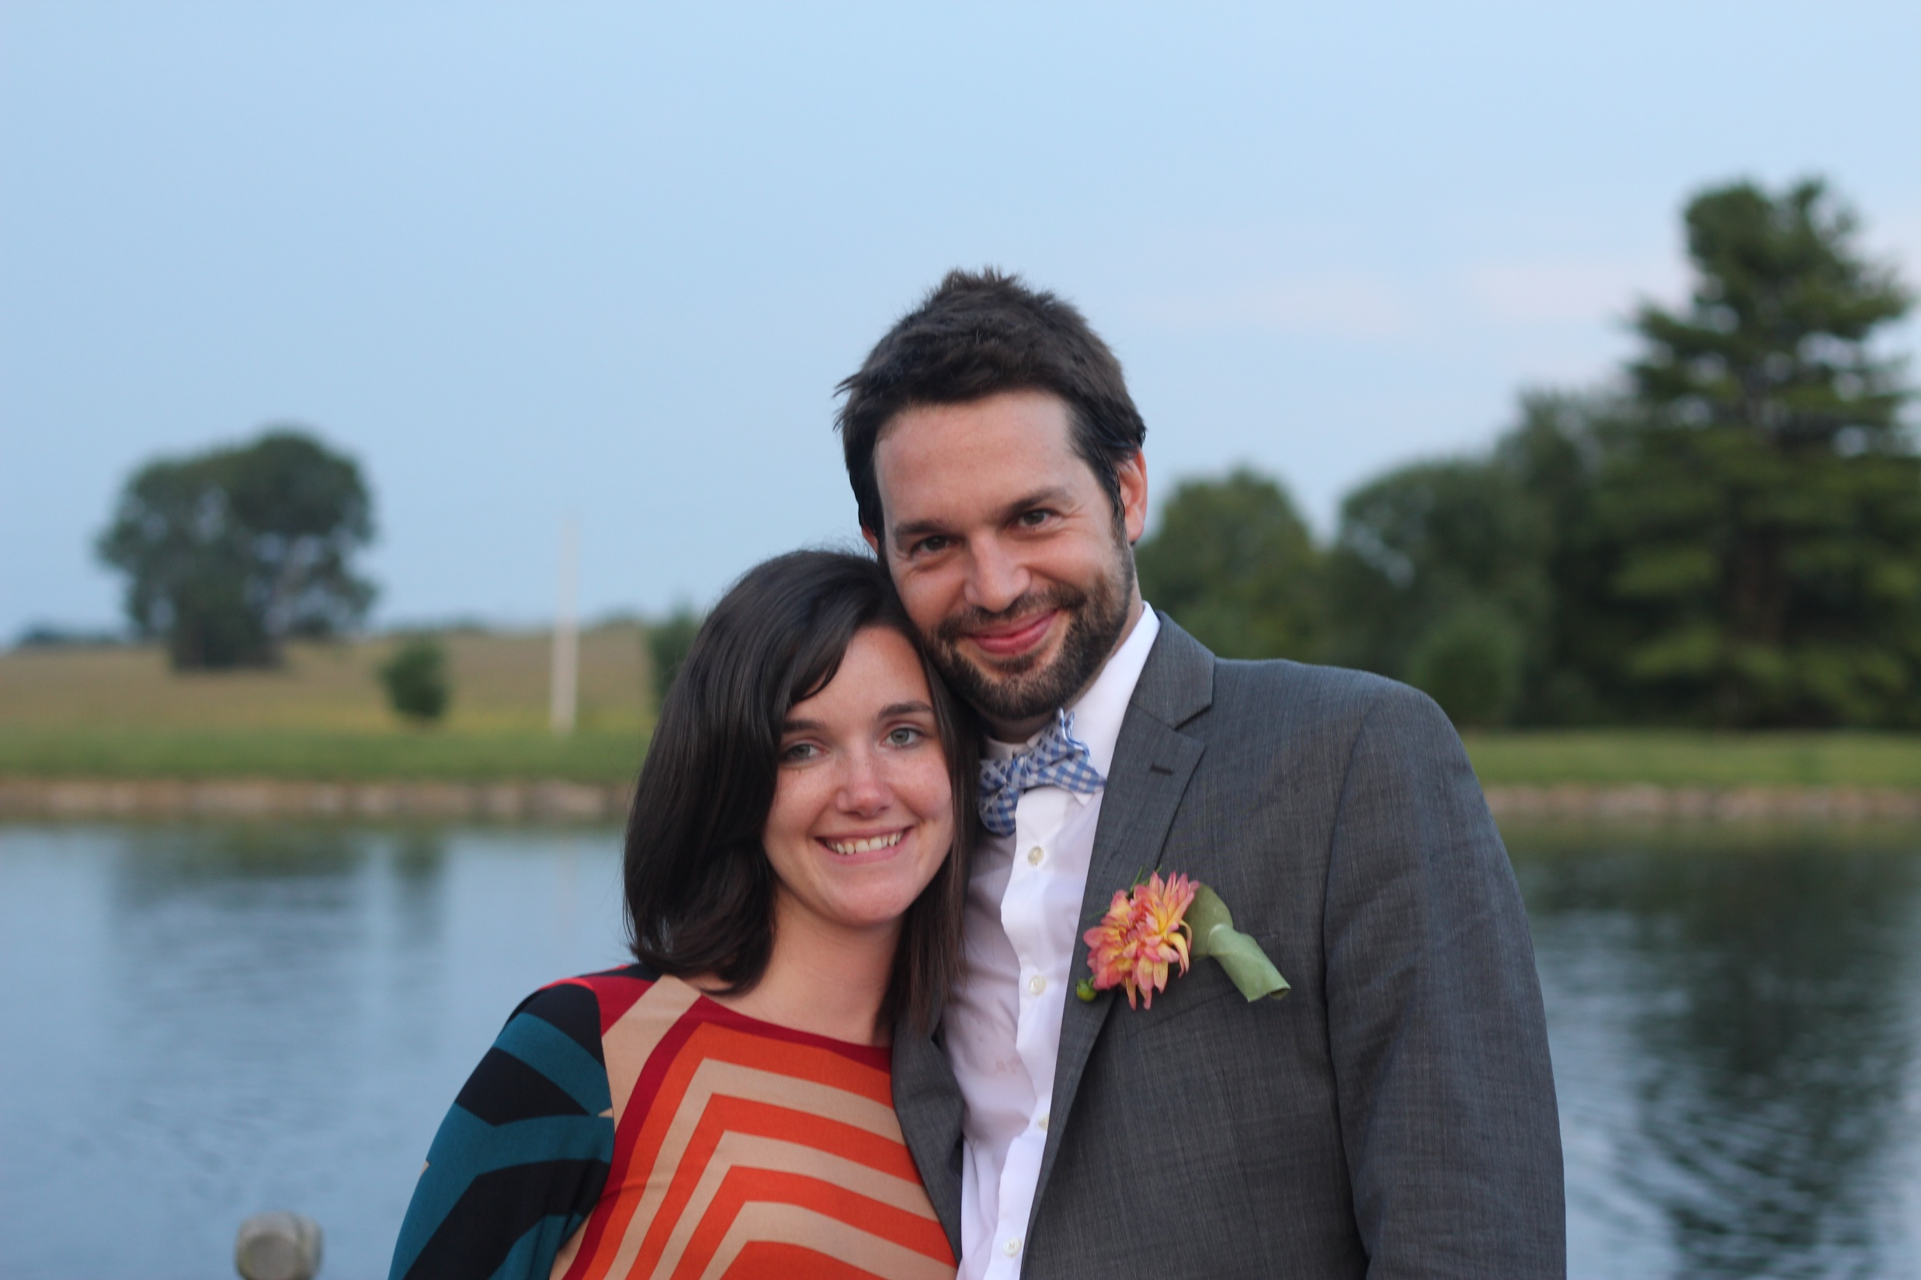
Erin & Matt
Our Story
Schedule
Location
Wedding Party
Honeymoon Fund
Slide Show
RSVP
Winter Solstice ⋅ December 21 st, 2019 ⋅ Maurice, Louisiana

Slide 2
Erin & Matt
Our Story
Schedule
Location
Wedding Party
Honeymoon Fund
Slide Show
RSVP
Winter Solstice ⋅ December 21 st, 2019 ⋅ Maurice, Louisiana

