Slide 1
Mashable
Brian Zhou
General Assembly – DAT SF 19

Slide 2
Project Details
Data Set:
The data set that I performed my analysis on was the Mashable dataset: https://archive.ics.uci.edu/ml/datasets/Online+News+Popularity
Problem:
Build a model that could predict whether an article fell within the category of TECH, BUSINESS, SOCIAL MEDIA, WORLD, or ENTERTAINMENT.
Milestones:
1. Identify a dataset that I was interested in
2. Explore and Understand the dataset
3. Pre-Process the data for use
4. Test multiple models on the dataset
5. Graph and Visualize my findings.
Notes:
Explain that you weren’t able to hit all

Slide 3
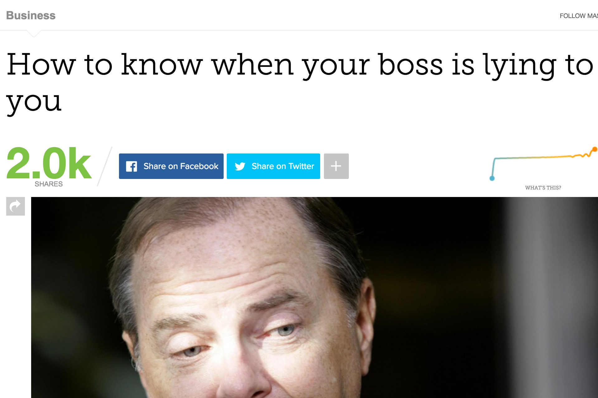
Dataset Details
Total of 39644 Blog Articles
Originally 61 labels
Reduced it to 30 labels
Added 6 new labels
Consolidated Day the post was release
H1 Tag
Title Tag
Author
Meta Description
Body Content
Notes:
- Reduced down to 30 labels because I didn’t understand them. I wanted to mimic this as if I was pulling the data from the scratch as I’d not want to work with data labels that I didn’t fully understand.

Slide 4
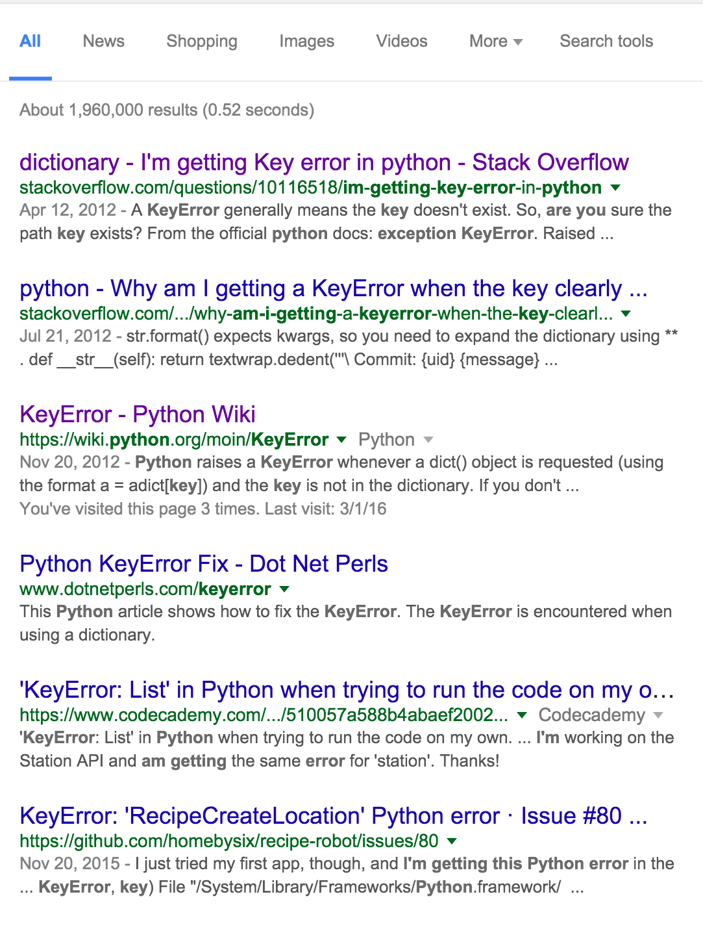
When Problems Started
However, a lot of problems arose when working with my data:
I realized that my scraper only returned an index of 38951 articles when the UCI Mashable dataset had 39644.
I realized that some of the articles within the Mashable dataset weren’t properly labeled, and had missing values when it came to what category it belonged in.
I had a lot of difficulties slicing and dicing around with the data as often times I would end up end up with DataFrames filled with NaN.
I thought I understood my data, but in actuality I didn’t.
I don’t understand!!!!

Slide 5
Models to Test
Process:
Applied Logistic Regression to identify which labels were important in determining if an article was published on what day of the week.
Applied Logistic Regression, Support Vector Machines (SVM), Decision Trees, Random Forest Classifier (RFC), and an Ensemble of Logistic Regression/ SVM/ Decision Trees to each category to identify which model worked best to predict if an article was to be well shared.
Applied Logistic Regression, Support Vector Machines (SVM), Decision Trees, Random Forest Classifier (RFC), and an Ensemble of Logistic Regression/ SVM/ Decision Trees to find which model would work best in predicting if an article fell within the listed article categories.
Apply Logistic Regression to explore if there was any relationship between the author of a post and how well the article was shared.
Partially done
Notes:
Need to know the ‘Why’ for each model
SVM – With an RBF kernel as we have a lot of labels
Logistic Regression – Started this model as it was one of the only ones I knew
Decision Trees – I wanted to explore the logic
Random Forest Classifier – I have a lot of labels
Ensemble – I wanted to combine most of them as many fell within a similar range so I wanted to try and push it above.

Slide 6
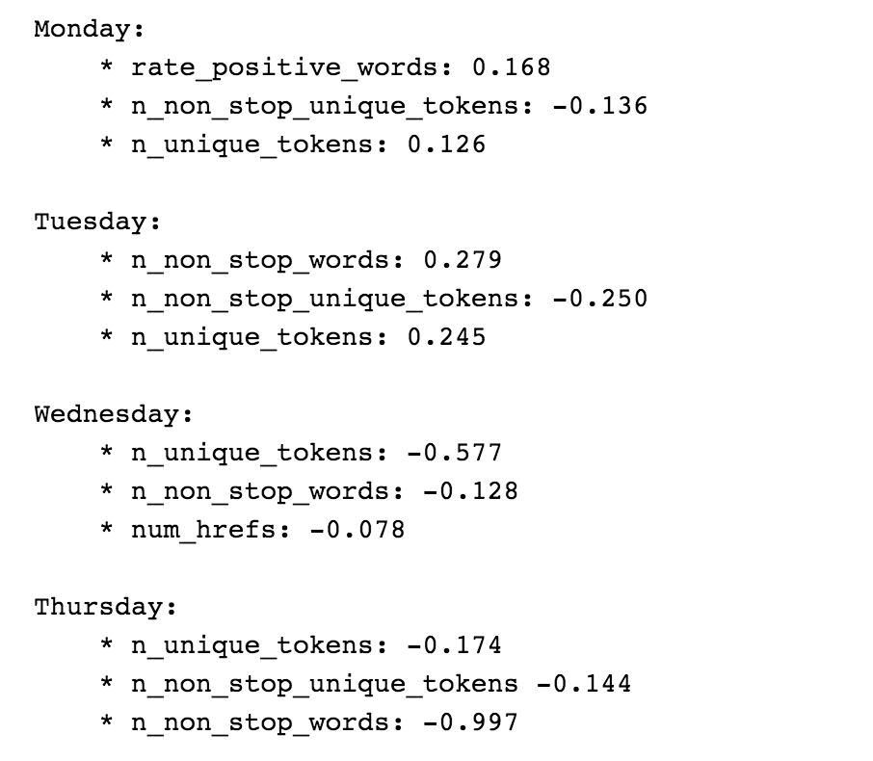
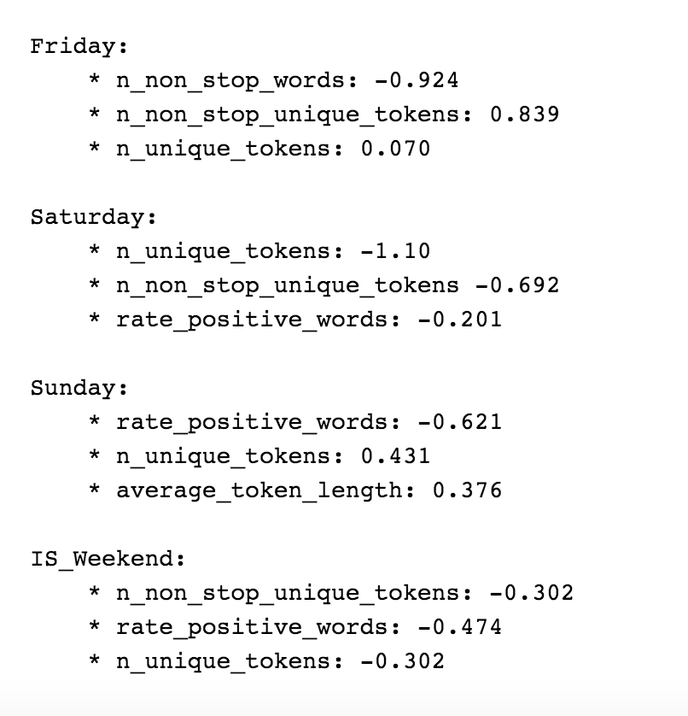
Day of the week
Dived the labels that were important in categorizing which articles were released on:
These 3 labels were consistently highest, pushing me to dive deeper into exploring its content.
Notes:
These 3 features were most important.

Slide 7
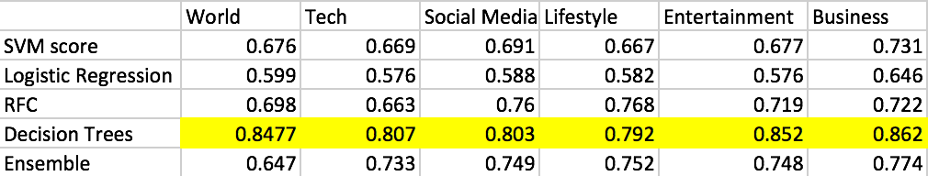
Category + Shares
The model that was best seen across the board was Decision Trees.
Notes:
Decision Trees had very low precision

Slide 8
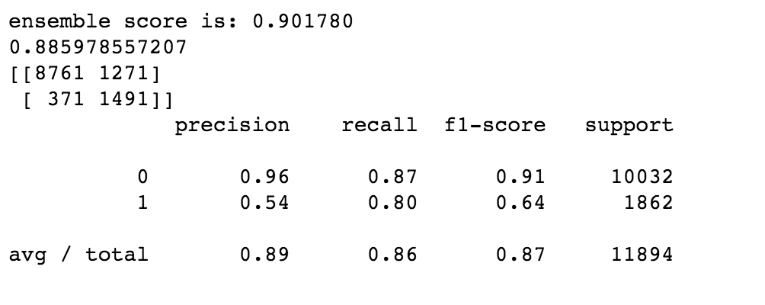
Predicting category ‘na’
All tested models performed well other than Decision Trees.
The best, by a small amount, was the Ensemble of Logistic Regression/ SVM/ Decision Trees
Notes:
I was able to identify if an article was going to fall within a category of mash/tech/etc

Slide 9
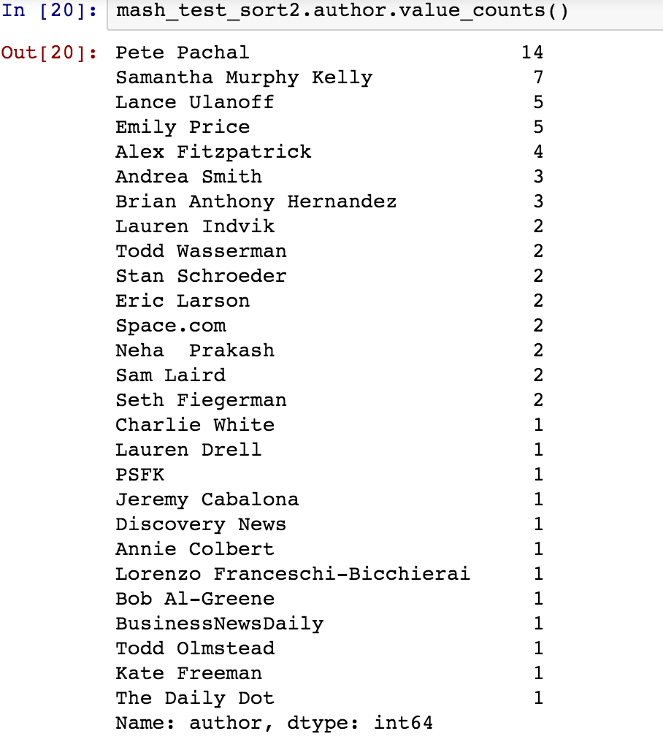
Authors + Shares
Logistic Regression returned a score of 0.769.
Target was if their articles’ shares were higher than the median.
Sample of authors tested on was small.
Notes:
Sample of authors need to be increased for better results; however, wasn’t able to get past a technical sisue.

Slide 10
Challenges/Learnings
Challenges:
Thought I understood my data but didn’t completely (didn’t properly do data exploration)
Needed to understand the ‘why’ for a model before applying it
Data Pre-Processing
Difficulty dealing with certain errors
Notes:
Challenges: Unable to distinguish between which models to use
Learnings: understanding why I wanted to apply some models.

Slide 11
Next Steps
Refine the tuning of the Models
Follow through with the NLP aspect of this project.
Begin scraping current data to incorporate into model
Try similar process on other data sets

Slide 12
Thank You

