Slide 1

Similarity Forests
November 1, 2018

Slide 2
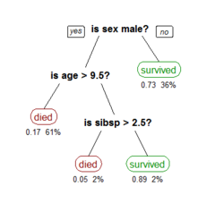
Background
Decision Tree
Goal
The goal is to create a model that predicts the value of a target variable based on several input variables.
Random Forest
Bootstrap aggregated (bagged) decision trees
builds multiple decision trees by repeatedly resampling training data with replacement, and voting the trees for a consensus prediction
A tree showing survival of passengers on the Titanic .
Your chances of survival were good if you were (i) a female or (ii) a male younger than 9.5 years with less than 2.5 siblings.

Slide 3
Introduction
Advantage of Random Forests
tremendous accuracy and robustness in various domains
e.g. A recent study evaluated 179 classifiers from 17 families on the
entire UCI collection of data sets, and concluded that random forests
were the best performing classifiers among these families
Weakness of Random Forests
Only work with multidimensional data. Because model sample features.
Cannot work with data like time-series data, discrete sequences, or graphs, a multidimensional representation might not exist.
How to solve this problem?
SimForest!!!

Slide 4
Why SimForest
Computational Complexity: One of the attractive features of SimForest is it excellent computational complexity. A single split of SimForest requires time that is linear in the number of points at the splitting node in the tree.
Incompletely Specified Similarities: SimForest can also be used in cases where only a subset of pairwise similarities are observed given that it is impossible to collect all pairwise similarities for a large data set.
Implicit Assumptions: One of the implicit assumptions behind SinForest is that the data points can be embedded in a multidimensional space even though the underlying similarity matrix is not semi-definite.

Slide 5

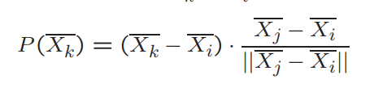
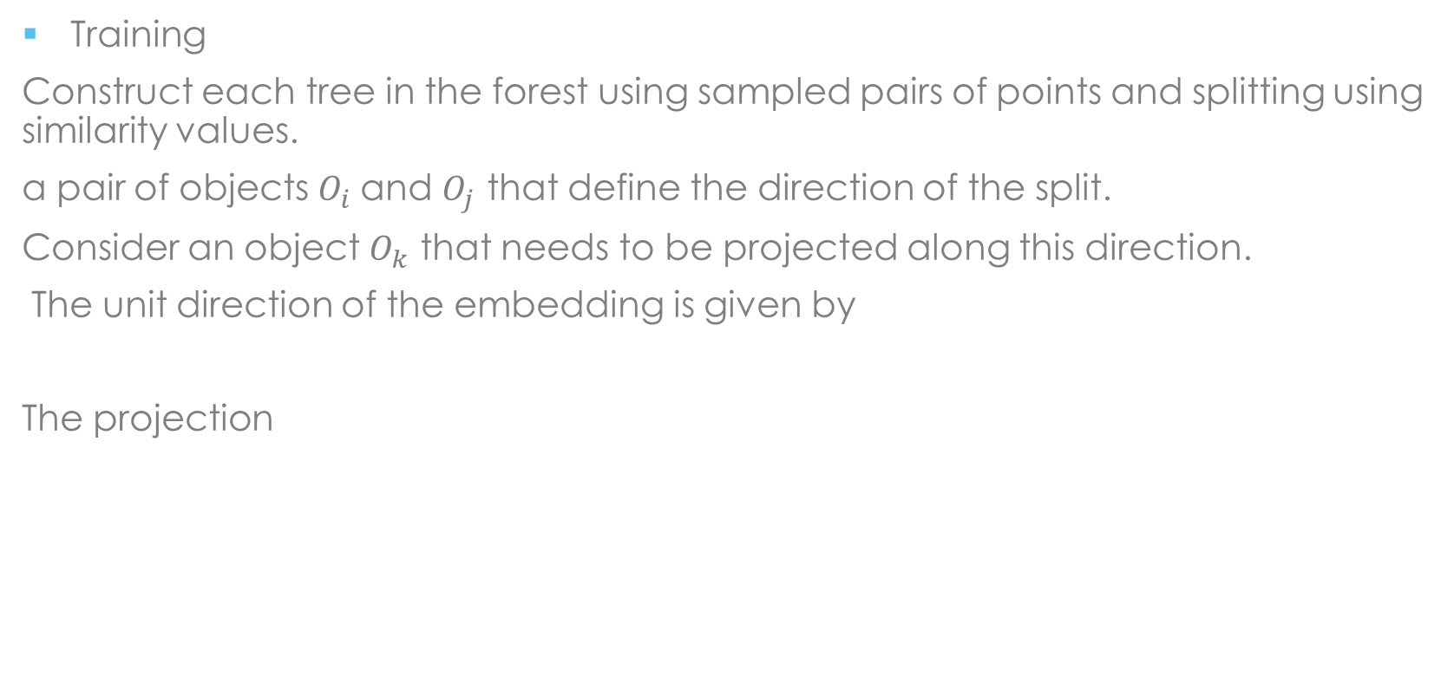
Algorithms
Training
Construct each tree in the forest using sampled pairs of points and splitting using similarity values.
a pair of objects $O_{i}$and $O_{j}$ that define the direction of the split.
Consider an object $O_{k}$ that needs to be projected along this direction.
The unit direction of the embedding is given by
The projection

Slide 6
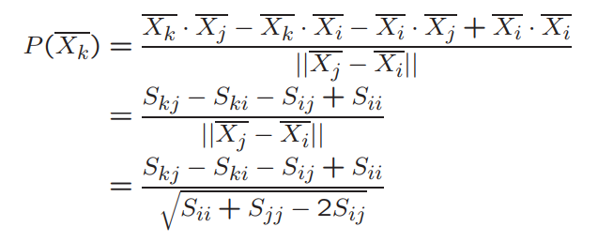

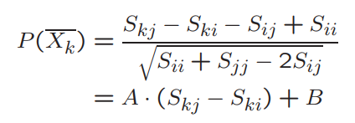
Express projection by similarities
simplified
Eventually, we can use
To order the points for the split

Slide 7
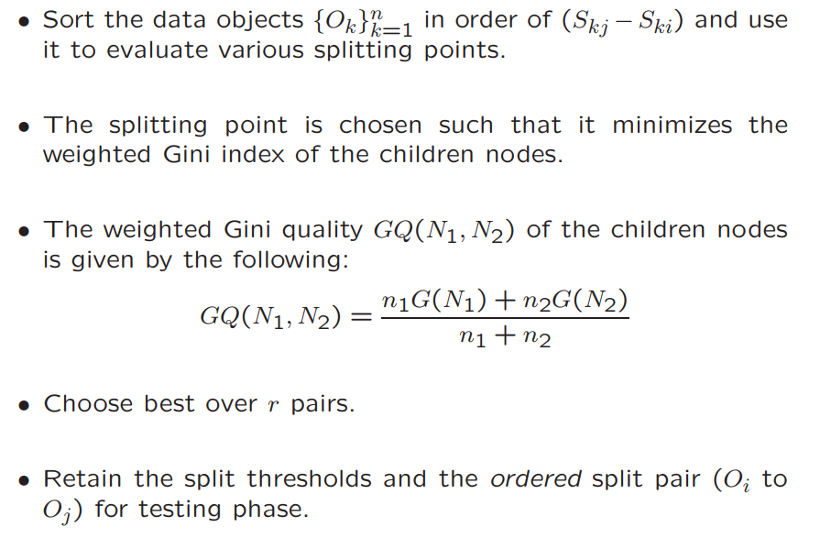
Splitting Implementation

Slide 8
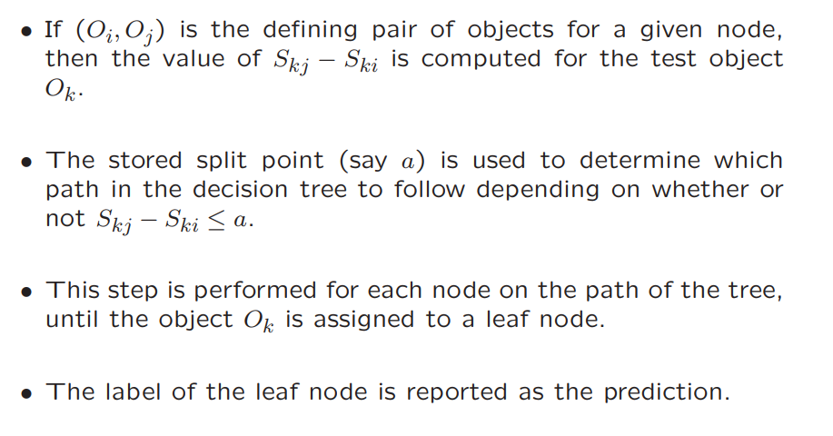
Testing phase
The testing phase uses an identical approach to project the test points on the line defined by the pairs of training points at each node.

Slide 9
Experimental Result
The primary use case of SimForest is one in which only the similarities between objects are available
Objects may not be multidimensional
The natural competitor is the kernel support vector machine
Experimental results comparing SimForest with other competitive techniques.
SimForest resistance to noise similarity
How missing similarity values affect the accuracy of SimForest
Show results on multidimensional data

Slide 10
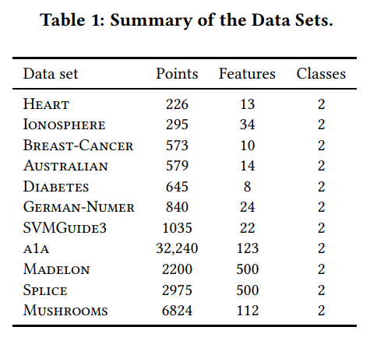
Data Sets
All data sets are obtained from the LibSVM Website repository of classification data sets.
All data sets were normalized to zero mean and unit variance
80% of the data set was used for training while 20% was used for testing
In many experiments, the training data set was further divided into portions for partitioning and parameter tuning.
Model performance is determined using accuracy

Slide 11
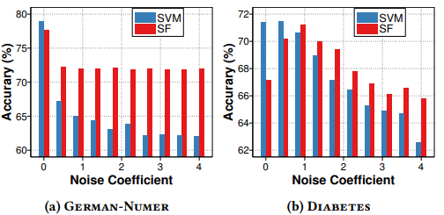
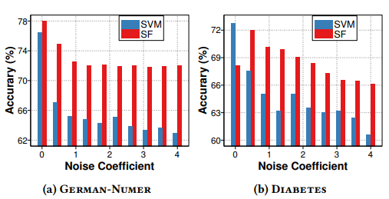
Performance with Noise Similarity Matrix
SVM attempts to maximize the inter class margin by using the support vectors. Misclassifications points and noise are usually the support vectors that occur on the other side of the decision boundary
Simforest is inherently noise tolerant because of its robust approach in averaging out the noise

Slide 12
Performance with Noise Similarity Matrix

Slide 13
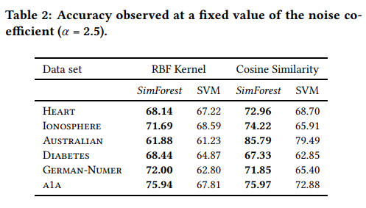
Evaluation Result
Model performance is measured using accuracy.
Accuracy the percentage of the correctly classified test data points.
SimForest is highly noise resistant and can constantly produce superior results over state-of-the-art methods like support vector machines.

Slide 14
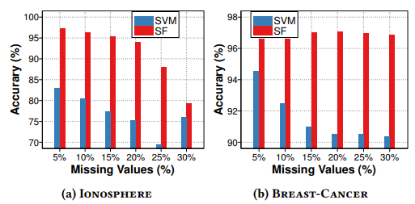
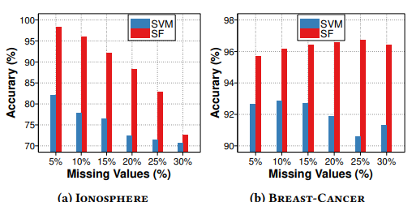
Effect of Missing Data
The presence of missing entries is natural when such matrices are derived from user feedback. All pairwise similarity will not be available
SVM used column-wise mean of the similarity matrix because the model cannot work directly with missing values

Slide 15
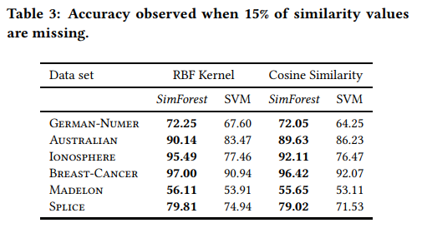
Evaluation Result

Slide 16
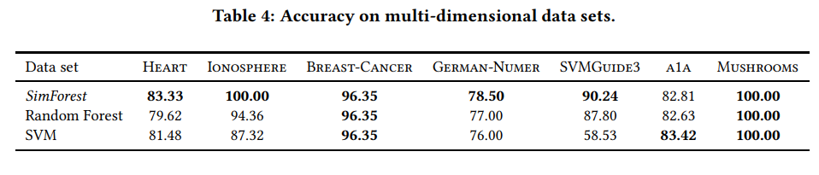
Accuracy of Multi-Dimensional Data Sets
Although SimForest is designed for settings in which only similarity is available, it is easy to use in cases where multidimensional features are available
Traditional random forest is included
SimForest is highly competitive to Random Forest and SVMs, even though SimForest was not originally designed for a multidimensional setting.
Random forest, however, comes very close to matching the accuracy of SimForest

Slide 17
Conclusion
A method for constructing random forests from arbitrary object data types by using a similarity-centric approach to decision-tree construction
This approach is resistant to noise in the data
Can work well with missing values
Provides competitive performance for traditional multidimensional data sets

