Slide 1

Similarity Forests Project Presentation by Yu Zhang and Udochukwu Nweke
Machine Learning
December 07, 2018

Slide 2
Introduction
Random Forests are part of the most successful models because of their effectiveness and accuracy.
Despite their high accuracy and effectiveness, they are only limited to a multidimensional dataset because they sample feature from the original dataset
Random forests cannot work in datasets like time-series data, discrete sequences, or graphs. There are no multidimensional representation in these datasets

Slide 3
Similarity Forest Problem Solving Method
The limitations of Random forests motivated the authors to come up with a model that will handle data sets that are not multidimensional and multidimensional as well
Given a set of n objects O1….On, which are labeled l1……..ln, construct a random forest with the use of only computed pairwise similarities between these objects and no access to multidimensional representation of these objects
We used Python programing language and python packages and libraries to implement the aldorithm.

Slide 4
Data Collection and Preprocessing
The first step we took was to get our dataset for this project
We got our data sets from https://www.csie.ntu.edu.tw/~cjlin/libsvmtools/datasets/binary.html#breast-cancer and converted it into a csv file
For the missing data, we use sklearn Label Encoder to convert categorical variable into numerical variable.
We normalized data set to zero mean and unit variance
We used two main datasets for this project and a randomly generated dataset for testing.
The heat dataset is for extra credit.

Slide 5
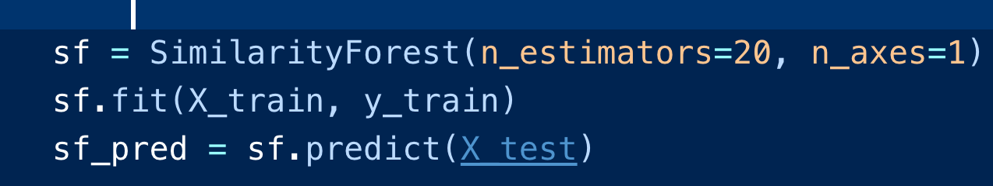
Similarity Forest Model
After data preprocessing, our dataset was ready for model fitting
The first model we used to fit our dataset is the similarity forest
Similarity forest does not have any package, we implemented this model from scratch
We created a package for similarity forest algorithm like every other machine learning algorithm package in sklearn
This package allowed us to fit the training

Slide 6
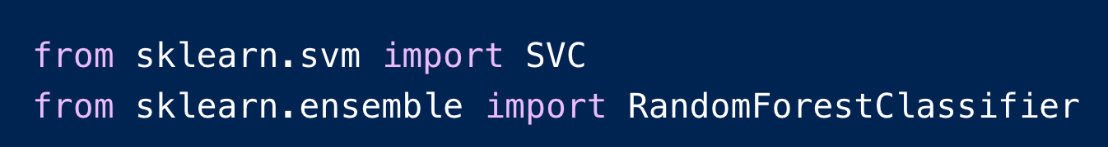
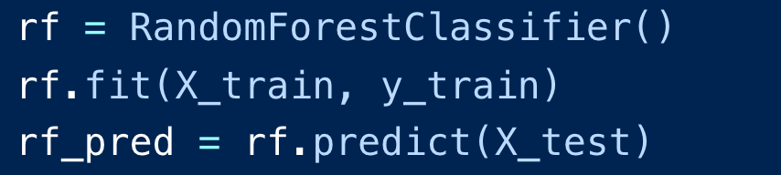
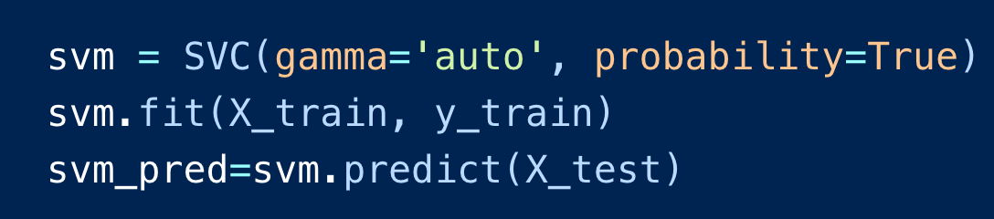
SVM and Random Forest Models
Our dataset is already prepared
We simply used sklearn package to import SVM and Random Forest Models

Slide 7
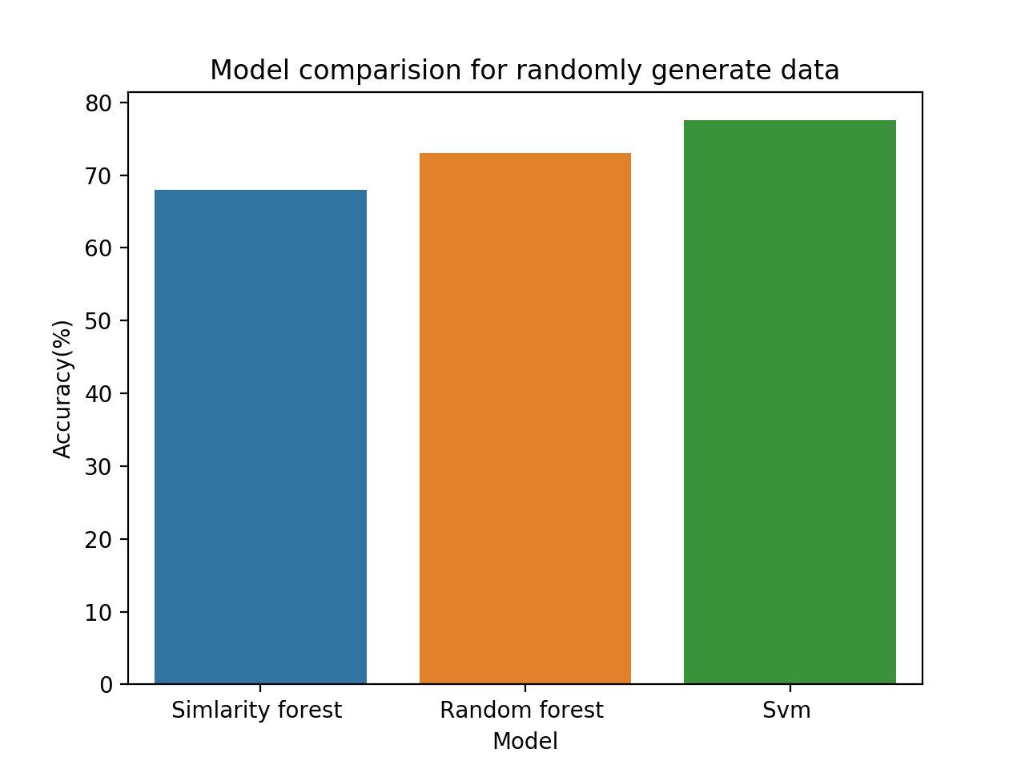
Testing Model with Randomly Generated Data Set
We used sklearn.datasets.make_blobs to randomly generate isotropic Gaussain blobs for clustering
The graph shows how SVM out performed Random forests and similarity forests Model
Randomly generated data was not tested in the original paper.
Accuracies for Randomly generated data:
Similarity Forest Accuracy: 0.69
Random Forest Accuracy: 0.71
SVM Accuracy: 0.77

Slide 8
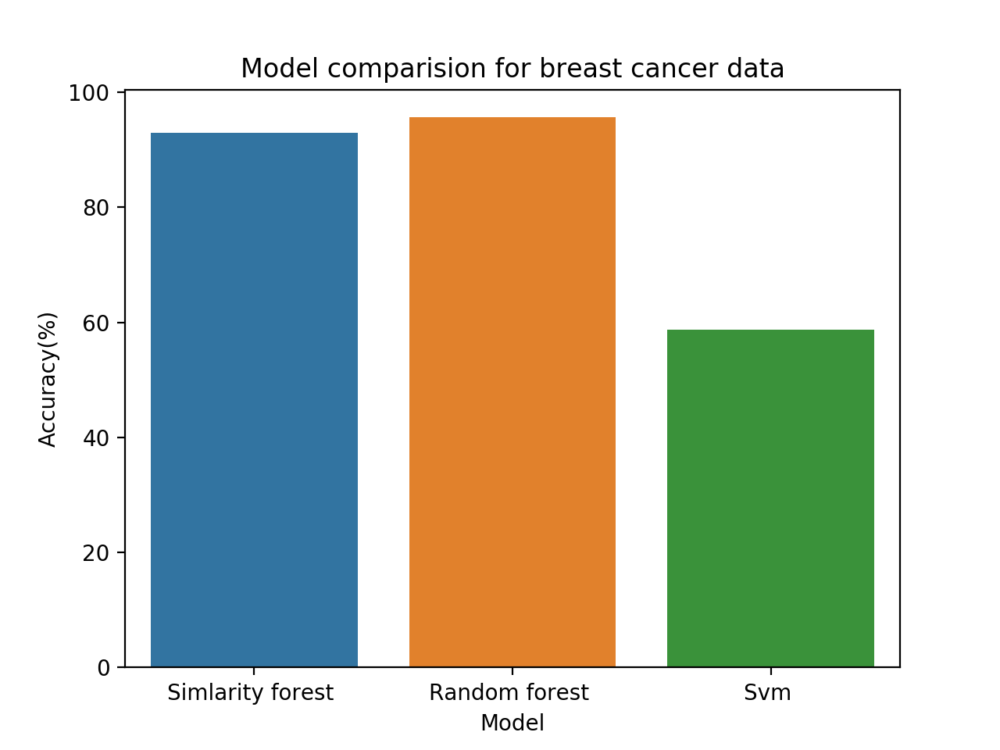
Testing Model with Breast_Cancer Data Set
For the breat_cancer dataset, Random forest and Similarity forest have almost the same accuracy.
SVM performed the least.
Accuracies for breast cancer dataset
Similarity Forest Accuracy: 0.947368421053
Random Forest Accuracy: 0.982456140351
SVM Model Accuracy: 0.587719298246

Slide 9
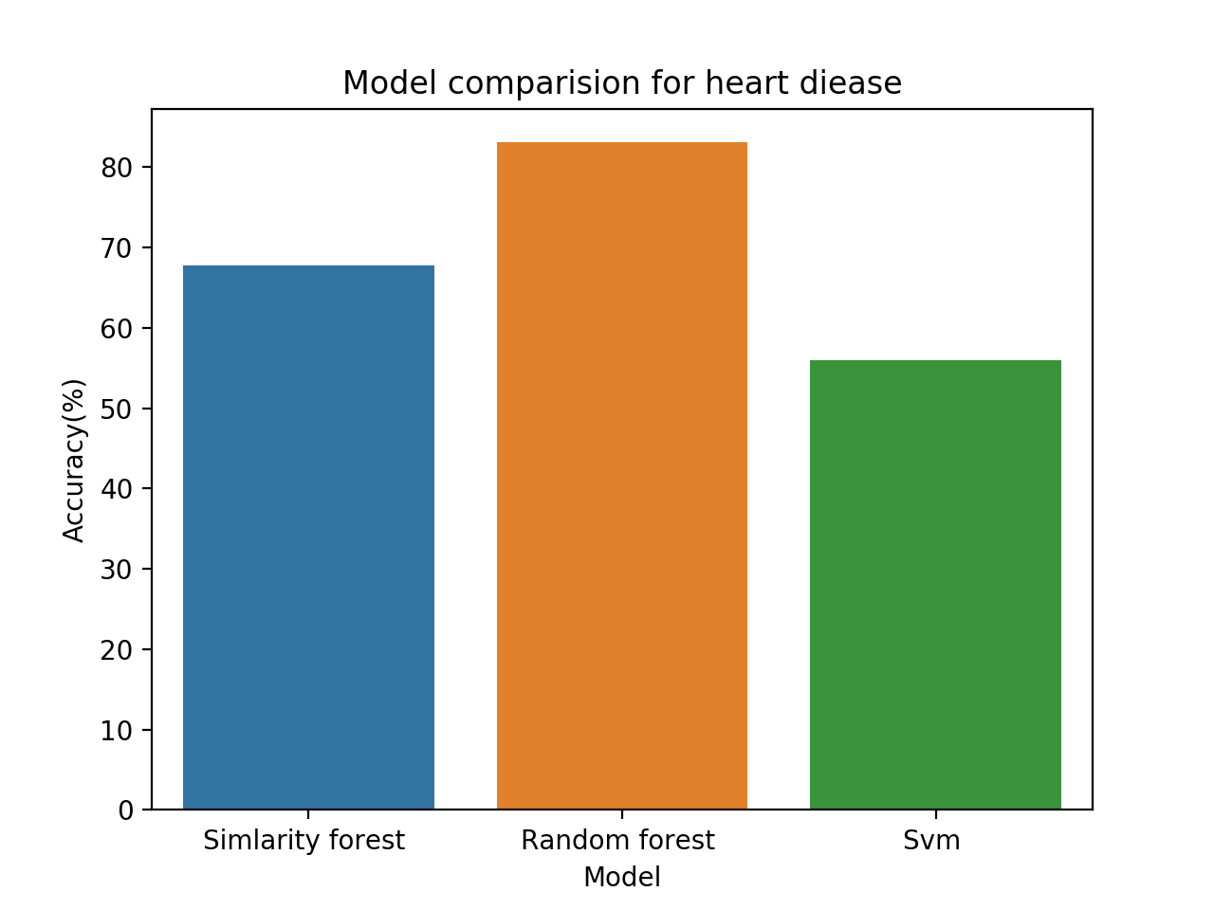
Testing Model with Heart Disease Data Set
For the heart disease dataset, Random forest performed better than Similarity forest.
SVM performed the least.
Accuracies for heart disease dataset
Similarity Forest Accuracy: 0.677966101695
Random Forest Accuracy: 0.779661016949
SVM Model Accuracy: 0.559322033898

Slide 10
Our Result and Observation
After comparing the models with different datasets, we observed that similarity forest and random forest have similar accuracy.
Random forest performed better in a multi-dimensional data sets
Similarity forest model did well both in a multidimensional dataset and a two dimensional dataset
Similarity forest and Random Forest outperformed SVM model.

Slide 11
Future Work
Performance with Noise Similarity Matrices.
Handling missing similarities: The impact of missing similarity values on SimForest and SVM

