Slide 1

ZILLOW’S HOME VALUE PREDICTION
YU ZHANG and Udochukwu Nweke
December 12, 2018

Slide 2
Introduction
Zillow is a real estate company created to give users as much information possible about homes and housing market. They provide company with the necessary information required before a home purchase
Zillow challenged data scientist on Kaggle to help push the accuracy of the Zestimate even further.
The goal of this project is to come up with a model that will the Zestimate residual error
Logerror = log(Zestimate) – log(SalePrice)

Slide 3
How We Achieved this Goal
Data Exploration and Visualization
Handling Missing Values
Choosing a model after trying different Models
Model Evaluation

Slide 4
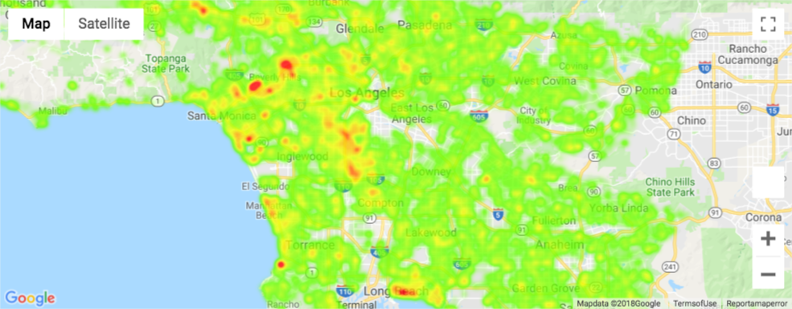
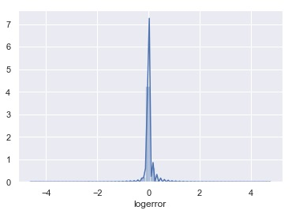
Exploration and Visualization
Positive logerror shows that Zestimate is overestimating while negative log error shows the Zestimate is understimating
The next feature we explored was location, we used heatmap to visualize locations
Some locations showed very high logerror. E.g. Malibu, Santa Monica, Beverly Hills, etc.
This explains that location is a bad feature for prediction

Slide 5
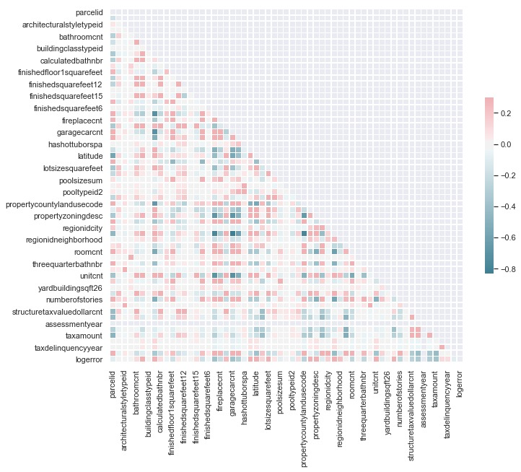
Correlation
Features like taxamount, fireplace, etc. showed a high correlation
Number of stories, region neighborhood has low correlation

Slide 6
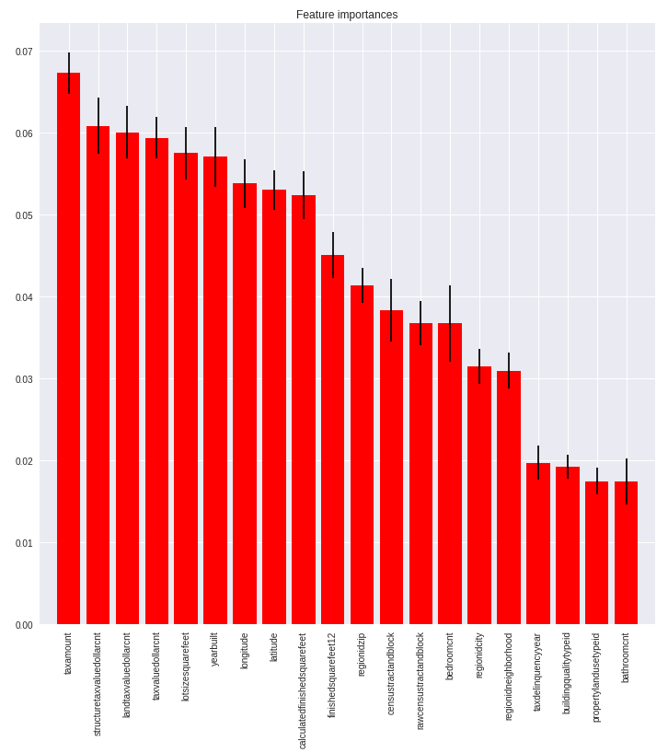
Important Features
"tax amount" is the most important variable followed by "structure tax value dollar count" and "land tax value dollar count“.
“bathroom count” is the least important variable followed by “property land use” and “building quality”.

Slide 7
Data Preprocessing
After exploring the data, we observed that missing values actually had meaning. Hence, we filled missing value with -1
The next thing we did was to transform categorical data into numerical variables
We used sklearn LabelEncoder package for transforming categorical attributes into numerical attributes

Slide 8
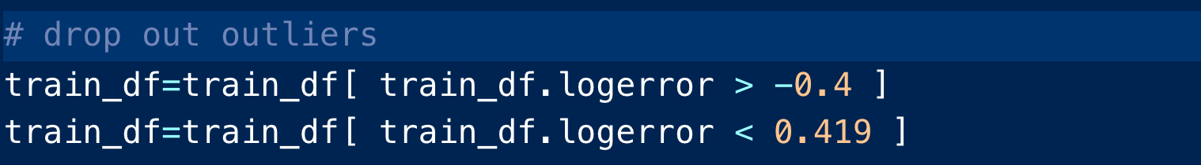
Handling Outliers
After plotting the log error, we observed some outliers. Features with log error > -0.4 and log error < 0.419 were deleted from the dataset
We used 95% confidence interval and tuned the parameter until we came up with the above values

Slide 9
Model Fitting
For Model Prediction, we used xgboost model .
Xgboost is an extreme gradient boosting machine learning technique for regression and classification
We used linear regression objective function, and Mean Absolute error as evaluation metric

Slide 10
Model Fitting Continues
Since our main task is to improve the Zestimate log error, we tried to do something different
we ran the model twice with deferent parameters
We assigned weights for the different prediction and came up with a better prediction.

Slide 11
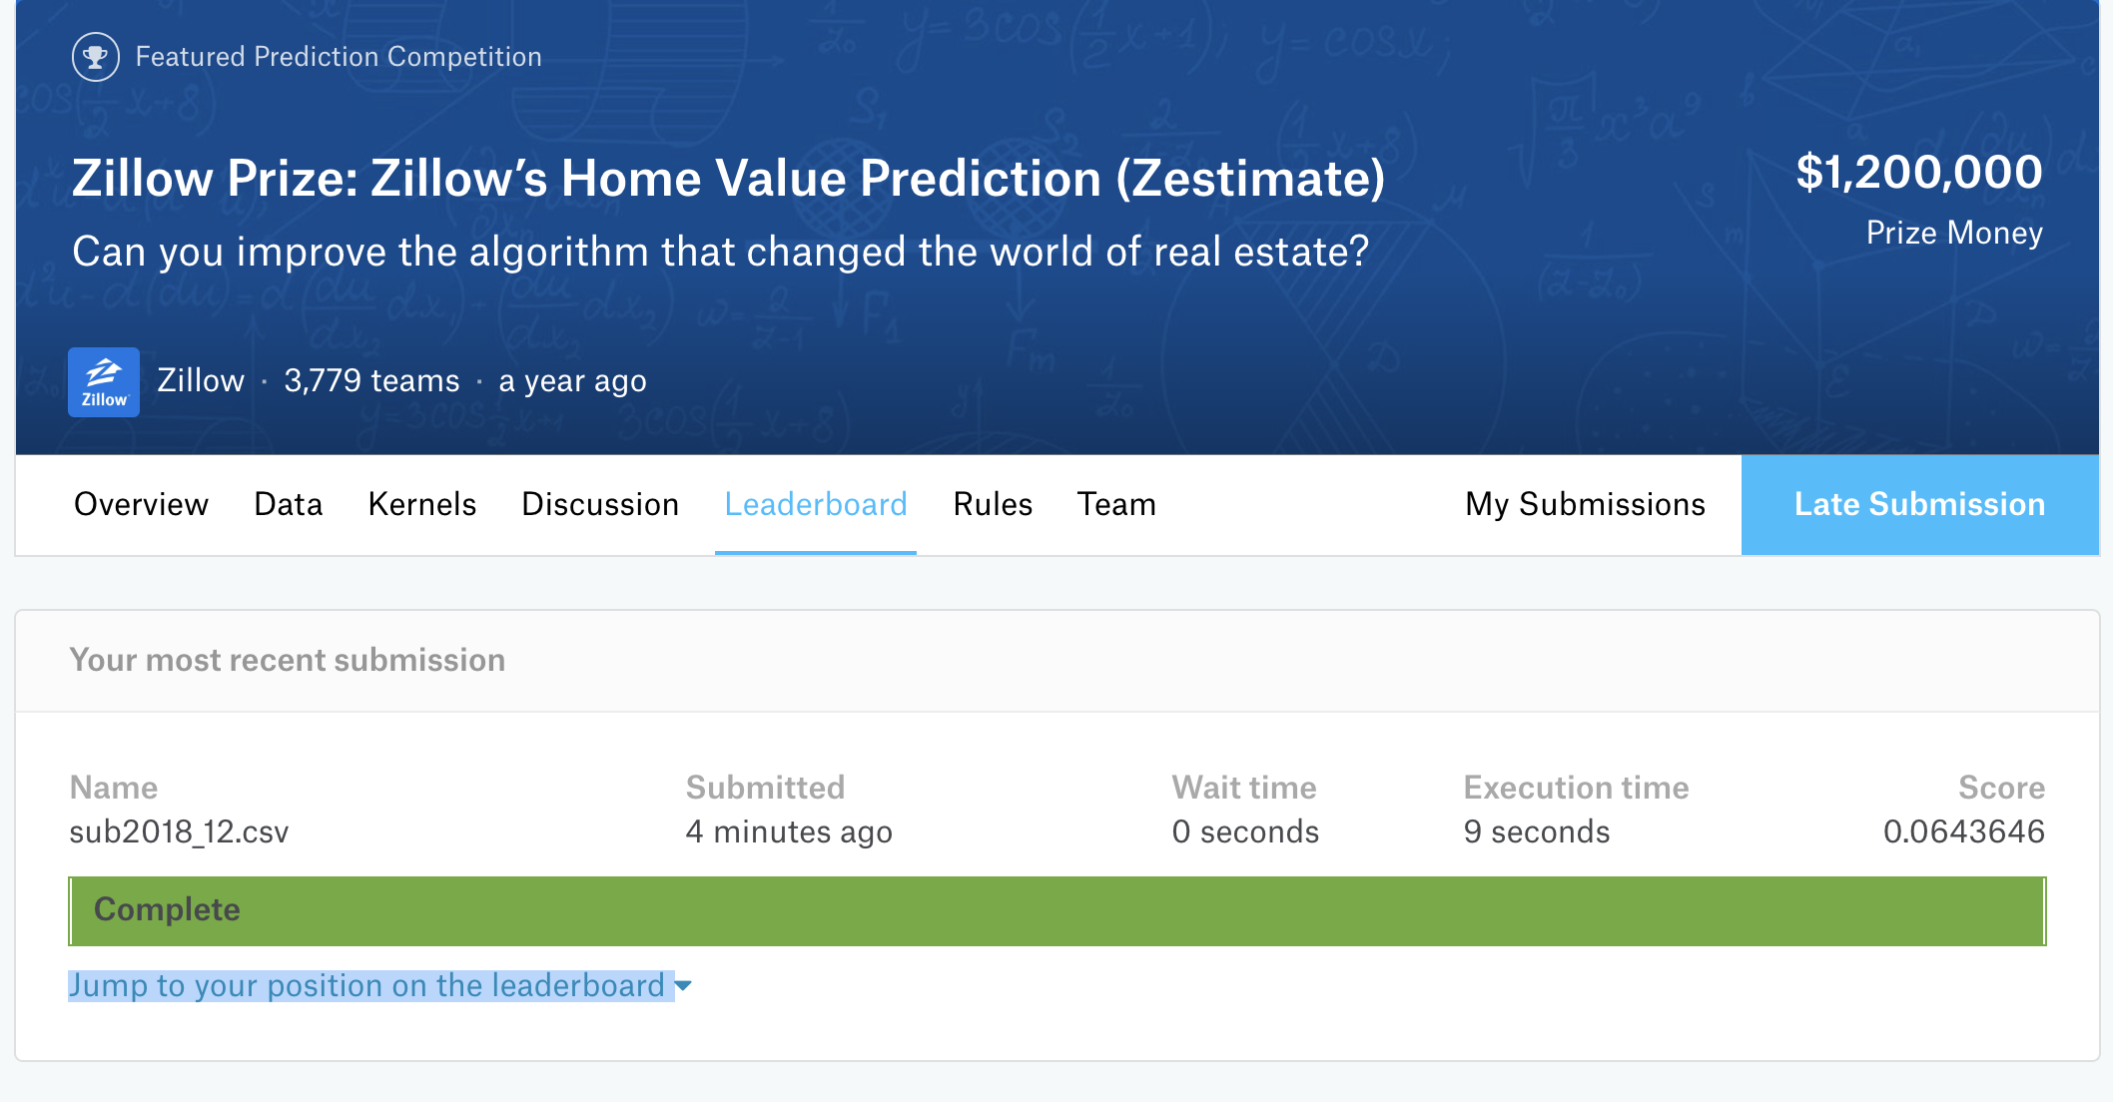
Our Result
Kaggle Submission

Slide 12
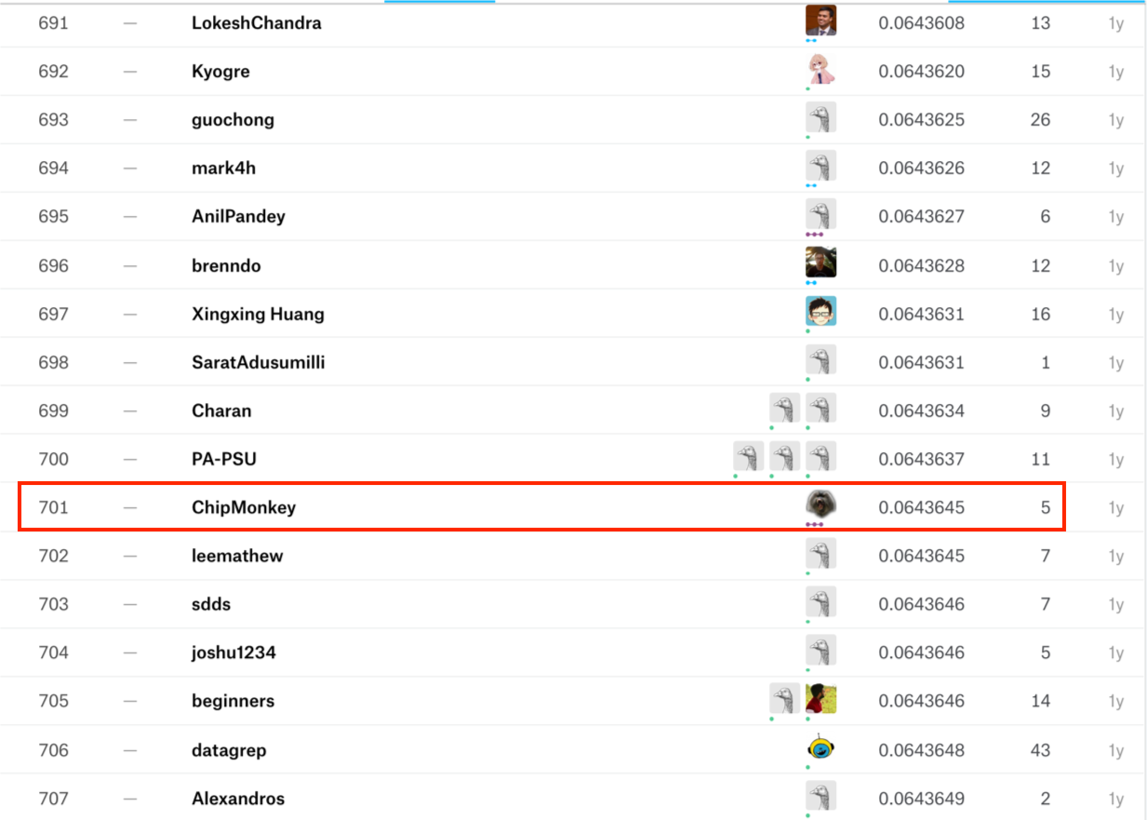
Our Result
Our Score.

