Slide 1




Mr.Bribe Mr.By Mr.Bytes Mr.Subscribe
Thumbs-Up
Airlines

Slide 2


Rows with Exit Doors
Thumbs-Up
Airlines
Business Class
Economy Class
Business Class
Economy Class

Slide 3
Mr.Bribe
Mr.By
Mr.Bytes
Mr.Subscribe
Thumbs-Up
Airlines
1. Childhood friends want to be placed next to each other
2. Strictly wants a row next to Exit doors
1. Travel is important, Prefers Business class, Ok with Economy as well.
2. No Seating preference
1. Business competitor of Mr.Bytes, want to avoid being in the same class as Mr.Bytes (Business or Economy)

Slide 4
Node 1
class=business
Node 2
class=business
Node 3
class=economy
exit-door=yes
Node 4
class=economy
Rows with Exit Doors
Kubernetes Cluster
Kube-scheduler
Business Class
Economy Class

Slide 5
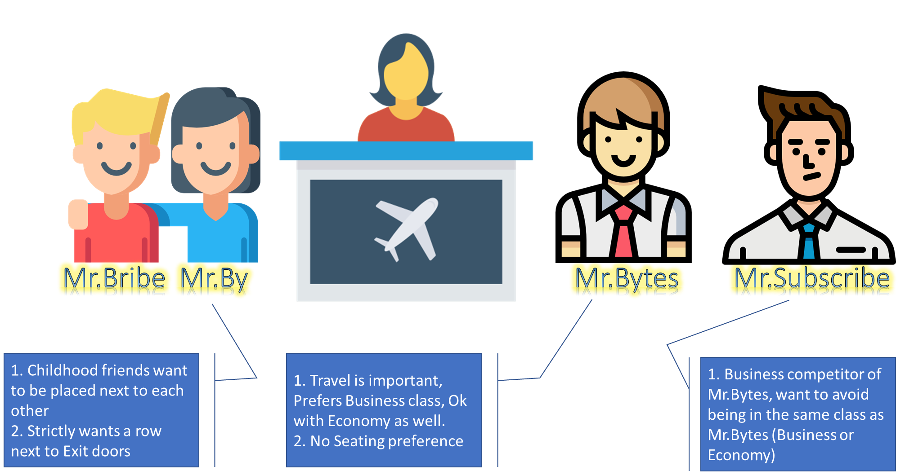
Node 1
class=business
Node 2
class=business
Node 3
class=economy
exit-door=yes
Node 4
class=economy
Kubernetes Cluster
Kube-scheduler
Business Class
Economy Class

Slide 6
Affinity/AntiAffinity variants
preferredDuringSchedulingIgnoredDuringExecution
requiredDuringSchedulingIgnoredDuringExecution
requiredDuringSchedulingRequiredDuringExecution – Future plans
preferredDuringSchedulingRequiredDuringExecution – Not in Kubernetes documentation

Slide 7
Pod Affinity/AntiAffinity Operators
In – Our example “class In economy”
NotIn
Exists
DoesNotExist

Slide 8
Topology Key – Our example -> kubernetes.io/hostname
In principle, the topologyKey can be any legal label-key. However, for performance and security reasons, there are some constraints on topologyKey:
For pod affinity, empty topologyKey is not allowed in both requiredDuringSchedulingIgnoredDuringExecution and preferredDuringSchedulingIgnoredDuringExecution.
For pod anti-affinity, empty topologyKey is also not allowed in both requiredDuringSchedulingIgnoredDuringExecution and preferredDuringSchedulingIgnoredDuringExecution.
For requiredDuringSchedulingIgnoredDuringExecution pod anti-affinity, the admission controller LimitPodHardAntiAffinityTopology was introduced to limit topologyKey to kubernetes.io/hostname. If you want to make it available for custom topologies, you may modify the admission controller, or simply disable it.
Except for the above cases, the topologyKey can be any legal label-key.
Ref: https://kubernetes.io/docs/concepts/scheduling-eviction/assign-pod-node/

Slide 9


Container Storage
POD
CONTAINER 2
CONTAINER 1

Slide 10
Volumes | empty-dir
POD
CONTAINER 2
CONTAINER 1

Slide 11
Volumes | local
POD
CONTAINER 2
Node
Persistent Volumes(PVs)
CONTAINER 1

Slide 12
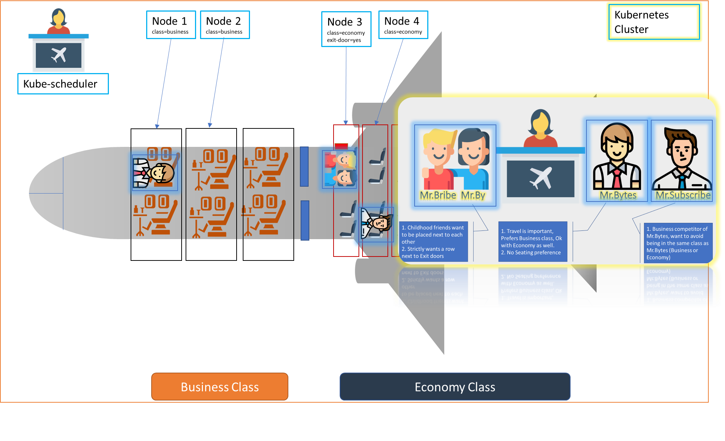

Slide 13
