Slide 1




Mr.Bribe Mr.By Mr.Bytes Mr.Subscribe
Thumbs-Up
Airlines

Slide 2


Rows with Exit Doors
Thumbs-Up
Airlines
Business Class
Economy Class
Business Class
Economy Class

Slide 3
Mr.Bribe
Mr.By
Mr.Bytes
Mr.Subscribe
Thumbs-Up
Airlines
1. Childhood friends want to be placed next to each other
2. Strictly wants a row next to Exit doors
1. Travel is important, Prefers Business class, Ok with Economy as well.
2. No Seating preference
1. Business competitor of Mr.Bytes, want to avoid being in the same class as Mr.Bytes (Business or Economy)

Slide 4
Node 1
class=business
Node 2
class=business
Node 3
class=economy
exit-door=yes
Node 4
class=economy
Rows with Exit Doors
Kubernetes Cluster
Kube-scheduler
Business Class
Economy Class

Slide 5
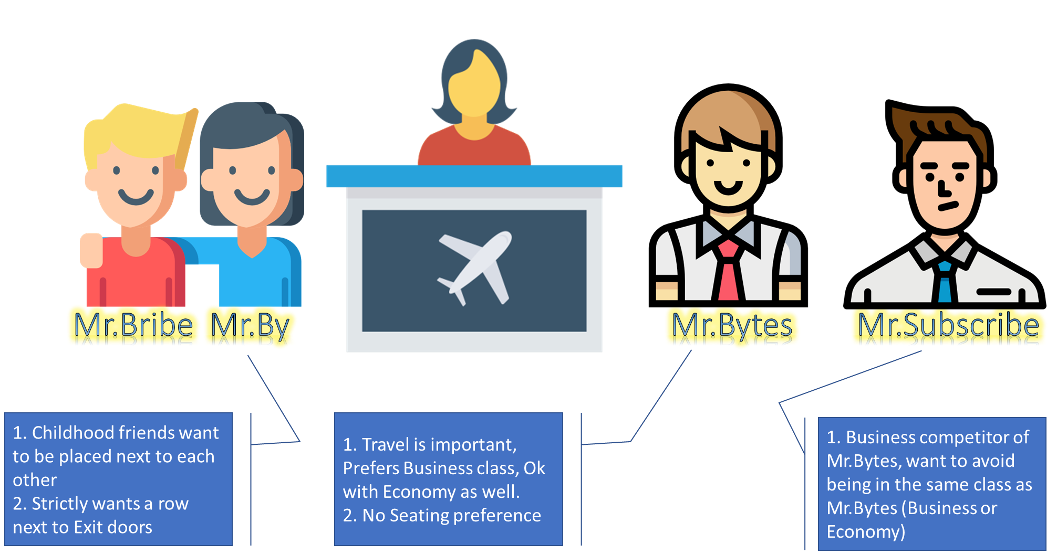
Node 1
class=business
Node 2
class=business
Node 3
class=economy
exit-door=yes
Node 4
class=economy
Kubernetes Cluster
Kube-scheduler
Business Class
Economy Class

Slide 6


Container Storage
POD
CONTAINER 2
CONTAINER 1

Slide 7
Volumes | empty-dir
POD
CONTAINER 2
CONTAINER 1

Slide 8
Volumes | local
POD
CONTAINER 2
Node
Persistent Volumes(PVs)
CONTAINER 1

