Slide 1



Eye-tracking data analysis using hidden semi-Markovian models to identify and characterize reading strategies
Brice Oliver⁽¹⁾, Jean-Baptiste Durand⁽¹⁾,
Anne Guérin-Dugué⁽²⁾
also with contributions by Sophie Achard, Benoit Lemaire, Yann Guédon
Project supported by PERSYVAL-Lab
Outline
  Aim of the study, experiment and data
  Model
  Results and interpretation
  Conclusion and perspectives

Slide 2
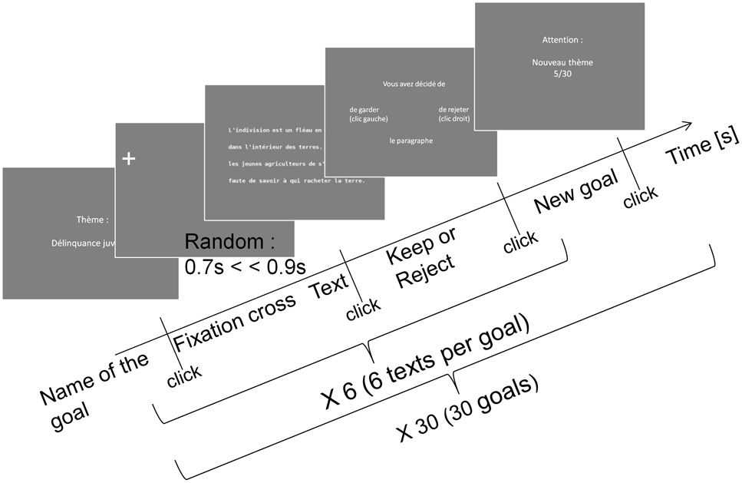
Protocol
Presentation of a goal topic (e.g. “bird hunting”) and then a text.
Question asked: is the text about that topic?
Frey et al. (2013)

Slide 3
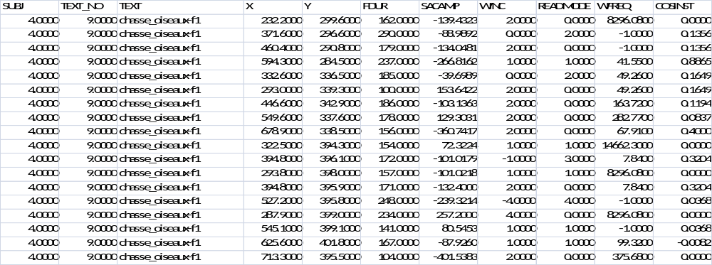
Data
Subject, text, topic
Sequences of coordinates x,y of fixations
Fixation durations, (signed) number of words between fixations
Word frequencies, length, semantic proximity to target topic

Slide 4
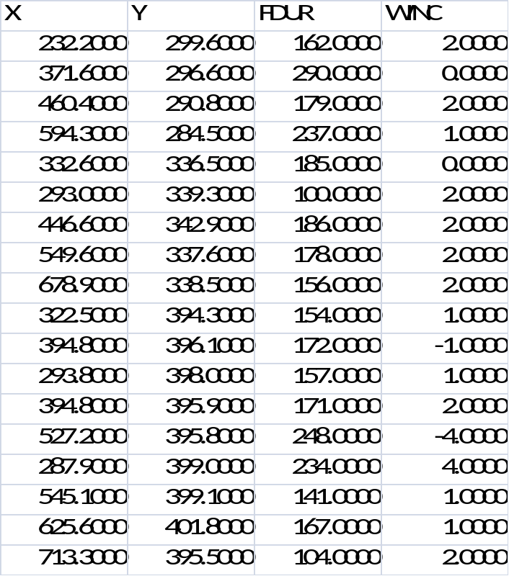
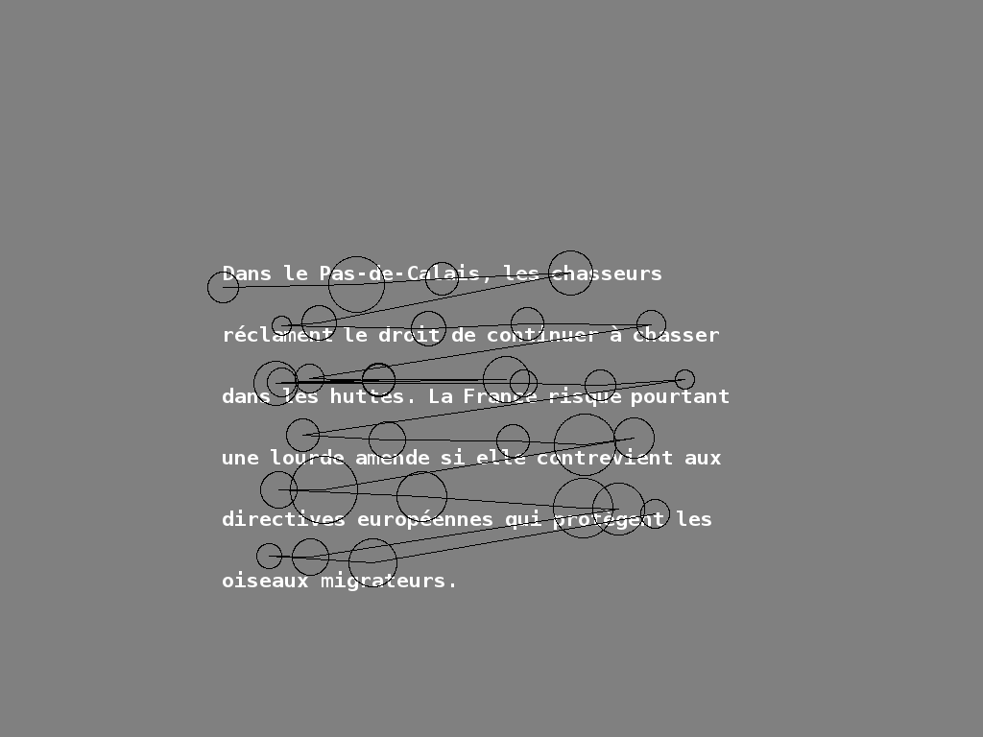
Example of a scanpath

Slide 5
Types of text
S: strongly related, U: unrelated, M: moderately related to topic
Example: Target topic “Bird hunting”
S U M
In the north of France, hunters claim the right to carry on hunting in huts. However, France could face heavy fines if European directives protecting migratory birds are not respected.
Fat balls coated with seeds are quite much appreciated by chickadees, which storm them as soon as the weather gets colder.
The French and Japanese space agencies decided to constitute working groups on natural risk monitoring. One of them will be in charge for better use of space data.
NB. “M”-texts may be more or less close to S or U…

Slide 6
Issues to be addressed
Segmentation of scanpaths into interpretable zones, in terms of cognitive phases in information acquisition and processing (speed reading, careful reading, taking a decision, …)
→ reading strategies
Characterization of the effect of different sources of variability (individual effects, text effects) on the reading strategy (global / local strategies)
Characterization of the effect of global (text type) and local text characteristics (word frequency, length, semantic proximity to target topic, …) on reading strategies.

Slide 7
Hidden semi-Markov chain models
Purpose: segmentation, variability in global reading strategies
Statistical model for time series X₁, …, X_{n}
Here time step t = fixation. The considered variable X_{t} (“observation”) should characterize the fixation.
Here: ReadMode (categorical)
0: more than 1 backward, 1: 1 backward, 2: same word,
3: next word, 4: more than 1 forward (increasing IncWord)
Number of possible reading strategies fixed in advance (must try several numbers, here: 5)
From one state to another, the probability of each ReadMode should change (eventually the probabilities define the states)
Simola et al. (2008)

Slide 8
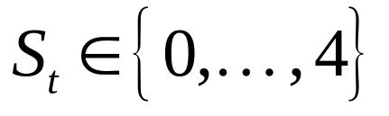
Model hypotheses and parameters
State S_{t} at fixation t: reading strategy at t.
Given S_{t} = k, X_{t} has distribution P_{k}.
Zone S_{t} = S_{t+1} =…= S_{t+L}: within this zone, the observations are independent with same distribution.
Changes of zones are ruled Markovian-like:
transition matrix A_{jk} = P(S_{t} = k | S_{t-1} = j)
Zone length L: random variable which distribution depends on current state of zone (this is the semi-Markov aspect)
All we know is X₁, …, X_{n}, the states must be deduced from them.

Slide 9
Parameter estimation
Parameters:
  A_{jk} = P(S_{t} = k | S_{t-1} = j)
  B_{rk} = P(X_{t} = r | S_{t} = k)
  Parameters of the zone length distributions (e.g. Binomial or Poisson with offset)
All trials are assumed to follow the same hidden semi-Markov distribution (no individual / text effect here).
Parameter estimation by maximum likelihood (numerical optimization by the EM algorithm)
Yu (2010)

Slide 10
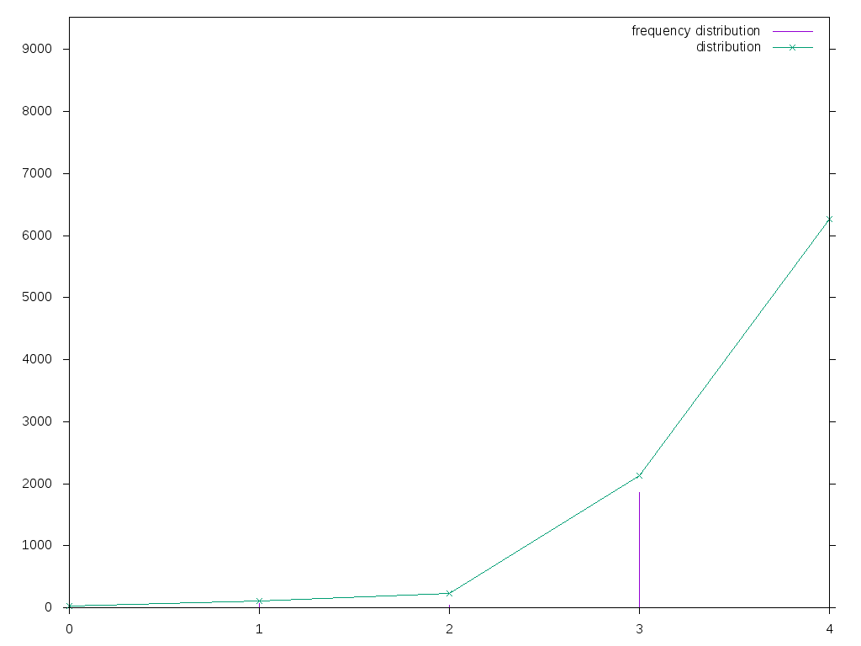
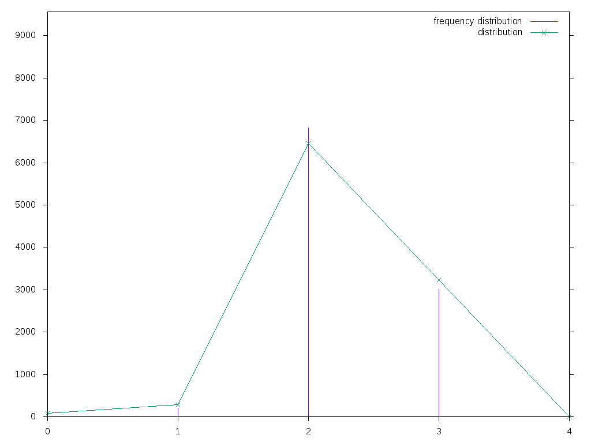
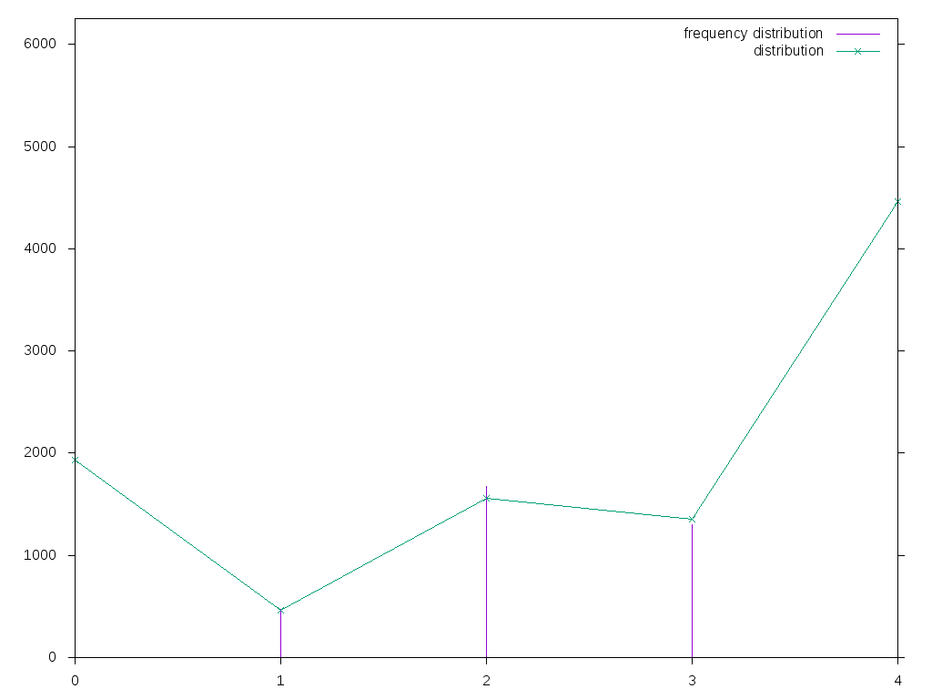
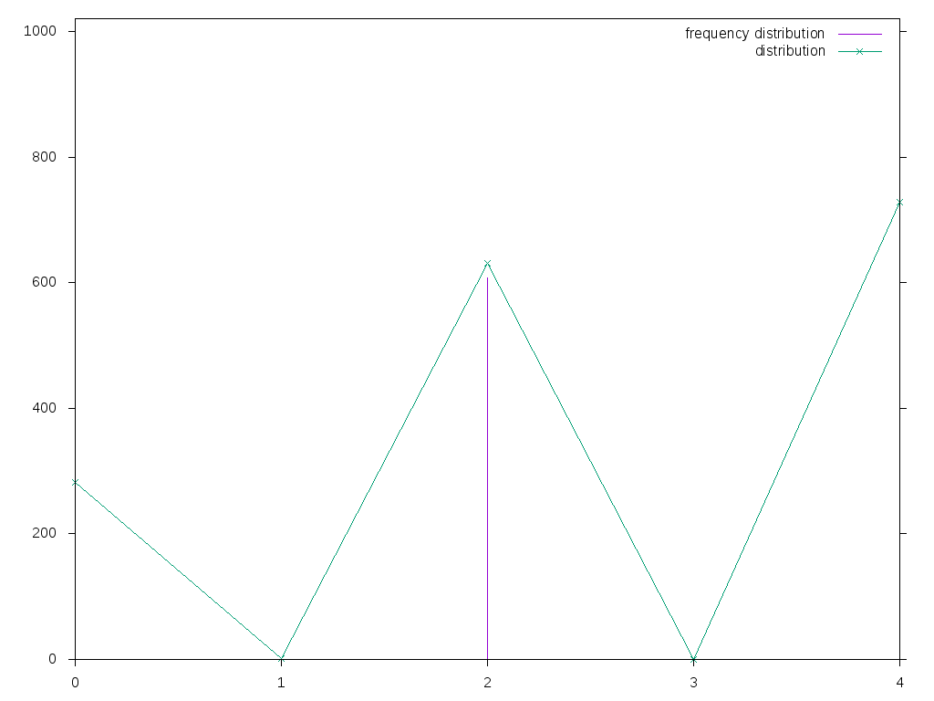
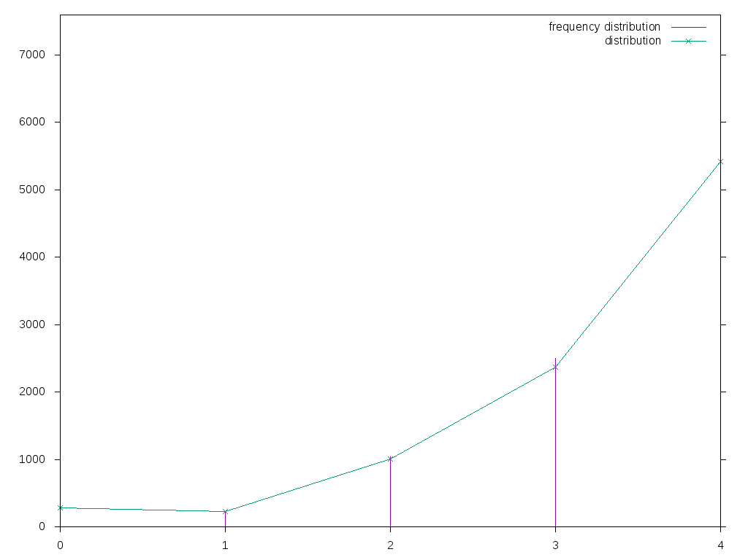
Transitions / observations
0
1
see next slides
4
confirmation
ReadMode
<-1 -1 0 1 >1
2
unsure
3
speed reading
0
1
2
3
4

Slide 11
“Hidden” aspects
Each possible value of ReadMode may be observed in several states (observation distributions overlap)
For example ReadMode = 3 (reading next word) may be observed in states 0, 1, 2 and 4.
Given the observed variable, we cannot be sure of current state, hence “hidden”

Slide 12
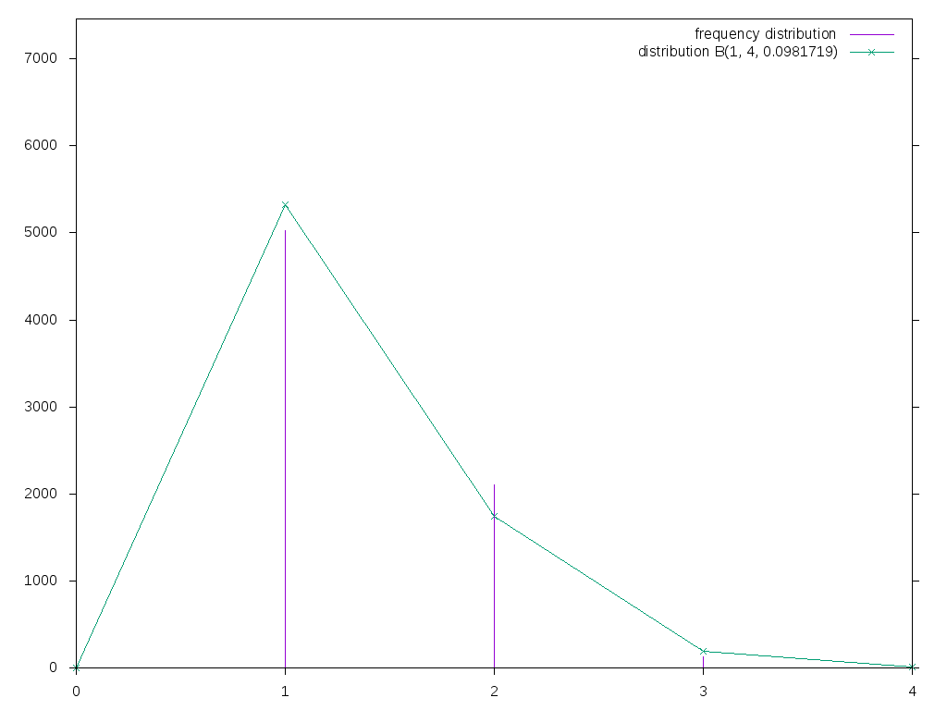
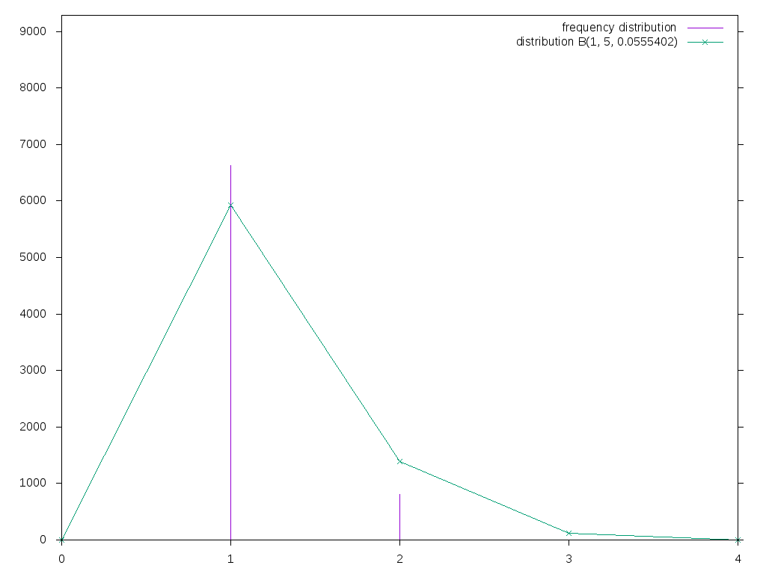
Phases
0
1
0
1
ReadMode
<-1 -1 0 1 >1
Duration distribution
Duration distribution
0
1
duration
normal reading
Alternation between short stays between 0 and 1 is a very strong pattern that will remain even in a 3-state model.
Combine 0/1 into one “phase” and call it “normal reading”

Slide 13
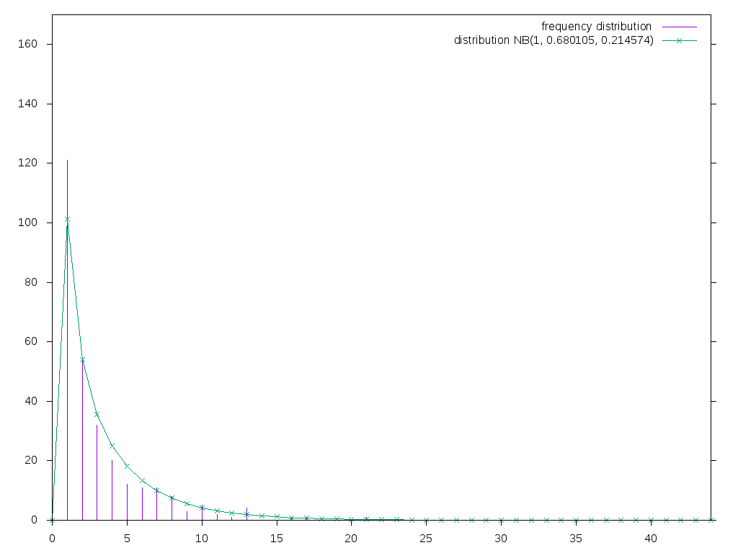
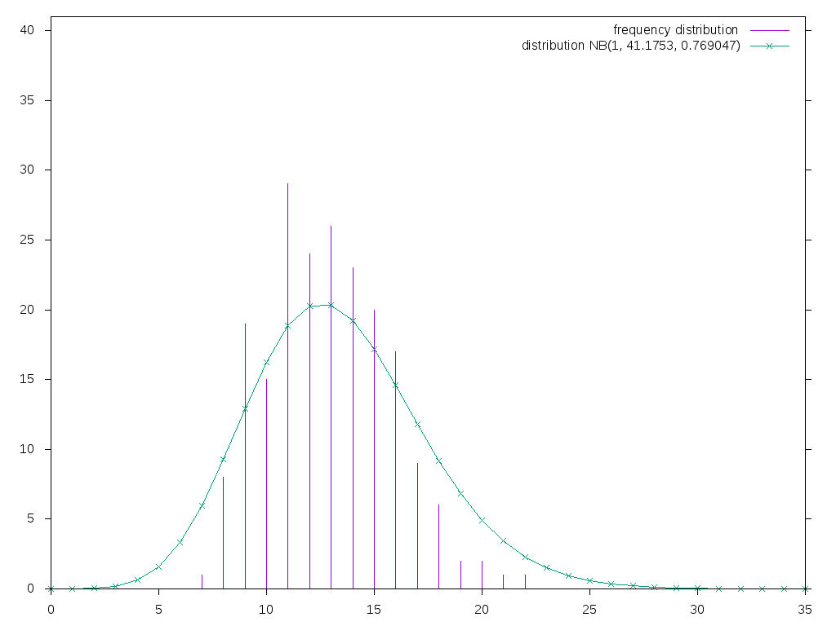
Sojourn duration distributions for other states
0
normal reading
2
unsure
3
speed reading
4
conf.
1
+∞

Slide 14
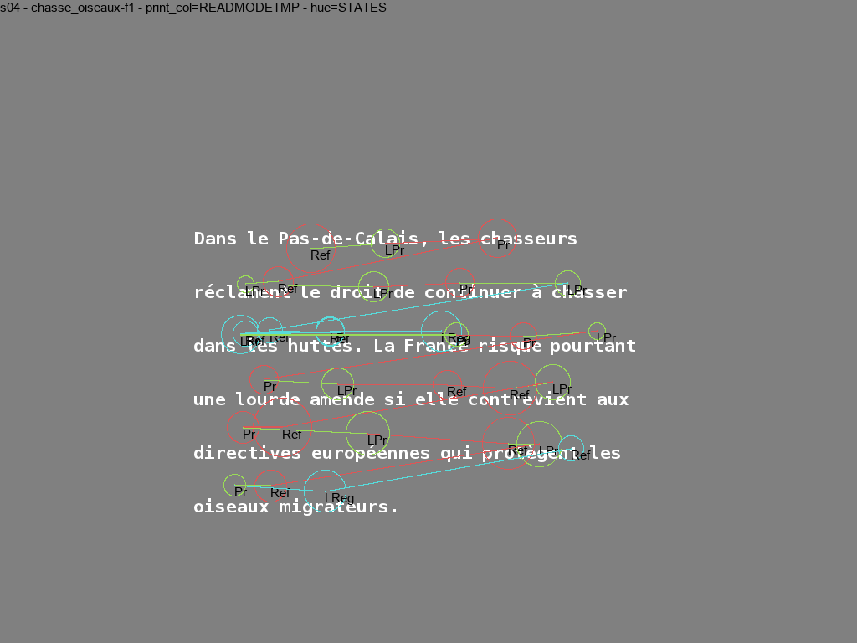
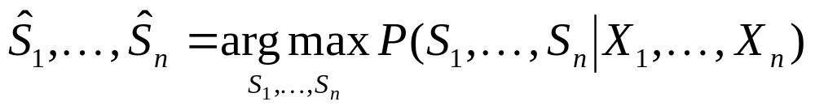
Segmentation
0
normal reading
1
2
unsure
3
speed reading
4
confirmation
Subject 4, text 26 (bird hunting)

Slide 15
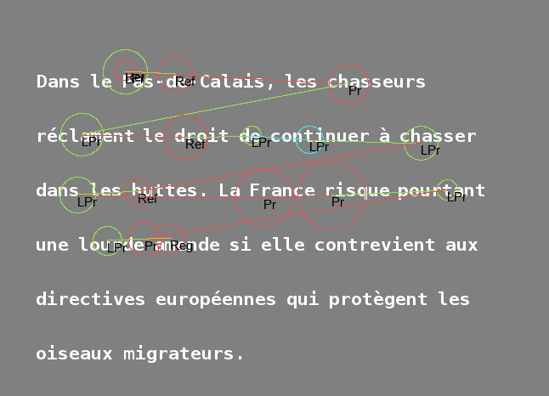
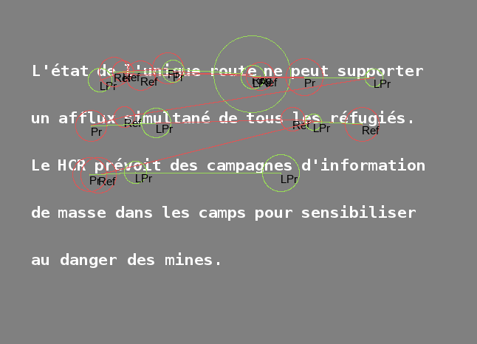
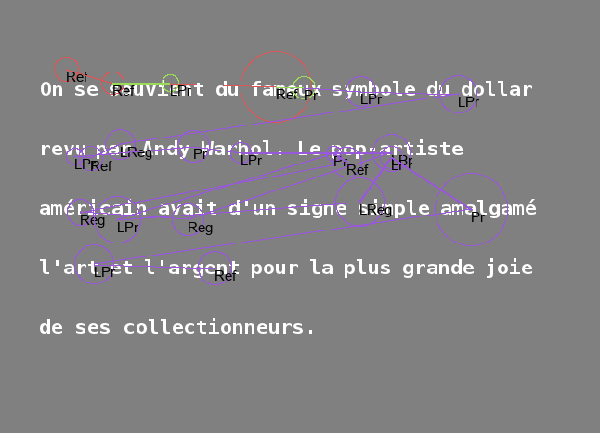
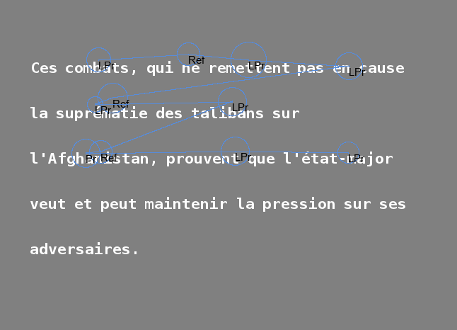
Variability: text effect
Subject 1,
4 different texts

Slide 16
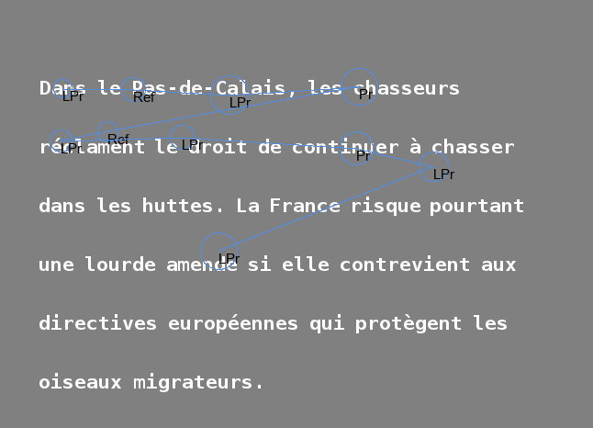
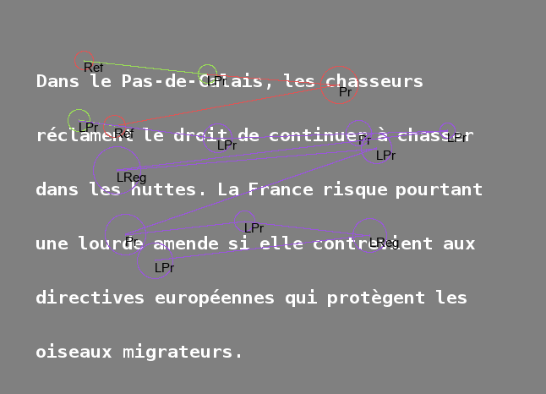
Variability: individual effect
Text 26,4 different subjects

Slide 17
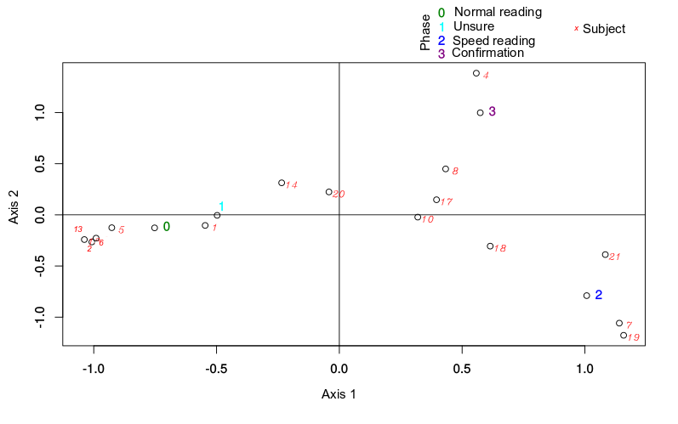
Variability: individual effect
Factorial Correspondence Analysis:
phase and subject
Clusters of individuals:
  + Normal reading / unsure ; - speed reading / confirmation
  + Speed reading ; - normal reading / unsure
  + Confirmation; - normal reading / unsure
→ gradient between fast and careful readers

Slide 18
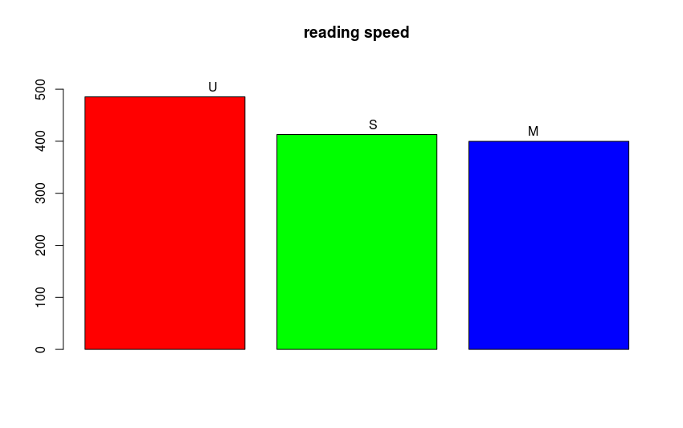
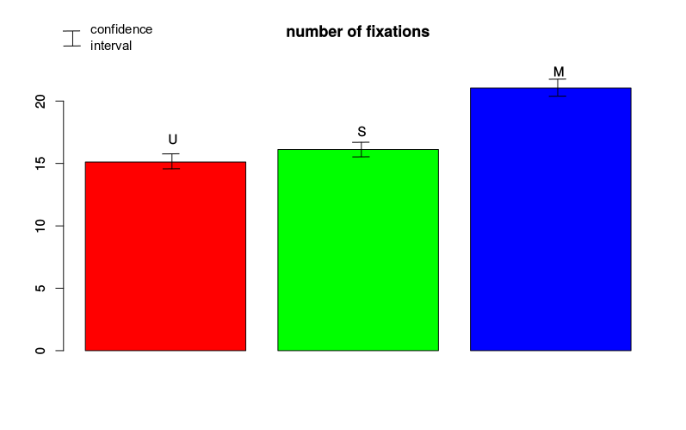
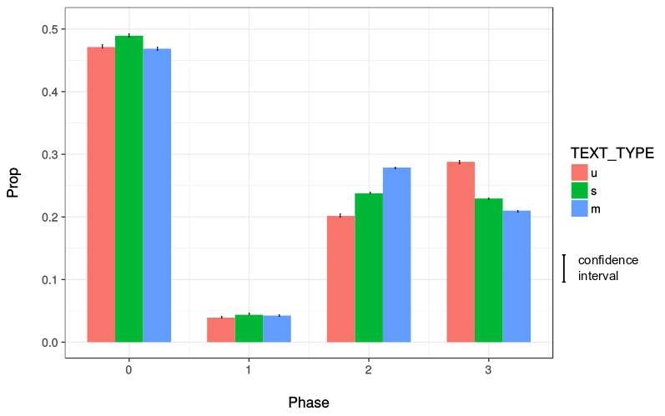
Type of text effect
Number of fixations per type of text
Reading speed in words
per minute
0
normal reading
Erreur de légende
1
unsure
2
speed reading
0
1
2
3
3
confirmation
Proportion of states per type of text

Slide 19
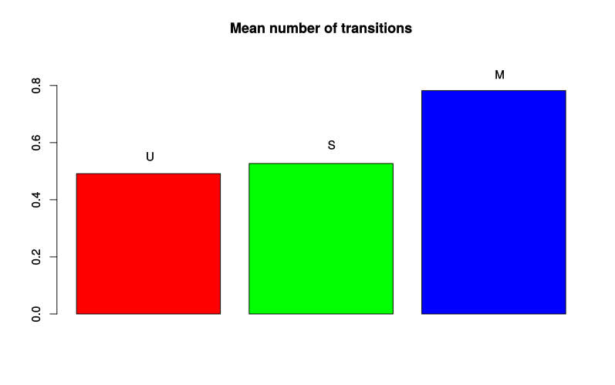
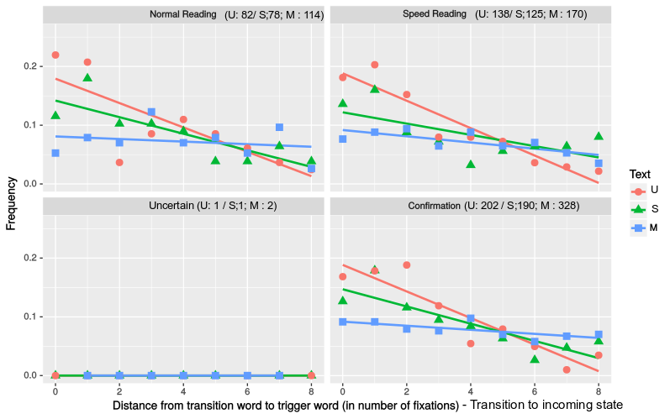
Type of text effect
Mean number of transitions
per type of text
trigger words

Slide 20
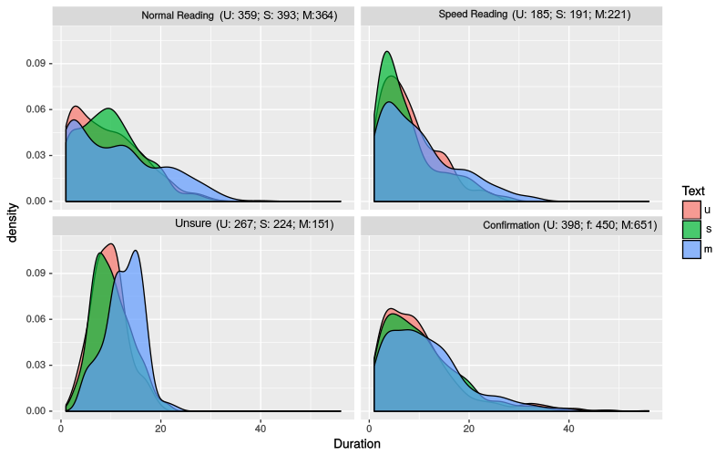
Type of text effect
Distribution of the number of fixations
per phase and type of text
Conclusion: gradient in complexity between U, S, M characterized by
Number of fixations
Reading speed
Time spent in confirmation vs. speed reading
Number of strategy changes
Effect of trigger words on strategy changes

Slide 21
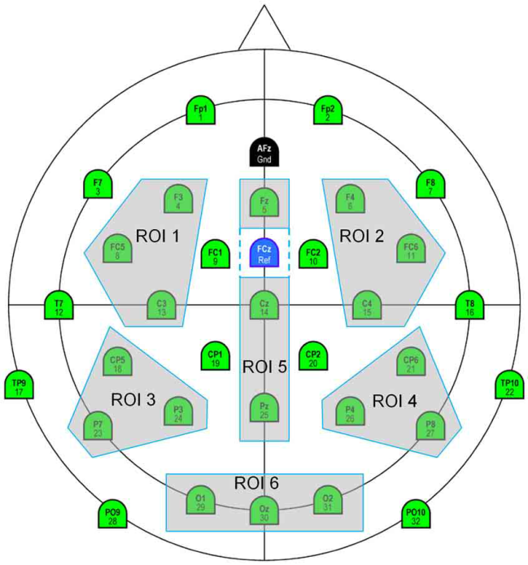
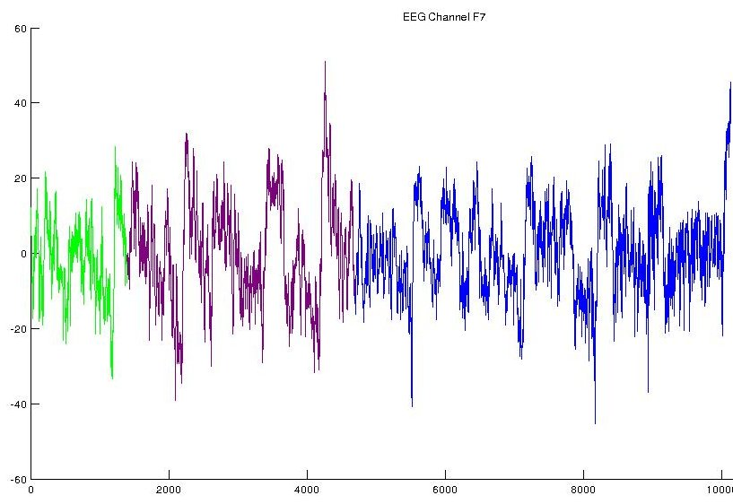
EEG data
Records: 10 s EEG on 30 channels at 1,000 Hz.
Ideally phases should have contrasted EEG properties
Use wavelet transform in place of Raw EEGs (too noisy for clear and contrasted patterns to emerge from phases)
First results on “S” texts only with a different 5-states model: differences in variances / correlations between channels / band frequencies regarding phases
normal reading
speed reading
careful reading
confirmation
Frey et al. (2013)

Slide 22
Conclusion and possible extensions
Hidden Markov models: useful approach to infer strategies
Strategies seemingly related to subjects, reading speed, type of text and semantic properties
Strong effect of type of text on taking decisions
Modeling eye movements and EEGs jointly
Coupling hidden Markov models
Infer zones in brains involved in different reading strategies and their synchronisms

Slide 23
References
A. Frey, G. Ionescu, B. Lemaire, F. Lopez Orozco, T. Baccino and A. Guérin-Dugué. Decision-making in information seeking on texts: an Eye-Fixation-Related Potentials investigation. Frontiers in Systems Neuroscience, 7, pp. 39 (2013)
J. Simola, J. Salojärvi and I. Kojo. Using hidden Markov model to uncover processing states from eye movements in information search tasks. Cognitive Systems Research 9(4), 237-251 (October 2008)
S.-Z. Yu. Hidden semi-Markov models. Artificial Intelligence 174, 215-243 (2010)

