Slide 1
RTC
A | B | C | D | E | F | G | H | I | J | K | L | M | N | O | P | Q | R | S | T
 |  |  |  |  |  |  |  |  |  |  |  |  |  |  |  |  |  |  |  | 14
 |  |  |  |  |  |  |  |  |  |  |  |  |  |  |  |  |  |  |  | 13
 |  |  |  |  |  |  |  |  |  |  |  |  |  |  |  |  |  |  |  | 12
 |  |  |  |  |  |  |  |  |  |  |  |  |  |  |  |  |  |  |  | 11
 |  |  |  |  |  |  |  |  |  |  |  |  |  |  |  |  |  |  |  | 10
 |  |  |  |  |  |  |  |  |  |  |  |  |  |  |  |  |  |  |  | 9
 |  |  |  |  |  |  |  |  |  |  |  |  |  |  |  |  |  |  |  | 8
 |  |  |  |  |  |  |  |  |  |  |  |  |  |  |  |  |  |  |  | 7
 |  |  |  |  |  |  |  |  |  |  |  |  |  |  |  |  |  |  |  | 6
 |  |  |  |  |  |  |  |  |  |  |  |  |  |  |  |  |  |  |  | 5
 |  |  |  |  |  |  |  |  |  |  |  |  |  |  |  |  |  |  |  | 4
 |  |  |  |  |  |  |  |  |  |  |  |  |  |  |  |  |  |  |  | 3
 |  |  |  |  |  |  |  |  |  |  |  |  |  |  |  |  |  |  |  | 2
 |  |  |  |  |  |  |  |  |  |  |  |  |  |  |  |  |  |  |  | 1
BH1745
Vent + pluie
Alim
largeur :
0,587 = 0,2”
longueur :
2 : 0,74 = 0,3”
3 : 0,99 = 0,4”
4 : 1,24 = 0,5”
5 : 1,49 = 0,6”
R
R
R
DHT22
Logic level shifter
R
BMP
Sensor to Nano (et I²C)
Data
Ground
I²C Bus
5V
3,3V

Slide 2
 | Sensor Nano
0
1
2 | DIO0
3 | Anemometre
4 | Pluviometre
5 | DHT22
6
7
8
9
10 | CS radio
11 | MOSI
12 | MISO
13 | SCK
A0
A1
A2 | WindDir
A3 | Ref 3,3V du low drop regulator
A4 | SDA
A5 | SCL
A6 | Battery temp
A7 | Battery Voltage
-
+
J
I
H
G
F
 | 1 | 2 | 3 | 4 | 5 | 6 | 7 | 8 | 9 | 10 | 11 | 12 | 13 | 14 | 15 | 16 | 17 | 18 | 19 | 20 | 21 | 22 | 23 | 24 | 25 | 26 | 27 | 28 | 29 | 30
E
D
C
B
A
-
+
Bat T+V
I2C
 | Vin | GND | RST | +5V | A7 | A6 | A5 | A4 | A3 | A2 | A1 | A0 | Aref | +3,3v | 13
 |  |  |  |  |  |  |  |  |  |  |  |  |  | USB
 |  |  | RST | GND
 | TX | RX |  |  | 2 | 3 | 4 | 5 | 6 | 7 | 8 | 9 | 10 | 11 | 12
Sensor to Nano
Radio Data
LD33V
LD33V
Alim Sensor
Radio Alim
Alim IN
Data
Ground
I²C Bus
5V
3,3V
Couper jonctions

Slide 3
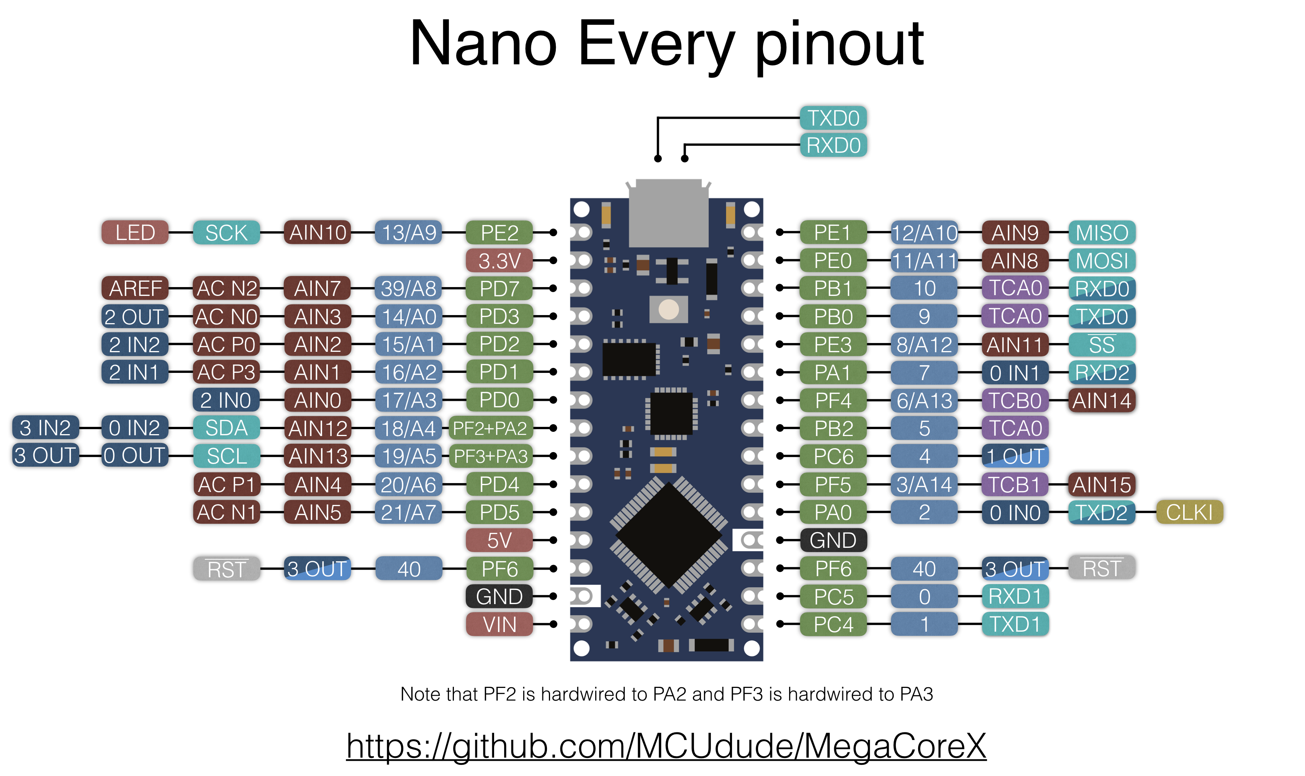
 | Vin | GND | RST | +5V | A7 | A6 | A5 | A4 | A3 | A2 | A1 | A0 | Aref | +3,3v | 13
 |  |  |  |  |  |  |  |  |  |  |  |  |  | USB
 |  |  | RST | GND
 | TX | RX |  |  | 2 | 3 | 4 | 5 | 6 | 7 | 8 | 9 | 10 | 11 | 12

Slide 4
 |  |  |  |  |  | Bat | En | Usb |  |  |  |  |  |  |  | Scl | Sda
 |  | Rst | 3V0 |  | Gnd |  |  |  |  |  |  | SCK | MO | MI | Rx | Tx

Slide 5
-
+
J
I
H
G
F
 | 1 | 2 | 3 | 4 | 5 | 6 | 7 | 8 | 9 | 10 | 11 | 12 | 13 | 14 | 15 | 16 | 17 | 18 | 19 | 20 | 21 | 22 | 23 | 24 | 25 | 26 | 27 | 28 | 29 | 30
E
D
C
B
A
-
+
RTC
R pluie
R anem
R girou
 |  |  |  |  |  | Bat | En | Usb | 13 | 12 | 11 | 10 | 9/A7 | 6 | 5 | Scl | Sda
 |  | Rst | 3V0 |  | Gnd | 14A0 | 15A1 | 16A2 | 17A3 | 18A4 | 19A5 | SCK | MO | MI | Rx | Tx
Vent + pluie
BH1745
BMP
R
DHT22

