Slide 1
N = 10 Results!

Slide 2









Slide 3
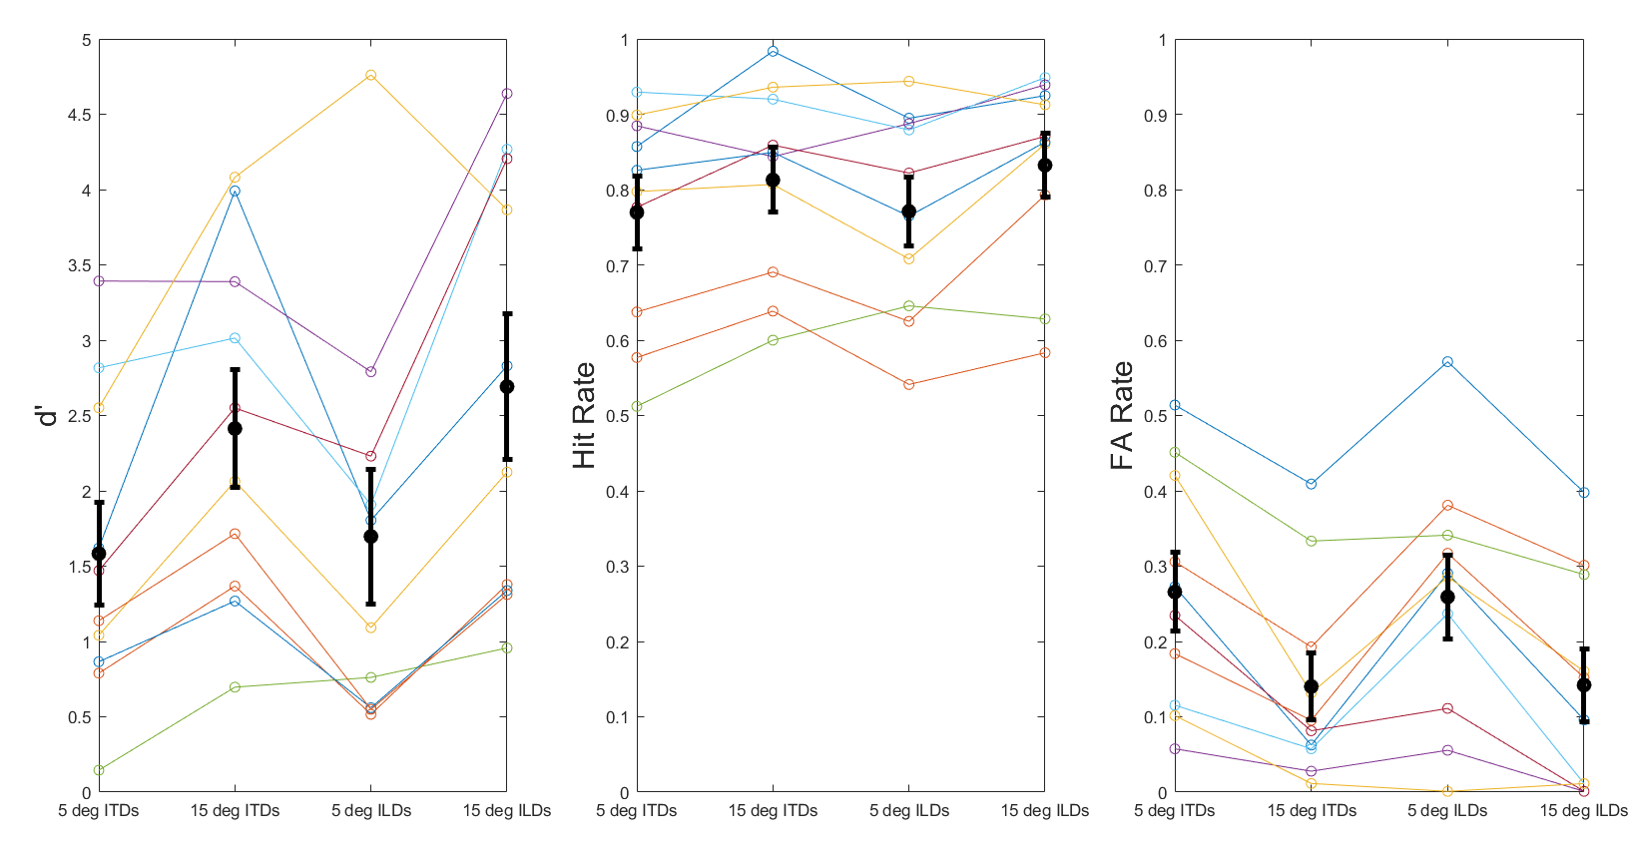

Slide 4
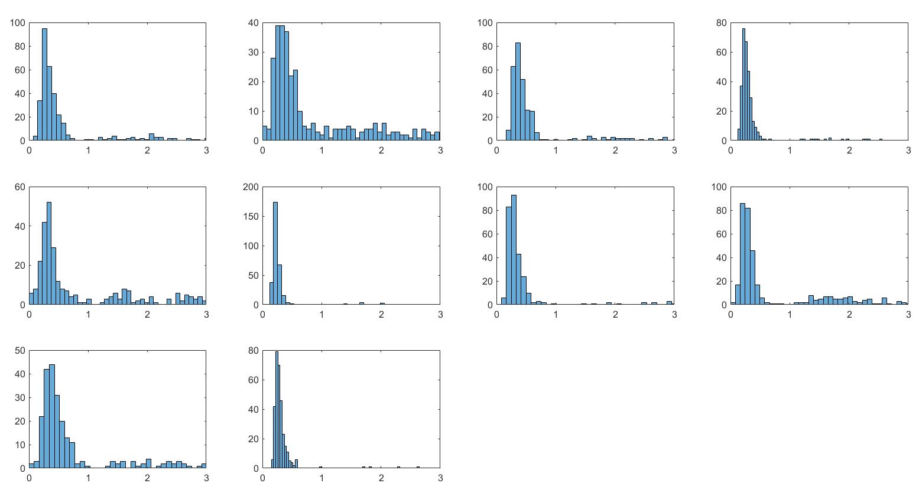
S1
S3
S4
S5
S6
S8
S9
S10
Number of clicks
S11
S12
Time re: closest target “bash” onset (s)

Slide 5
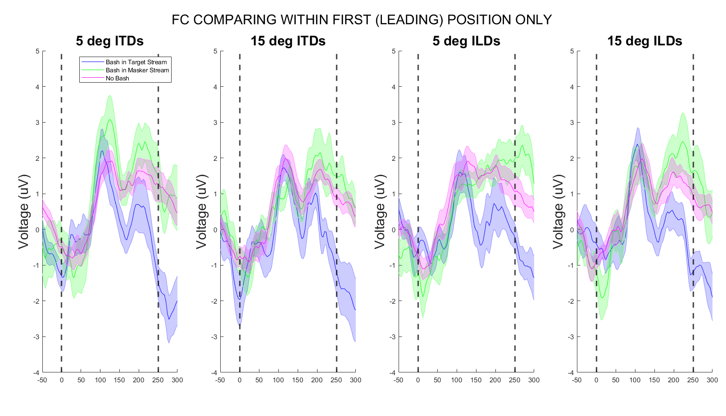

Slide 6
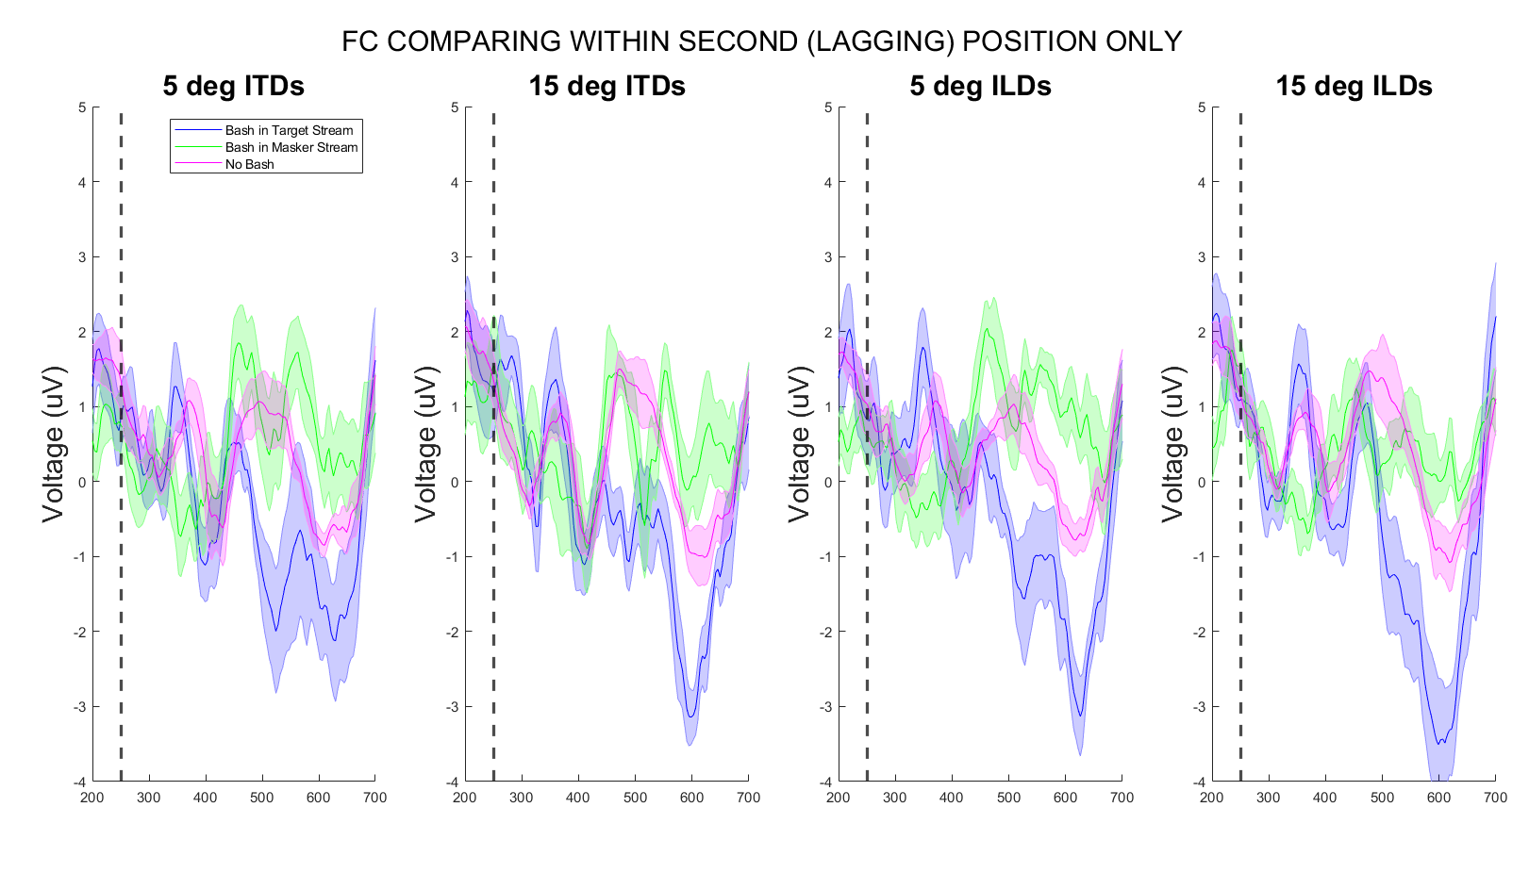
NOTE*: Baseline w.r.t. the onset of first syllable

Slide 7
What if baseline to the onset of the second syllable?

Slide 8
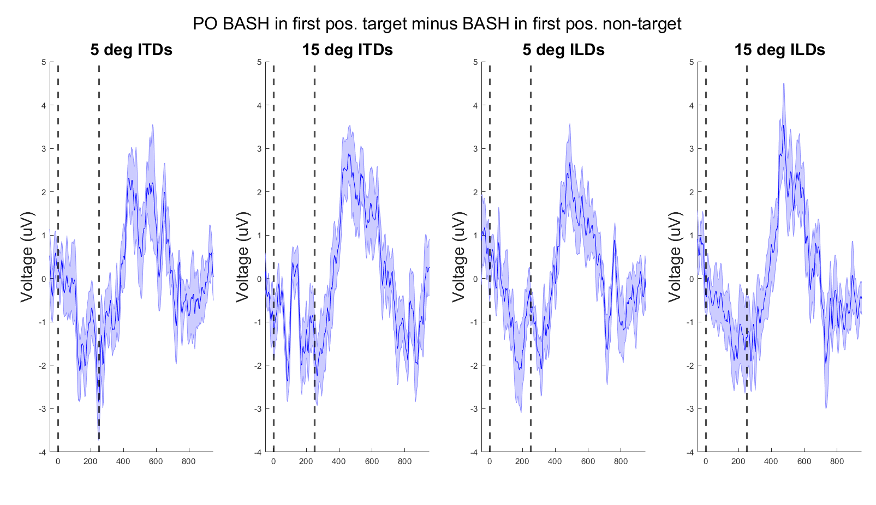

Slide 9
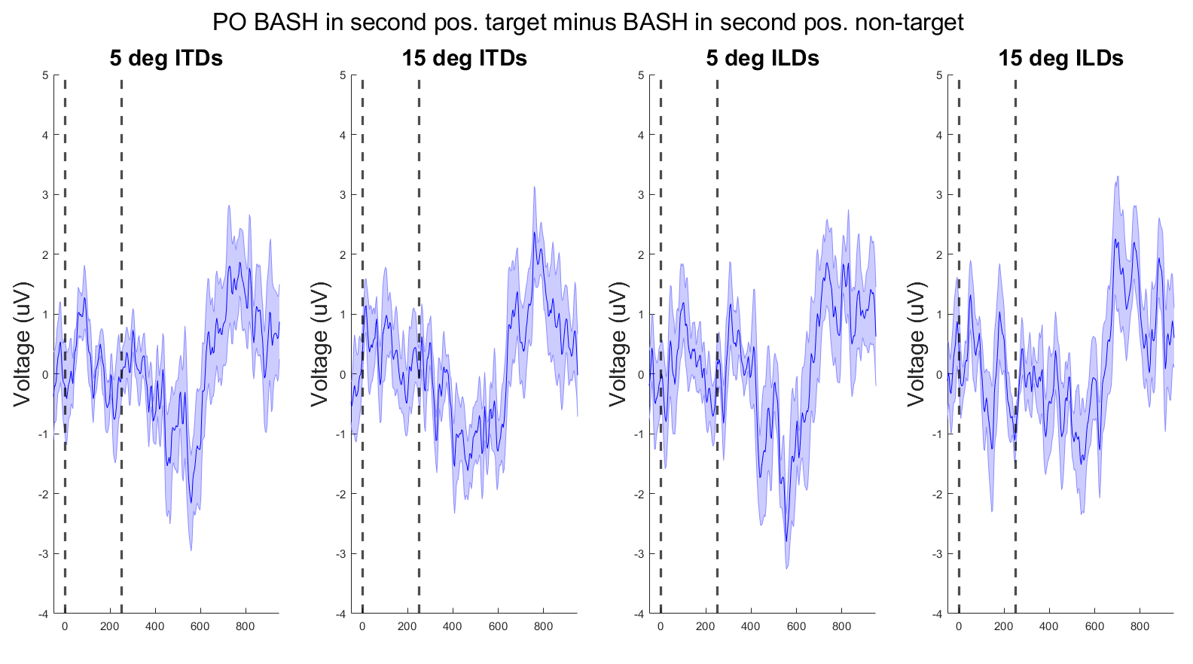

Slide 10
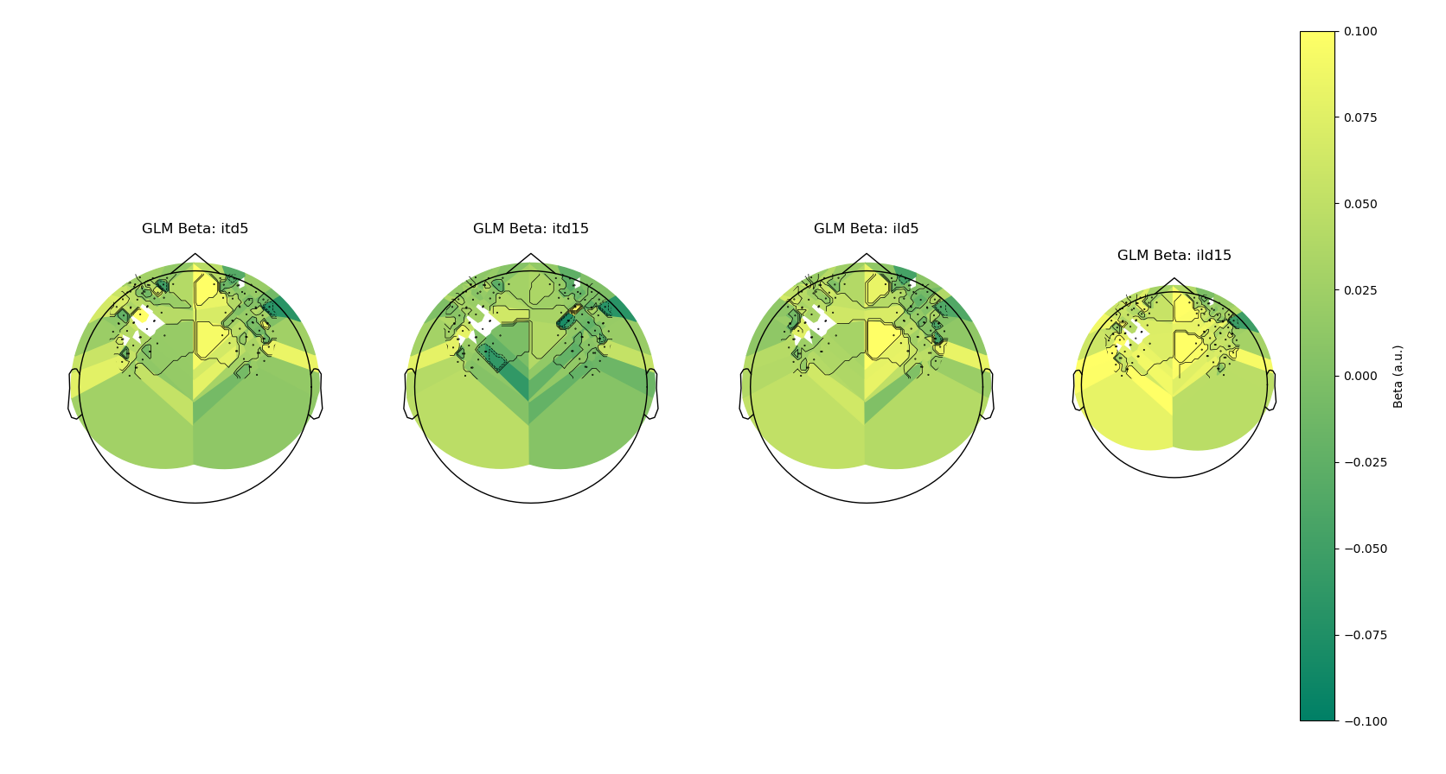

Slide 11
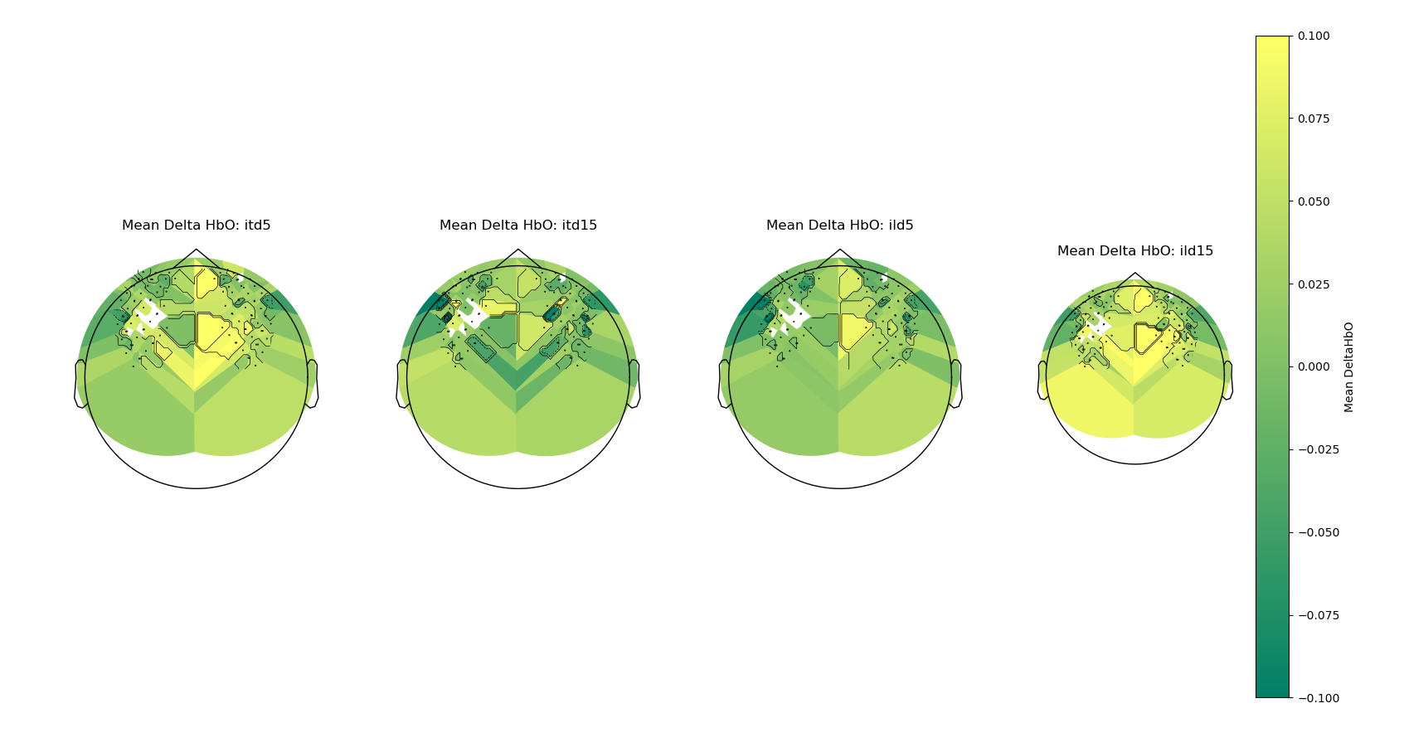

Slide 12
Compare
ALL WORDS in target stream vs. ALL WORDS in masker stream?
Break up behavior by lead/lag
Ensure that collapse across attend L/R is proper (take the count of hits and THEN divide, do not take the mean of the rates).
Plot P300 with the same breakdown as the FC ERPs

