Slide 1
Let’s Start Data Collection!!

Slide 2
How do ITDs, ILDs and magnified ILDs support cortical processing of competing, spatially-separated
sound streams?

Slide 3
Where we’re at
Behavior (d’)
500 us ITD > 50 us ITD
5 degree Magnified > 5 degree Natural
NH subjects plateau after ~10-15 degrees natural ILDs
fNIRS (mean HbO & GLM beta show same pattern), n = 9
500 us ITD > 50 us ITD
No diff. between 5 & 5 mag
EEG, n = 6
For leading syllable, N1 Bash > N1 Non-Bash
For lagging syllable, N1 target Bash > N1 {masker bash, non-bash}
Possible P3 effects

Slide 4
We will measure 3 different populations
Young, NH Listeners (n = 40)
Aim 1 → Combined fNIRS/EEG
BiCI Users (n = 20)
Aim 2 → Dense PFC fNIRS
NH age-match listeners to BiCI Users (n = 20)
Aim 2 → Dense PFC fNIRS

Slide 5
Today is the day we decide on conditions (4 conditions gets us good SNR for all measures)
Young, NH
(Combined fNIRS/EEG)
BiCI, NH age match
(Dense PFC fNIRS)
 | ITDs | ILDs
Small (5 degrees)
Large (15 degrees)
 | Natural ILDs | Magnified ILDs
Small (5 degrees)
Large (15 degrees)
Which large azimuth? Match to 500 us ITDs (i.e. very large)?
10 degrees to possible see differences with Mag?

Slide 6
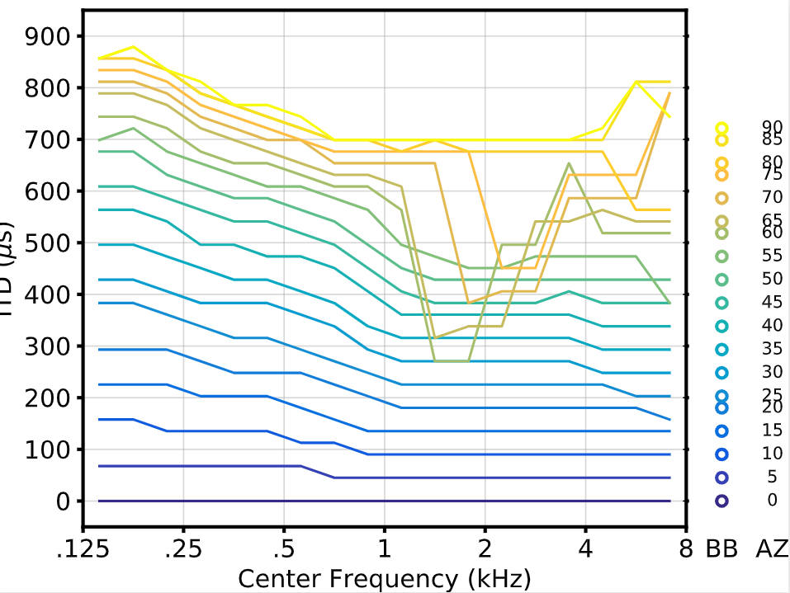
ITD (us)

Slide 7
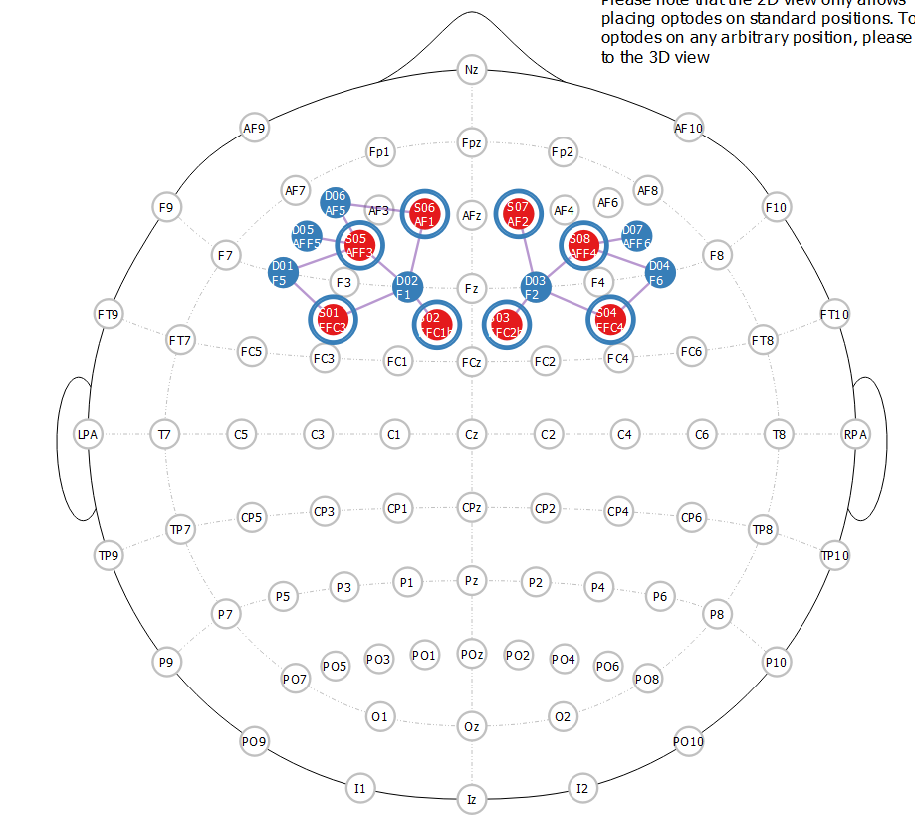
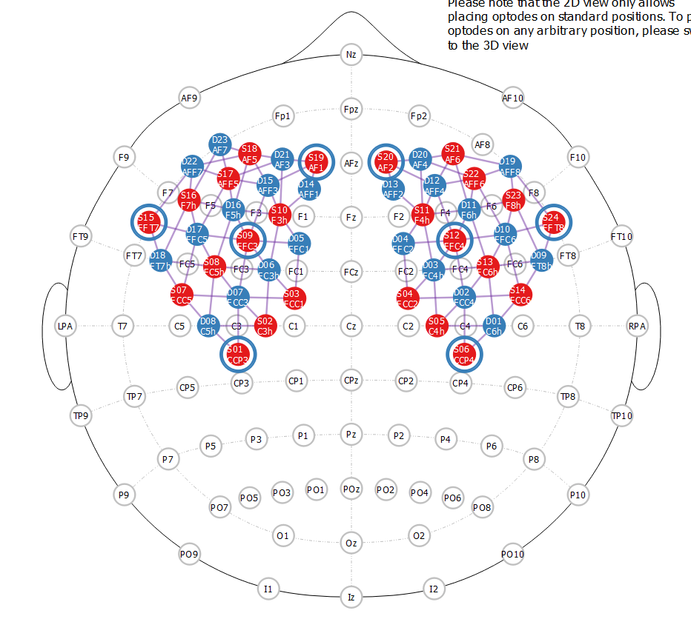
fNIRS Montages
Combined fNIRS/EEG
Dense PFC

Slide 8
Button Press Mini-Task Pilot
3 10-minute blocks
Only fixation cross (no audio/visual stim)
Click randomly throughout, leaving at least 1 second between clicks
N = 2 lab members (Sub 1 is me)

Slide 9
600 presses

Slide 10
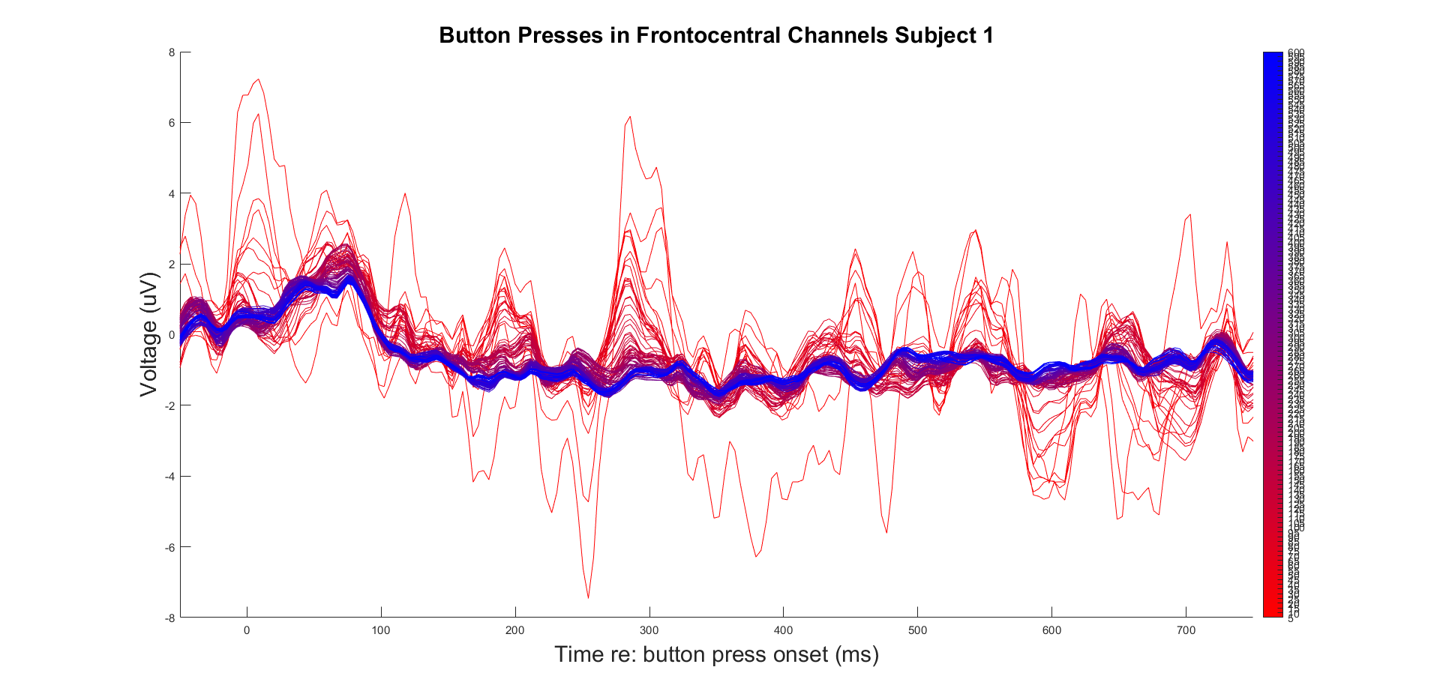

Slide 11
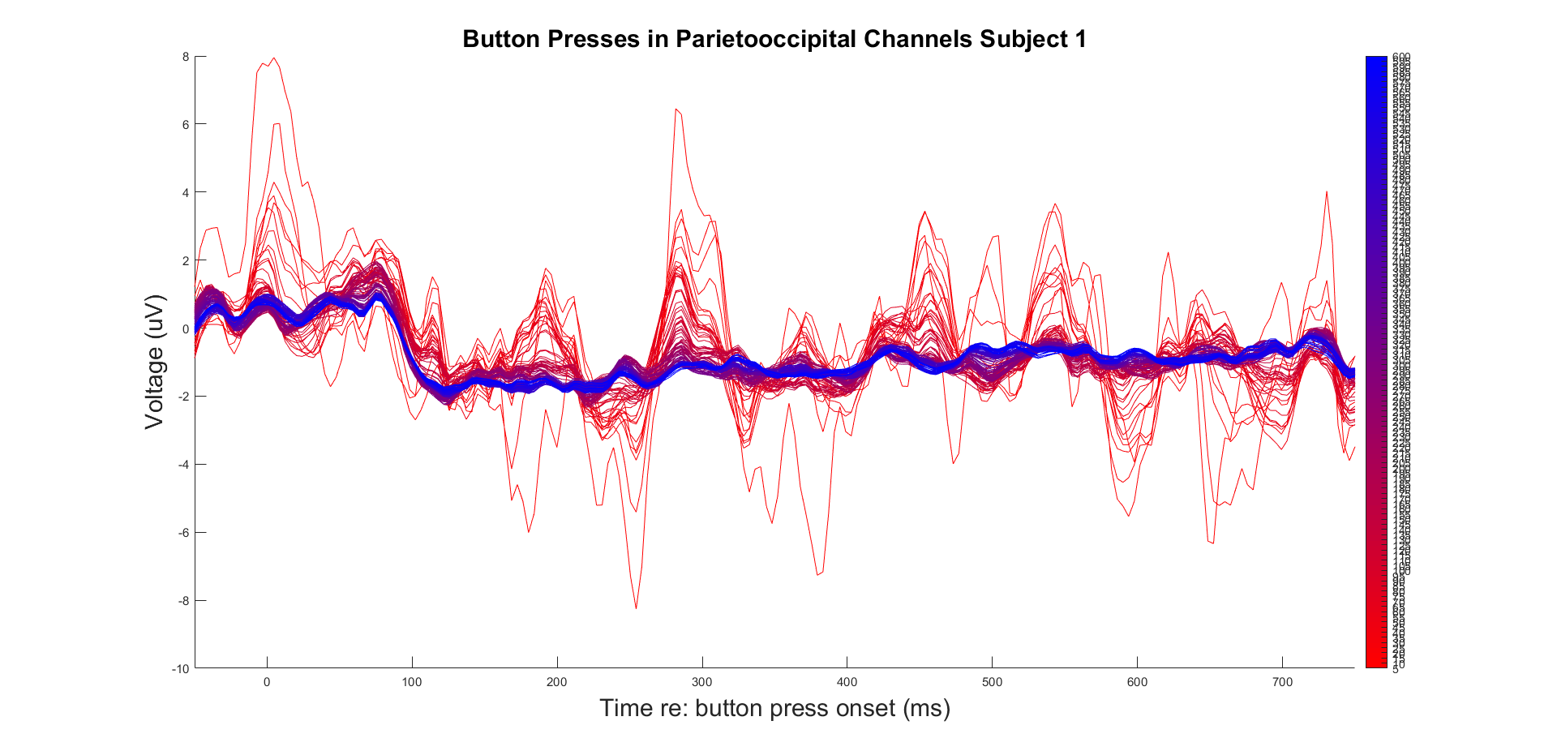

Slide 12
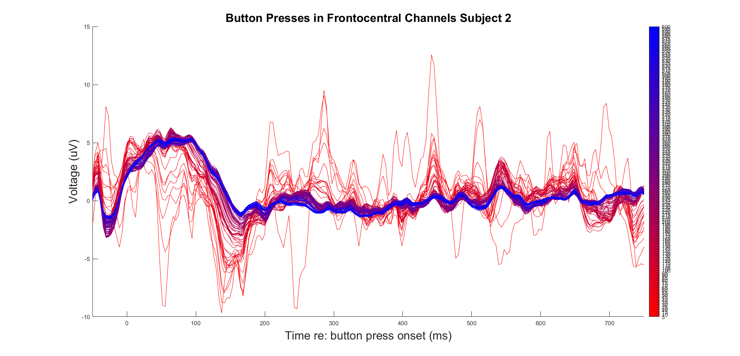

Slide 13
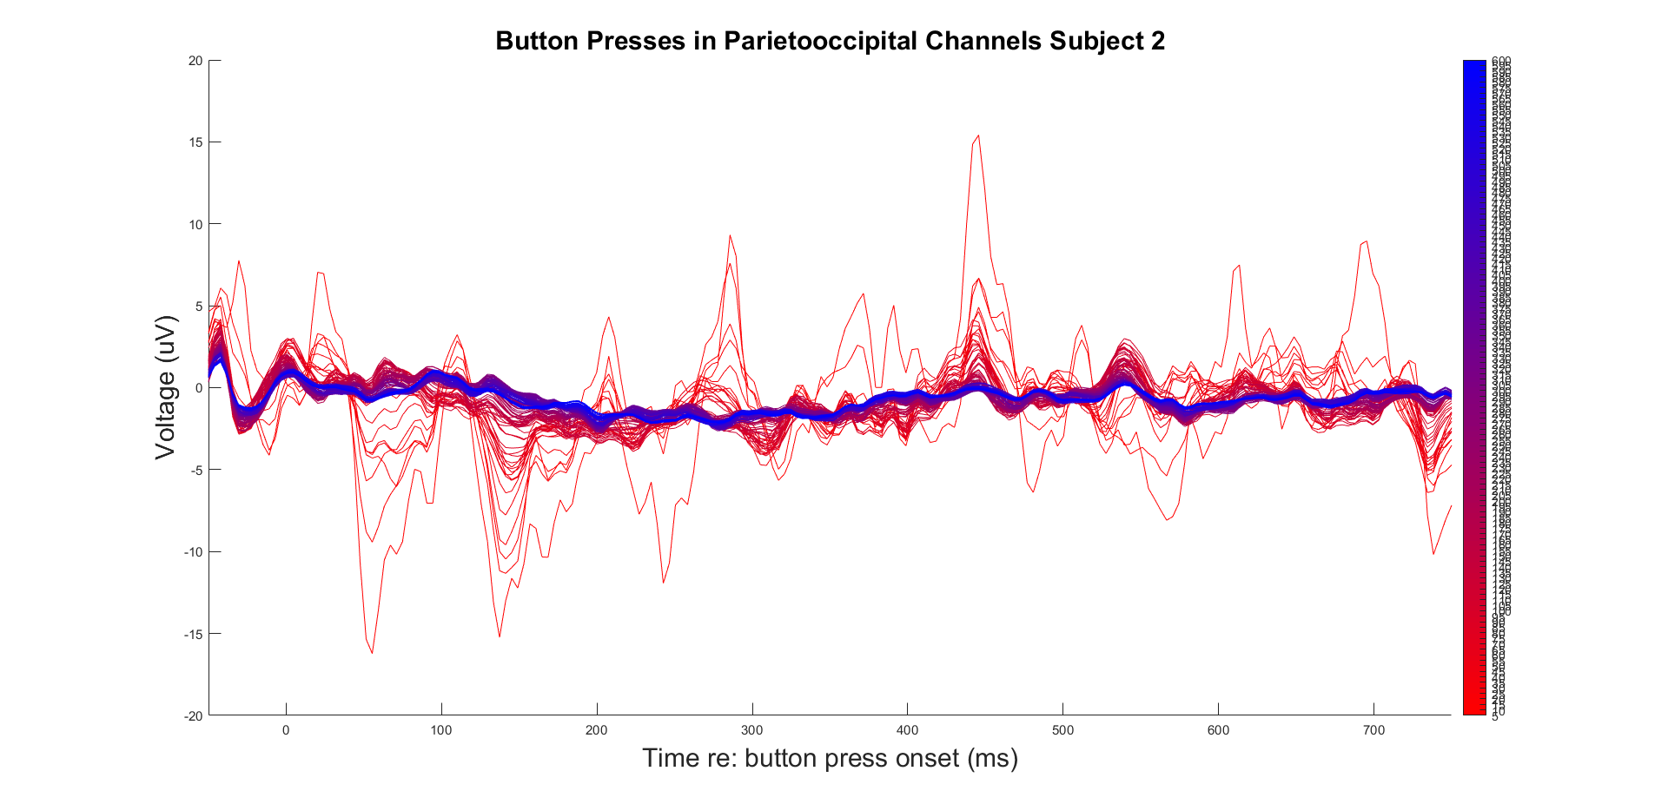

Slide 14
First 70 presses

Slide 15
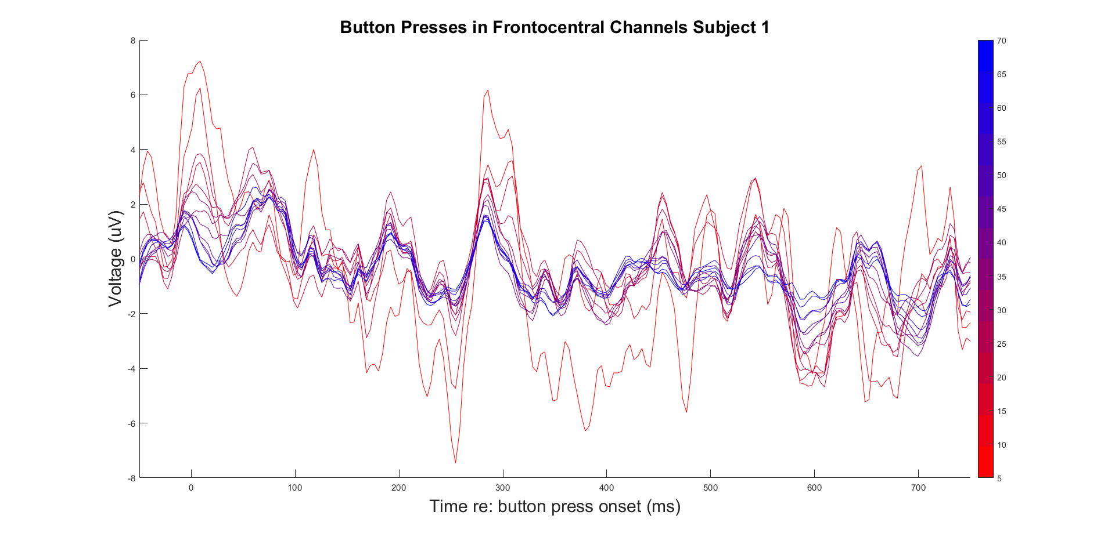

Slide 16
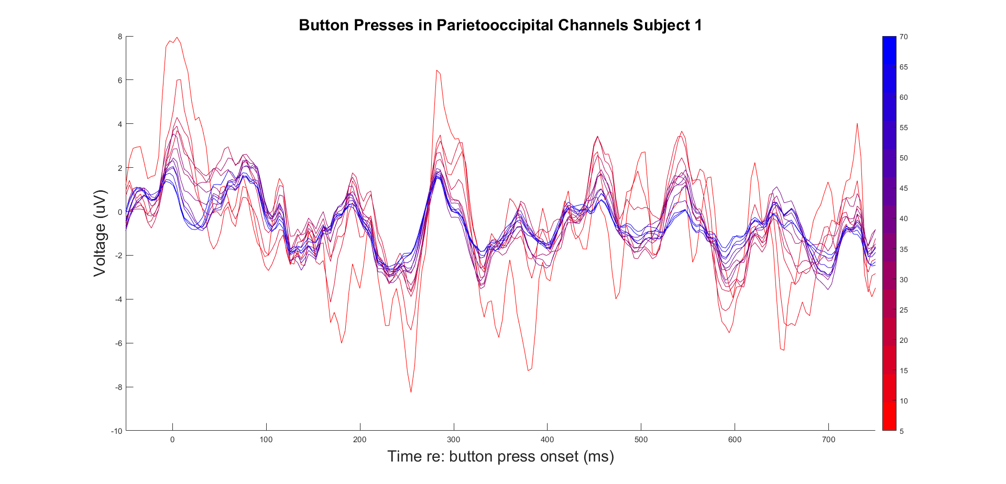

Slide 17
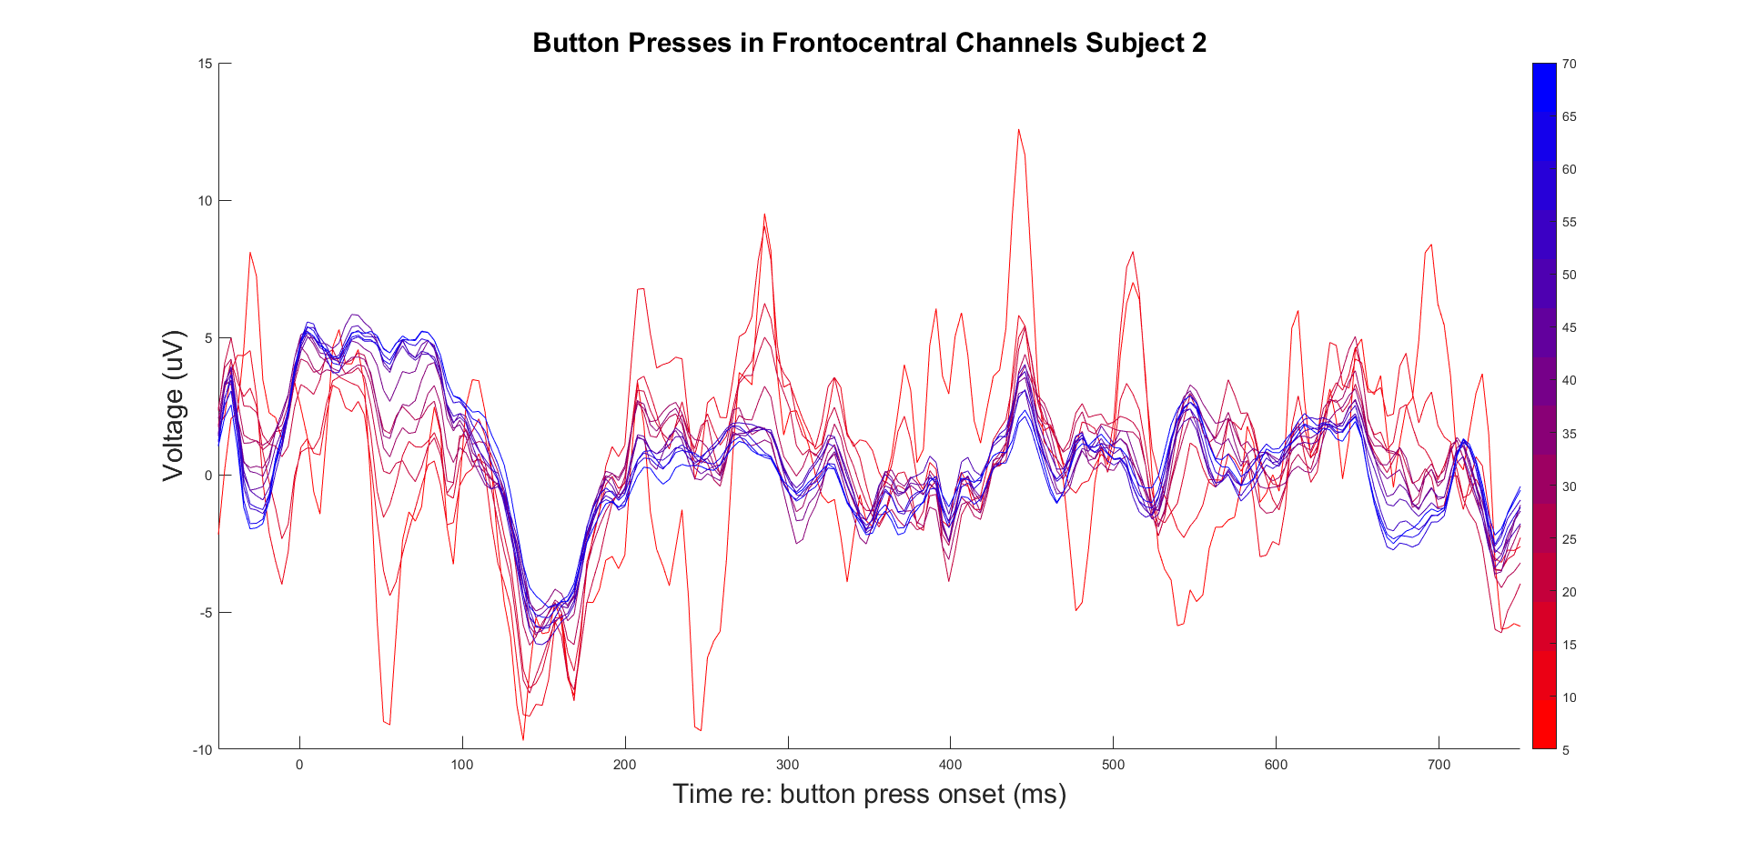

Slide 18
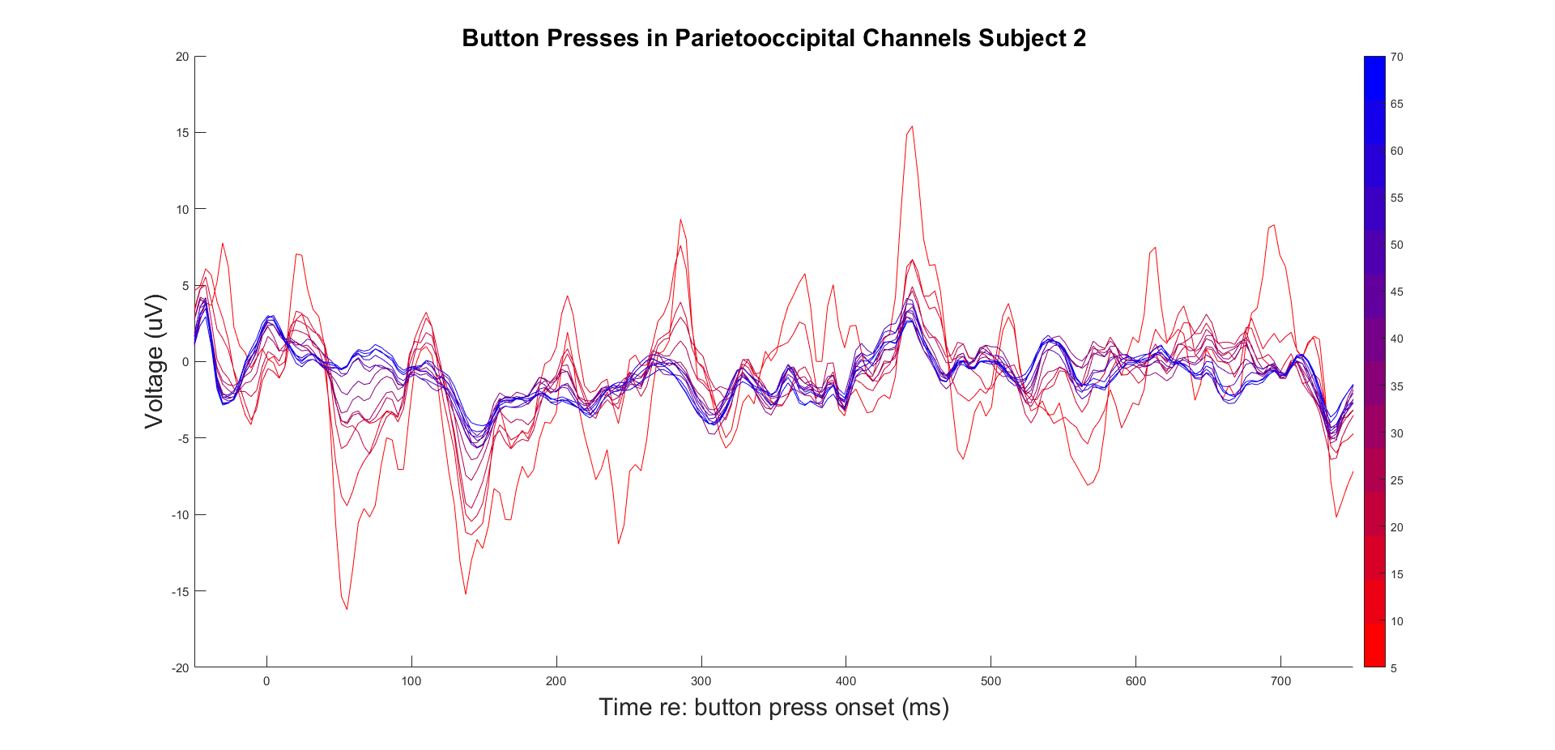

Slide 19
Random 100 presses

Slide 20
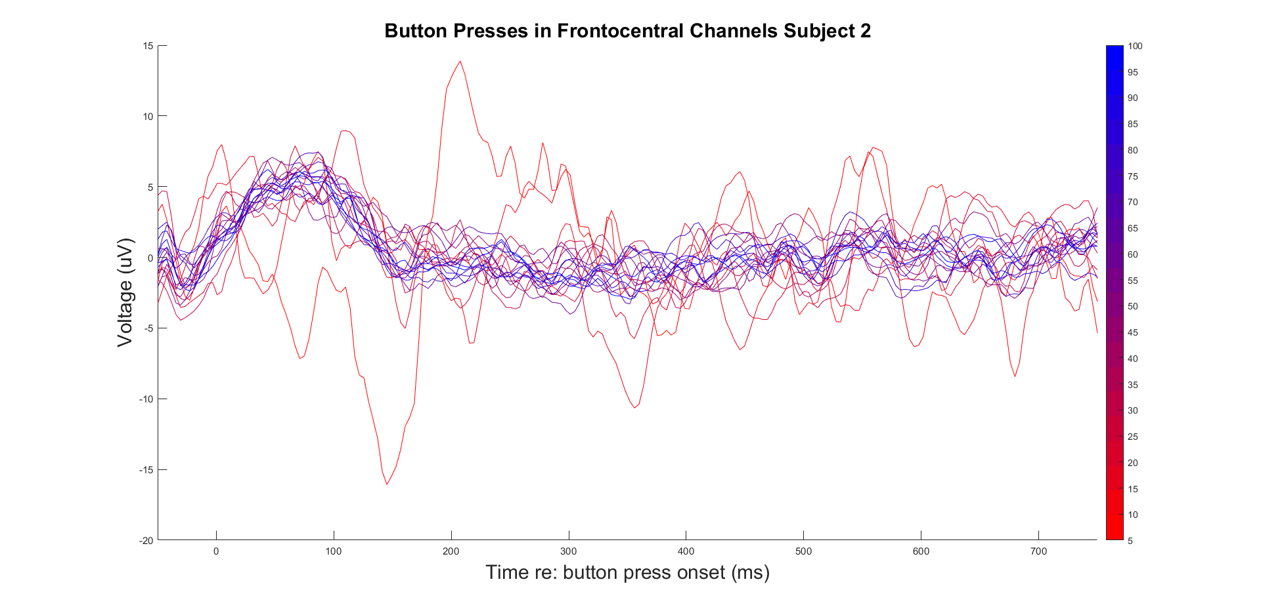

Slide 21
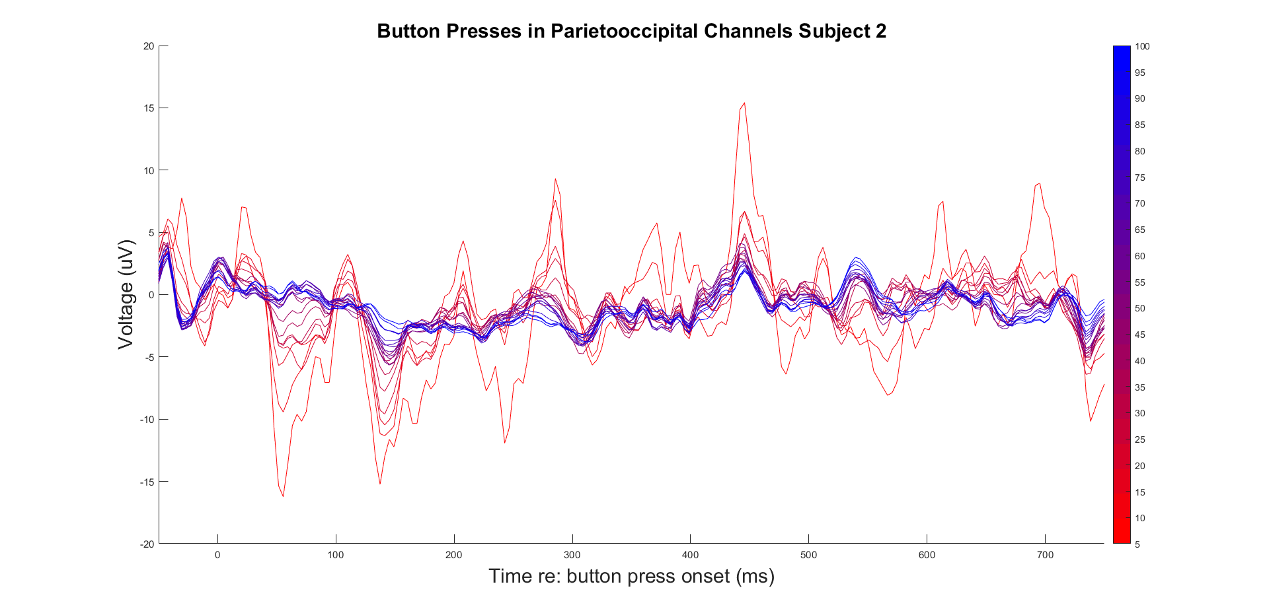

Slide 22
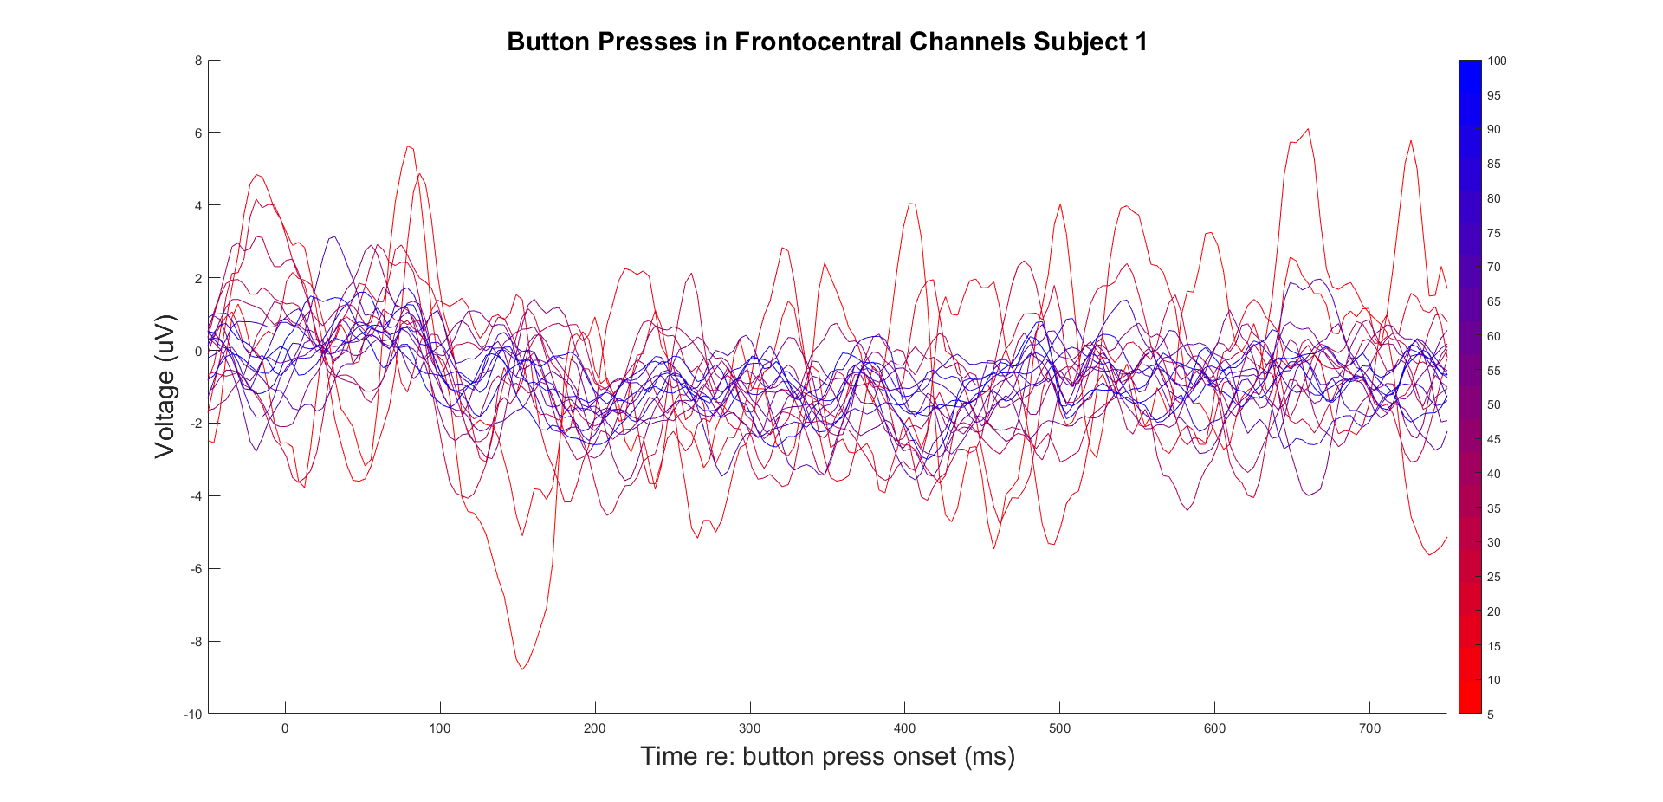

Slide 23
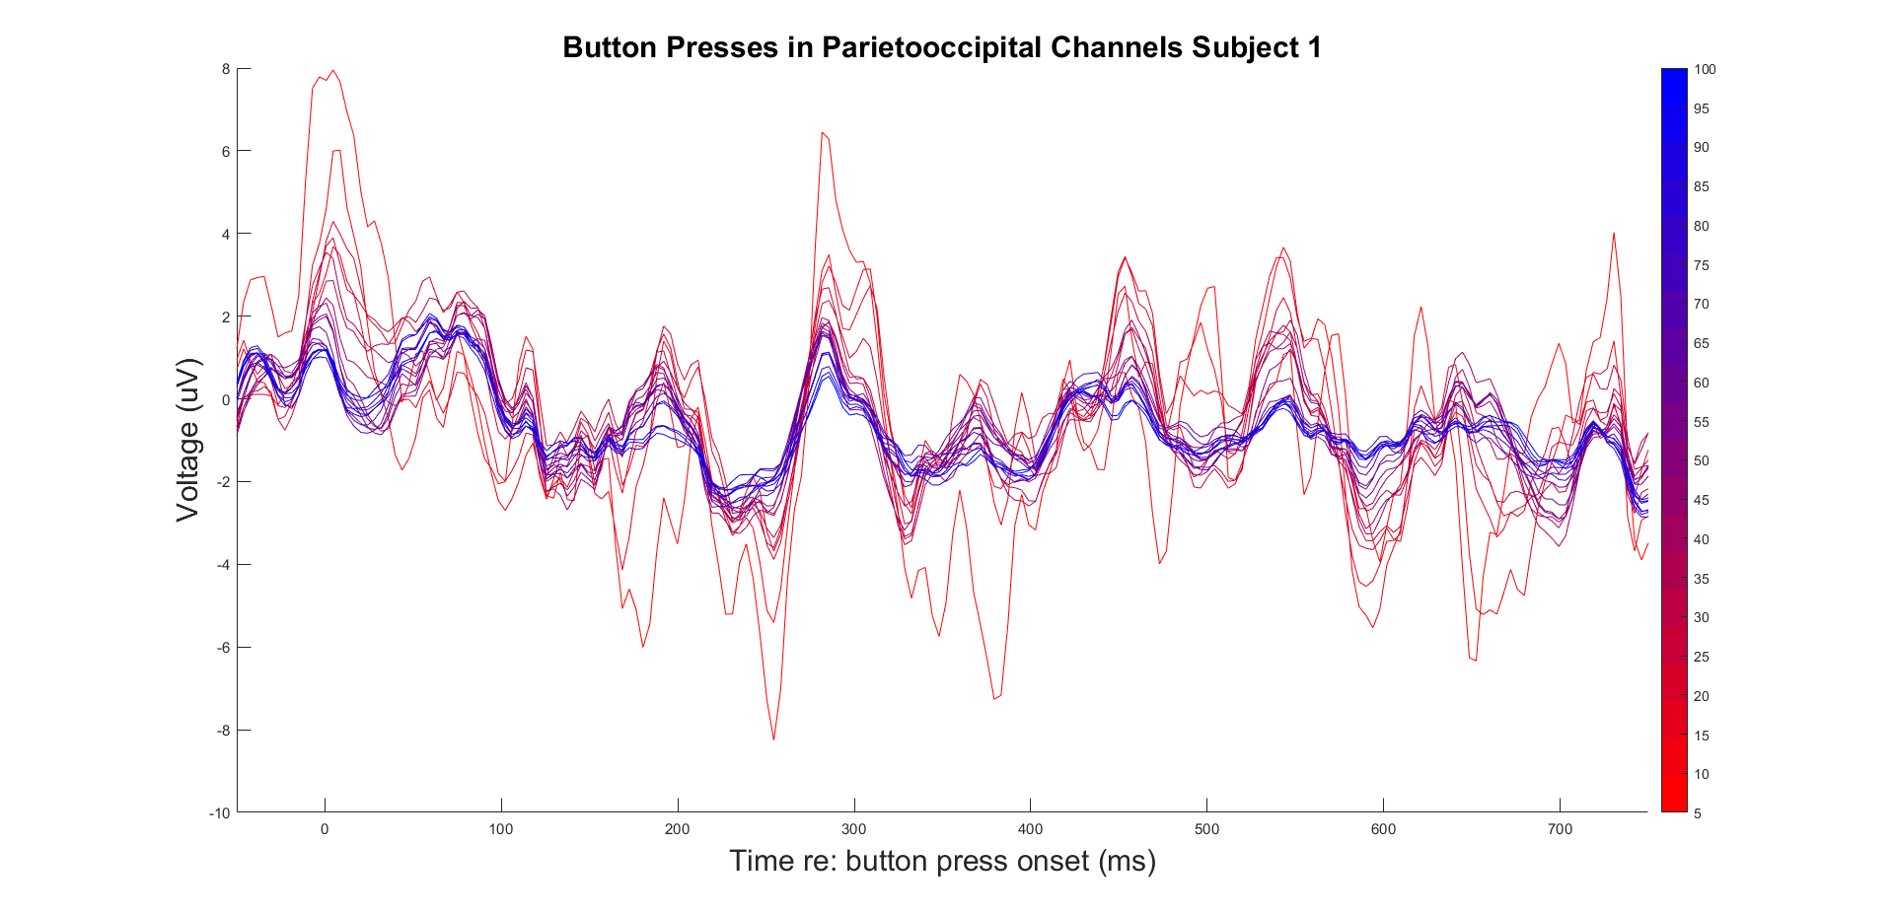

Slide 24
https://www.frontiersin.org/journals/human-neuroscience/articles/10.3389/fnhum.2015.00355/full

