Slide 1
Mild Master Neuroimaging pilot

Slide 2
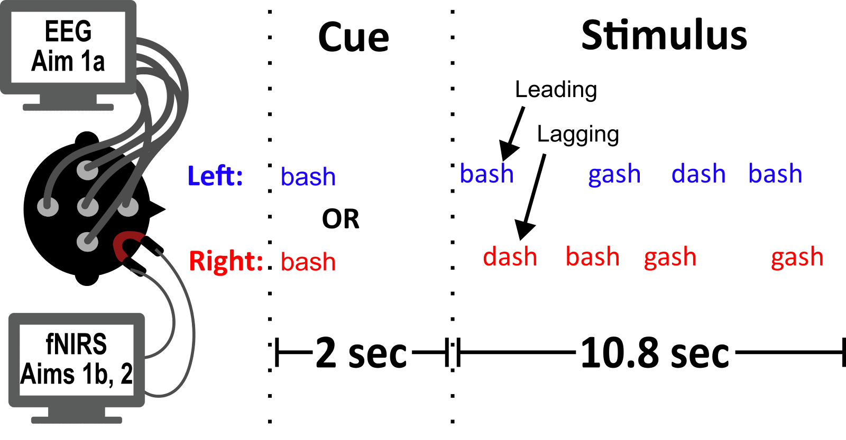
300 ms
?
50 ms
?
250 ms
?
8 token pairs * 600 ms/pair = sec

Slide 3
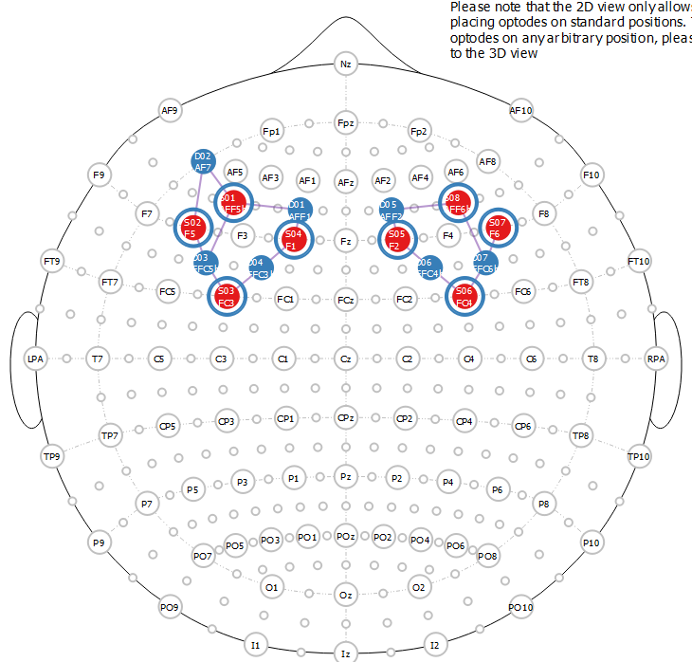
Imaging
32 channel EEG + fNIRS

Slide 4
Fullpilot1
50 us ITD, 500 us ITD, 5 deg ILD, 5 deg ILD + Mag
60 trials per condition (30 attend right, 30 attend left)
300 ms tokens
5 – 7 sec rest

Slide 5
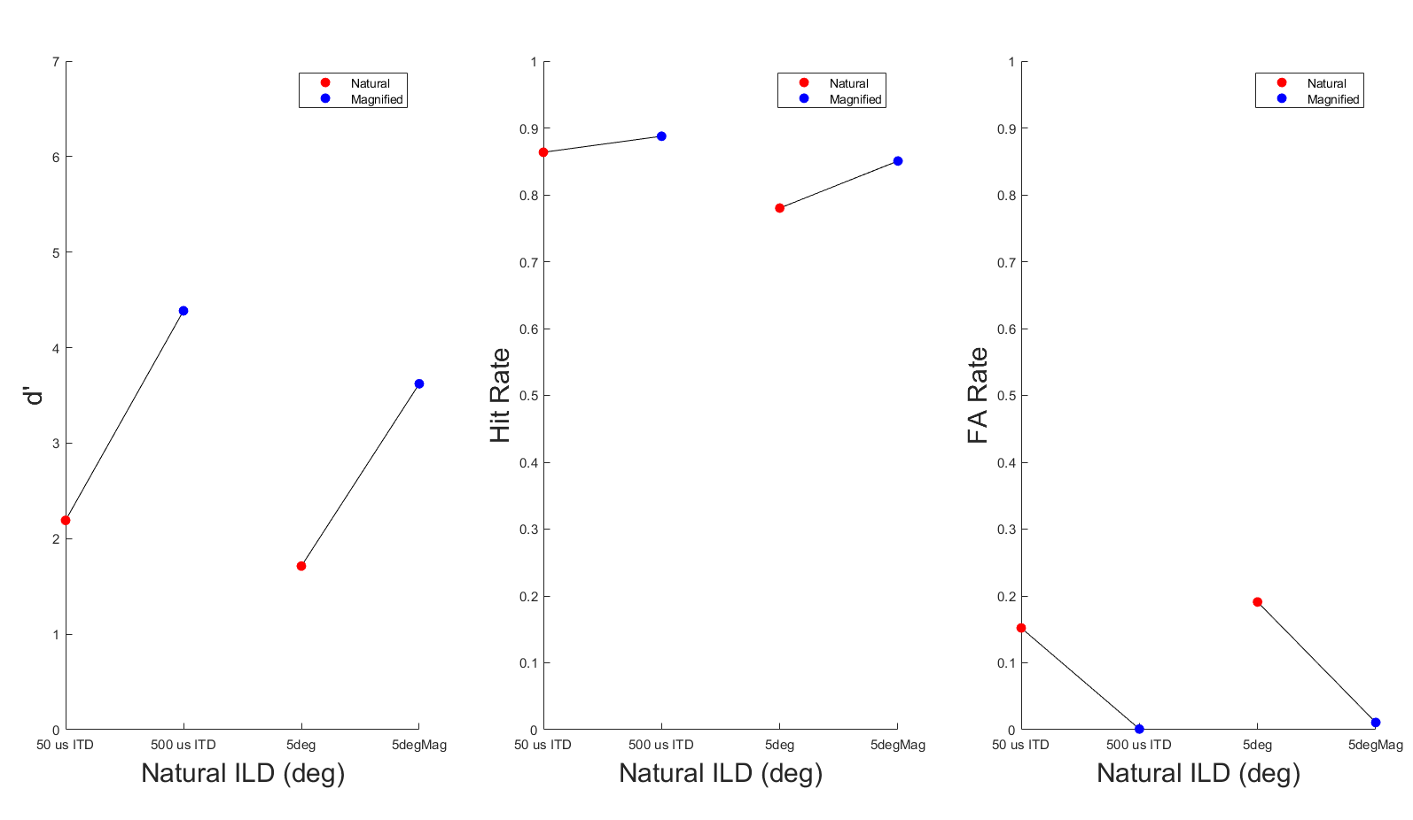
Behavior

Slide 6
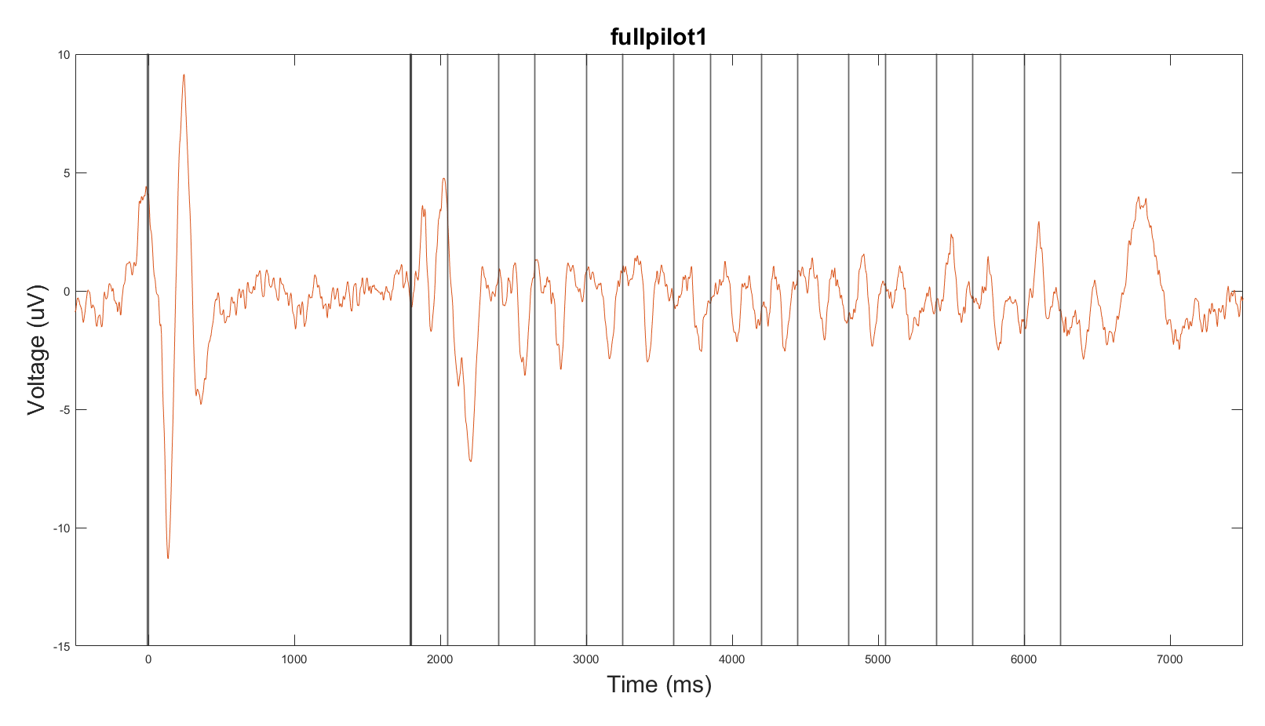
Whole Trial Mean Response over frontocentral channels

Slide 7
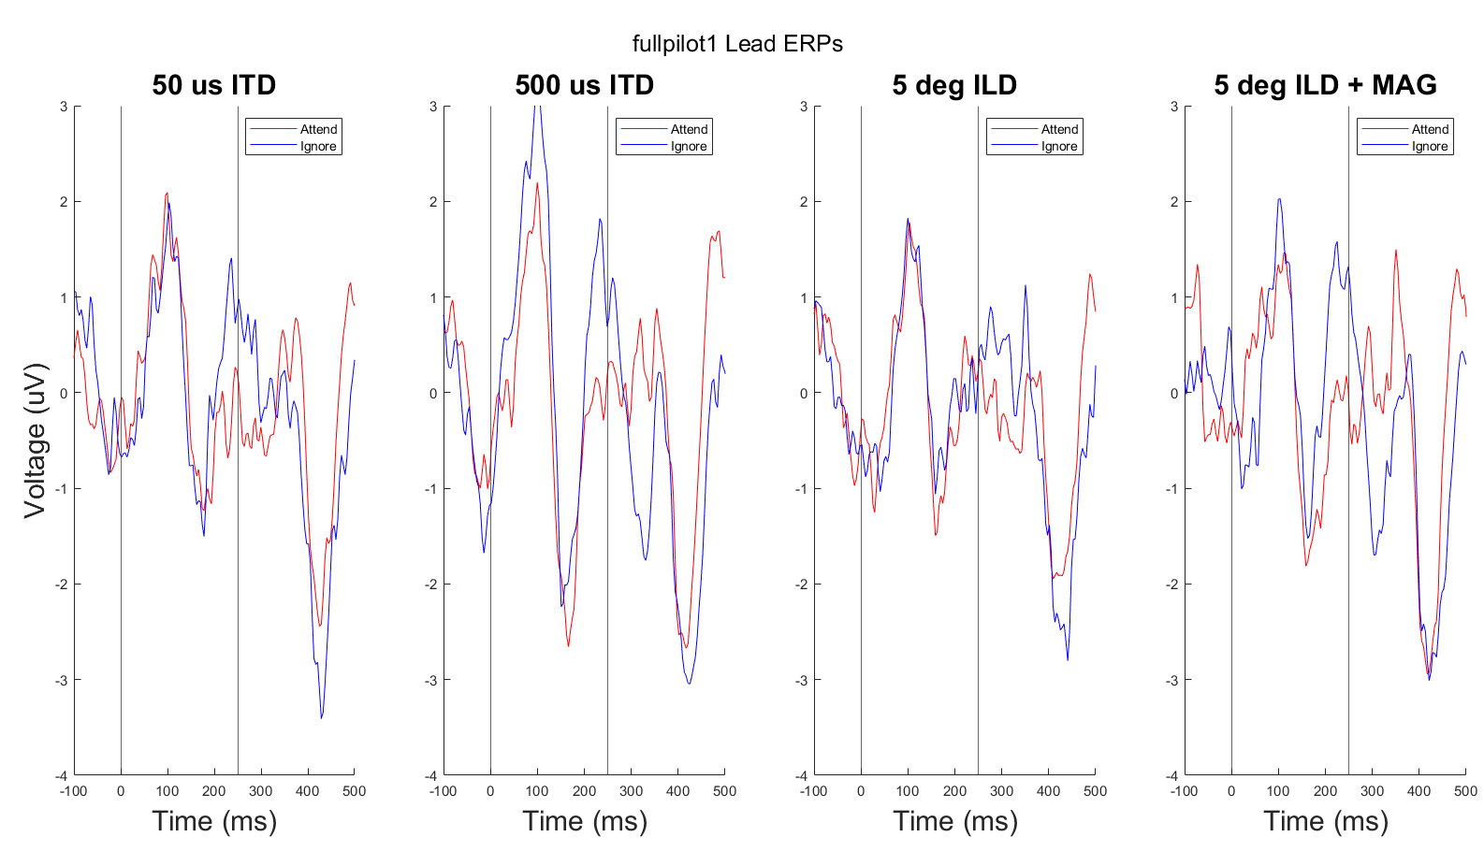

Slide 8
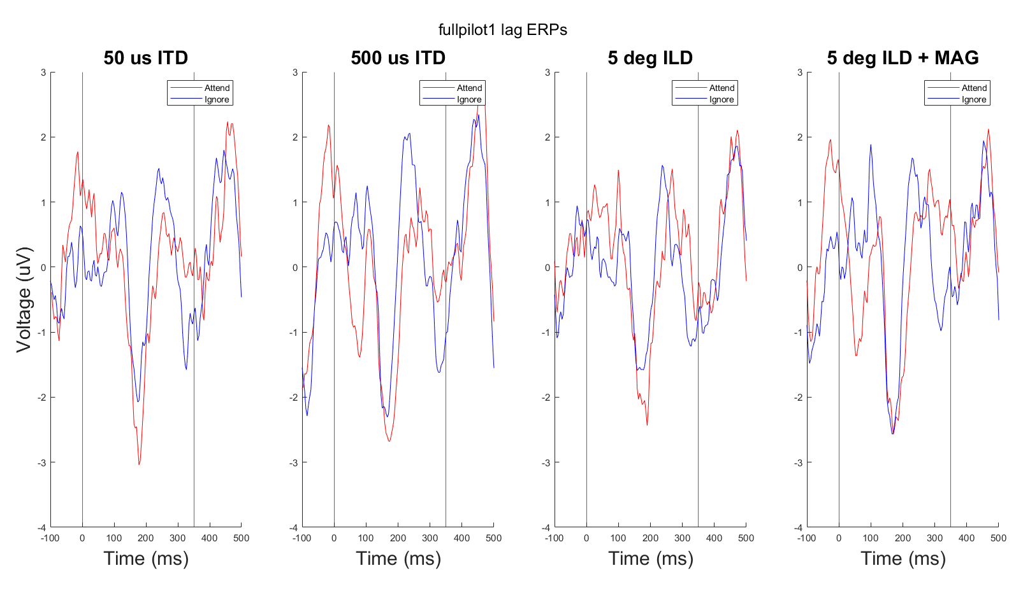

Slide 9
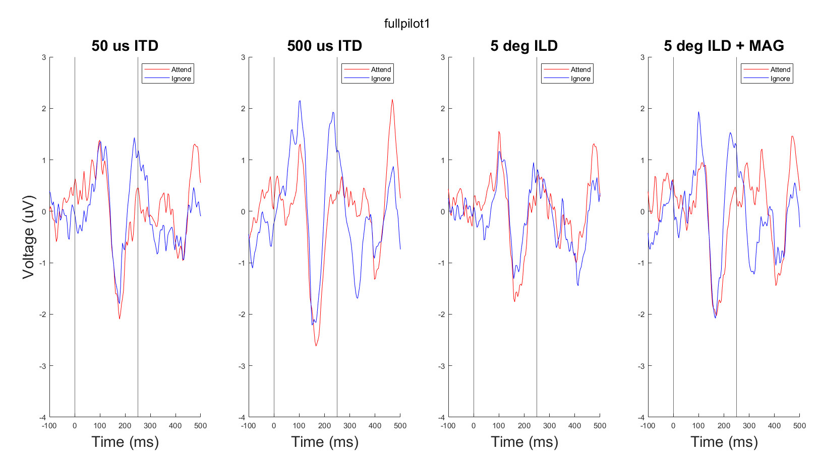
Mean of both, baselined together

Slide 10
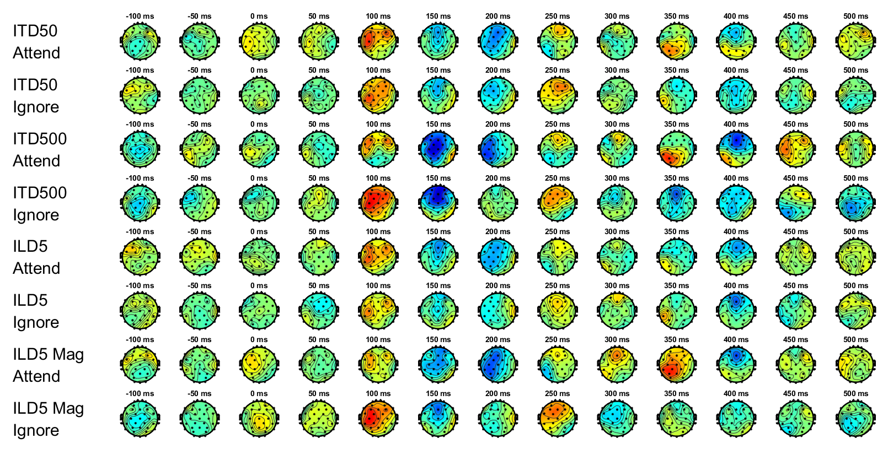
Mean ERP topographies

Slide 11
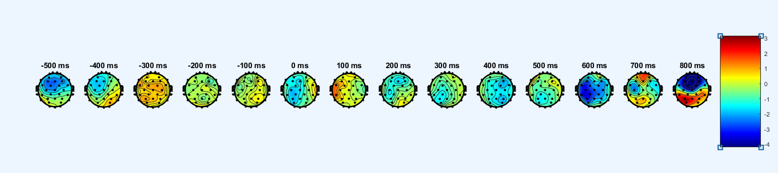
Button press topography

Slide 12
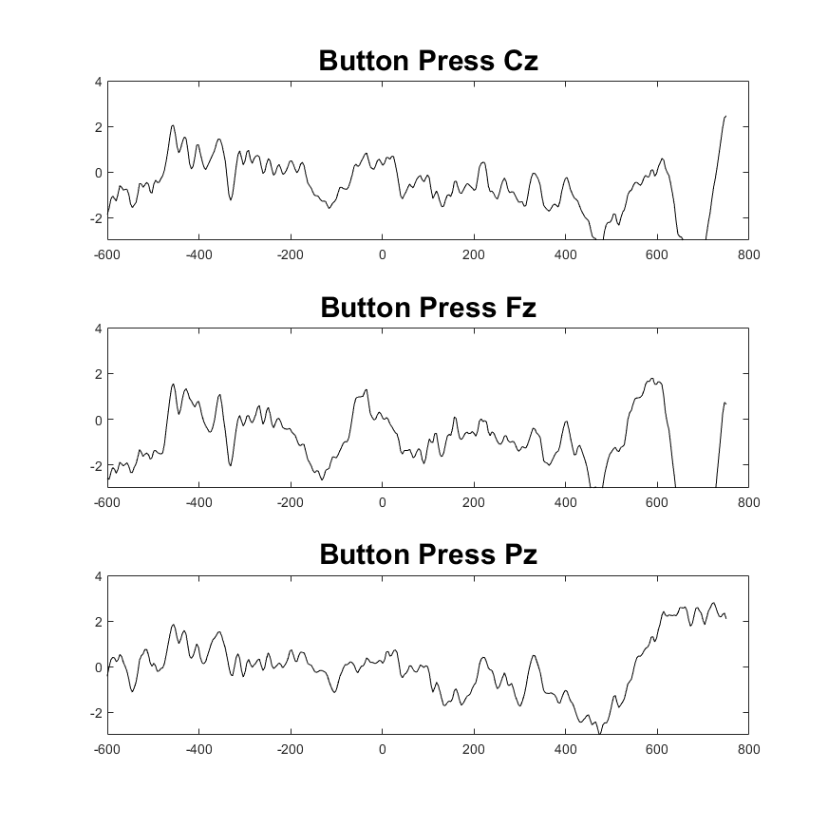
Button press at Cz, Fz, and Pz

Slide 13
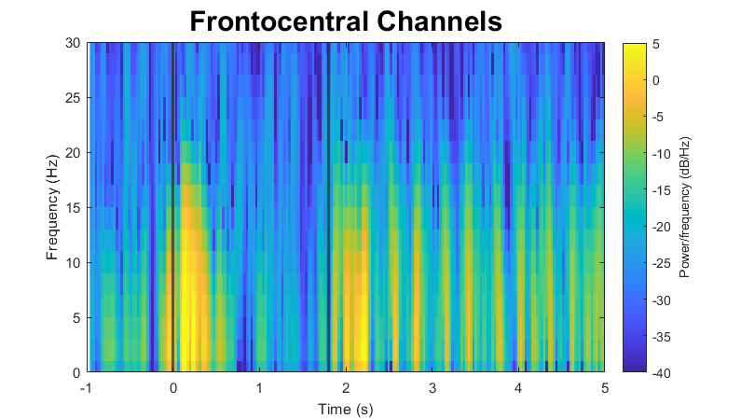
Spectrogram of whole trial

Slide 14
Spectrogram of whole trial

Slide 15
Alpha question from Ben
Need to subtract the mean response over the whole trial to see induced alpha more clearly?

Slide 16
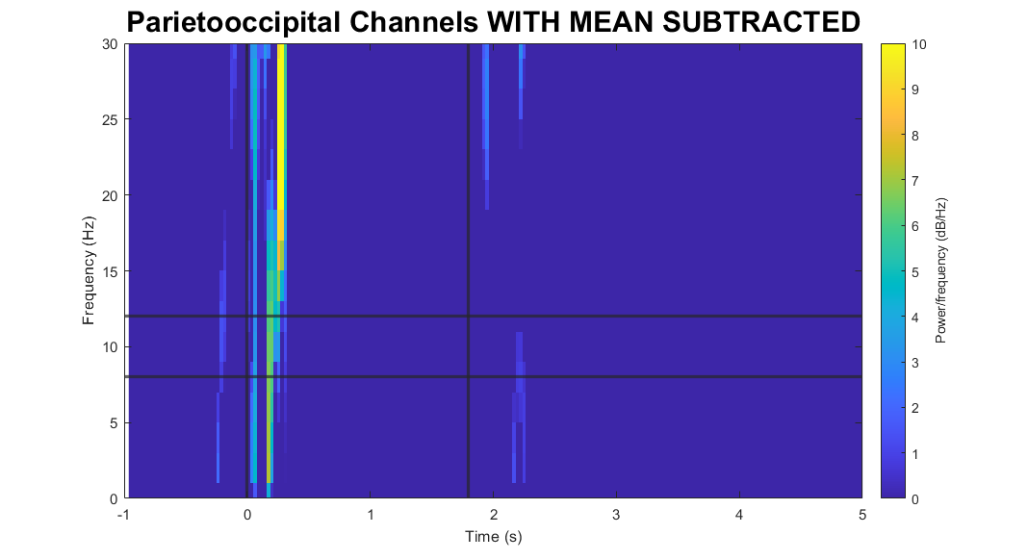
If I try subtracting

