Slide 1
Mild Master Neuroimaging pilot

Slide 2
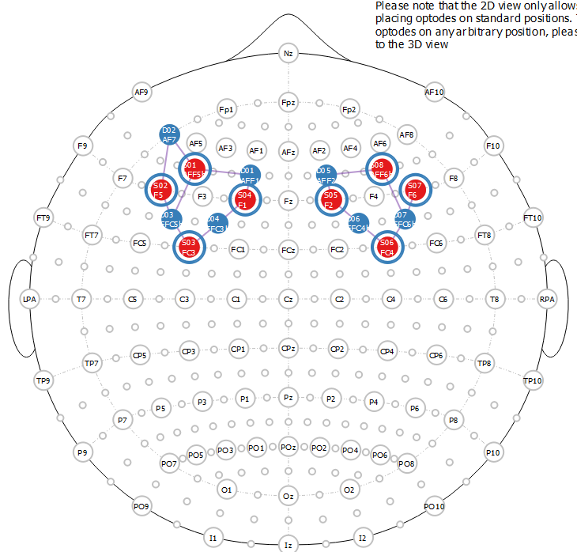
Imaging
32 channel EEG + fNIRS

Slide 3
Fullpilot1
50 us ITD, 500 us ITD, 5 deg ILD, 5 deg ILD + Mag
60 trials per condition (30 attend right, 30 attend left)
300 ms tokens
5 – 7 sec rest

Slide 4
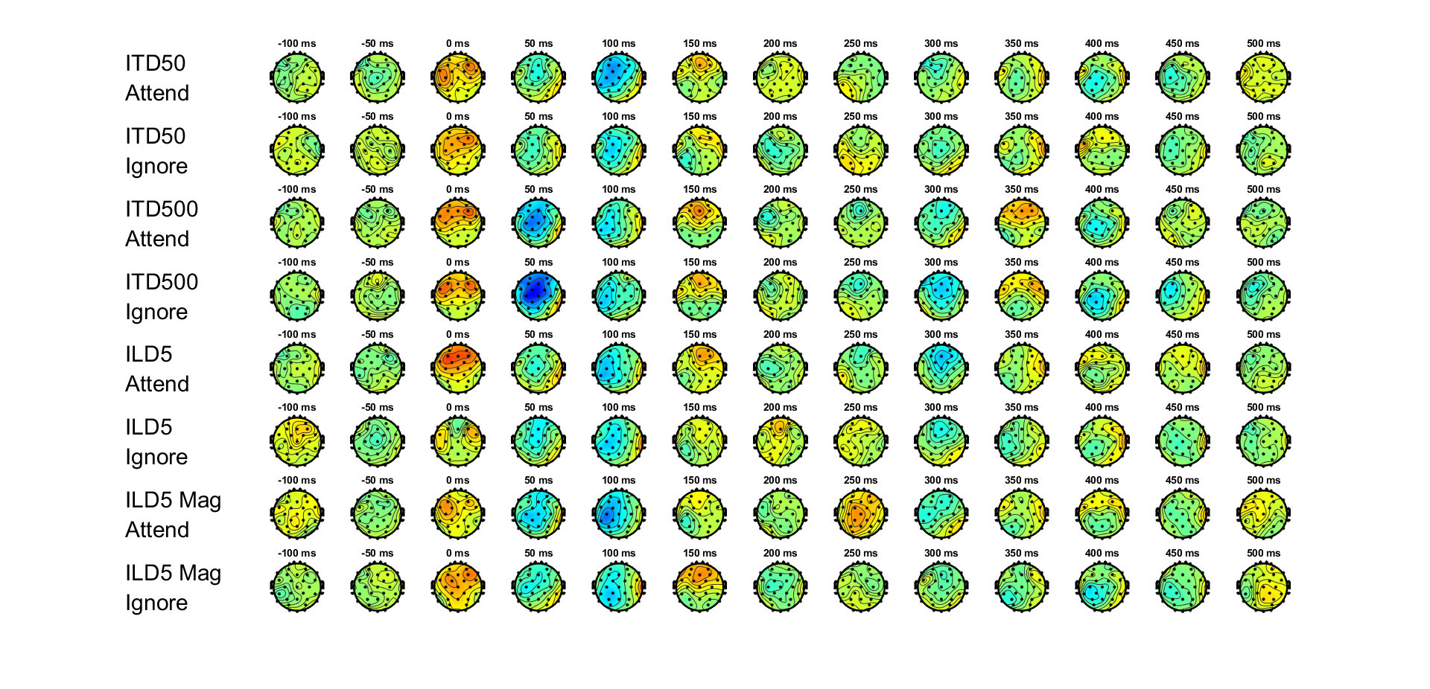
ERP topographies

Slide 5
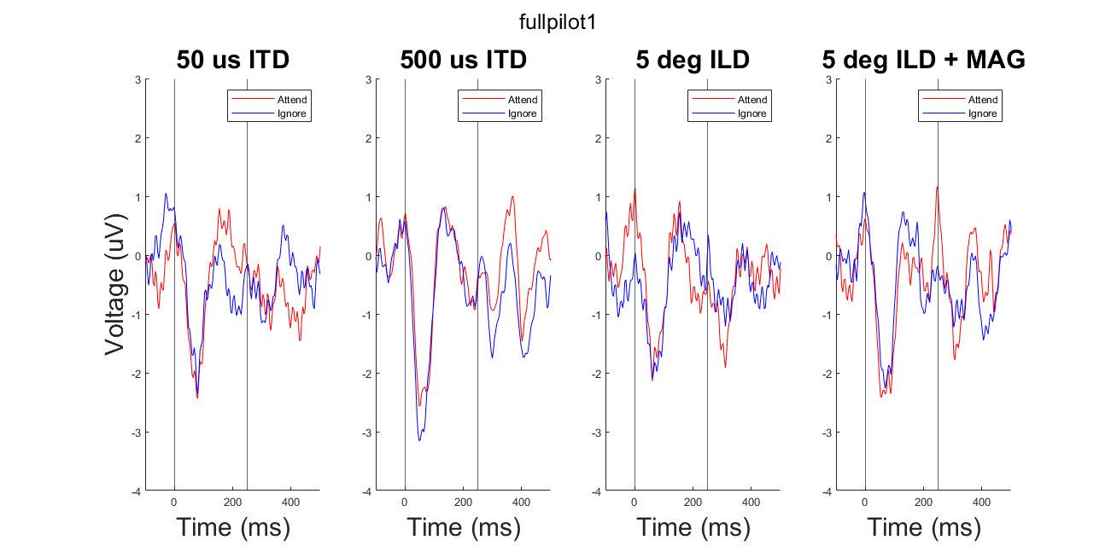
ERPs at Cz

Slide 6
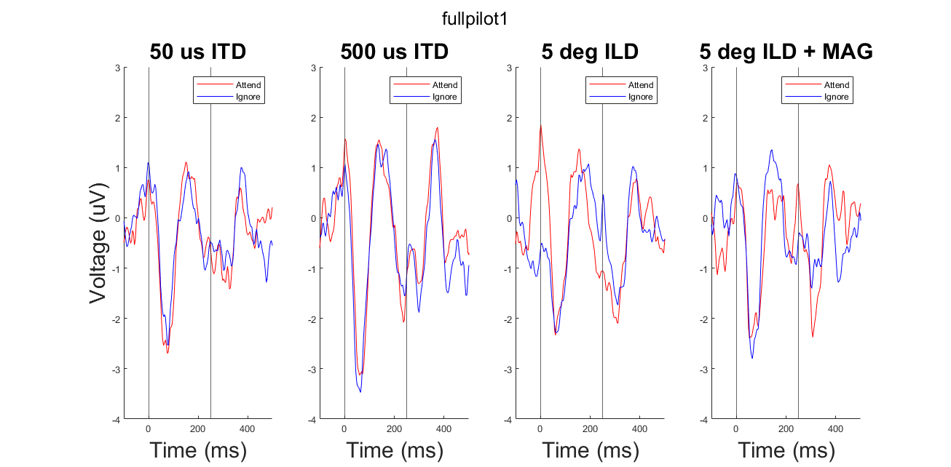
ERPs at Fz

Slide 7
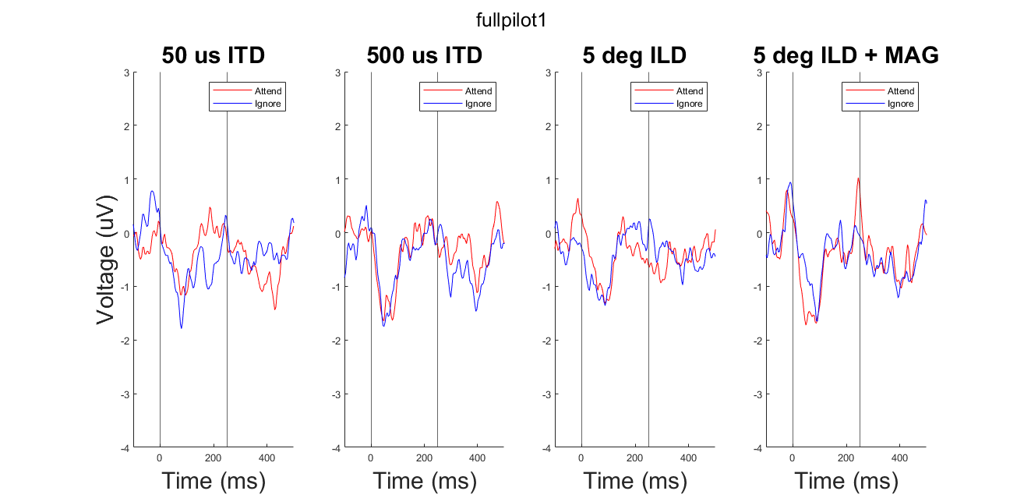
ERPs at Pz

Slide 8
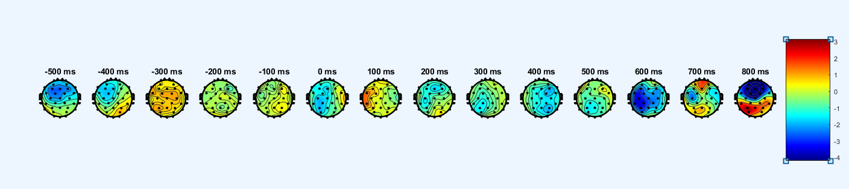
Button press topography

Slide 9
Button press at Cz

Slide 10
Button Press at Fz

Slide 11
Button Press at Pz

