Slide 1


Bread ‘n’ Milk
Java Bootcamp
Team 1.
Mārtiņš Klevs
Guntars Bērziņš
Roberts Stašķevičs
Jānis Lazda
Lauris Lazda
Ernests Auziņš
Jēkabs Aizpurvs

Slide 2
Business analysis
Grocery shopping is something everyone does
People obsess about saving money
Prices vary between stores and change frequently
Applications with the same functionality popular abroad
Out of Milk (Germany)
Bring! Shopping List (Switzerland)
Smart Shopping List – Listonic (Poland)
No such application in Latvia
app.rimi.lv

Slide 3







Used tools
Used workload management approach
Java
Git
Balsamiq Mockup
Android Studio
Mysql Workbench
Eclipse
PHP
Windows/Lubuntu
Android 6.0 and Higher
pad.riseup.net
SCRUM

Slide 4
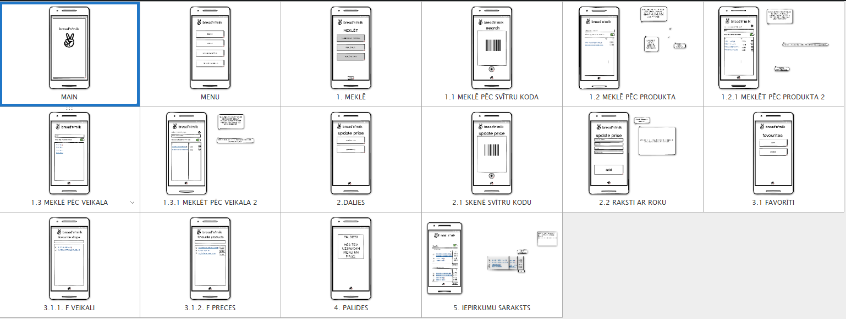
Balsamiq Mockups sketch

Slide 5
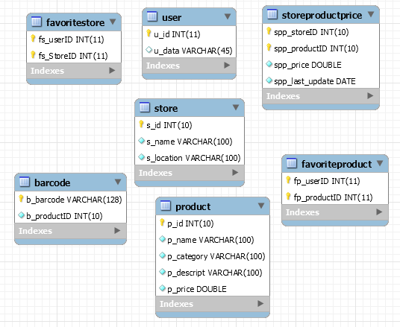
System data model
Database table constraints
Secured at Java code level.

Slide 6

System building and deployment
Manual testing
Debugging
Junit tests for local DB

Slide 7
Final overview:
URL to project resources:
https://github.com/bricht/piens-un-maize - main project
https://github.com/ErnestsA/SQLite_Test - local database
https://github.com/LaurisLazda/WebDataReader - web scraper

Slide 8
Biggest challenges in the project and lessons learned
First time Android application development
Web scraper
Local database (unresolved)
Remote database
Documentation

Slide 9
List of team members and their main contribution to project
Mārtiņš Klevs - Front-end (search activities, barcode implementation)
Guntars Bērziņš – Back-end (remote database)
Roberts Stašķevičs – Front-end (UI managment, git management, share activity layouts)
Jānis Lazda – Back-end (web scraper, remote database population)
Lauris Lazda – Back-end (web scraper) + Front-end (shopping list activities)
Ernests Auziņš – Back-end (local SQLite database)
Jēkabs Aizpurvs – Front-end (UI planning and managment, favorites activities)

Slide 10
Future work
Implement Categories
Get product prices from Maxima, Elvi, Lats et cetera
Implement multiple user database usage
Overcome app.rimi.lv
Show nearest shop
Share shopping list with another user
See weekly/monthly shopping habits/statistics

Slide 11
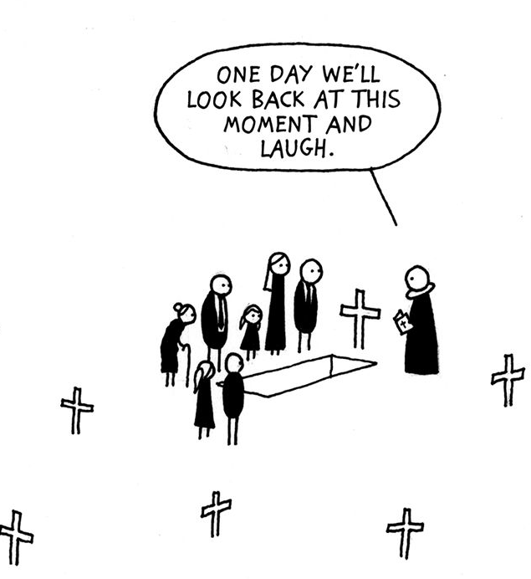
Thank you for your attention!

