Slide 1
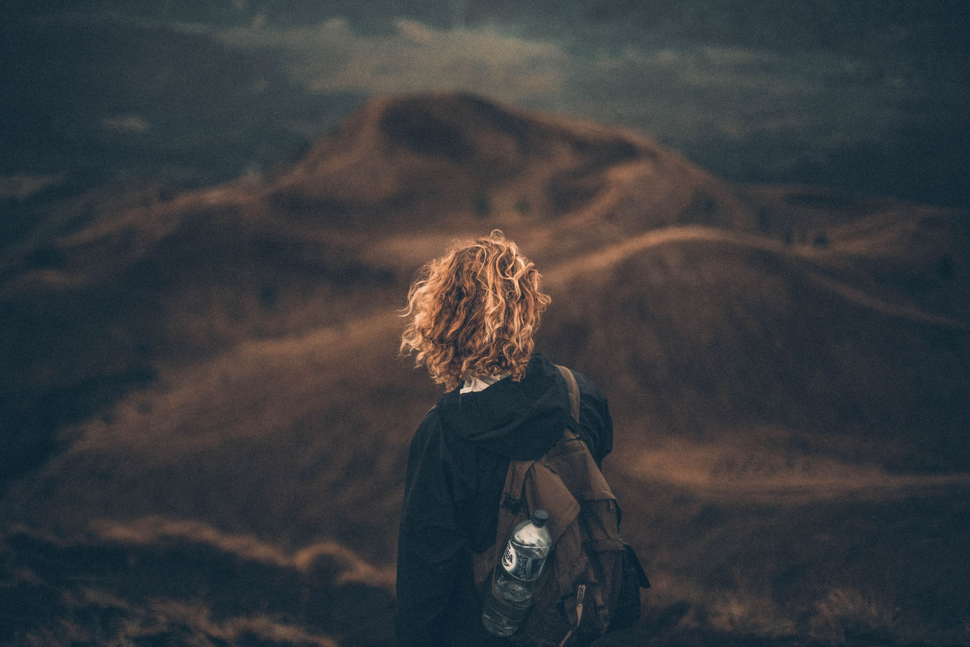
Travel habits of Millennials
By Thomas Legnach

Slide 2
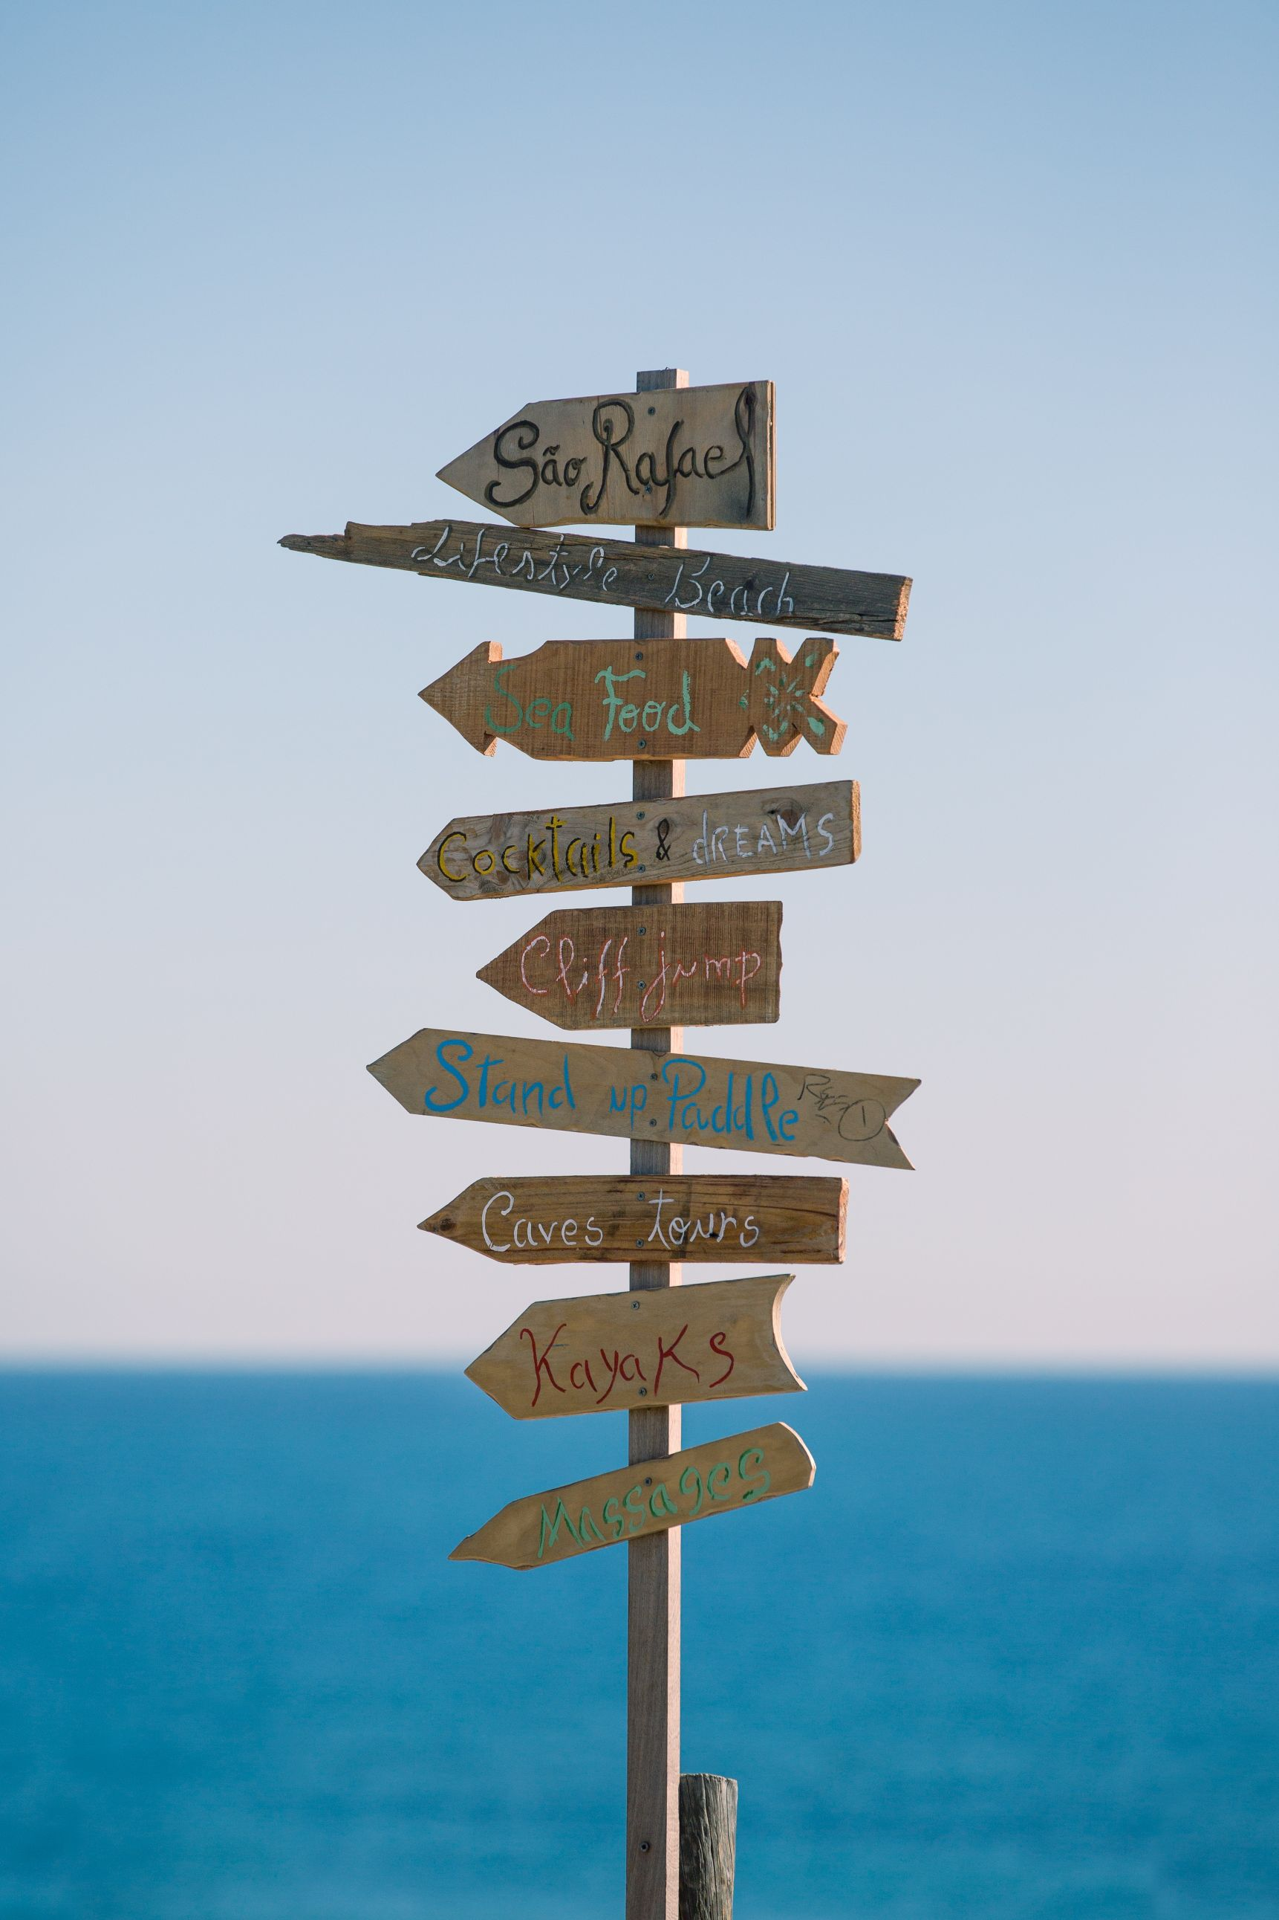
Millennial backpackers are getting less adventurous and more vain.
"Thoughts of going on holiday alone intimidates me"
32%
33%
53%
BABY
BOOMERS
GENERATION
X
MILLENNIALS

Slide 3
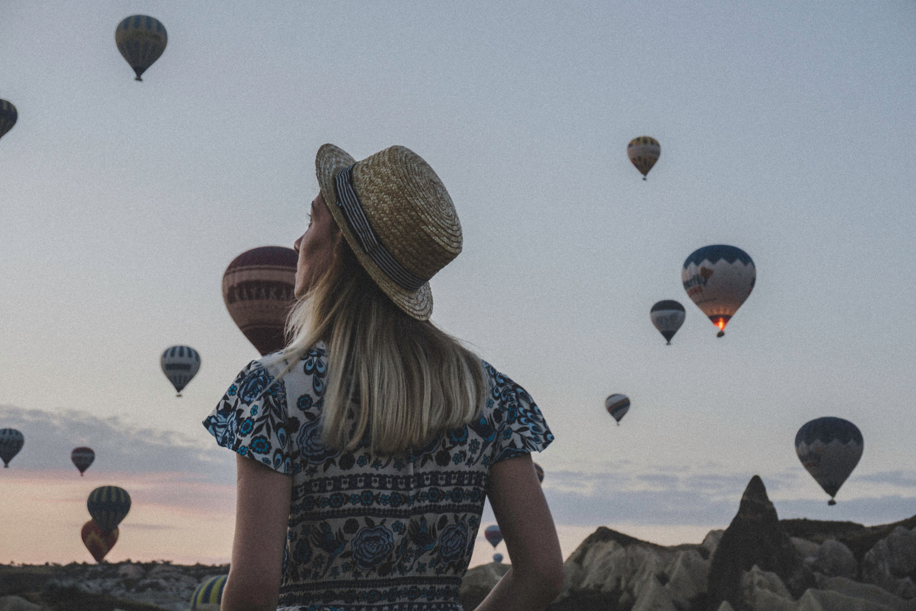
Engagement Steps
“We are investing in content creation and getting travel journalists to write relevant articles from different locations. The more we are able to do that, the more they trust the content.”
Establish a presence on Social Media
1
Heavily encourage users for reviews
2
Make sure all links work
3
Use a stong ecommerce system
4

Slide 4
Thank you
Thomas Legnach

