Slide 1
Projekt: SVG fine-tune LLM
Noah Karletshofer
Levi Mayer
Supervisor: Poonam Poonam

Slide 2
Structure
Related Work
Goal and Method
Demo
User Study
Discussion
Conclusion

Slide 3
related work
Tableau | Drag-and-drop GUI + optional AI assistant | own trained ai, visual output
Vegalite | Code-based chart grammar | Requires programming knowledge
ChatGPT | Text-to-chart | picture based
LIDA | text-to-rule-based modification | limited to predefined changes
our Method | text-to-code-based modification | more flexible
Notes:
Tableau ai only works within its environment
heavily uses everything tableau has built prior
proprietary
seems to be getting very powerful
vegalite is a programming grammar without any automations
chatgpt can by now make charts in a picture format on its own
not realy there yet but getting better
has a lot of problems when creating charts with vegalite code
Lida uses llm´s with a structured prompting, a template system, visualization taxonomy
can also make changes to the charts with a rule based system

Slide 4
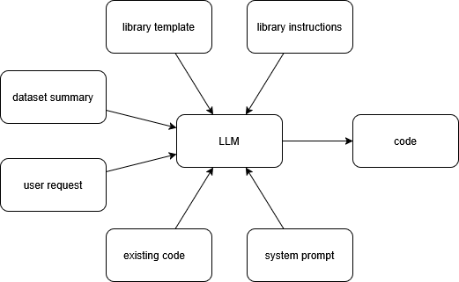
Lida VisOps
Notes:
The goal of our project is to explore whether a general-purpose language model — specifically ChatGPT — can modify existing data visualizations using natural language, and whether it can do so more flexibly than a specialized system like LIDA’s VisOps module.

Slide 5
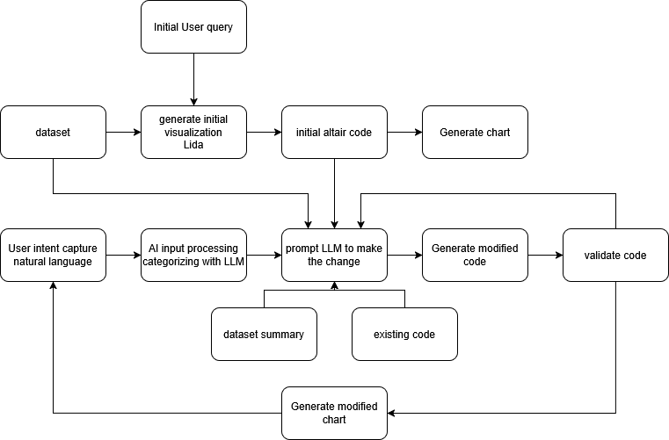
our approach
Notes:
Our system starts with a base visualization, typically generated using LIDA. Then, the user gives a natural language instruction to modify the chart — for example, 'change this bar chart to a line chart,' or 'color the points by species.'
To process these requests, we give ChatGPT a structured prompt. But instead of letting the model guess freely, we categorize the user request into one of several predefined chart modification types — like changing axes, filtering data, or changing the chart type.
If the instruction is ambiguous or doesn't fit a category, we fall back to free-form generation. We then take the modified Altair code ChatGPT gives us, run it, and show the result. If something breaks, we retry with an updated prompt.
our system is stateless: every request is independent, which helps us avoid memory-related mistakes — but it also means the user has to repeat some context if they want to build on previous steps.
With this method, we want to find out whether a general-purpose LLM can outperform a specialized visualization editor in terms of flexibility, usability, and edit success rate.

Slide 6
Demo
Noah/Levi

Slide 7
User Study
Levi

Slide 8
Discussion
Levi

Slide 9
Conclusion
Levi/Noah

